Slide 1
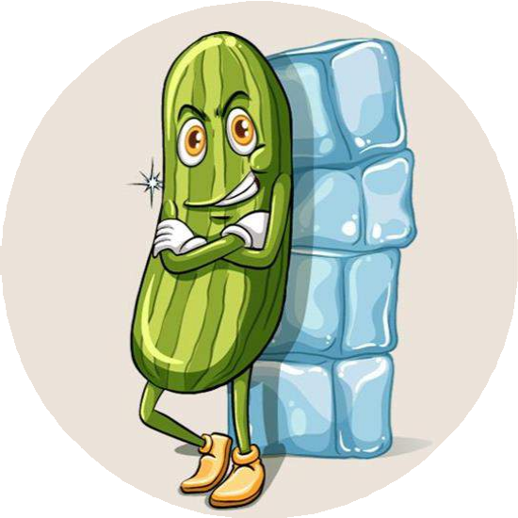
Similes
90 Minutes
Making the future of young minds

Slide 2
Objectives
Making the future of young
minds
Recognise similes in sentences.
Visualise similes to understand their meanings by drawing a picture.
Compare objects/concepts/ideas using similes.
Create taglines using similes in a digital space using Megaminds.

Slide 3
Ground Rules
Making the future of young
minds
Be respectful of one another. Listen to your teammates.
Raise your hands if you have anything to share.
Listen attentively and follow instructions.
Complete tasks in
given time

Slide 4
Which car would you buy?
Making the future of young
minds
Look at the examples carefully.
Buy the all new Sierra Multipro

Slide 5
Which car advertisement is interesting?
Why?
Making the future of young
minds

Slide 6
Similes
Similes are comparisons that use the words "like" or "as" to describe something by likening it to another thing. They make descriptions more vivid and colorful.
Making the future of young
minds

Slide 7
Making the future of young
minds
Why do we use Similes?
Where can you use similes? Can you share an example?

Slide 8
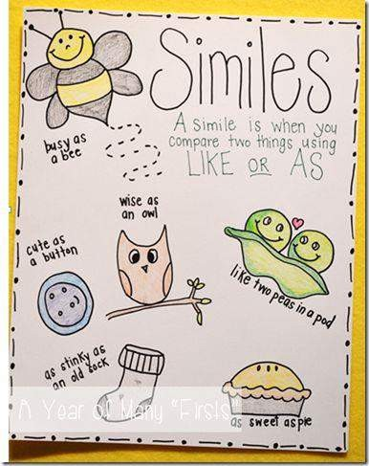
Simile Sketches
Duration - 15 minutes
Making the future of young minds
Let’s draw similes to understand them!

Slide 9
Let’s Team Up!
Making the future of young minds

Slide 10
Choose your role!
Project Manager
Resource Manager
Collect materials and tools from the teacher.
Ensure team members are
using them properly. Return when you are done!
Time Keeper
Keep track of time! Check the timer every few mins.
Presenters
Help your team members to stick to their tasks!
Share your creation with your classmates.
Help team members to complete the task on time.
Note down the feedback
received.
Monitor what they are doing.

Slide 11
Rules
Making the future of young
minds
Each team will receive a worksheet with a few similes written on it.
The team members will discuss among themselves and draw a picture
for each simile to understand its meaning.
Once done, each team will display their drawings on the activity board.
Remember the ground rules!

Slide 12
Example
Making the future of young
minds
As sweet as cake

Slide 13
Let’s Create a Simile Tagline for an Advertisement!
Duration: 25 minutes
Making the future of young minds

Slide 14
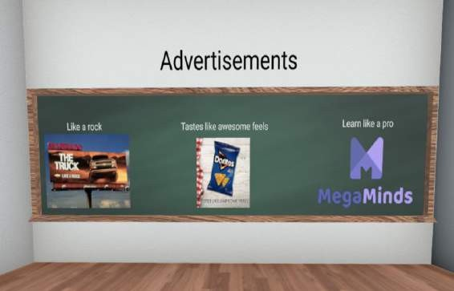
Create your simile advertisement!
Duration - 20 minutes
Making the future of young minds
Steps to follow
Go to https://megaminds.world/
Let the teacher guide you how to navigate the virtual
classroom.
Revisit what we have learned about similes as you move through the classroom.

Slide 15
Create your simile advertisement!
Duration - 20 minutes
Making the future of young minds
As you enter the classroom, zoom into the wall, which
mentions why and how advertisements use similes.
Move ahead to look at examples of advertisements,
which have used similes.

Slide 16
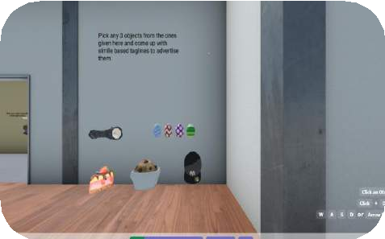
Create your simile advertisement!
Duration - 20 minutes
Making the future of young minds
Move towards the activity wall, where the
advertisement products are displayed.
As a group of three, choose three products from the
wall to create simile taglines.

Slide 17
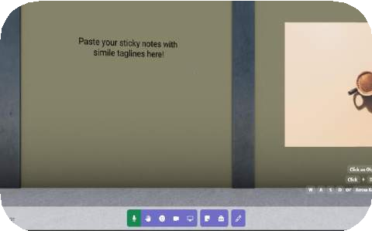
Create your simile advertisement!
Duration - 20 minutes
Making the future of young minds
Once you have designed your three taglines, move
inside toward the activity wall.
Write your three taglines on a digital sticky note
(available on the toolbar) and paste it on the activity
wall.

Slide 18
Simile Slam!
Duration - 15 minutes
Making the future of young
minds
Present the taglines you have created in front of
the classroom and explain its meaning.
Listen to others when they present their taglines.
Now, you will have a list of similes you can use in
everyday conversations.

Slide 19
Let’s Reflect!
Making the future of young
minds
Now think:
How to make your tagline more interesting?
Which tagline did you like the most? Why?
Do you think looking at the objects through a virtual tour helped you design your
tagline?
What can be improved about the virtual tour?

Slide 20
Thank You
edm8ker is a fully owned brand of Makedemy Pte Ltd
A member of the SL2 group of social enterprises.

