Slide 1
Factor Fiesta!
Unlocking the secrets of prime numbers!
60 minutes

Slide 2
Objectives
Identify prime numbers
Understand factors
Use virtual manipulatives to derive factors of numbers
Differentiate between prime and composite numbers
Notes:
Begin by sharing the overview. Apprise students of the tasks they’d accomplish in the class.

Slide 3
Ground Rules
Be respectful of one another. Listen to your teammates.
Raise your hand if you have anything to share.
Listen attentively and follow instructions.
Complete tasks in given time
Notes:
Discuss the ground rules with students and stress on the importance of them being followed throughout the class.

Slide 4
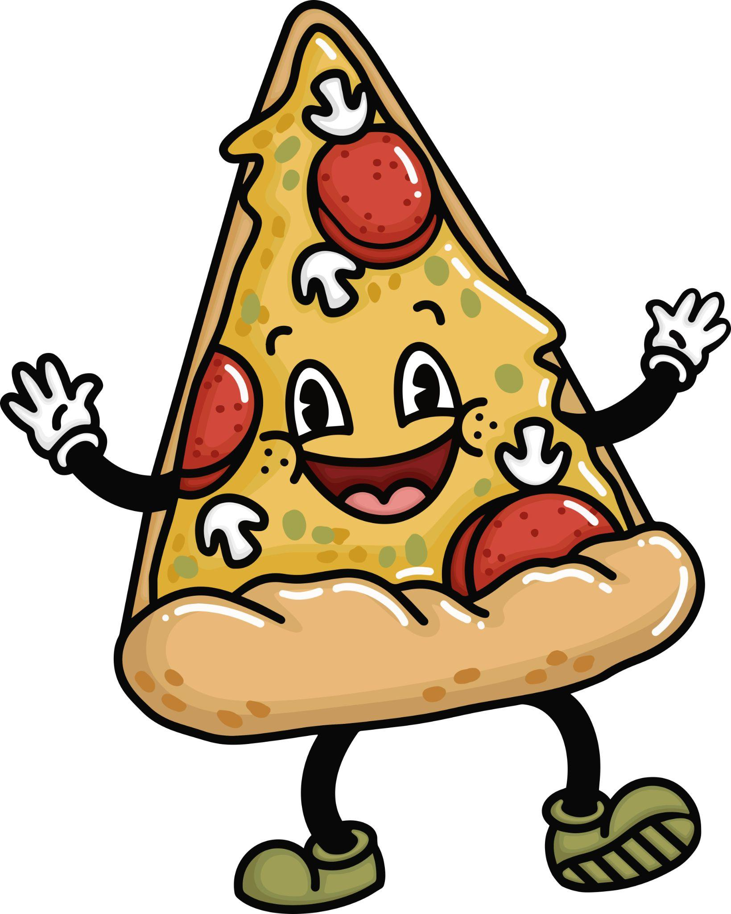
Pizza Party!
15 minutes
Imagine that you are hosting a pizza party and you have a large pizza with 8 slices.
However, you are not sure of how many of your friends will be coming to the party.
In how many different ways can you divide the pizza so that each friend gets an equal number of slices?
Write the equations in your notebook.

Slide 5
Pizza Party!
15 minutes
The possible situations are
8 friends get 1 slice each (8 ÷ 1 = 8)
4 friends get 2 slices each (8 ÷ 2 = 4)
2 friends get 4 slices each (8 ÷ 4 = 2)
Everyone cancels and you get to eat the whole pizza by yourself! (8 ÷ 8 = 1)
How many equations did you get right?

Slide 6
What are factors?
The different ways of dividing the pizza represent the factors of the total number of slices.
So, for a pizza with 8 slices, the factors (the number of slices) are 1,2,4, and 8 because these are the ways in which the pizza can be divided evenly.
So, just like with pizza slices, factors are numbers, which can divide another number evenly without any leftovers!

Slide 7
Pizza Party!
Now, imagine another pizza party. However, this time, your dog or your cat had snuck one slice of pizza and you have 7 slices but 4 friends.
You want to share the pizza in a way that each person has an equal number of slices.
Do you think it is possible for each friend to have an equal number of slices? If not, why?

Slide 8
Prime Numbers
You cannot split the 7 slices into smaller equal groups because 7 is a prime number.
A prime number is a special type of number that has only two factors (1 and itself)
When you try to divide a prime number by any other number, there will always be a remainder (leftover slices of pizza)
So, a prime number like 7 can only be divided into 2 groups (1 and 7), with no leftovers.

Slide 9
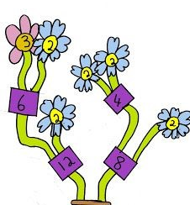
Factor Fiesta with Mathigon!
30 minutes
Let us find factors for all numbers ranging from 1 to 50 using virtual manipulatives offered by Mathigon.

Slide 10
Rules
Form groups of three.
Let your teacher guide you on how to use Mathigon
Raise your hand if you have any doubts.
Keep track of time!

Slide 11
Let’s Collaborate!
Notes:
5 students per group

Slide 12
Team Roles
Project Manager
Resource Manager
Time Keeper
Help your team members to stick to their tasks!
Monitor what they are doing.
Collect materials and tools from the teacher.
Ensure team members are using them properly.
Return when you are done!
Keep track of time! Check the timer every few mins. Help team members to complete the task on time.

Slide 13
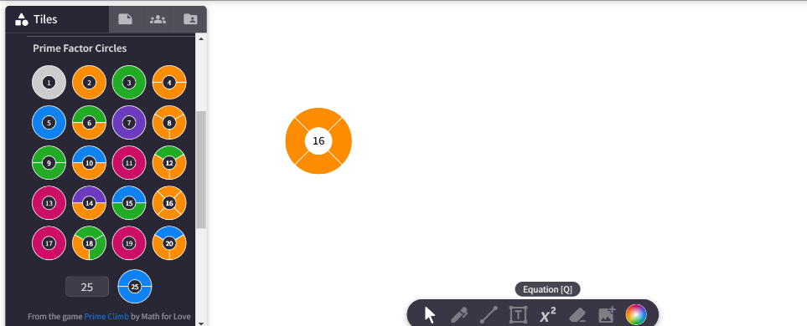
Try it out!
Can you split 16 to find out its factors?

Slide 14
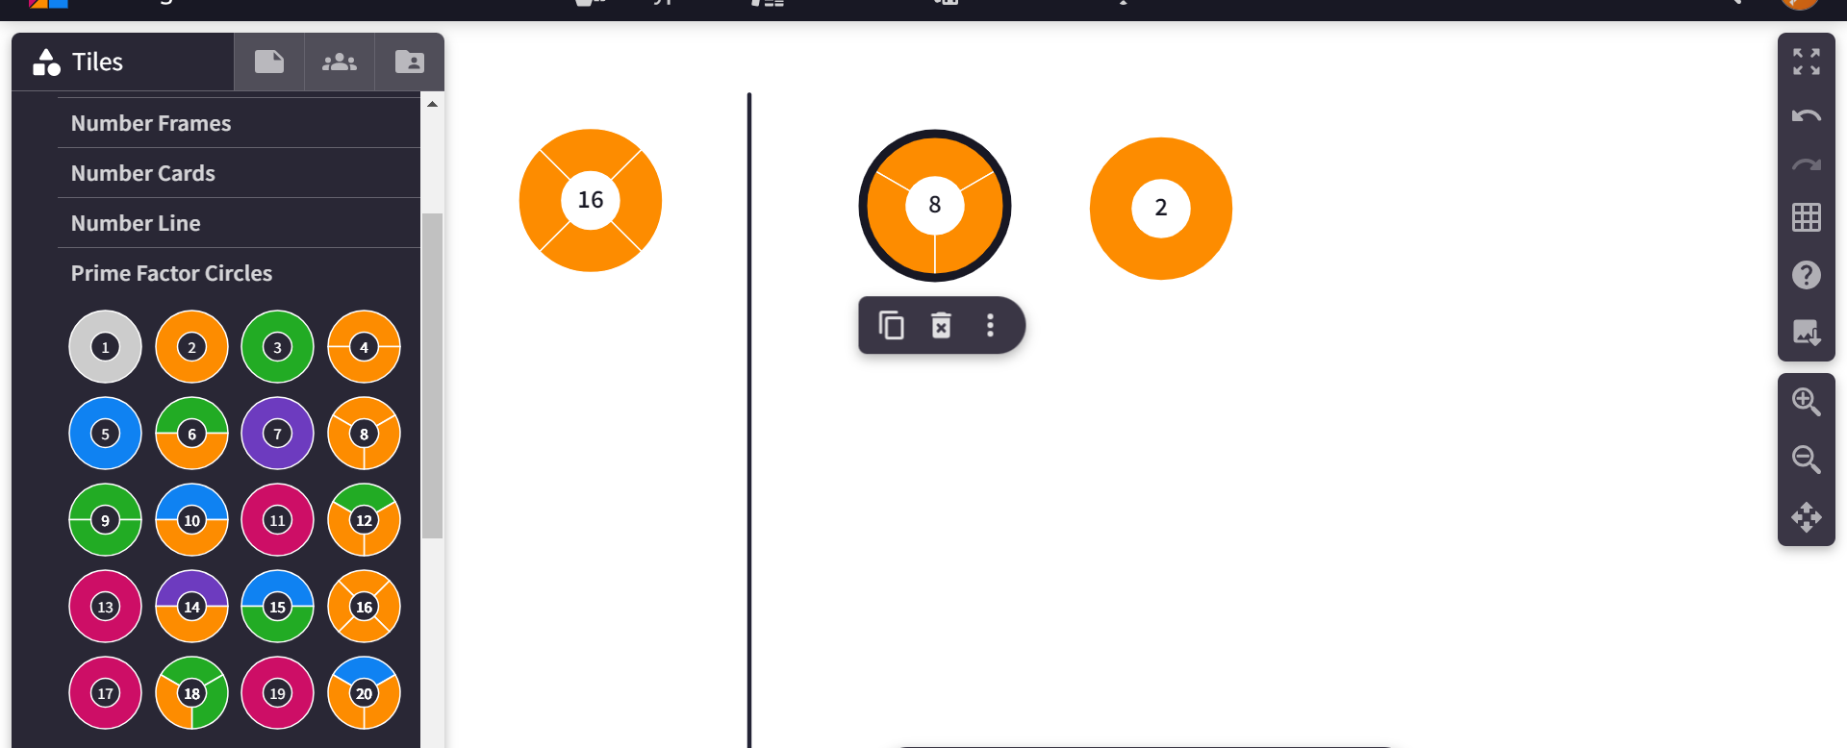
Try it out!
Now, you can see that two of its factors are 8 and 2, can you split it to find one more factors?

Slide 15
Reflection
What strategies did you use to find factors of the numbers?
Did you notice any relationships between the numbers and their factors?
Do you think using virtual manipulatives made the activity easier and more interesting?

Slide 16
Prime Detectives
15 minutes
Rules
Numbers from 1-50 will be randomly called out.
If it is a prime number, raise your hands.
If it is not, fold your hands.

Slide 17
Thank You
edm8ker is a fully owned brand of Makedemy Pte Ltd A member of the SL2 group of social enterprises.

