Slide 1
Adjective Express!
60 Minutes

Slide 2
Objectives
Recognize adjectives and recall their purpose.
Explain the role of adjectives in adding description and detail to nouns.
Use appropriate adjectives to create sentences that effectively describe various objects, animals, or people.

Slide 3
Ground Rules
Be respectful of one another. Listen to your teammates.
Raise your hands if you have anything to share.
Listen attentively and follow instructions.
Complete tasks in
given time

Slide 4
Describing the Dog!
Think of a few words that you can use to describe this dog!

Slide 5
Introduction to Adjectives
If you used words like happy, excited, friendly, brown, you used adjectives.
Adjectives are words that are used to describe nouns by providing more information about their qualities, characteristics, or attributes.
They play a crucial role in adding detail and depth to our language, allowing us to create more vivid and specific descriptions.

Slide 6
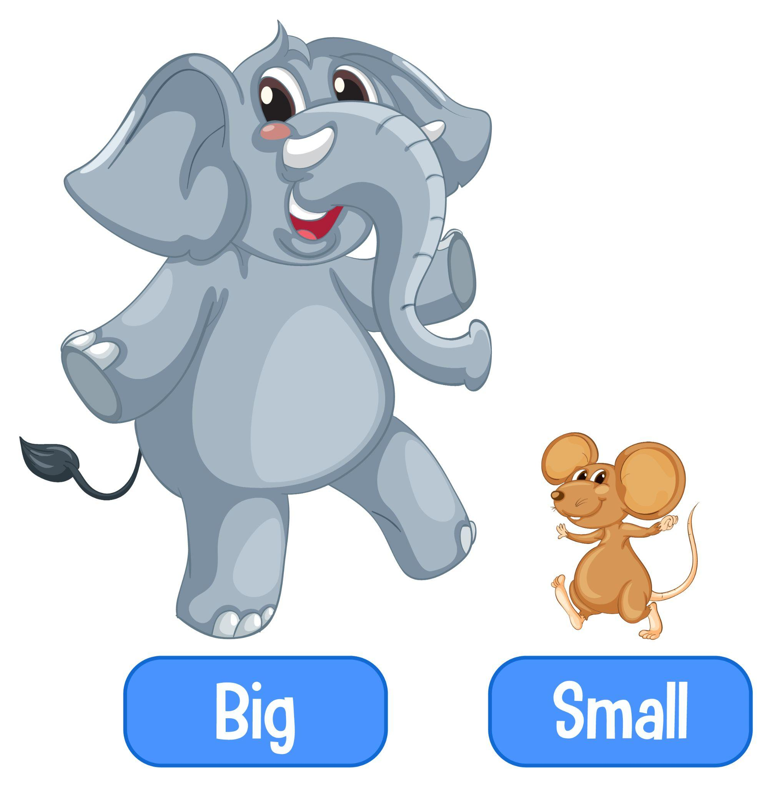
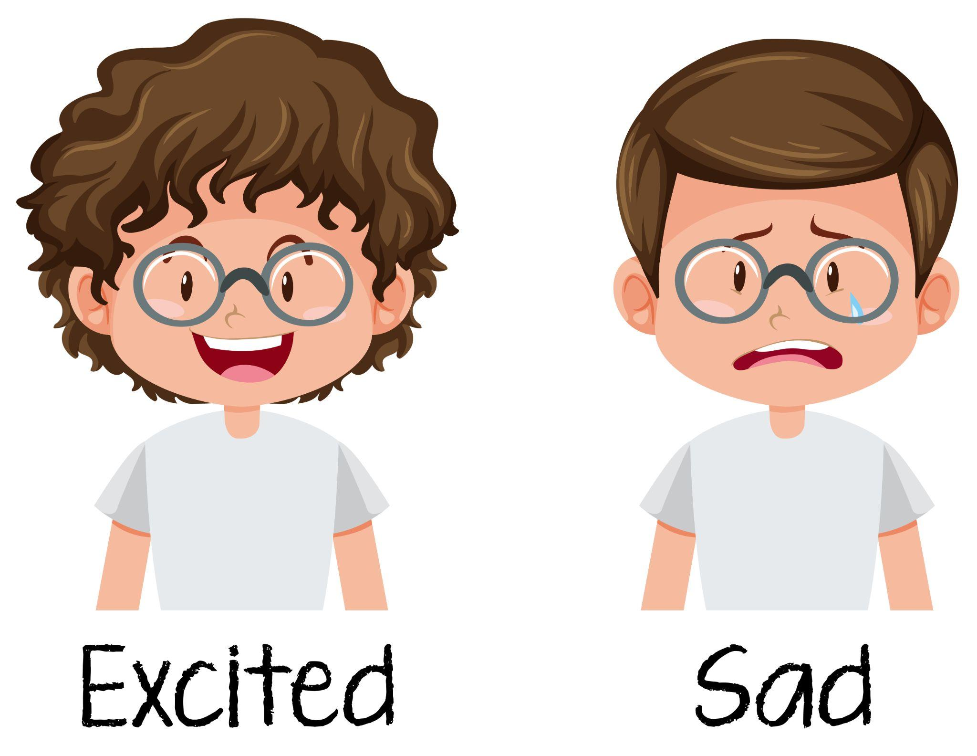
Adjectives can describe various aspects of noun, such as:
Appearance
Size
Quality
Emotion
Quantity
Age
Origin
Material

Slide 7
Descriptive Diaries with Flip!
25 minutes
Pick any object from your surroundings and use adjectives to describe it. It could be something simple, like a pencil, book, toy, or any object that you find interesting.
You will use Flip to record the video.
Start by introducing yourself and then show the object you’ve selected to the camera.
Let your teacher guide you on how to use Flip.

Slide 8
Using Flip
Go to Flip. Join the group by asking your teacher for the code or the link.
Click on ‘record’ to record your response to the prompt.
Once done recording, click on ‘next’ to proceed.
You can add a caption to your video if you’d like or simply click on ‘Post to Topic’.

Slide 9
Features by Flip!
While recording a video, you can access the toolbar on the right side of your screen. The toolbar offers the following features:
Adding text to your video.
Drawing while recording a video.
Adding stickers to the video.
Adding GIFs to to the video.
Using filters to edit the video.
Using a whiteboard.
Uploading an image file.

Slide 10
Feedback with Flip!
20 minutes
Once you and all your classmates have uploaded their respective videos, pick any five videos and leave a comment, providing constructive feedback.
The comment must use
An adjective to describe the presentation.
A few alternative adjectives to describe the object that appears in the video.
For example, if you chose a video where your classmate is describing a ball, you can comment “This is an engaging video. The ball can also be described as round and bouncy.

Slide 11
Constructive Feedback
Constructive feedback is when you share your thoughts, observations, and ideas in a kind and helpful way. It's not about telling someone what's wrong; it's about pointing out things that are good and suggesting ways they can make things even better.
For example, instead of saying "Your video looks fine," you could say "I love the way you used bright backgrounds to make your video engaging!”

Slide 12
Reflection
How do adjectives contribute to making our writing more engaging and descriptive?
Can you think of any other ways adjectives can be used to enhance communication?
How did providing feedback to your peers help you develop a better understanding of using adjectives effectively?

Slide 13
Thank you!
edm8ker is a fully owned brand of Makedemy Pte Ltd
A member of the SL2 group of social enterprises.

