Slide 1
Beats & Brushes: Painting Music with Hyperscore
Fourth/Fifth/Sixth Grade
60 minutes

Slide 2
Overview
Gain an understanding of how music has the ability to evoke various emotions and create distinct moods.
Use Hyperscore to craft musical pieces.
Notes:
Begin by sharing the overview. Apprise students of the tasks they’d accomplish in the class.

Slide 3
Ground Rules
Be respectful of one another. Listen to your teammates.
Raise your hand if you have anything to share.
Listen closely and follow instructions.
Complete the tasks on time.
Notes:
Discuss the ground rules with learners and stress on the importance of them being followed throughout the class.

Slide 4
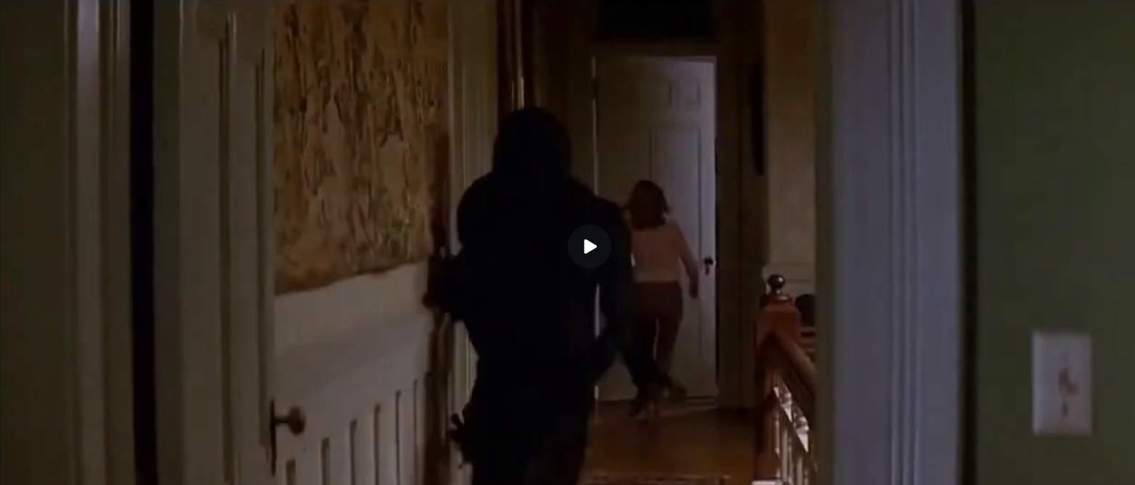
Scary or not?
Link - https://www.canva.com/design/DAF59cSKse8/3AYXTq5XUAa9Bry0UELROA/watch?utm_content=DAF59cSKse8&utm_campaign=designshare&utm_medium=link&utm_source=editor

Slide 5
How did you feel while watching the video?

Slide 6
Scary or not?
This video clip is originally from a horror movie.
Do you find it enjoyable or fun when you watch a horror movie?

Slide 7
Why didn’t the video feel scary?

Slide 8
Musical Magic
It’s because of the music.
Music can transform our reactions and make an unexpected, amusing twist to what we see on screen.
Get ready to create some music!

Slide 9
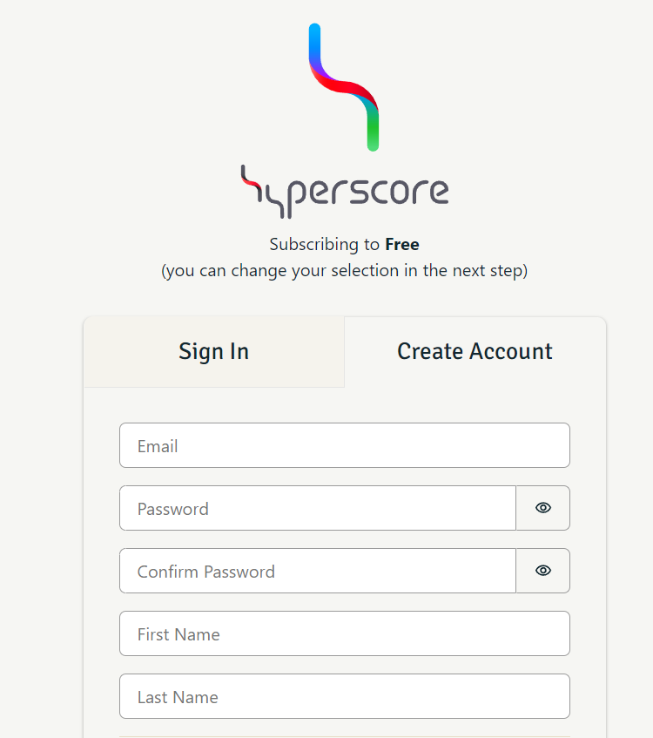
Introduction to Hyperscore
Hyperscore is a music composition software that allows users to create unique musical compositions by drawing colorful lines and shapes, translating visual elements into music.
Visit this link to create an account on Hyperscore

Slide 10
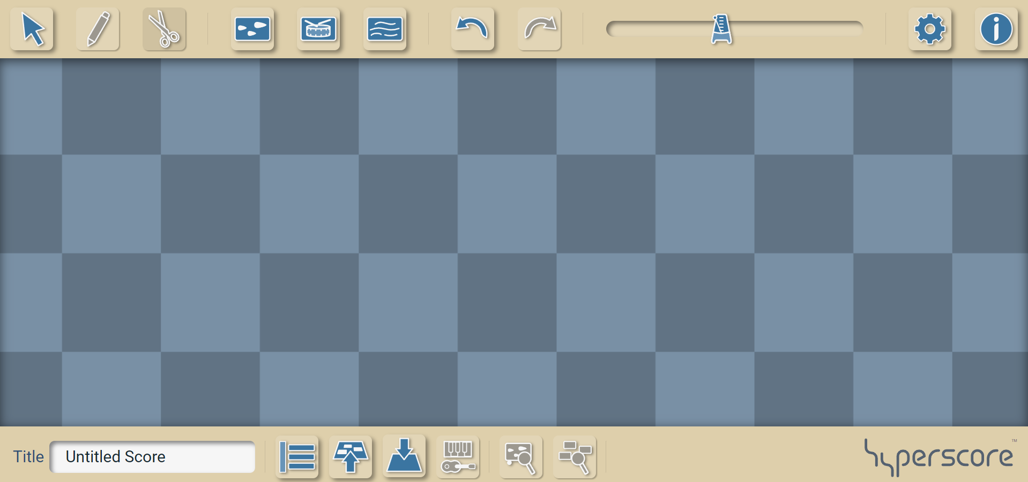
User Interface
Pen Tool
Melody Window
Sketch Window
Tempo
Select Tool
Percussion Window
Working Space
Save and download
Name of your music

Slide 11
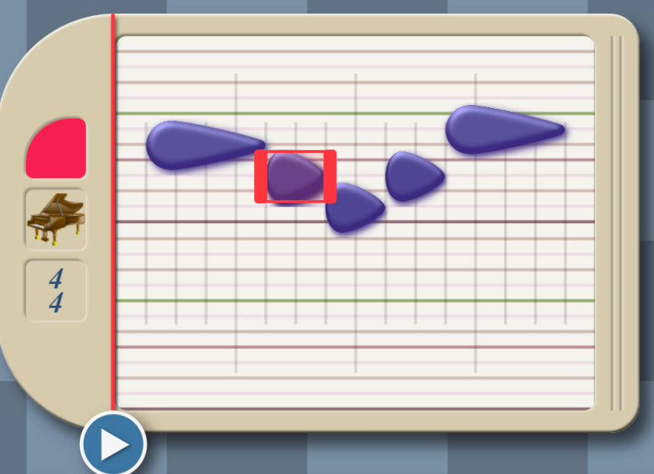
User Interface: Melody Window
2
Place the rain drop shaped notes in the melody window
Color label
Select the instrument from different available options
Try to create a simple melody.
1
Increasing pitch
3
Click on the play button
You can adjust the length of the note

Slide 12
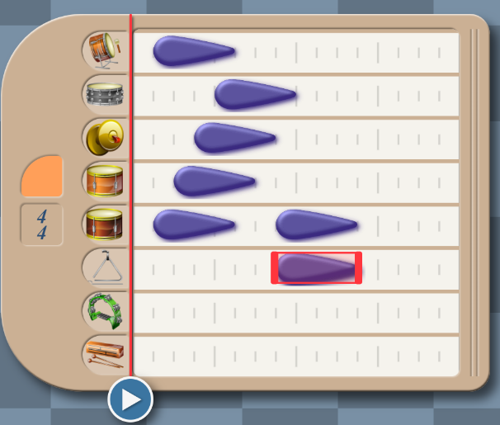
User Interface: Percussion Window
Melody Window
Sketch Window
Each row represents a different musical instrument.
Percussion Window

Slide 13
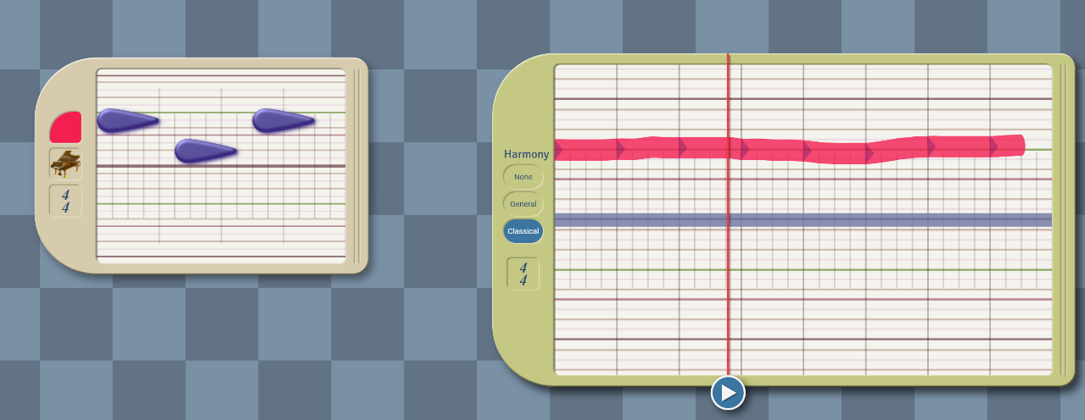
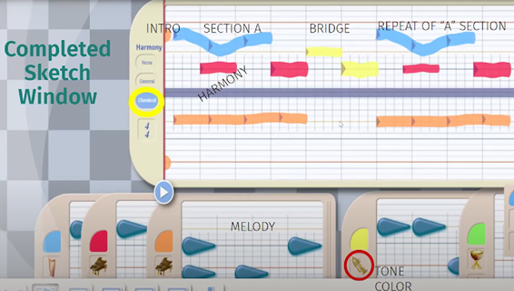
User Interface: Sketch Window
Sequence of notes (labelled in red color)
A piece of music. The pen tool is used to draw this.
Notice how different melody windows are used to craft a musical piece using the sketch window
A motive (made using the melody window) is a small musical piece (sequence of notes).
When you draw lines in the sketch window, you're guiding how the music based on that motive will sound—whether it goes higher, lower, or stays the same.

Slide 14
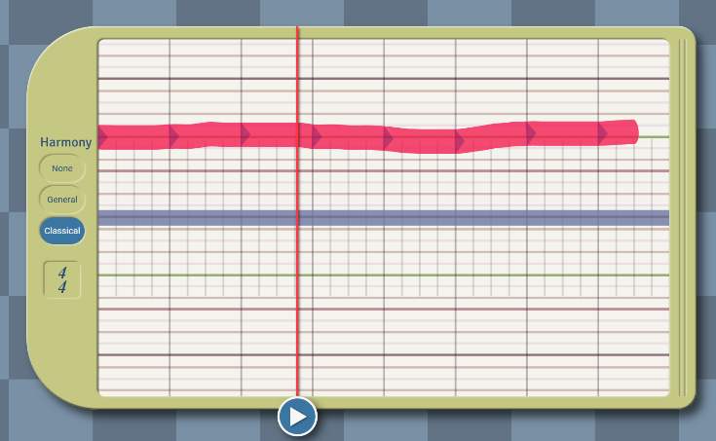
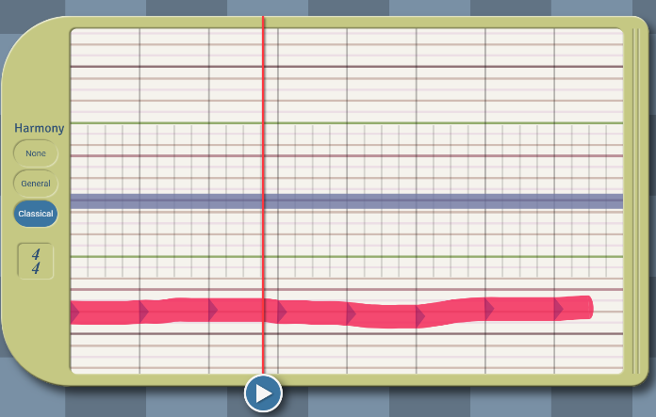
Sketch Window
What’s the difference between these two musical lines?
Note: Hyperscore incorporates Western musical harmony rules. When you turn them on, these rules help adjust the notes to match the chosen scale or key, keeping the music sounding good.

Slide 15
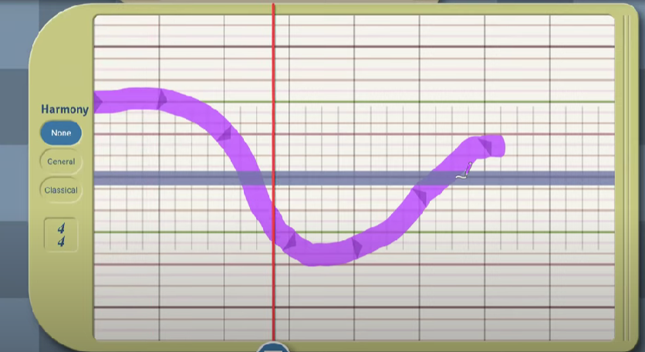
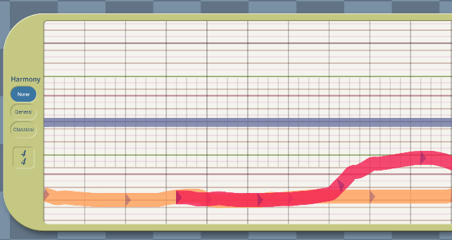
Different ways to draw musical lines
Flat line
Line with varying pitch
Overlapping Lines

Slide 16
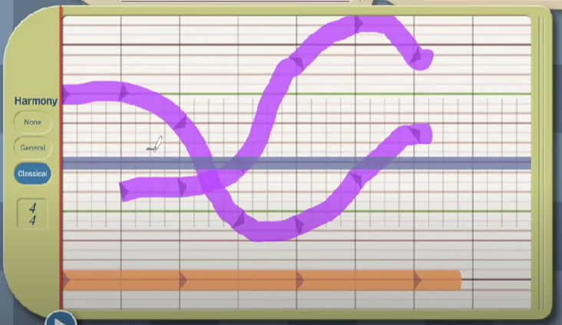
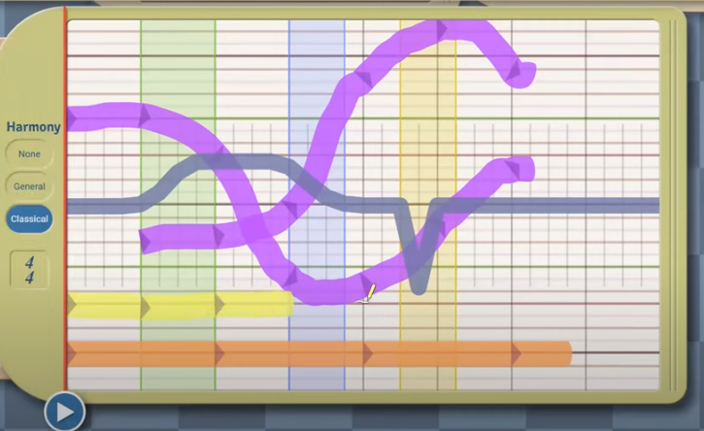
Harmony line
Harmony line: The gray line running through the middle of the sketch window
Using the harmony line one can introduce regions of tension, suspense, and resolution, adding interest to the musical piece.
Flat lines
Try to create a simple musical piece using the sketch window.
Note: Use the select tool while adjusting the harmony line.

Slide 17
What things in music make us feel happy or sad?

Slide 18
Happy Vs Sad Vs Horror
Aspect | Fun/Happy Music | Sad Music | Horror Music
Notes | Short | Long | A mixture of short and long notes
Pitch | High | Low | Low
Melody | Ascending | Descending | Abrupt
Tempo | Fast | Slow | Slow to moderate
Note: This is just a generalization, and various musical elements contribute to the overall mood in each genre.

Slide 19
Final Task
You are given three videos.
Video 1 and video 2 have a horror theme, while Video 3 is centered around fun. The original audio has been removed.
You are only required to compose music using Hyperscore for one of the videos based on your preference.
Note: Make sure that the duration of your music is similar to that of the video you chose.
Source of videos: https://pixabay.com/videos/search/

Slide 20
Steps to create a musical piece using Hyperscore

Slide 21
Step 1: Decide on the type of music
Determine the mood of your music: whether you want it to be happy or sad or something else.

Slide 22
Step 2: Use the melody window to create motives
Open the Melody Window and start placing teardrop-shaped notes to create basic motives for your piece.
Feel free to use multiple Melody Windows to experiment with different musical ideas
You can extend the length of this melody window

Slide 23
Step 3: Use the Percussion Window if Required
If rhythm is essential, navigate to the Percussion Window and add elements to enhance your composition

Slide 24
Step 4: Use the sketch window to craft your music
Open the Sketch Window to draw lines with colors representing your motives.
Utilize the Harmony to create regions of tension, suspense, and resolution, shaping the overall emotional narrative of your composition.
Experiment with the Sketch Window and Harmony Line to fine-tune the structure and emotional feel of your music.
You can extend the length of this sketch window

Slide 25
Share It!
Keep the video (the one you chose) open in your media player.
Play the music (created by you) using Hyperscore.
Play the video.
Share it with your classmates and observe their reactions.

Slide 26
Thank You
edm8ker is a fully owned brand of Makedemy Pte Ltd A member of the SL2 group of social enterprises.

