Slide 1
Biodiversity Bonanza!
60 Minutes

Slide 2
Objectives
Define the concept of biodiversity and its significance.
Identify and list a variety of species indigenous to the chosen area.
Utilize research skills to gather information about biodiversity in a specific region.
Construct an interactive Story Map that effectively presents the biodiversity of the chosen region.
Propose potential conservation strategies or actions based on an understanding of biodiversity.

Slide 3
Ground Rules
Be respectful of one another. Listen to your teammates.
Raise your hands if you have anything to share.
Listen attentively and follow instructions.
Complete tasks in
given time

Slide 4
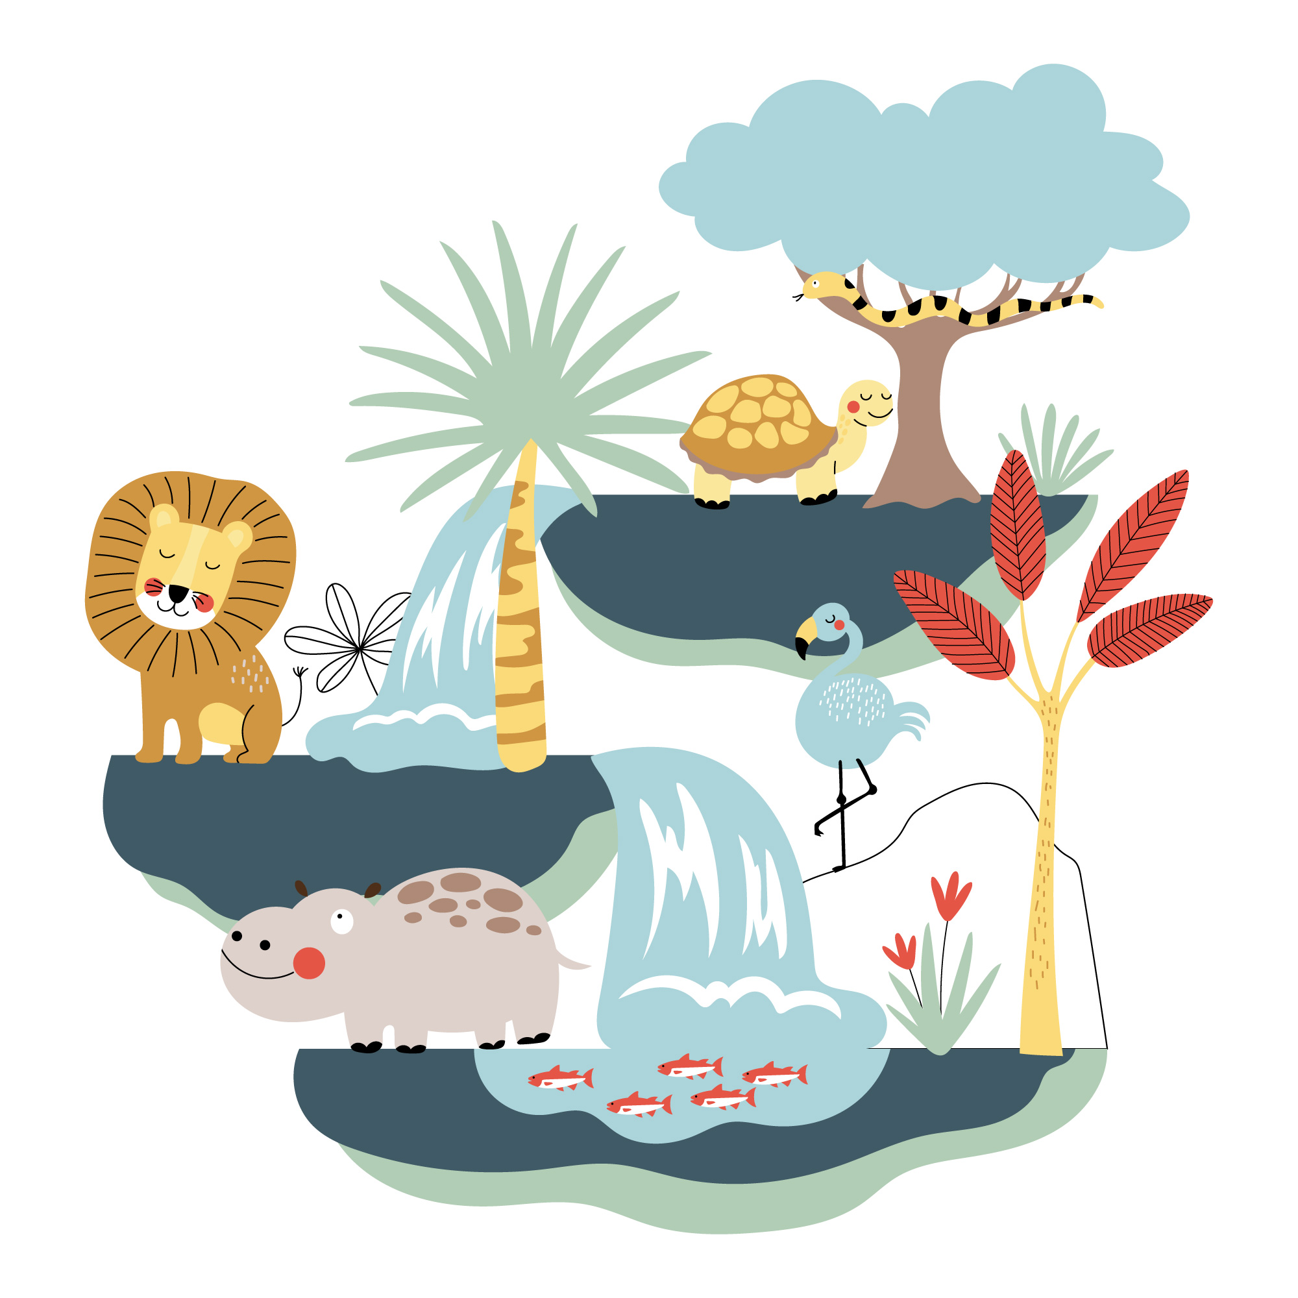
Have you ever visited a place, like a park or a natural reserve, where you saw a wide variety of different plants and animals? What was it like, and how did it make you feel?

Slide 5
Introduction to Biodiversity
Biodiversity is all the different kinds of life you’ll find in one area—the variety of animals, plants, fungi, and even microorganisms like bacteria that make up our natural world.
In simpler terms, biodiversity is like the colorful tapestry of life on Earth. It encompasses the different species of plants, animals, and tiny organisms that live in various places like forests, oceans, deserts, and even your backyard.
Each species has its unique role or job in the natural world, such as helping with pollination, decomposing organic matter, or regulating climate.

Slide 6
Importance of Biodiversity
Biodiversity is crucial for several reasons:
Ecosystem Stability: Biodiversity contributes to the stability and resilience of ecosystems. A diverse ecosystem is better equipped to withstand environmental changes.
Resource Availability: Many of the resources essential for human survival and well-being, such as food, medicine, and building materials, come from diverse ecosystems.
Climate Regulation: Biodiversity, especially forests, plays a significant role in regulating the climate. Forests absorb carbon dioxide (a greenhouse gas) from the atmosphere and release oxygen. They also help regulate local and global temperatures.

Slide 7
BioQuest!
30 minutes
Instructions
Learners will divide themselves into groups of 4 and pick a region of their choice.
Learners will do their research with regard to the biodiversity within their chosen region. For example, if you choose a country, you can explore the biodiversity in different cities/states.
Learners will build an interactive story map using Story Map JS to demonstrate their research.
You can refer to this pre-designed story map to get an idea.

Slide 8
Let’s Team Up!
Making the future of young minds

Slide 9
Project Manager
Resource Manager
Time Keeper
Presenters
Help your members stick to the task. Monitor what they are doing.
Collect materials and tools from the teacher. Ensure team members are using them properly. Return when you are done!
Keep track of time and help your teammates stick to the time limit.
Share your creation with the classmates and note down the feedback received.

Slide 10
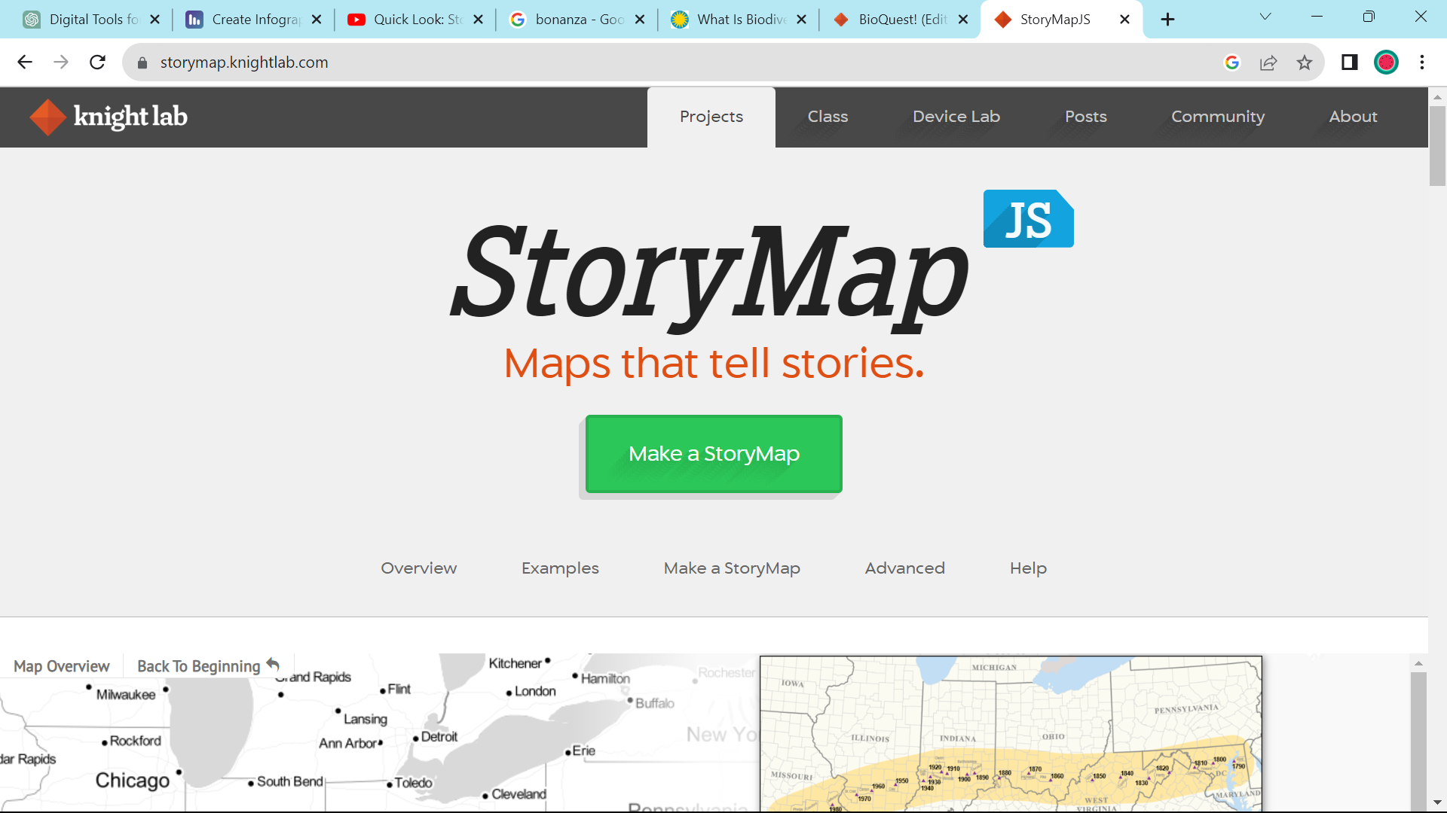
Getting started with StoryMap JS!
Go to StoryMap JS.
You need to have a Google Account to sign up and access.
Click on ‘Make a Map’ to start.
Let your educator guide you on how to use StoryMap JS!

Slide 11
Global Guardians!
15 minutes
Now that you have an idea of the diversity within a particular region, explore the challenges that the region is facing. For example, prone to poaching, deforestation, etc.
Strategize ways in which those challenges can be overcome.
Once you are done, present your map to the class!

Slide 12
Let’s Reflect!
How does biodiversity contribute to the overall health of ecosystems and human well-being?
What do you think are some ethical and moral reasons for preserving biodiversity?
Reflect on the process of creating a Story Map. How did it enhance your understanding of biodiversity and its challenges?

Slide 13
Thank you!
edm8ker is a fully owned brand of Makedemy Pte Ltd
A member of the SL2 group of social enterprises.

