Slide 1
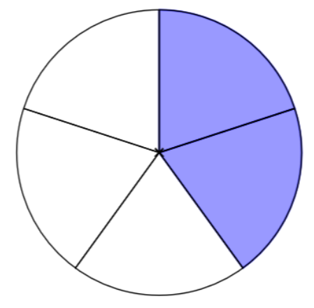
Making the future of young minds
Names: ____________________________________
Class: ____
Group Name: _________________
Write down the fraction you are going to train your machine on. | Draw the visual representation of that fraction.
For example: 1/2 | For example:
¼
¾
$$2/5$$
1
½

Slide 2
Making the future of young minds
As a group, complete the following questions after creating your AI model.
Test your own model with 25 images. How many of them are identified correctly, and how many are identified wrongly?
3 are identified correctly and 1 are identified wrongly.
The accuracy of your model is calculated using the following equation:
What is the accuracy of your model? 75%
How would you improve the accuracy of your model even further?
Inputting more data so the machine can learn to differentiate the fractions better.
4. How would you use machine learning to improve your classroom or school? Give an example.
Have the machine to recognise garbage on the floor and attach it to a bin and machine so it can identify and automatically clean the area.

