Slide 1
Discovering Language Superpowers with NLP
60 minutes

Slide 2
Objectives
Recognise how Natural Language Processing (NLP ) is used on a daily basis.
Use adjectives and their synonyms to describe how they would like to feel while watching movies.
Relate adjectives to movie genres.
Test an artificial intelligence model to provide movie recommendations based on moods.
Notes:
Begin by sharing the overview. Apprise students of the tasks they’d accomplish in the class.

Slide 3
Ground Rules
Be respectful of one another. Listen to your teammates.
Raise your hand if you have anything to share.
Listen attentively and follow instructions.
Complete tasks in given time
Notes:
Discuss the ground rules with students and stress on the importance of them being followed throughout the class.

Slide 4
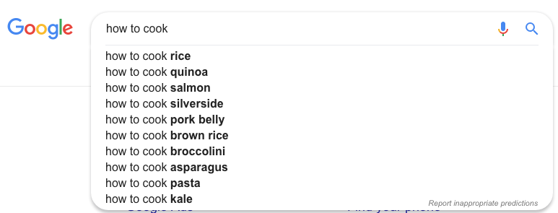
Have you seen Google auto-complete your search queries?

Slide 5
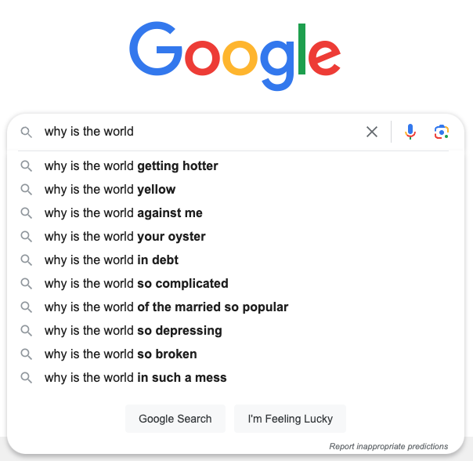
What do you think Google Search will suggest?
???

Slide 6
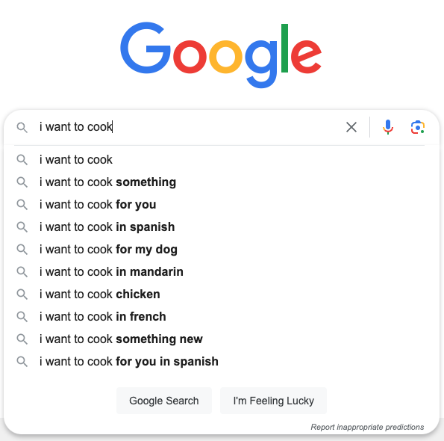
How do you think Google comes up with these suggestions?

Slide 7
Natural Language Processing (NLP)!
Google uses NLP to provide suggestions:
Based on phrases that other people have searched for
Based on phrases that share a meaningful relationship with your starting words
Are many people looking to translate “I want to cook” into different languages?

Slide 8
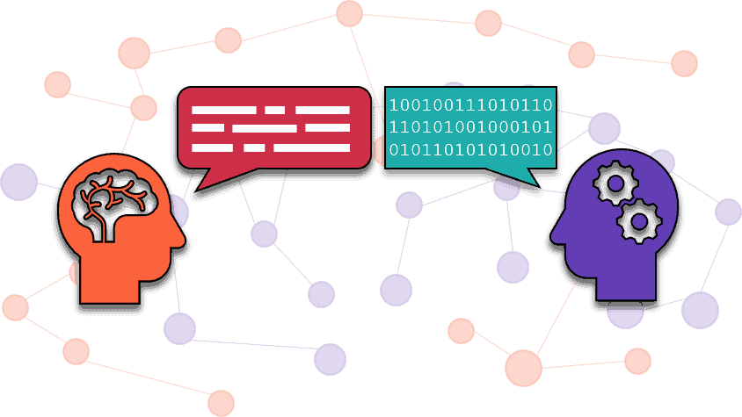
What is Natural Language Processing?
Natural language processing is teaching computers to understand and talk like humans.
Just like we learn languages to communicate with each other, NLP helps computers understand and work with the words we use.

Slide 9
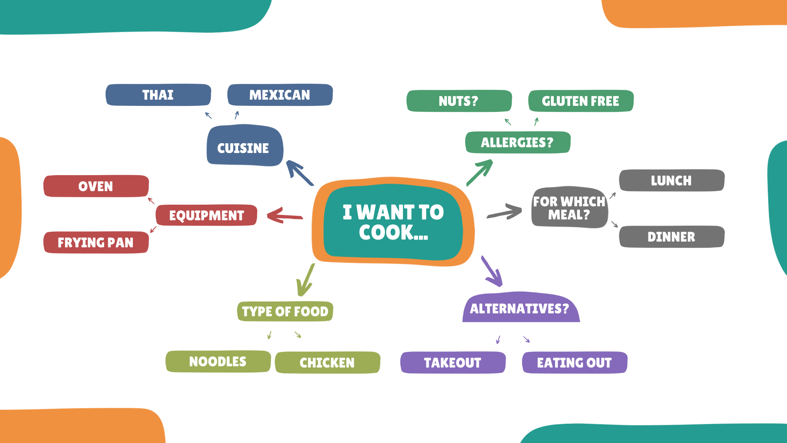
This is similar to developing a mind map…
How is a mind map different?

Slide 10
Semantris - Word Association Game
Duration - 10 minutes
1
To access the game, scan the QR code or type the link on the browser below
bit.ly/guessanimal
You’ll see a word with an arrow next to it. Type a word that’s related in order to get points!
https://bit.ly/3Ca89u7
2
Notes:
Game link: https://wordwall.net/resource/12588472/guess-the-animal

Slide 11
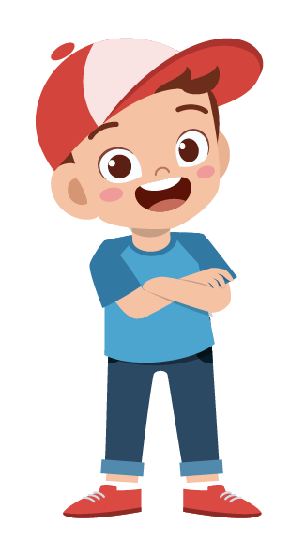
How many words did you manage to move to the bottom?
Were there any words that you weren’t able to move to the bottom on the first try? Why?
How did you think of what to type? What kinds of associations did you make?
What happened when TWO target words were given? How did your strategy change?
Notes:
How did you manage to guess the animal correctly. What made some animals harder to guess than others?

Slide 12
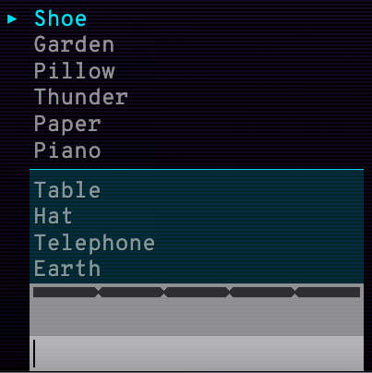
From the game, we learn that NLP...
Lace – boot – sole – walk
Identifies Word Associations
NLP helps identify a list of related words
Sleep – snore – sheets
Write – trees – cut

Slide 13
From the game, we learn that NLP...
Requires Data
NLP requires textual data (i.e. words, phrases or sentences)
Cobbler?

Slide 14
Movie Mania
Duration - 30 minutes
Your mission - Use Natural Language Processing (NLP) to help Tobi recommend movies based on your moods.
Who is Tobi?
Tobi is your friend from Pictoblox, who
will accompany you on your mission.

Slide 15
Movie Mania
Duration - 30 minutes
Steps to follow:
Form groups (3 people in each group)
Go to https://pictoblox.ai/
Let the teacher guide you on how to download the Pictoblox software.
Once done, wait for the teacher to show you how to use Pictoblox as well as a demo of the activity.

Slide 16
Let’s Collaborate!
Notes:
5 students per group

Slide 17
Team Roles
Project Manager
Resource Manager
Time Keeper
Help your team members to stick to their tasks!
Monitor what they are doing.
Collect materials and tools from the teacher.
Ensure team members are using them properly.
Return when you are done!
Keep track of time! Check the timer every few mins.
Help team members to complete the task on time.

Slide 18
Movie Mania
Duration - 30 minutes
Just like Tobi recommend some action-packed movies when you felt adventurous or thrilled, use some adjectives to describe how you feel when you watch
‘Feel-good’ movies (for example, cheerful)
Science-fiction movies (for example, curious)
Note : You can pick out movies for each genre from the list provided to you.

Slide 19
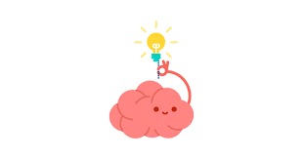
Reflection
Did associating adjectives with movie genres help you better understand the characteristics and themes of each genre?
Reflect on your own preferences. What movie genre do you most associate with? Share it with your friends.
Can you think of any other examples where NLP has been used?
Hint: They are similar to Tobi.

Slide 20
Word Weavers
Duration - 10 minutes
Now that you have a fair idea of how Natural Language Processing Works, let’s arrange scrambled sentences provided in the worksheet.
The idea is to help you understand that NLP algorithms rely on grammatical rules to determine the correct order of words and meanings of sentences just like you do!

Slide 21
Thank You
edm8ker is a fully owned brand of Makedemy Pte Ltd A member of the SL2 group of social enterprises.

