Slide 1
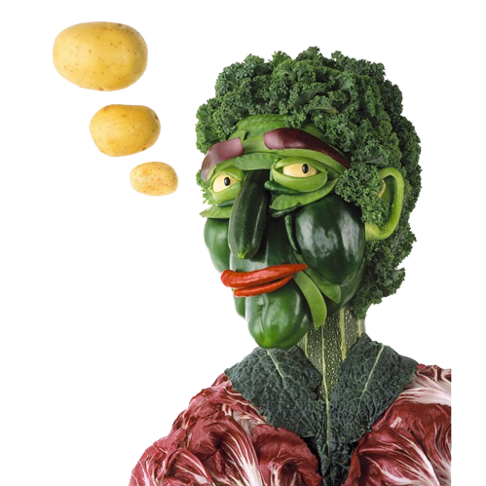
Fruit of Imagination
Second Grade
120 minutes
Notes:
Image Source: Telegraph.co.uk. Link: https://www.telegraph.co.uk/foodanddrink/foodanddrinkpicturegalleries/8051096/Carl-Warners-Foodscapes.html

Slide 2
Overview
Identify the main idea of an illustration.
Create Arcimboldo-inspired food art that shares a story.
Narrate and present the food art to my peers.
Notes:
Begin by sharing the overview. Apprise students of the tasks they’d accomplish in the class.

Slide 3
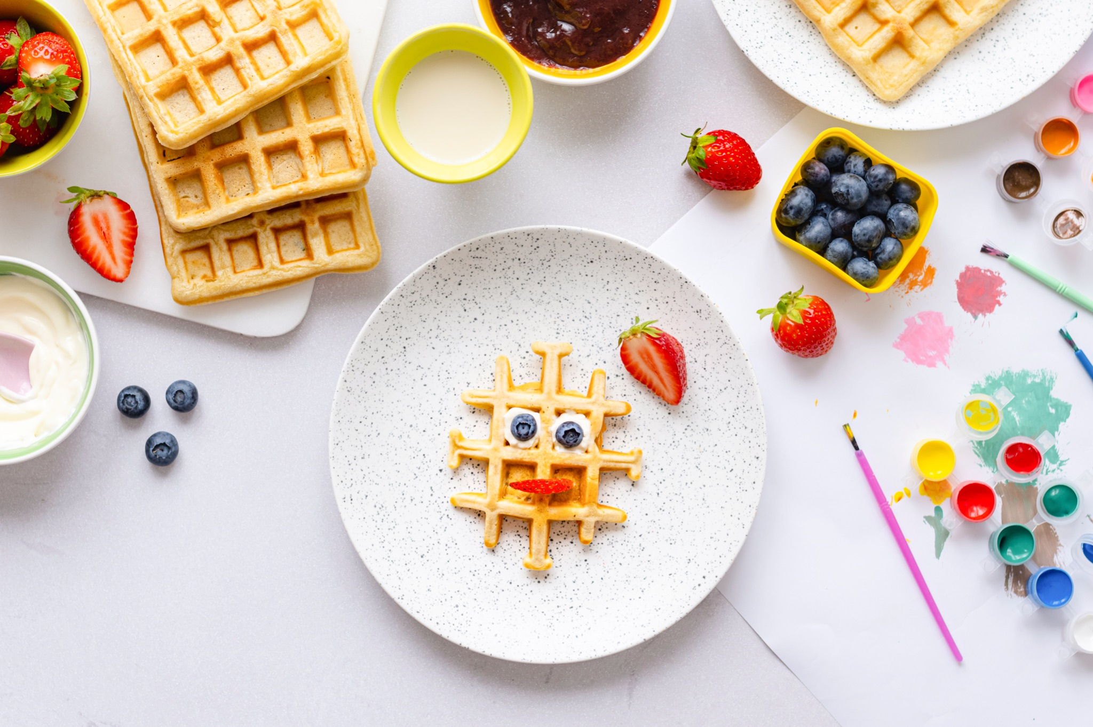
What is your favorite food?

Slide 4
Every Picture tells a story
Notes:
Artist: Carl Warner. Credits: Behance.net

Slide 5
Every Picture tells a story
Notes:
By Giuseppe Arcimboldo - LSH 97136 (sm_dig12951), Public Domain, https://commons.wikimedia.org/w/index.php?curid=36899673

Slide 6
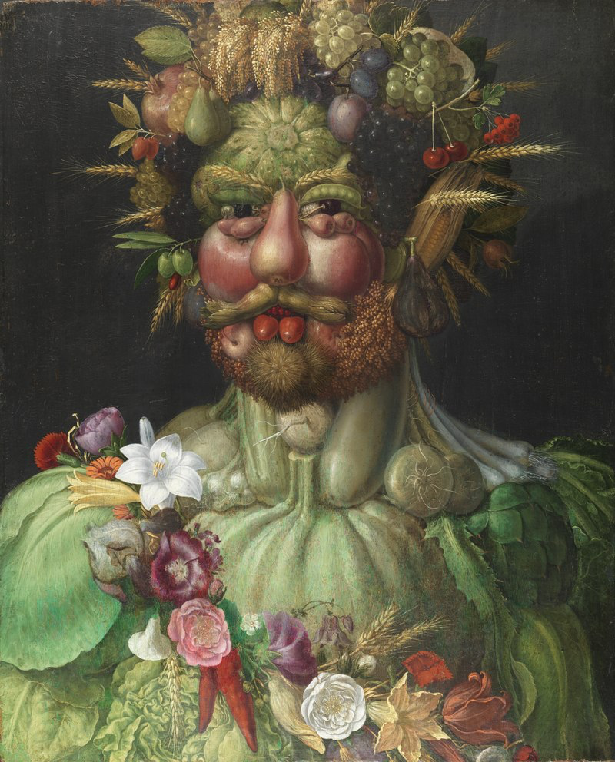
What comes to your mind when you look at this picture?

Slide 7
















What is Arcimboldo Art?
Arcimboldo art is a style of art created by the Italian artist Giuseppe Arcimboldo in the 16th century. He was known for creating portraits made entirely out of fruits, vegetables, and other objects. These portraits often depict people with faces made up of food items, such as a face made of apples, grapes, and other fruits.

Slide 8
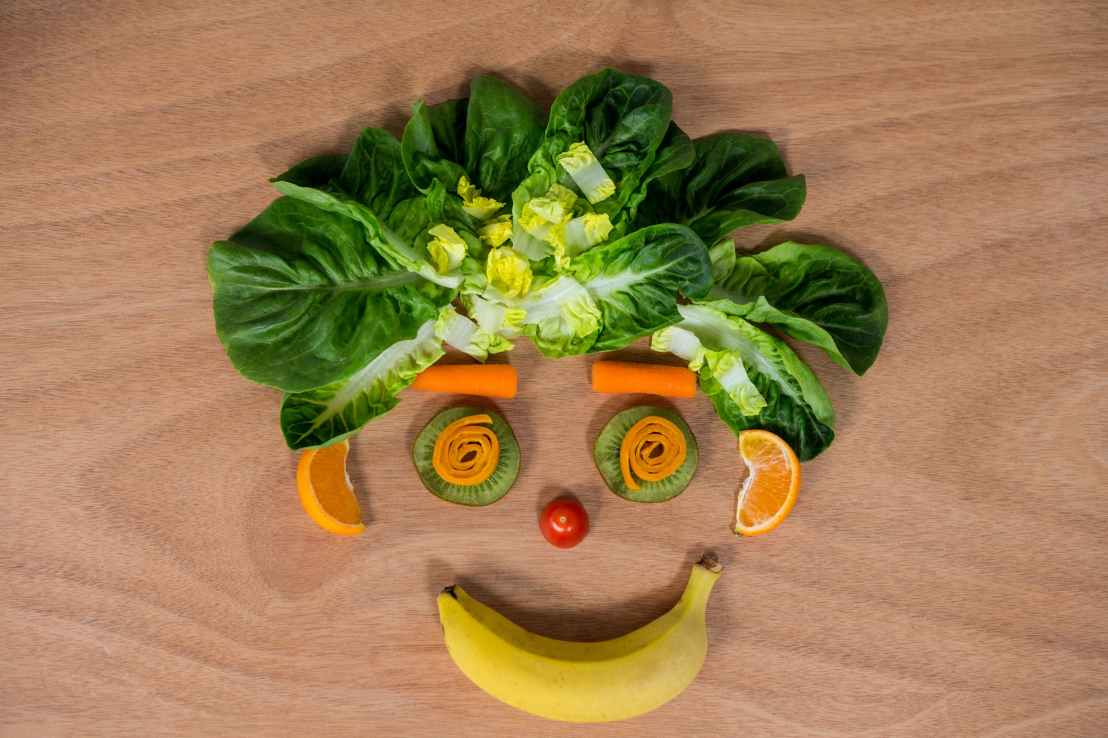
Your Food Story
Task: Create Arcimboldo art and narrate a story supporting it.
Time limit: 30 minutes

Slide 9
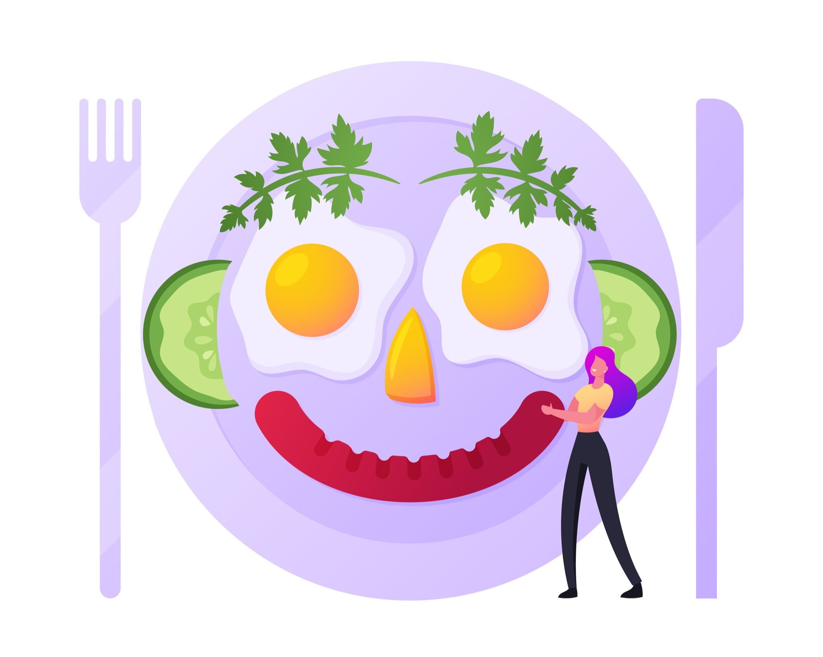
Remember
Everything in your story, be it character, setting, should be made completely out of flowers, fruits, vegetables or food items.

Slide 10

Ideation time.
Brainstorm within your group and come up with a story idea that you want to illustrate via food art.
Notes:
https://docs.google.com/document/d/1CXsHrJoxHNkbiVSZzm63ynUIk0FgA3Zk2grGIGpdrY0/edit?usp=sharing

Slide 11

Creation time
We will use Canva to bring our food art story to life.
Notes:
Image source: https://medium.com/canva

Slide 12
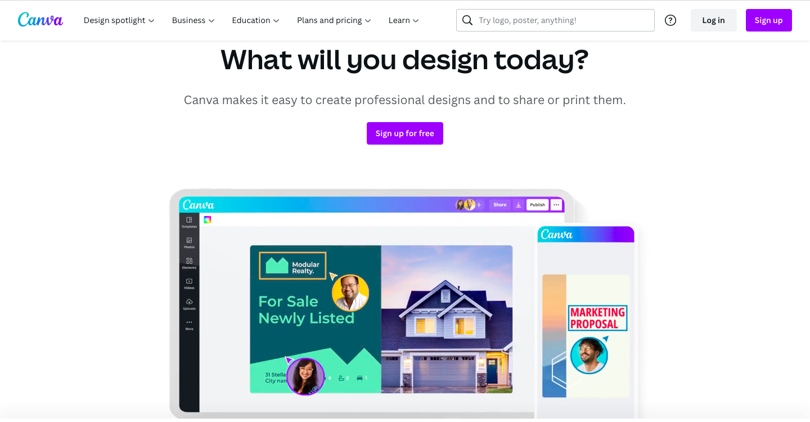
Creating your food story
Step 1.) Open canva by clicking on the link https://www.canva.com/en_in/
Step 2.) Click on “Sign up”

Slide 13
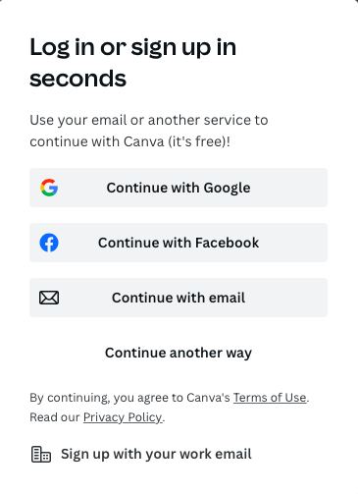
Setting up Canva
Step 3.) Click on “Continue with Email”.

Slide 14
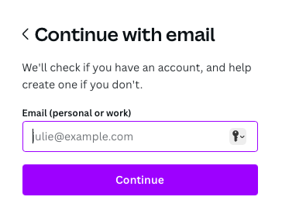
Setting up Canva
Step 3.) Enter your email address.
Step 4.) Click “continue”.

Slide 15
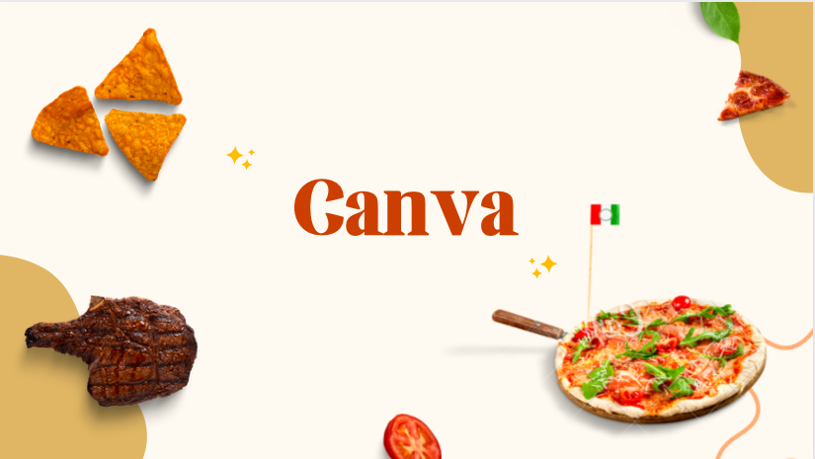
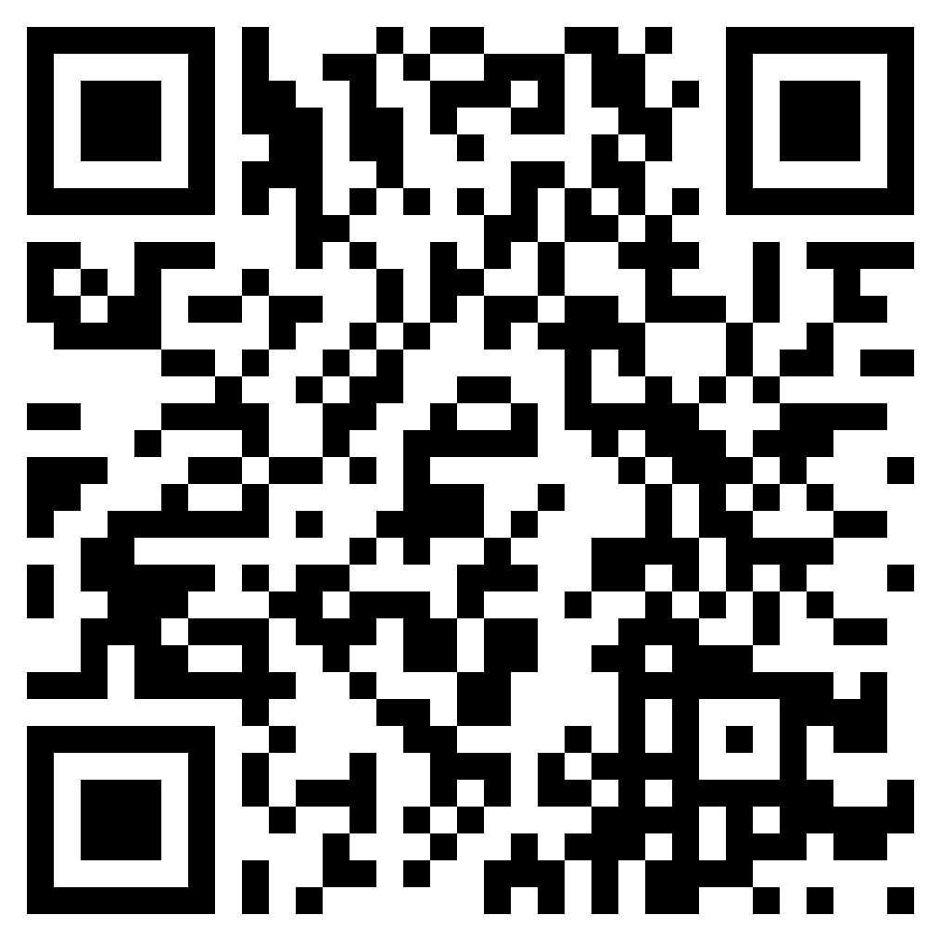
Creating your food story
Step 5.) Open the Canva template on your device.
https://www.canva.com/design/DAFbRY3cx8Y/Uk2qt_V5zwgIUVaGnPr4sQ/view?utm_content=DAFbRY3cx8Y&utm_campaign=designshare&utm_medium=link2&utm_source=sharebutton
Notes:
Canva template: https://www.canva.com/design/DAFbRY3cx8Y/Uk2qt_V5zwgIUVaGnPr4sQ/edit

Slide 16
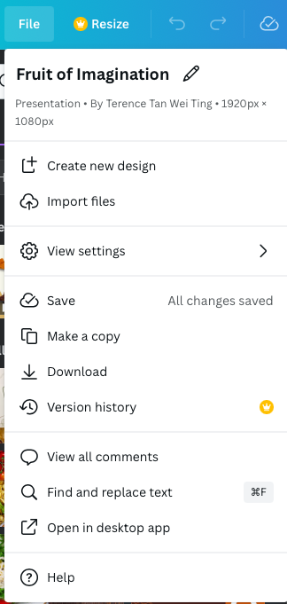
Duplicating the template
Step 6.) Click on “File”.
Step 7.) Click on “Make a copy”.

Slide 17
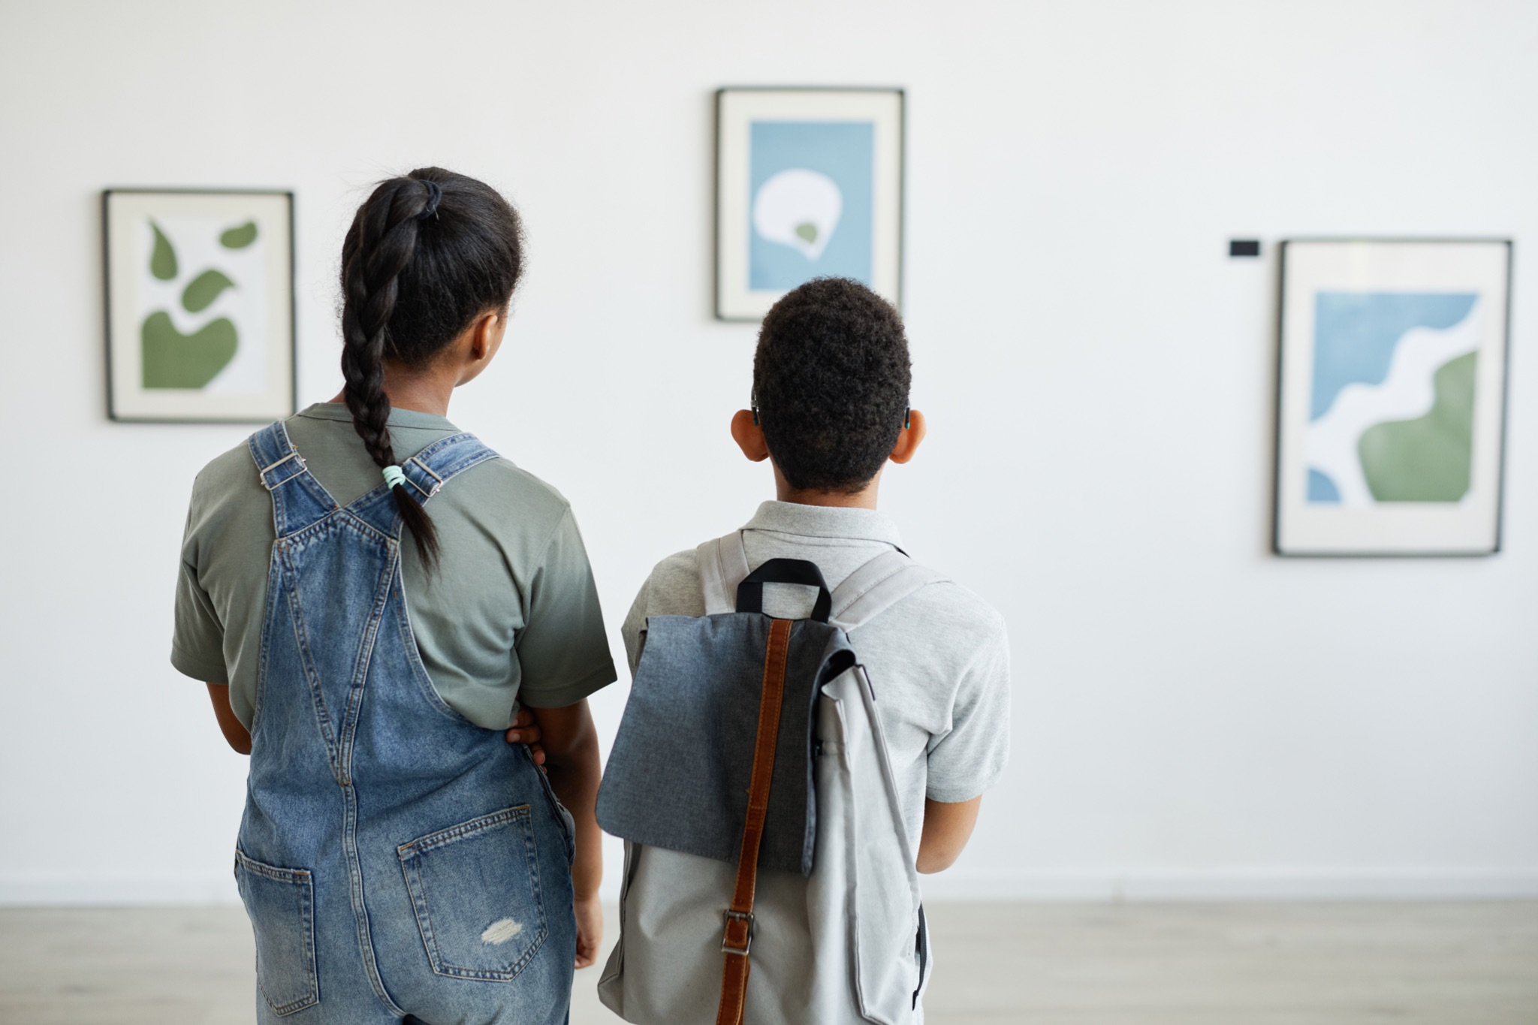
Gallery Walk
It’s now time to share your creation with the rest of your class.

Slide 18

Rules for the Gallery Walk
Move from one station to the next observing each other's food art.
Only one team at each station.
Move to the next station when instructed by the teacher.
Do not touch or make changes to the art work.

Slide 19
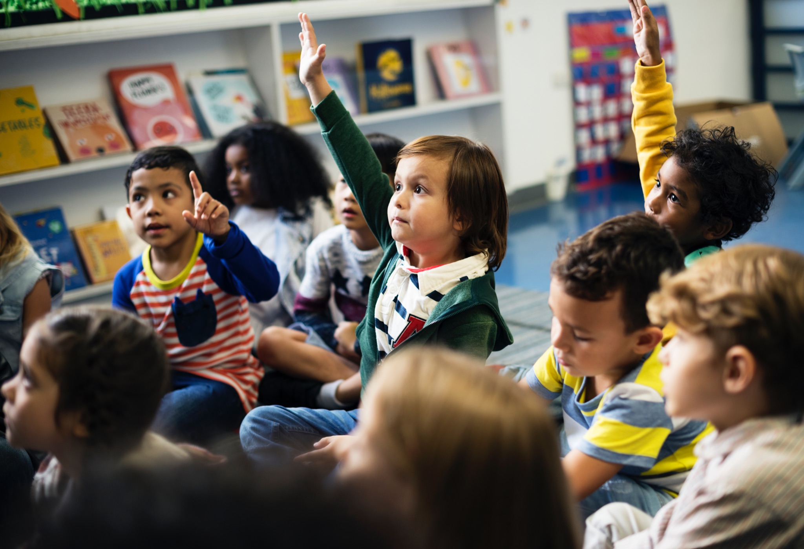
Let’s Summarize!
Describe how you’re feeling after creating the food art story, in one word.

Slide 20




Thank You
edm8ker is a fully owned brand of Makedemy Pte Ltd
A member of the SL2 group of social enterprises.

