Slide 1
Mathematics
Shape Up Your Art!
First Grade
60 minutes

Slide 2
Overview
Identify and build knowledge of different kinds of shapes.
Recognize shapes around us.
Use the shapes to create original works of art.
Notes:
Begin by sharing the overview. Apprise learners of the tasks they’d accomplish in the class.

Slide 3
Ground Rules
Be respectful of one another. Listen to your teammates.
Raise your hand if you have anything to share.
Listen closely and follow instructions.
Complete the tasks on time.
Notes:
Discuss the ground rules with learners and stress on the importance of them being followed throughout the class.

Slide 4
Let’s Team Up!
Notes:
5 learners per group

Slide 5
Team Roles
Project Manager
Resource Manager
Cleanup Crew
Help your team members to stick to their tasks!
Monitor what they are doing.
Collect materials and tools from the teacher.
Ensure team members are using them properly.
Return when you are done!
Responsible for cleaning up the materials and work after the project is completed

Slide 6
Shape Detectives
Your Task: Identify and collect shapes around you, using special shape magnifying glasses.
Time limit: 10 minutes

Slide 7
Shapes everywhere
You may find shapes hidden in your classroom, in things and in patterns. Look closely through your shape detecting glasses.

Slide 8
Shapes around us!
Triangle
When three straight lines come together, a triangle is created. Every triangle has three corners (angles) and three sides .
Traffic cone
Signs
Pyramids
Pizza Slice
Tortilla Chips
Ice cream Cones

Slide 9
Shapes around us!
Circle
A circle is a round-shaped figure that has no corners or edges.
Ball
Clock
Donut
Swim ring
Tire
Button

Slide 10
Shapes around us!
Square
A square is a shape that has four corners and four sides of equal length.
Cracker
Chess board
Window
Cheese slice
Clock
Napkin

Slide 11
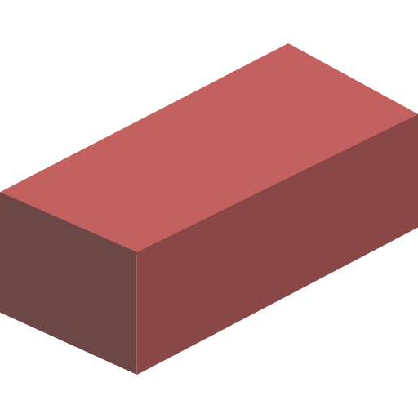
Shapes around us!
Rectangle
In a rectangle, the opposite sides are equal in length, with one pair being longer than the other pair.
Brick
Chocolate bar
Door
Ruler
Television
Briefcase

Slide 12
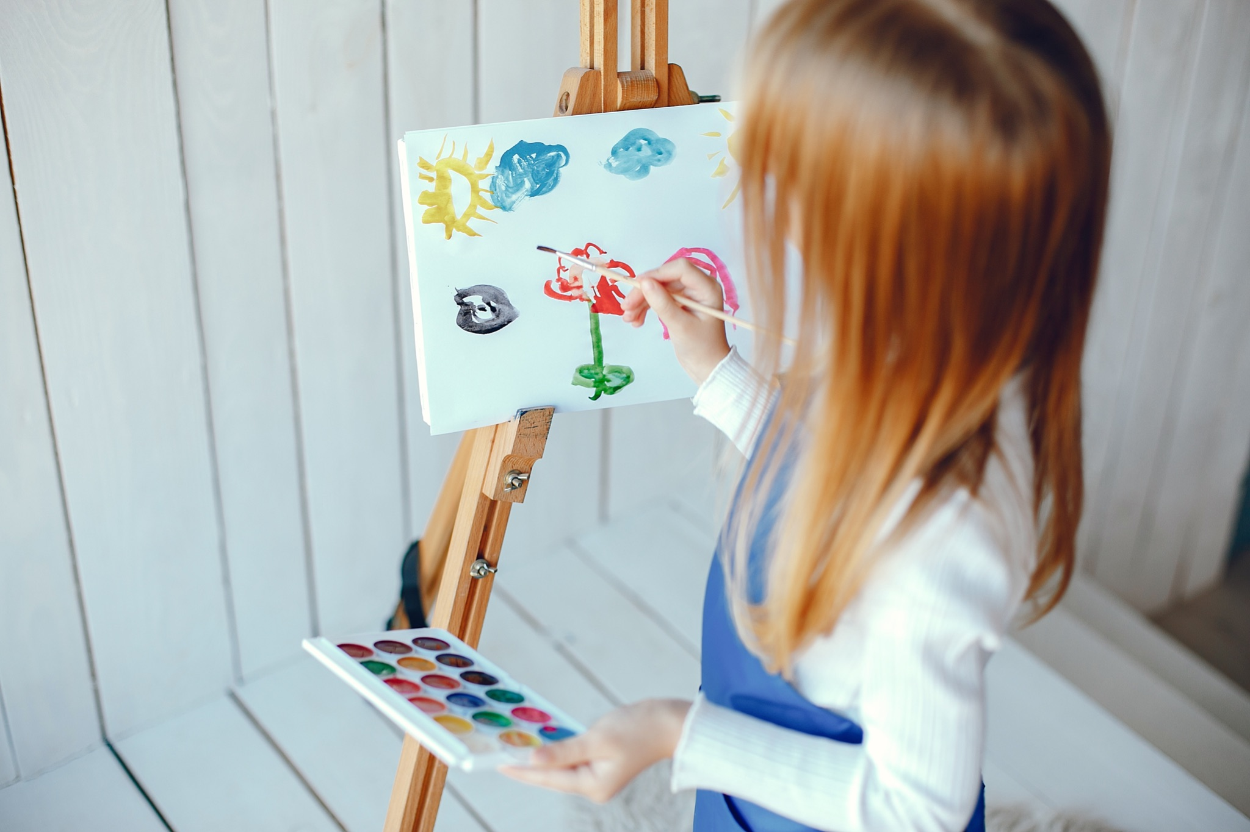
Shape Art
Your Task: Create art with just shapes.
Time limit: 30 minutes
Notes:
https://sketch.io/sketchpad/

Slide 13
Rules
You can use only the following shapes in your artwork:
- Triangle
- Circle
- Square
- Rectangle.
Be creative.

Slide 14
Reimagining creatures as shapes
Which parts of the image could be replaced with shapes?

Slide 15
Reimagining creatures as shapes

Slide 16
Reimagining things as shapes
Which parts of the image could be replaced with shapes?

Slide 17
Reimagining things as shapes

Slide 18
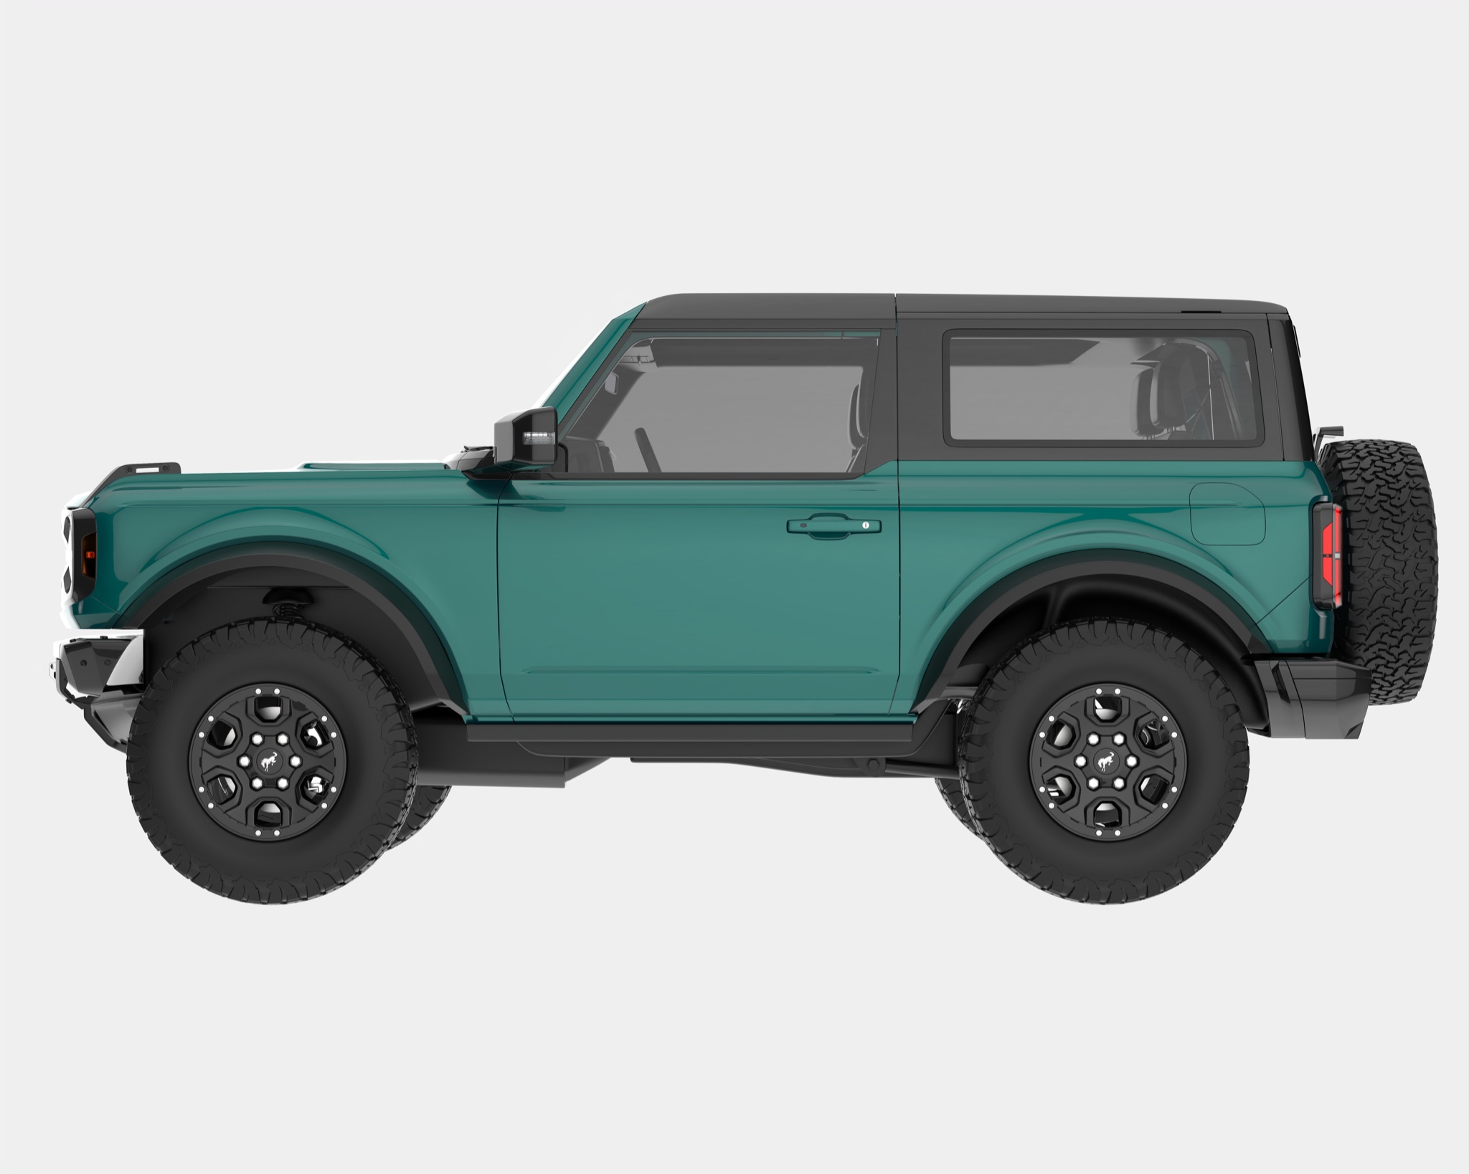
Reimagining objects as shapes
Which parts of the image could be replaced with shapes?

Slide 19
Reimagining objects as shapes

Slide 20
All about the interface
Notes:
Beginners Guide: https://docs.google.com/presentation/d/1cR-054o9dfXy6veIZtSr4ISfOzrjY5-4wLQtWtG-_Vo/edit?usp=sharing

Slide 21
The Shape Drawing
Notes:
https://sketch.io/sketchpad/

Slide 22
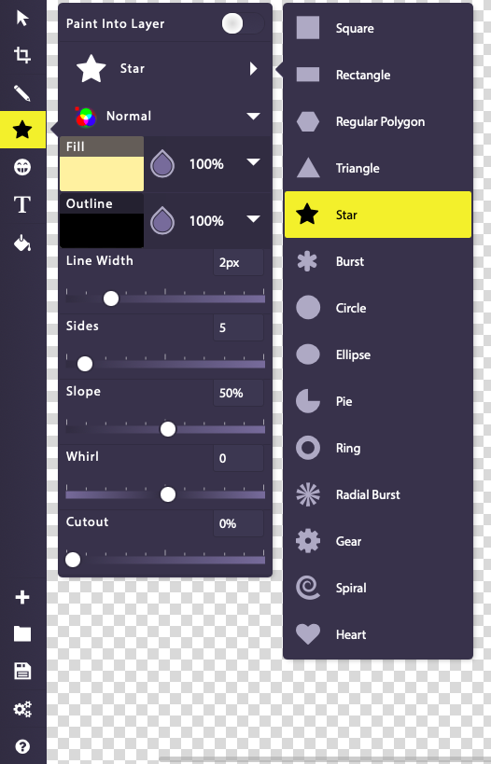
Create a shape
Create a Shape using the shapes option highlighted.
Notes:
https://sketch.io/sketchpad/

Slide 23
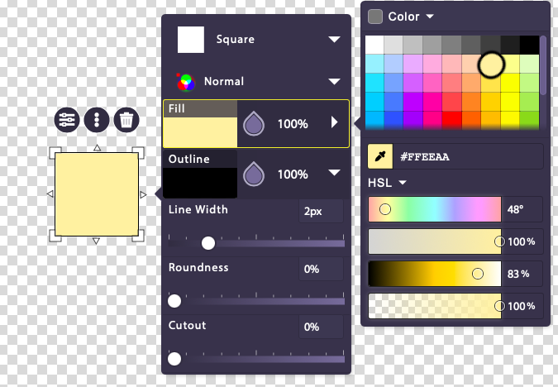
Now fill a different color
1
2
3
Add a different color to the shape you created.
Notes:
https://sketch.io/sketchpad/

Slide 24
Rotate the Shape!
Step 1: Select the shape.
Step 2: Press the circular double headed arrow.
Step 3: While pressing the arrow, drag it in the direction you want to rotate the shape in. Leave once done.
2
1
3
Notes:
https://sketch.io/sketchpad/

Slide 25
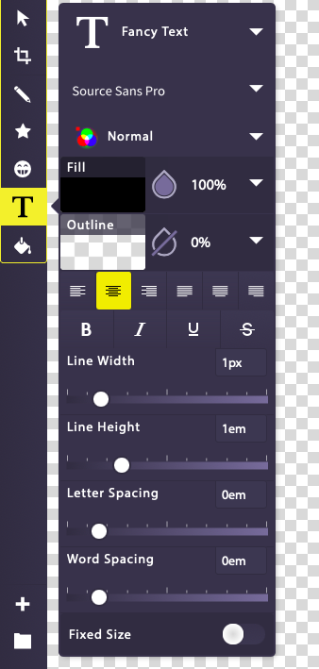
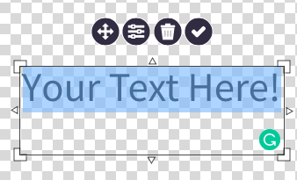
Give your Shape creature a name
Give your shape creature a name using the text option highlighted.
Step 1: Select the tool.
Step 2: Tap anywhere on the canvas.
Step 3: Type the shape name.
Notes:
https://sketch.io/sketchpad/

Slide 26
Gallery Walk
It’s now time to share your creation with the rest of your class.

Slide 27
Rules for the Gallery Walk
Move from one station to the next observing each other's shape art.
Observe closely how creatively your peers have used shapes to create artwork.
Appreciate the work you like by saying things like “I like… in your art”, “Good job in using shapes in place of everyday things!”.
Only one team at each station.
Move to the next station when instructed by the teacher.
Handle the artwork with care.

Slide 28
Let’s Summarize!
In one sentence, share something new that you learned in today’s class.

Slide 29
Thank You
edm8ker is a fully owned brand of Makedemy Pte Ltd A member of the SL2 group of social enterprises.

