Slide 1
Mathematics
Towering Arithmetic
Second Grade
60 Minutes

Slide 2
Objectives
Introduction to Number Operations.
Solve Numerical problems while playing a game of Jenga.
Solve Numerical problems to create a mystery lego monument.
Notes:
Begin by sharing the overview. Apprise students of the tasks they’d accomplish in the class.

Slide 3
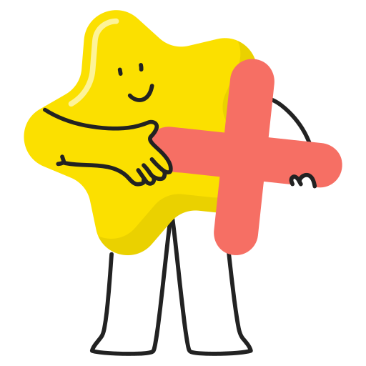
Addition
Addition is the process of calculating the sum of two or more numbers.
In math , the plus sign (+) is used to indicate addition.

Slide 4
Subtraction
Subtract in math refers to the operation of determining the difference between two numbers or quantities.The “-” sign is used to indicate subtraction.

Slide 5
Multiplication
Multiplying in math is the same as adding equal groups. The
“X” sign is used to indicate multiplication.

Slide 6
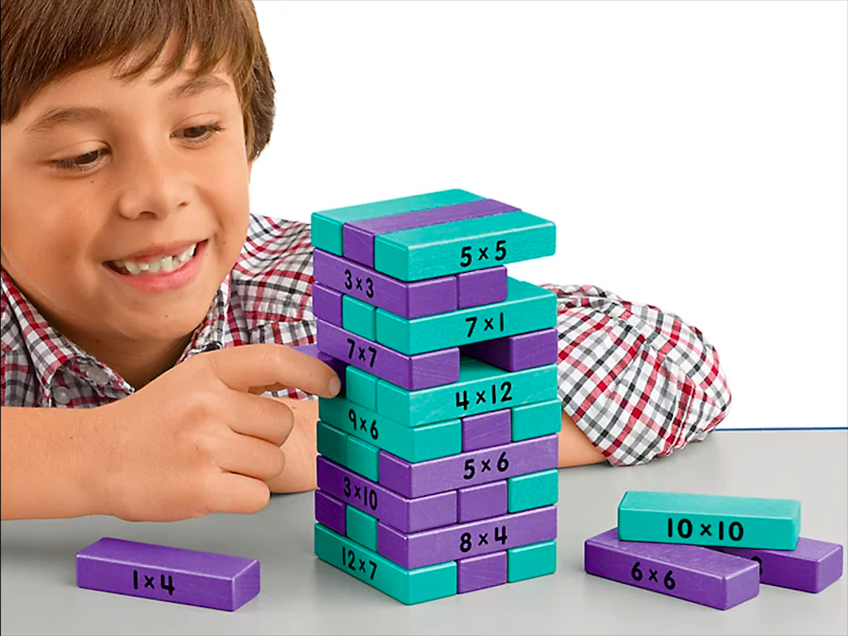
Jenga Tower Arithmetic
Notes:
Image Source: https://www.lakeshorelearning.com/products/games/fine-motor-games/multiplication-tower-of-math-game/p/TT853/

Slide 7
Jenga Math Rules
Players can only use one hand at a time.
Solve the problem on the Jenga block you pulled out.
If you’ve answered it correctly, you can keep the jenga block with yourself. If you’ve answered it incorrectly, stack the block back.
When the time for this activity ends, the team with the highest number of Jenga blocks wins.

Slide 8
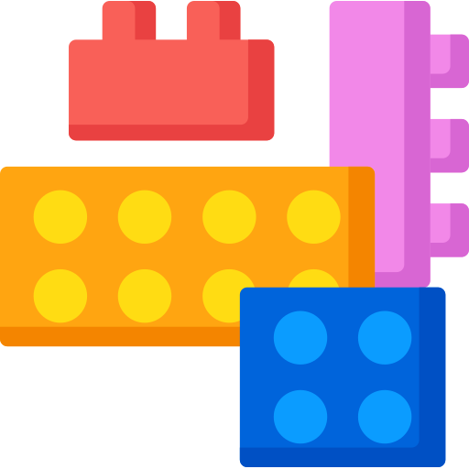
Mystery Monument
Your Task: Solve the Lego worksheet to successfully create a Mystery monument.
Time duration: 45 minutes

Slide 9
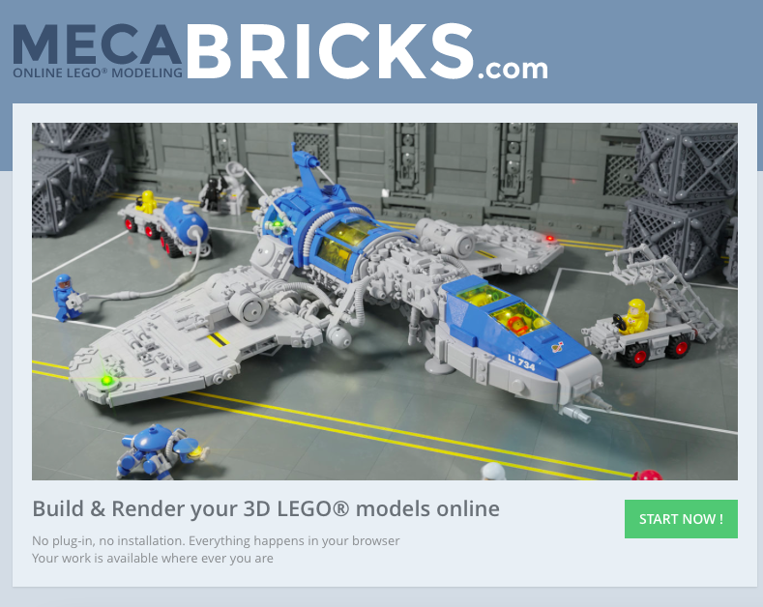
Tool: Mecabricks
Mecabricks is a tool for virtual Lego Model creation.

Slide 10
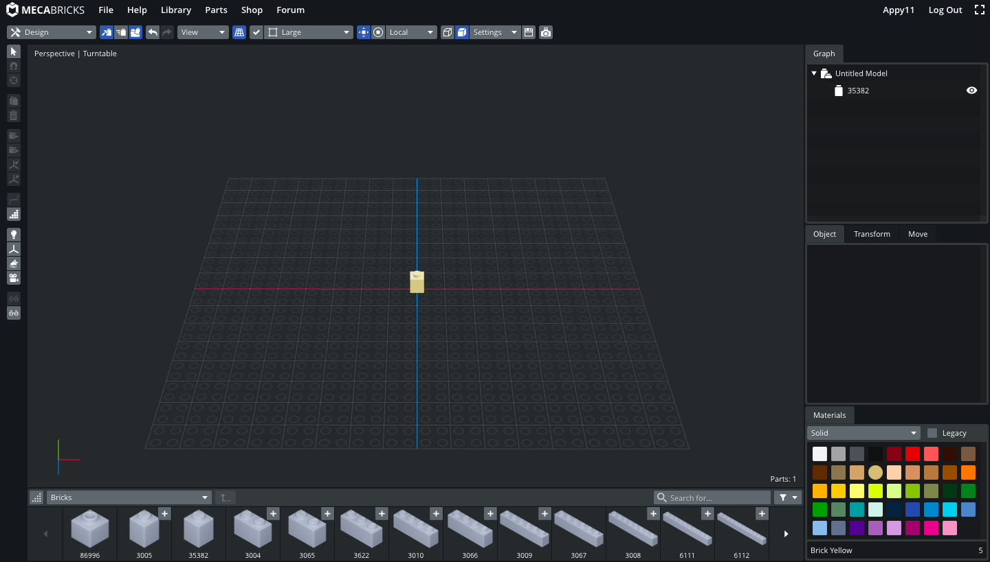
Adding a block
Step 1: Add a lego block to the project by simply tapping on the block from the parts library.

Slide 11
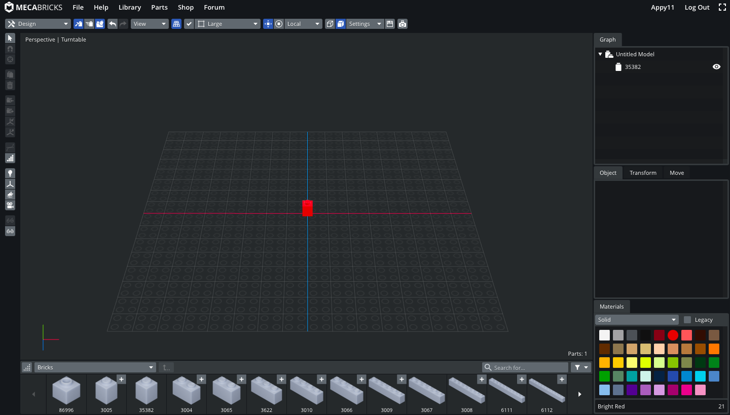
Changing color
Step 1: Select the block you want to change color of.
Step 2: Select color from the color palette.

Slide 12
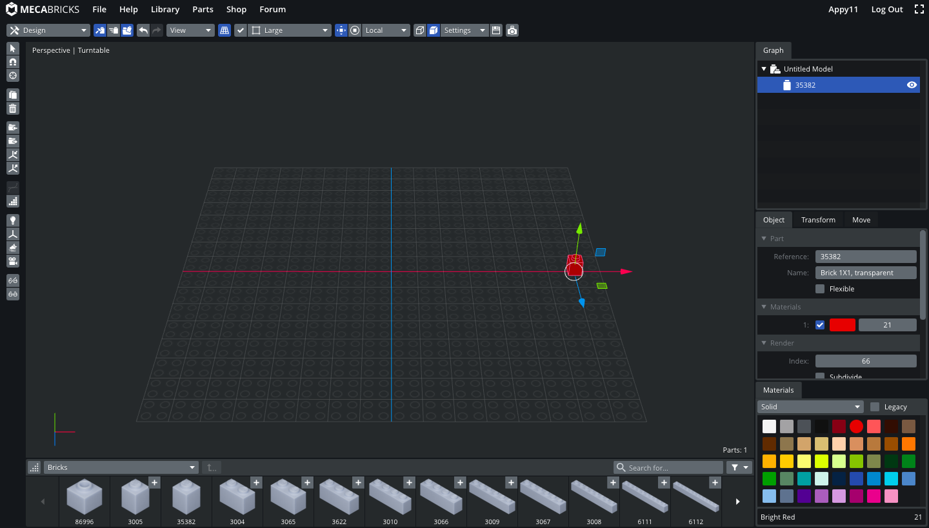
Moving a block
Step 1: Select the block you want to change position of.
Step 2: Press one of the arrows and drag to move the block along any axis.

Slide 13
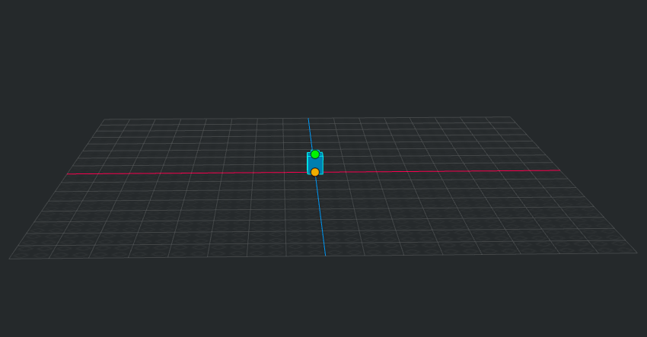
Adding a brick to another brick
Step 1: Hover your mouse over the brick you want to attach another brick on.
Step 2: Click one one of the two orange dots. The dot you click on will decide where the new brick would be added.

Slide 14
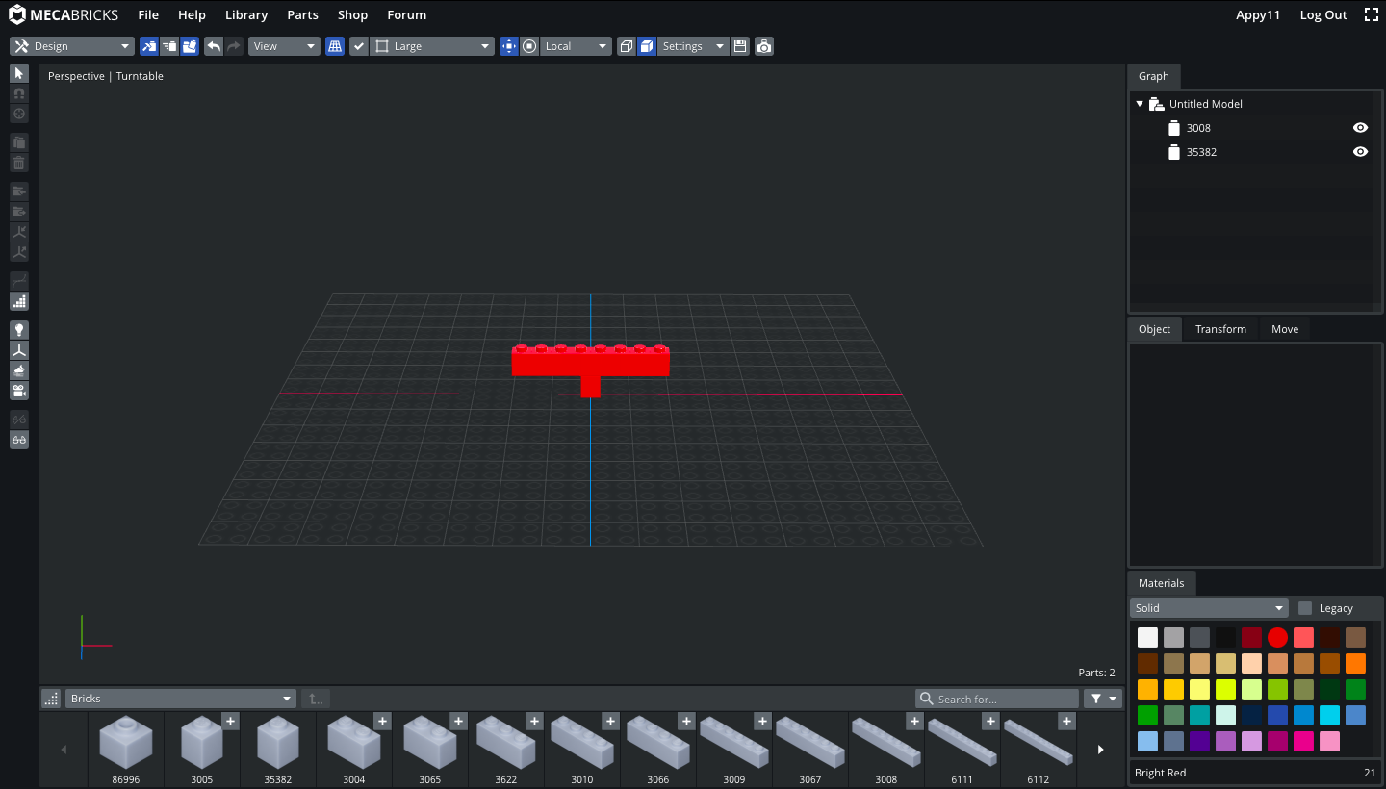
Adding a brick to another brick
Step 1: Now simply tap to select the brick that you want to add.
The new brick will be added to your choice of position.

Slide 15
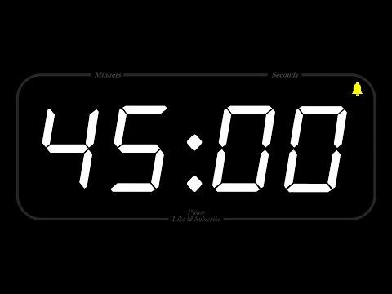
Timer

Slide 16
Reflection time
Rose
Thorn
Bud
One accomplishment that makes you proud.
What is one thing that excites you?
What is one area you need more help?

