Slide 1
Graphify: Create a Data-Driven Bar Graph App
120 Minutes

Slide 2
Objectives
Learn about Bar Graphs and its impact.
Create Bar Graphs to visually represent data in Excel Sheets.
Create a Bar Graph App in Thunkable.
Notes:
Begin by sharing the overview. Apprise students of the tasks they’d accomplish in the class.

Slide 3
You plan on opening an Organic food Market in U.S., for which you need data to know the area where consumption is high.
Data in what form would be easier for you to analyse and share with fellow company members?

Slide 4
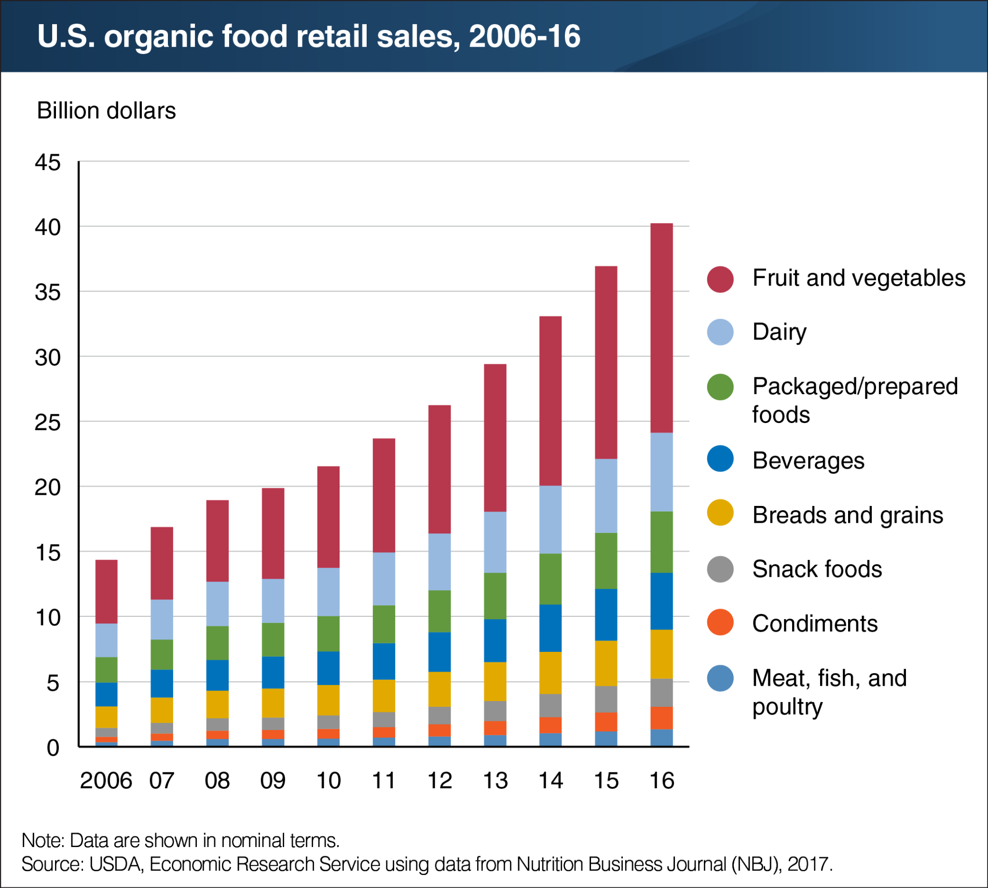
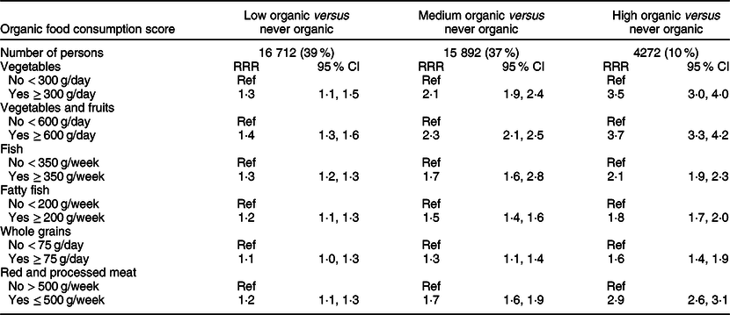
Which method of Data representation would you prefer?

Slide 5
Bar Graphs
A bar graph is a visual way to show information using bars or strips. It's a tool that helps us compare and contrast different categories of data, such as quantities or numbers. Bar graphs are useful when we want to represent data in a way that is easy to understand and see patterns. They are particularly helpful for showing differences between groups or categories.

Slide 6
What are some advantages of displaying data via Bar Graphs?

Slide 7
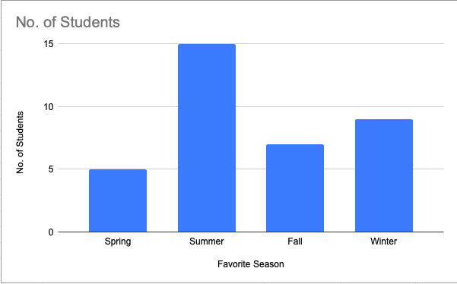
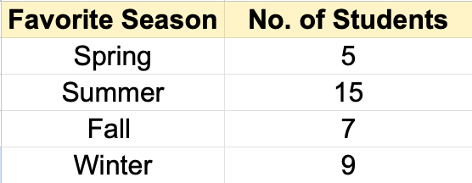
How to represent data using a bar graph?

Slide 8
Elements of Bar Graph
Horizontal Axis: This is the axis that shows the categories or groups being compared, such as different years or products.
Vertical Axis: This is the axis that shows the scale or values being compared, such as revenue, sales or quantity.
Bars: The bars represent the values of each category, with the height or length of the bar corresponding to the value being represented.
Title: A descriptive title is provided to summarize the purpose or main message of the graph.

Slide 9
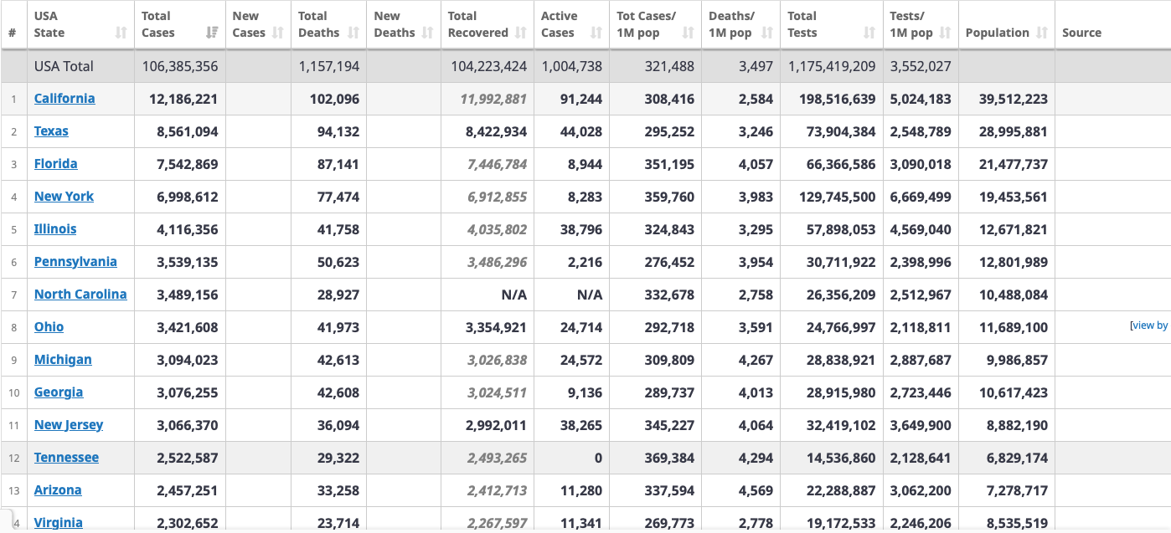
Let’s Compare Data

Slide 10
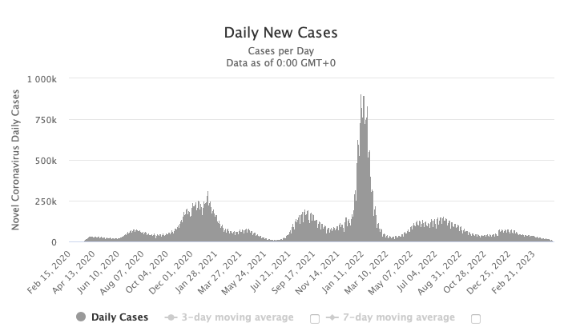
Let’s compare Data

Slide 11
Thunkable
Today we will create a Custom App that will display data as a bar graph.

Slide 12
What are some of your favourite mobile apps?
Have you created mobile apps before? If yes, list the apps you have created
Think Pair Share!

Slide 13
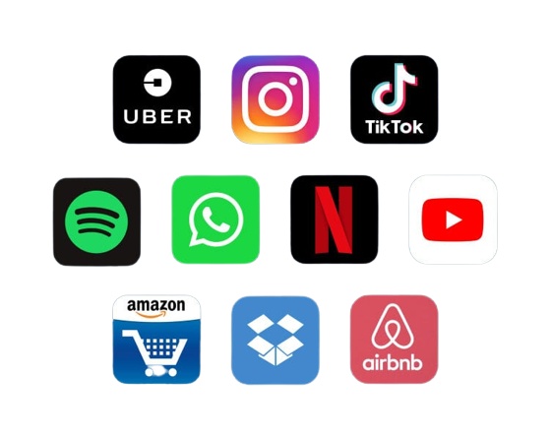
Some popular Applications
Notes:
Source: https://www.netsolutions.com/insights/top-10-most-popular-apps-2018/

Slide 14
What are the steps involved in creating an app??

Slide 15
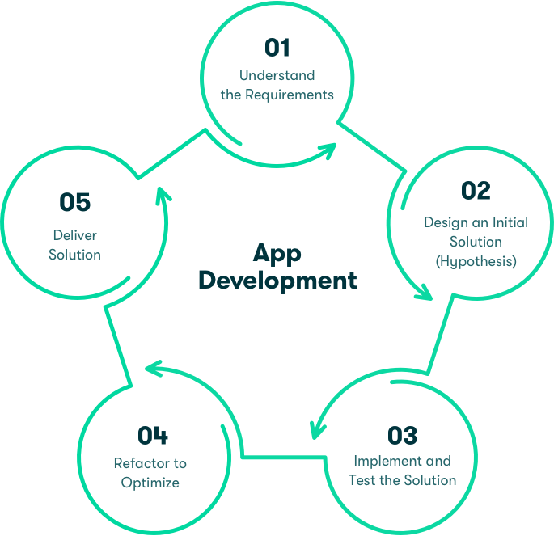
Steps of App Development
Ideate
Improve
Design
Test
Code

Slide 16
Ideation Time
Step 1.) Think of a genre for your app.
Step 2.) Finalise the data you need. Then conduct interviews and store the data in an Excel Sheet.
Step 3.) Create a wireframe of the layout you envision on your app.

Slide 17
Can you guess and share what is a Wireframe?

Slide 18
Wireframe
A wireframe is like a blueprint for a website, app or software. It is a simple drawing that shows where everything goes on the screen, like pictures, text, and buttons. It helps people who are designing a website or app to figure out how it should look and work before they make it.

Slide 19
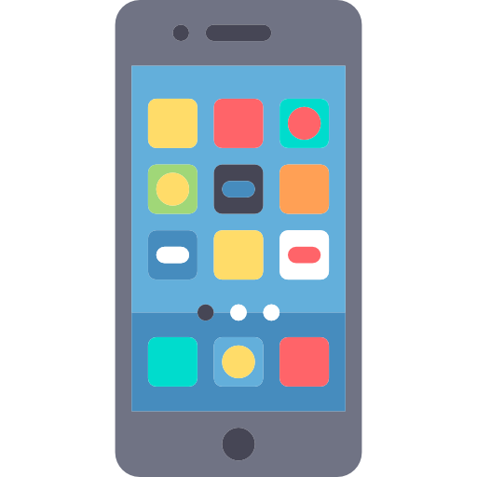
Step 1
What kind of data will your app collect and display as a bar graph?
Some categories are:
Sports
Education
Health and Fitness
Entertainment
Lifestyle
Travel
Weather

Slide 20
Do it yourself!
Brainstorm and fill the Ideation Sheet.
Interview peers and collect information you need for the app. Store this information in an Excel sheet.

Slide 21
Creating Bar Graphs

Slide 22
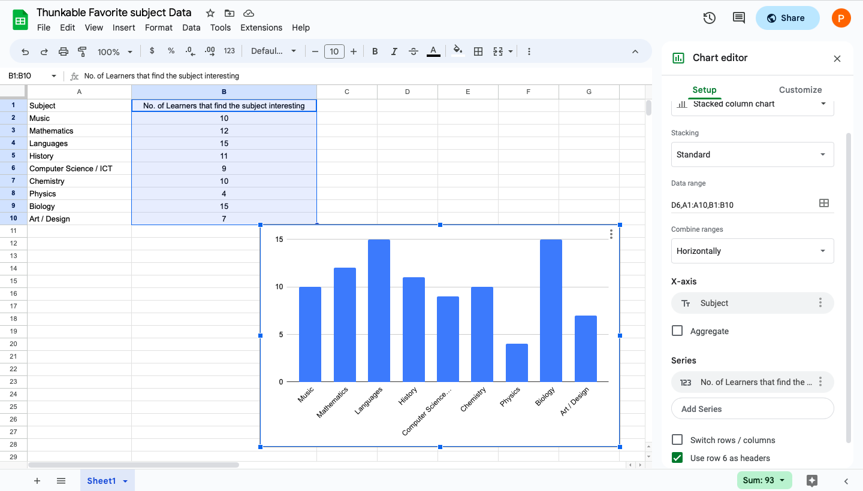
Output
This is what the bar graph would look like.

Slide 23
Step 2:Time to Create a Wireframe

Slide 24
Let’s start creating the app interface

Slide 25
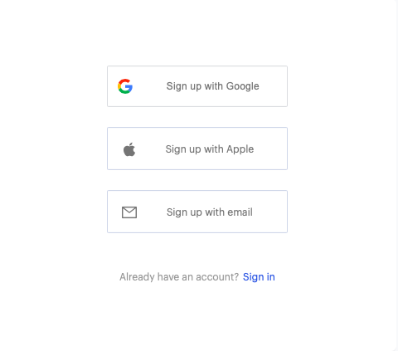
Sign Up
1
2
Step 1. Visit https://x.thunkable.com/signup
Step 2. Click “Sign Up”
Step 3. Choose a method to sign up from the options provided

Slide 26
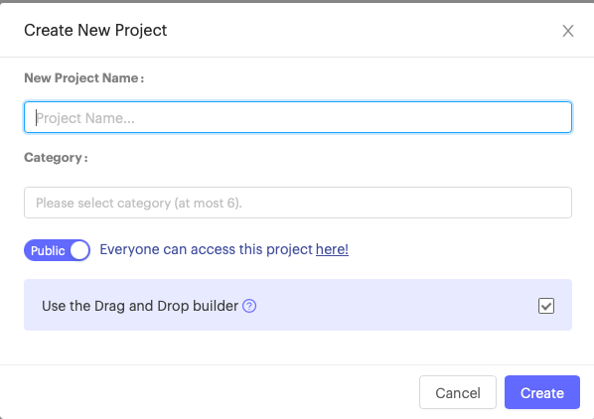
Create a Project
1
Step 1. Click on “Start Building”
Step 2. Enter the Project name, select a category and click create.
Note: Ensure that the “Use drag and drop builder” checkbox is checked.
2
3
4
5

Slide 27
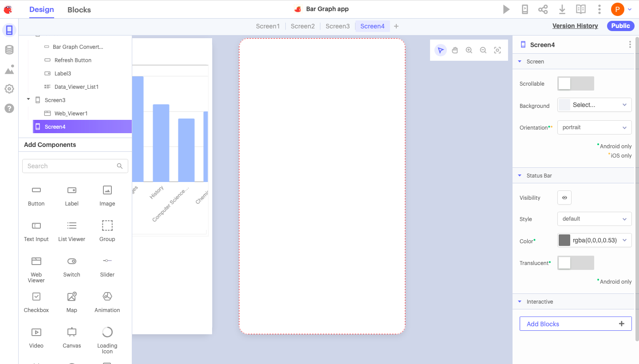
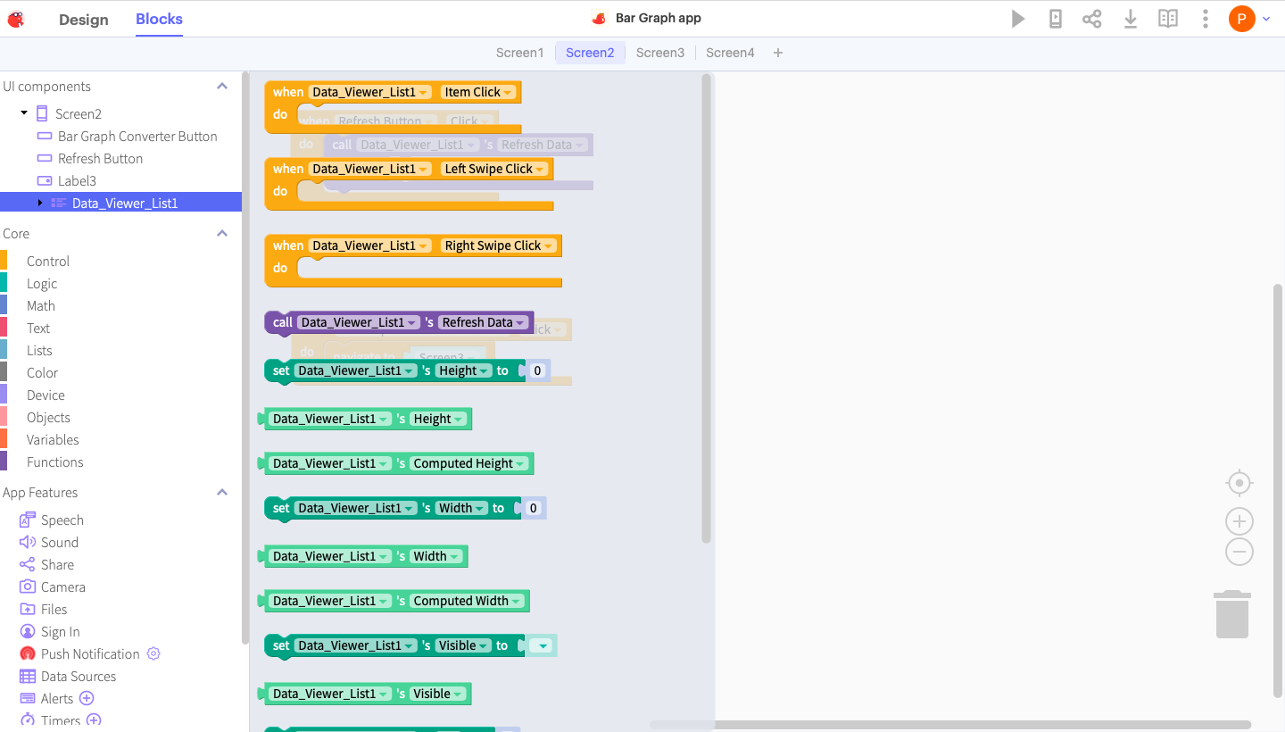
Two Interface
Designer Window Block Window

Slide 28
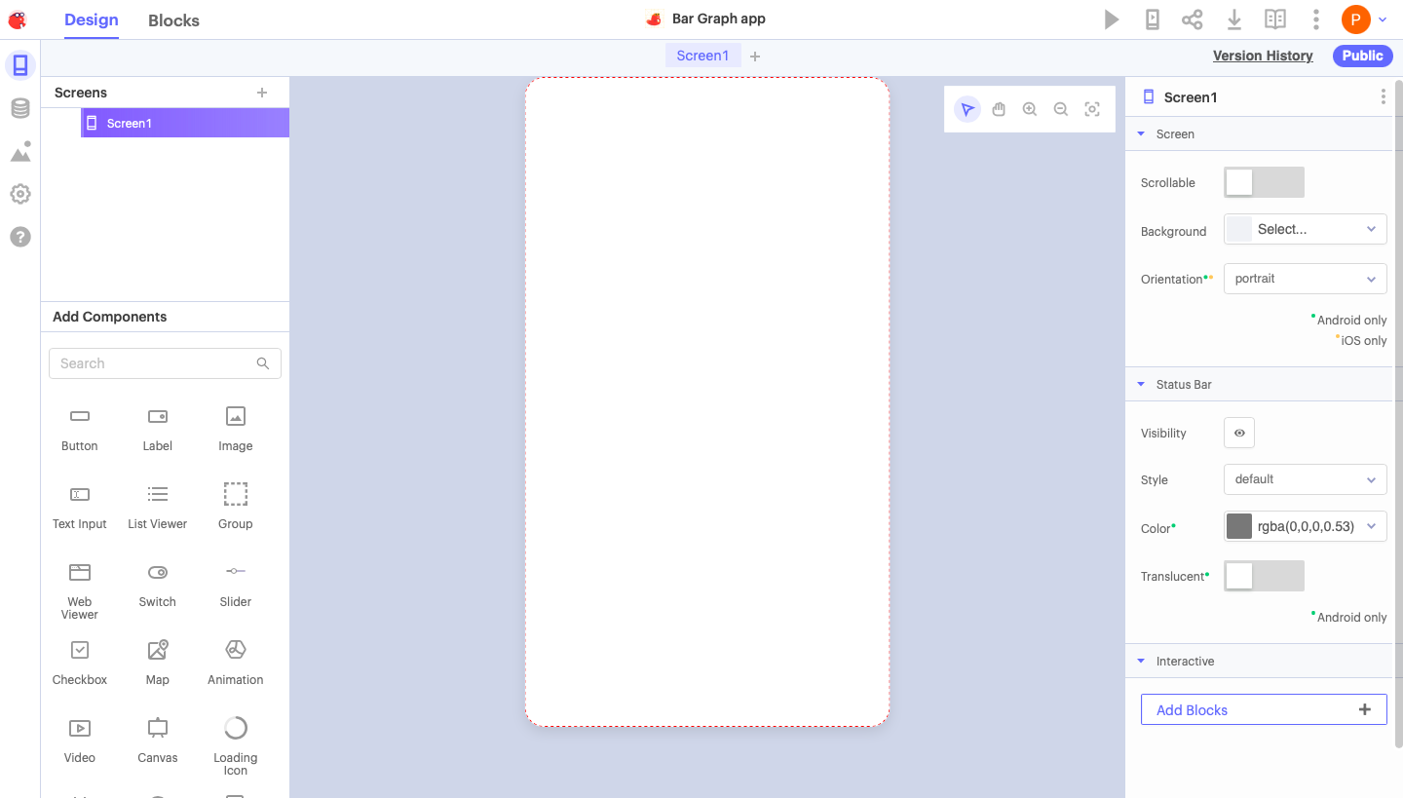
Design Interface

Slide 29
Let’s Create the app interface

Slide 30
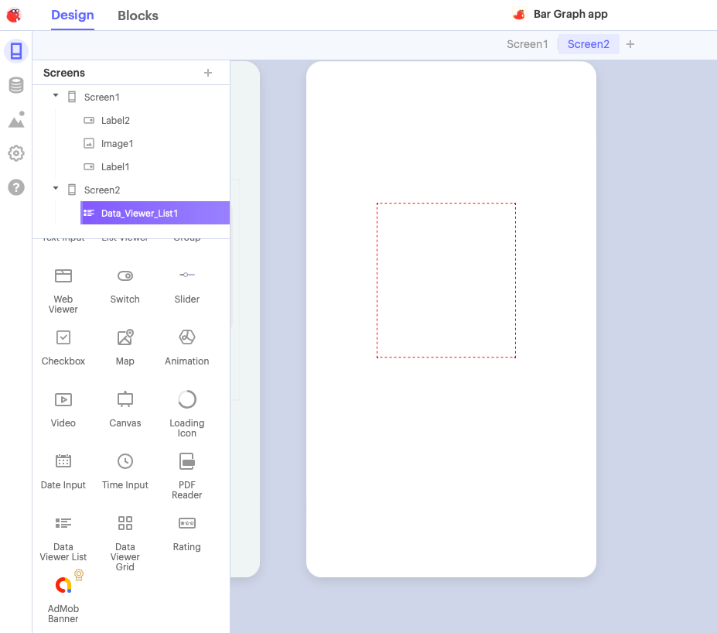
What is a Data Viewer List?
The purpose of this component is to link the excel file that contains the data to your app.

Slide 31
Do you think the app will work now?

Slide 32
Let’s make the app interactive

Slide 33
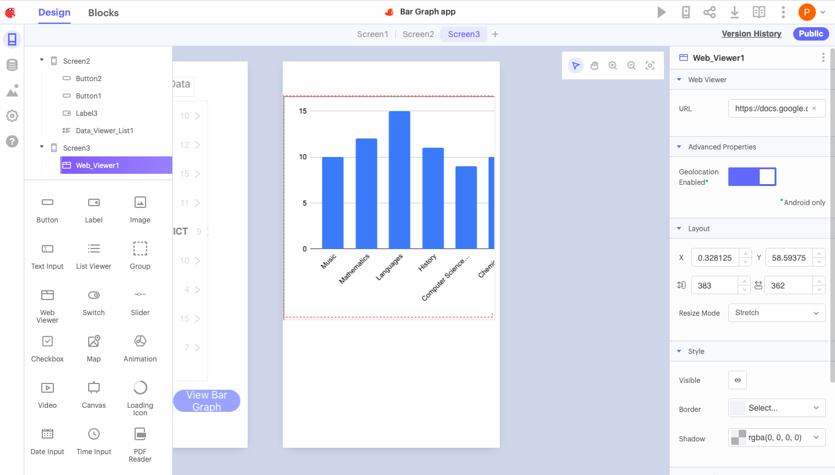
Output Check
This is what your Screen 3 will look like.

Slide 34
Task
Customise your app to meet the needs of your user.
Customisation of the app may look like:
Adding graphics relevant to the genre of the app.
Adding supporting text to make the user experience rich.
Adding a screen for user feedback.

Slide 35
App Presentation

Slide 36
Thank You!

