Slide 1
Irony Illustrated!
60 Minutes

Slide 2
Objectives
Define the concept of irony and its importance in literature.
Differentiate between the three main types of irony.
Analyze instances of irony in text.
Demonstrate the ability to apply irony creatively by developing comics.
Reflect on how irony can serve as a powerful tool for social commentary, satire, and humor, and how it influences the way readers interpret texts.

Slide 3
Ground Rules
Be respectful of one another. Listen to your teammates.
Raise your hands if you have anything to share.
Listen attentively and follow instructions.
Complete tasks in
given time

Slide 4
Irony
Irony is a literary and rhetorical device that involves a contrast between expectations and reality.
It often creates humor or emphasizes a deeper meaning by presenting situations where things are not what they seem.
Irony is a powerful tool in literature as it challenges readers to to think beyond the surface and consider hidden meanings or contradictions.
Irony allows authors to convey complex ideas, social commentary, or criticism indirectly, making it accessible to a wide audience.

Slide 5
Types of Irony
Verbal Irony: Verbal irony is a form of irony in which a person says one thing but means another. It involves a deliberate contrast between the literal meaning of the words spoken and the intended meaning. Verbal irony is often used to convey humor, sarcasm, or to make a point indirectly. For example, on looking at this image of a littered park you hear someone say, “What an eco-friendly park we have here, with trash decorating every corner”. While they originally intend to criticize the people for littering, they do so using a verbal irony.

Slide 6
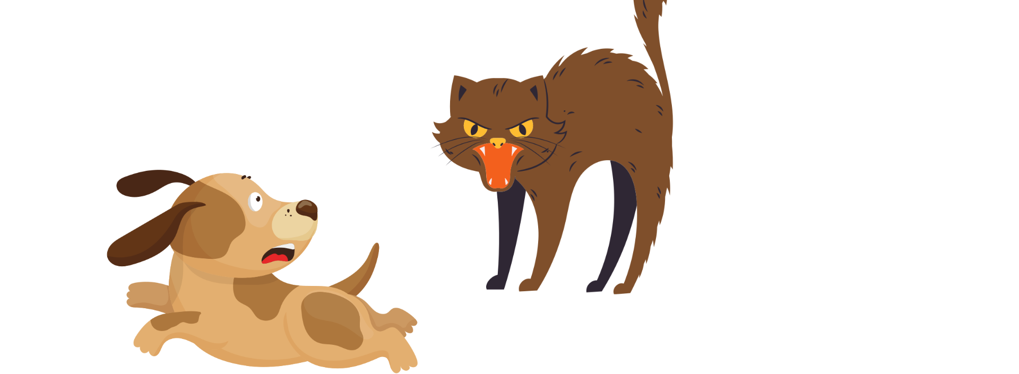
Types of Irony
Situational Irony: Situational irony occurs when there is a contrast between what is expected to happen in a situation and what actually happens. It involves a discrepancy between what seems appropriate or likely based on the circumstances and the outcome that occurs. It captivates the audience's attention by introducing unexpected and often humorous twists in the narrative, making the story more engaging and memorable. To understand situational irony, look at the example below.

Slide 7
Types of Irony
Dramatic Irony: Dramatic irony is when the audience knows something that the characters in a story or play do not. It creates suspense and often leads to humorous or tragic situations because the characters' lack of knowledge can cause them to make decisions that the audience knows will have unexpected consequences.
For example, In a horror movie, the audience often knows that the villain is hiding nearby, but the characters do not. This creates tension and fear as the characters walk into danger unknowingly.
Can you recall any play or book, which uses dramatic irony?

Slide 8
Irony Illustrator (25 Minutes)
Now that you have an idea about irony and its types, it is time to illustrate it!
Rules
Form groups of 4.
Let your teacher guide you on how to use Canva
Create a comic strip using Canva Ensure that your comic strip has ironic elements. You are free to choose the background, characters, and dialogues.
Let your teacher guide you on how to do the activity.
Refer to this pre-designed comic strip to get an idea.

Slide 9
Let’s Team Up!
Making the future of young minds

Slide 10
Project Manager
Resource Manager
Time Keeper
Presenters
Help your members stick to the task. Monitor what they are doing.
Collect materials and tools from the teacher. Ensure team members are using them properly. Return when you are done!
Keep track of time and help your teammates stick to the time limit.
Share your creation with the classmates and note down the feedback received.

Slide 11
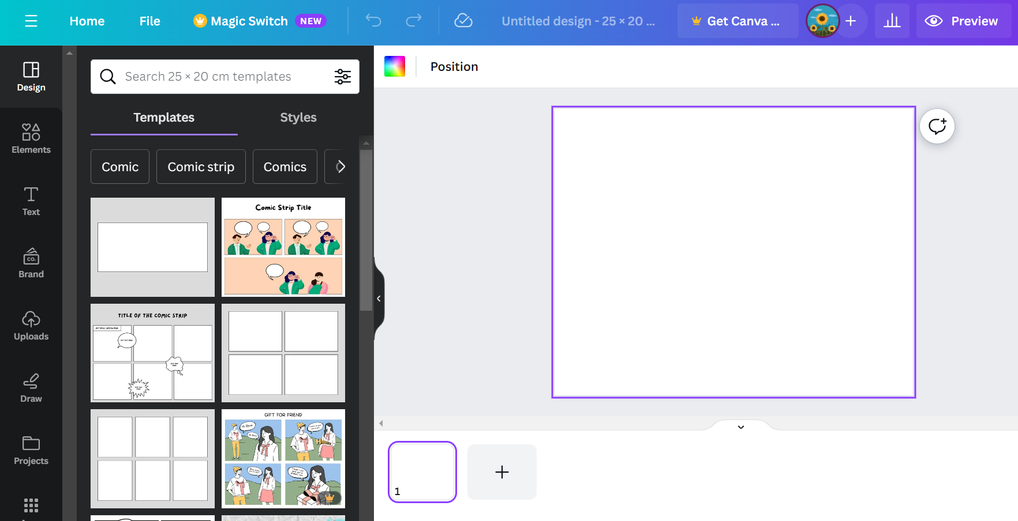
Getting started with Canva
Go to https://www.canva.com/
Create an account by entering your credentials.
Click on ‘create a design’ on the top right corner of your screen.
Type ‘comic strip’ in the search bar.
Choose from the multiple templates available to get started.

Slide 12
Unmasking Irony (15 Minutes)
Once all the teams have prepared their respective comic strips, they will take turns to present them in front of their fellow classmates.
The learners will pay attention to each comic strip and identify the types of irony used in the different scenes.
The learners will also think of alternate ways to add irony elements to each team’s comic strip.

Slide 13
Let’s Reflect!
How does recognizing irony enhance your understanding of humor and storytelling?
Did you face any challenges while illustrating irony? How did you overcome them?
Do you think you'll notice and appreciate irony more in literature, movies, or everyday situations after this lesson?

Slide 14
Thank you!
edm8ker is a fully owned brand of Makedemy Pte Ltd
A member of the SL2 group of social enterprises.

