Slide 1
LEGO Economics: Building Monuments on a Budget
Fourth Grade
120 Minutes

Slide 2
Objectives
Learn about Money and its importance.
Learn about denominations in circularity.
Understand the concept of budgeting and apply it to create a skyscraper.
Calculate the total cost of their Lego creation by multiplying the price per Lego brick by the number of bricks used.
Use critical thinking skills to make creative choices about what to build and how to build it within their budget.
Notes:
Begin by sharing the overview. Apprise students of the tasks they’d accomplish in the class.

Slide 3
What is money?

Slide 4
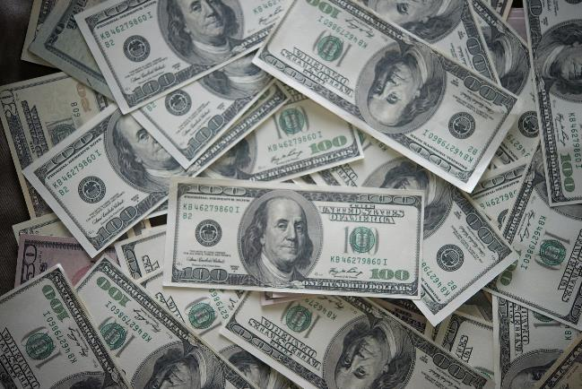
Money
Money is something that we use to buy things that we want or need. It can be in the form of coins or paper bills.

Slide 5
Why is Money important?

Slide 6
Importance of Money
Money is important because it allows us to buy things we need and want and supports economic transactions

Slide 7
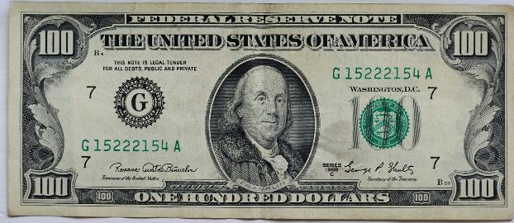
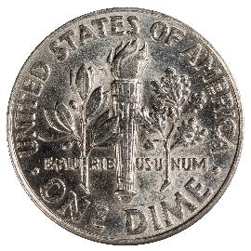
Types of money
Paper Money
Coin

Slide 8
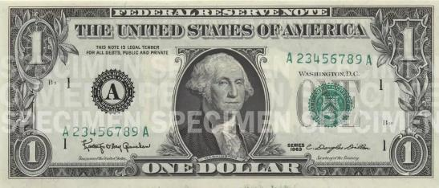
Denominations
= 1 $
Denomination refers to the value or amount assigned to a particular currency, such as a coin or a bill. Different denominations are used to represent different values of money.
Notes:
Source: https://www.uscurrency.gov/denominations

Slide 9
Can you share the different denominations you know?

Slide 10
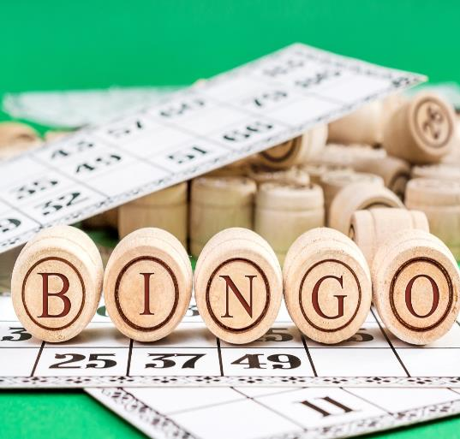
Currency Quest Bingo!
Time to check our denomination knowledge while having some fun.
Task: Match the money operations on screen to the correct answer in your bingo card

Slide 11
Currency Bingo Checklist
I have the bingo card and a marker/pencil in my hand.
I can see the Currency Quest Bingo ppt clearly.

Slide 12
Bingo Time!

Slide 13
Were there any particular bills or numbers that were more challenging than others? Why?
How did working in team affect your experience?
Reflection Time

Slide 14
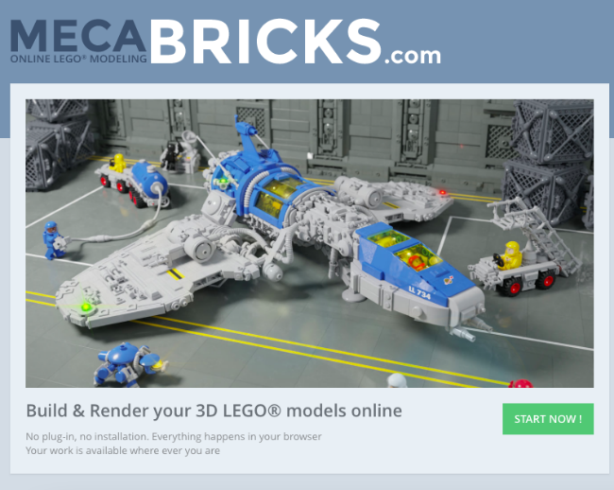
Getting to know the Tool: Mecabricks
Mecabricks is a tool for virtual Lego Model creation.

Slide 15
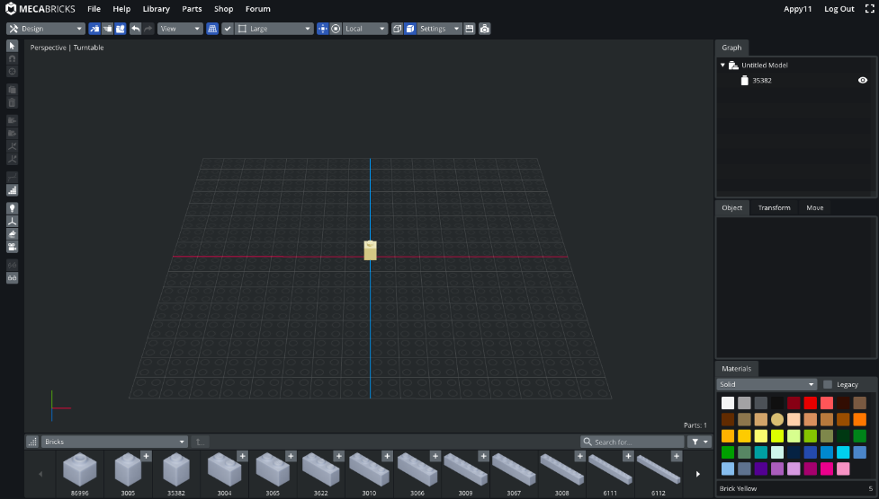
Adding a block
Step 1: Add a lego block to the project by simply tapping on the block from the parts library.

Slide 16
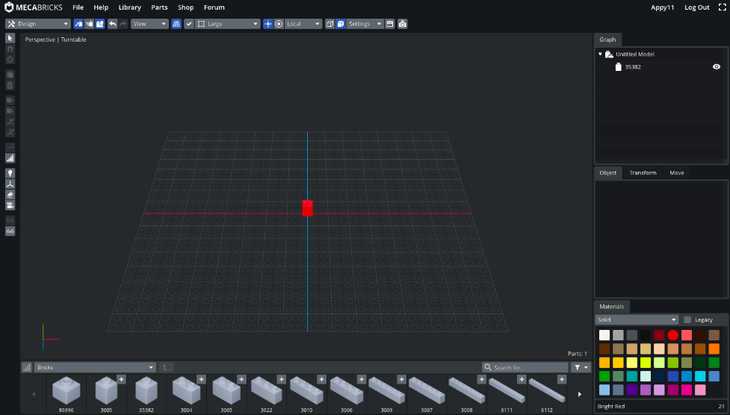
Changing color
Step 1: Select the block you want to change color of.
Step 2: Select color from the color palette.

Slide 17
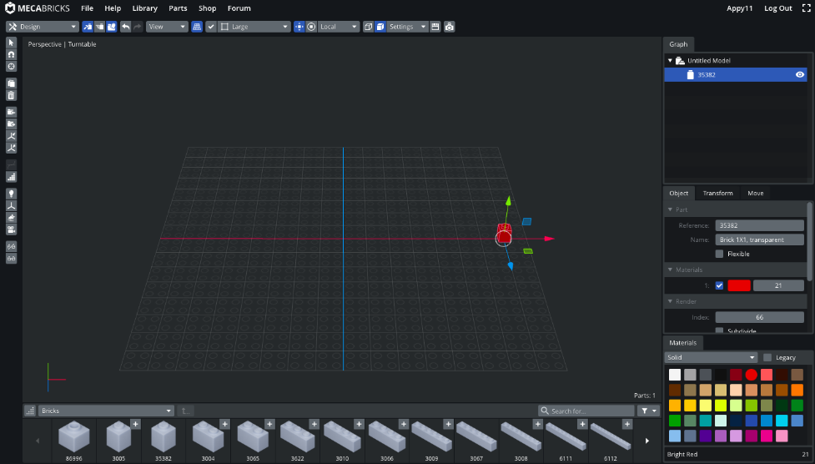
Moving a block
Step 1: Select the block you want to change position of.
Step 2: Press one of the arrows and drag to move the block along any axis.

Slide 18
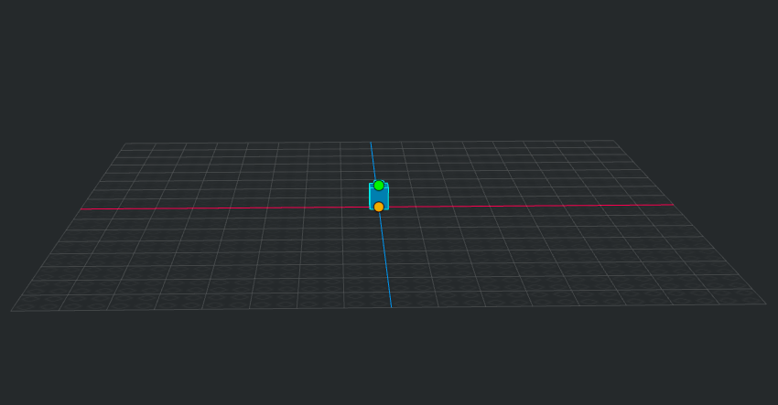
Adding a brick to another brick
Step 1: Hover your mouse over the brick you want to attach another brick on.
Step 2: Click one one of the two orange dots. The dot you click on will decide where the new brick would be added.

Slide 19
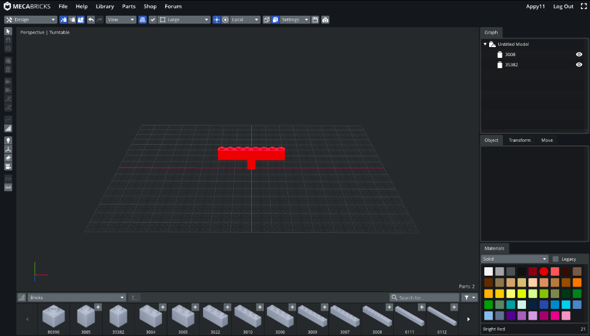
Adding a brick to another brick
Step 1: Now simply tap to select the brick that you want to add.
The new brick will be added to your choice of position.

Slide 20
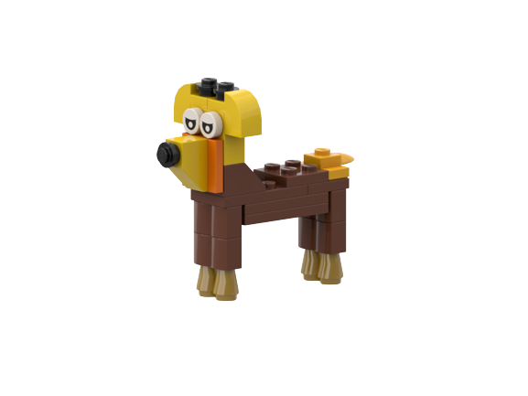
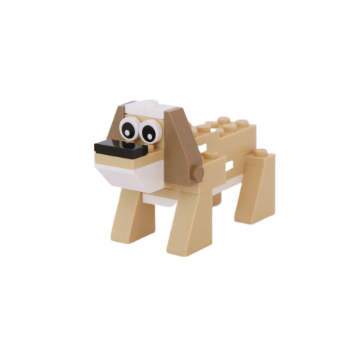
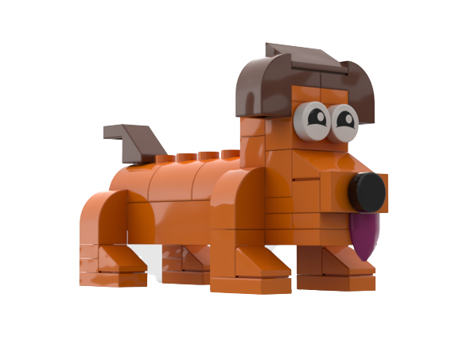
Time to explore the tool.
Can you create a brick dog?

Slide 21
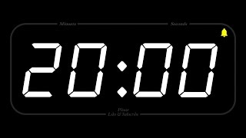
Timer

Slide 22
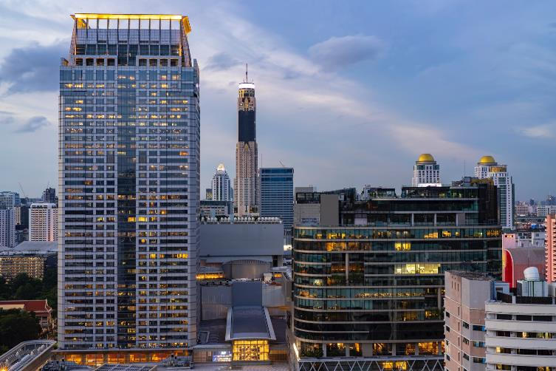
Skyscraper Challenge
Task: Ideate and create a stable skyscraper sticking to the budget of 500 $.

Slide 23
Skyscraper Challenge Checklist
I have the material price list.
I have the ideation sheet.
I have a basic knowledge of the tool: Mecabricks

Slide 24
Let’s Ideate
Brainstorm within your group and note down your ideas on the ideation worksheet.

Slide 25
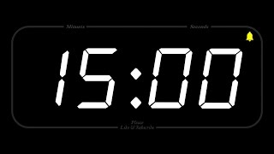
Ideation time

Slide 26
Let’s Create
Time to bring your idea to life.

Slide 27
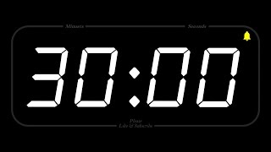
Creation Time

Slide 28
Did you need to make any trade-offs when designing your model to stay within your budget? If so, what were they?
How did your final model compare to your initial design ideas? Did you make any changes along the way?

Slide 29
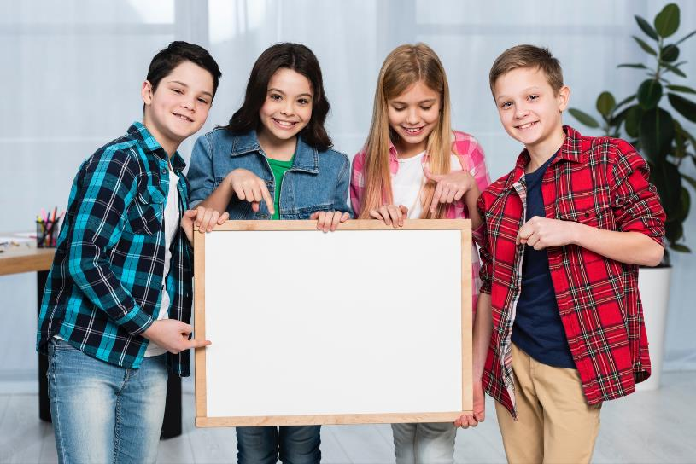
Sharing Time
Time to share your creation with the rest of the class.

Slide 30
Presenter dialogue
Introduction: Introduce your team.
Context: Share context, such as the inspiration behind your skyscraper.
Design elements: Highlight the key design elements of your Lego skyscraper, such as the height, shape, and unique features.Talk about any tips that helped you create it on budget.
Challenges: Mention the challenges you faced while creating and how you overcame them.
Conclusion: Conclude your presentation with an argument on what makes your design the most efficient skyscraper within budget.
Q&A: Open the floor for peer feedback.

Slide 31
Critique Dialogue
Like
Notice
Wonder

Slide 32
Presentation Time

Slide 33
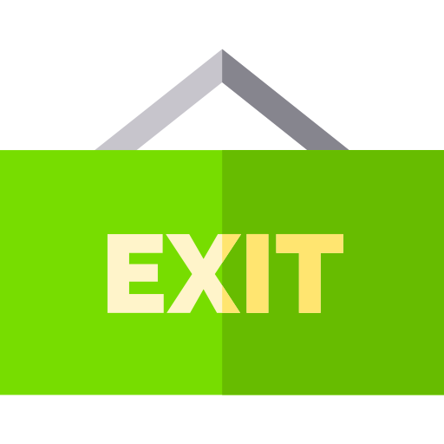
If you could do this activity again, what changes would you make to your Lego skyscraper or your budgeting strategy?

Slide 34
Thank You
edm8ker is a fully owned brand of Makedemy Pte Ltd A member of the SL2 group of social enterprises.

