Slide 1
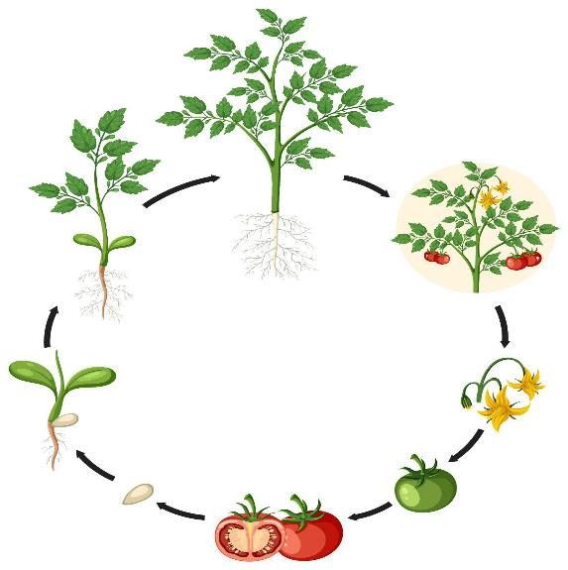
Science
Life Cycle of Plants
Fifth grade
120 Minutes

Slide 2
Overview
Identify and describe the stages of plant life cycle.
Create an interactive 3D model illustrating each stage of plant life cycle using Assemblr Edu.
Explain the significance of each stage in the plant’s growth.

Slide 3
Ground Rules
Be respectful of one another
Raise your hand if you have anything to share.
Listen attentively and follow instructions.
Complete tasks in given time

Slide 4
Let’s Collaborate
Notes:
Buyers and sellers

Slide 5
Team Roles
Project Manager
Resource Manager
Time Keeper
Help your team members to stick to their tasks!
Monitor what they are doing.
Collect materials and tools from the teacher.
Ensure team members are using them properly.
Return when you are done!
Keep track of time! Check the timer every few mins.
Help team members to complete the task on time.

Slide 6
Have you ever wondered how something as simple as a tiny seed can grow into a towering tree or a colorful flower?

Slide 8
Let's explore the mystery behind this incredible transformation and the plant life cycle in general.

Slide 9
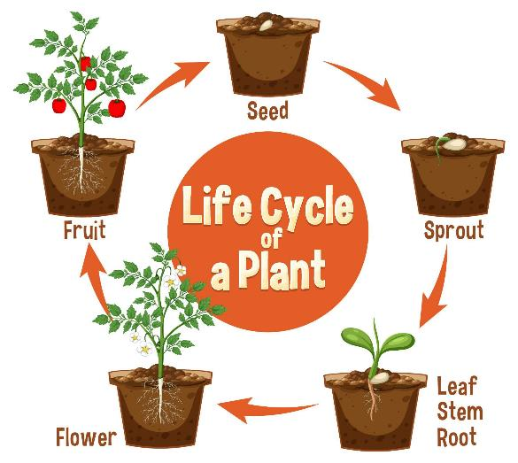
What is Plant Life Cycle?
As plants grow and reproduce like any other living being ,they commence a new life, grow and develop, and return to the first reproduction stage by following a cyclic process.

Slide 10
Stages of Plant Life Cycle

Slide 11
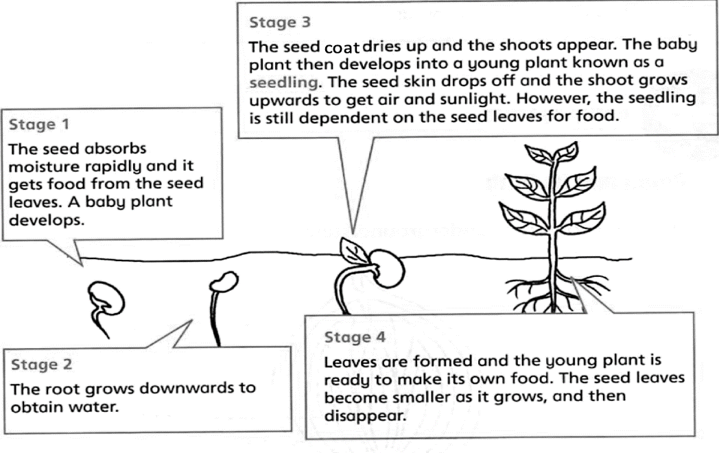

Slide 12
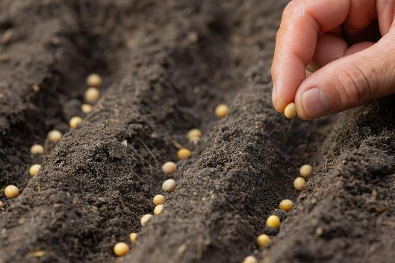
Stage 1: Seed
Seeds can be compared to human babies as they contain the plant embryo, which has the much-needed food and an outer protective coat.
The seed holds all the information needed for the plant to grow.

Slide 13
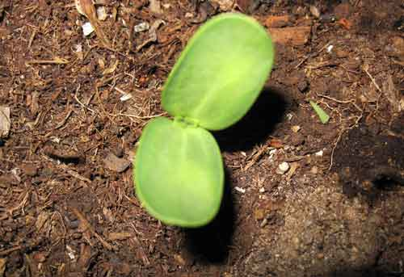
Stage 2 : Germination & Seedling
When the soil conditions are ideal, the seed begins to germinate. It breaks the outer coat and starts growing its leaves and roots.
The seedling needs water, warmth, and soil to sprout.

Slide 14
Stage 3: Growing to Maturity
When the plant matures, it has to develop sturdier roots and also increase its leaves and branches. They can develop flowers and seeds at this stage.

Slide 15
Have you ever wondered how you eat sprouted Green Gram and other lentils that burst into life?

Slide 16
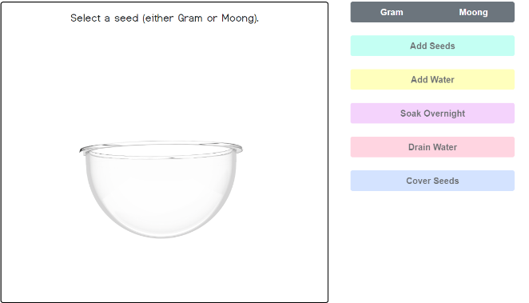
Engage in Experiment
Click on the link below:
Germination & Seedling of Moong
Experience this virtual experiment to discover the intricate germination and seedling growth process.

Slide 17
Before and After:
Use this worksheet to provide information:
What did you know about germination and seedling growth before the experiment, and how has your understanding changed after the experiment?

Slide 18
Could you imagine infusing life into these stages through the magic of a 3D simulation?

Slide 19
Creation Time!
Let’s create a 3D simulation of Plant life cycle:
Revisit the stages of plant life cycle with the student’s handout.
Create a 3D simulation with Assemblr Edu.

Slide 20
Let’s Create a 3D Simulation of Plant Life cycle!

Slide 21
Start with your project!
Go to
https://edu.assemblrworld.com/

Slide 22
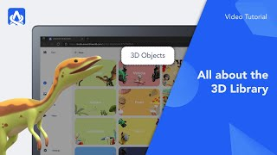
Use 3D Objects in your Project

Slide 23
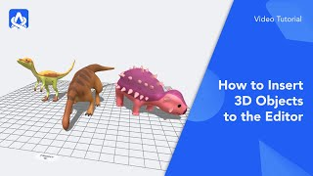
Edit the 3D Objects

Slide 24
Insert Videos and Modify them

Slide 25
Preview Your Project

Slide 26
Save your Project

Slide 27
Publish Your Project

Slide 28
Get Your Project’s Link

Slide 29
Timer

Slide 30
Share your Creation!
Upload your 3D simulation on the link below:
My 3D Simulation of Plant Life cycle

Slide 31
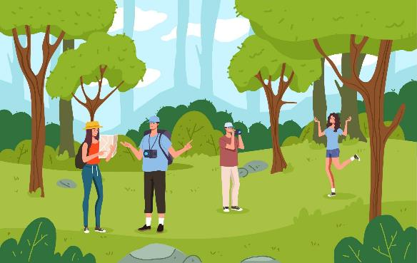
Nature Walk and Talk
Go for a walk outside and find real plants. Can you identify which stage they are in?
Talk about how your simulation helped you understand them better.

Slide 32
Thank You
edm8ker is a fully owned brand of Makedemy Pte Ltd A member of the SL2 group of social enterprises.

