Slide 1
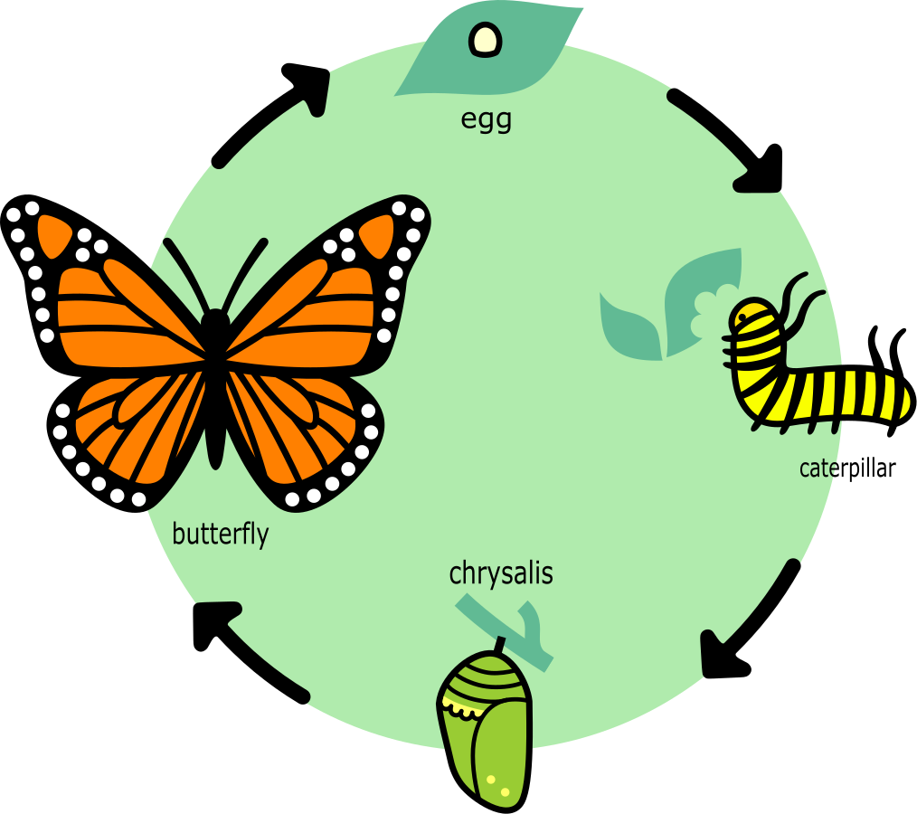
The Cycle of Life
Third Grade
120 minutes

Slide 2
Overview
Define what is meant by the term "life cycle" and explain why it is important to study.
Describe the different stages in the life cycle of a butterfly and a frog.
Explain the importance of the life cycle in the growth and development of these organisms.
Notes:
Begin by sharing the overview. Apprise students of the tasks they’d accomplish in the class.

Slide 3
Ground Rules
Be respectful of one another. Listen to your teammates.
Raise your hand if you have anything to share.
Listen closely and follow instructions.
Complete the tasks on time.
Notes:
Discuss the ground rules with learners and stress on the importance of them being followed throughout the class.

Slide 4
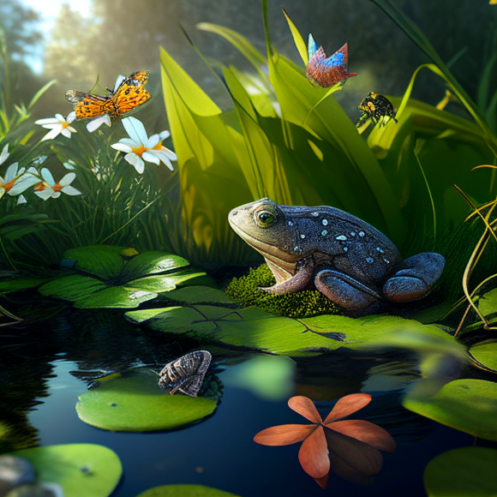
Nature's Wonders
Identify the different living creatures present in the image.

Slide 5
The Beauty of Life in Nature
Nature is full of a wide variety of organisms.
From the smallest bacteria to the largest whales, every organism plays a unique and important role in the ecosystem
The beauty of life can be seen in the intricate patterns on a butterfly's wings, the vibrant colors of a flower, and the sound of birds singing.
Learning about different organisms can help us better understand and appreciate the world around us.

Slide 6
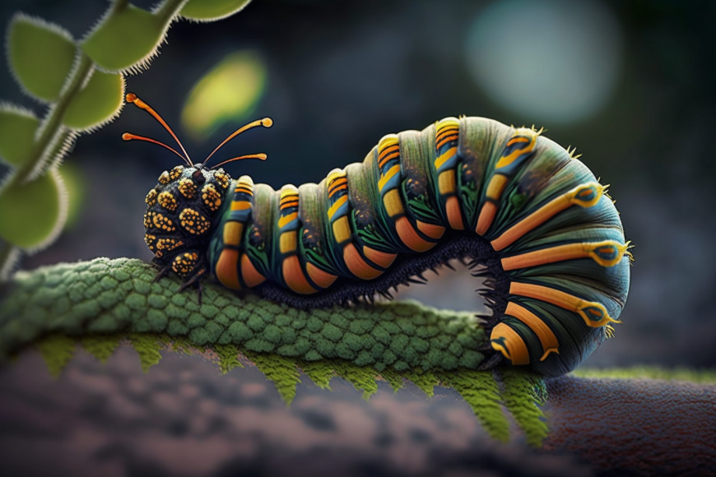
Have you observed?
Have you ever noticed how a caterpillar turns into a butterfly? What do you think happens during this transformation?
Have you seen a tiny seed transform to a tree?

Slide 7
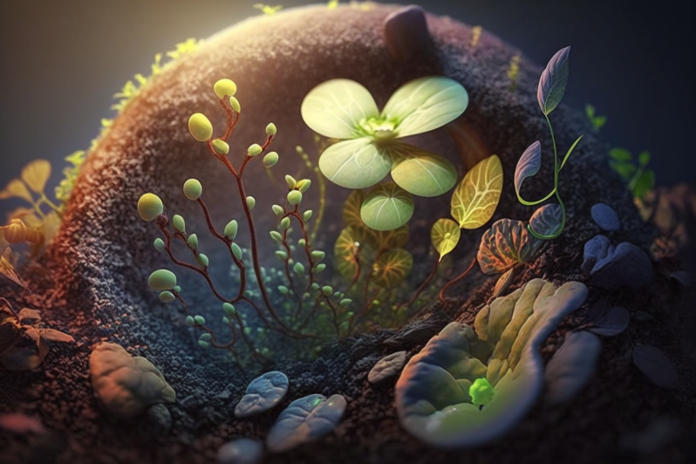
The Miracle of Birth
The birth of a new organism is a miraculous event that marks the beginning of a unique life cycle.
Every organism, whether plant or animal, goes through a series of changes and stages of development throughout its life.
Understanding the life cycle of an organism is important for many reasons, including predicting growth and behavior and understanding an organism's role in the ecosystem.

Slide 8
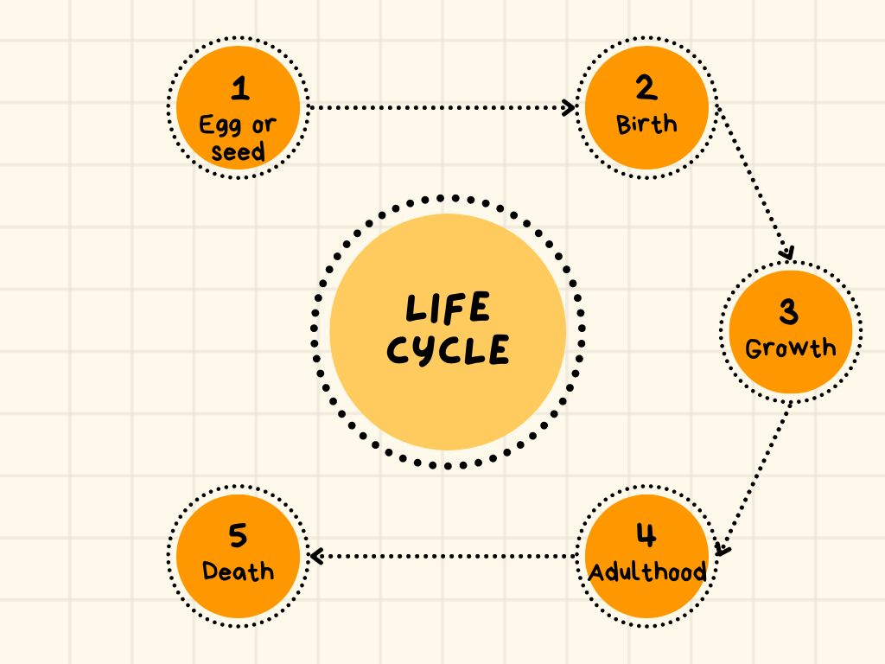
Life Cycle
Life cycle: Series of changes in the life of an organism.
Different organisms go through a different series of changes.

Slide 9
Introduction to ThingLink
ThingLink is a great tool for creating interactive images and videos.
We will use it to explore different parts of the life cycle of different organisms and learn more about the changes that take place.

Slide 10
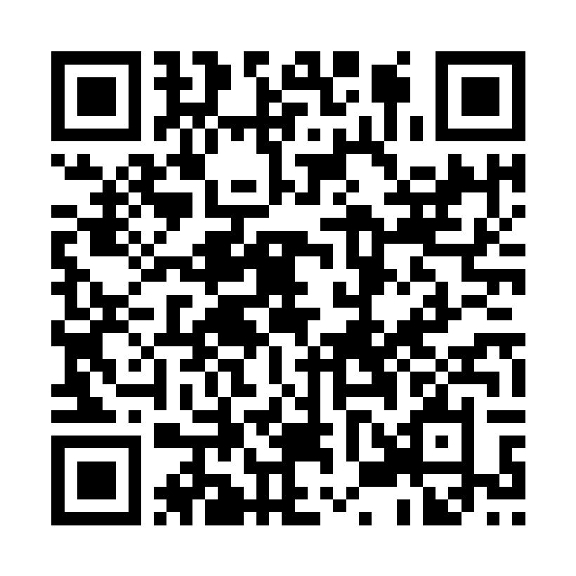
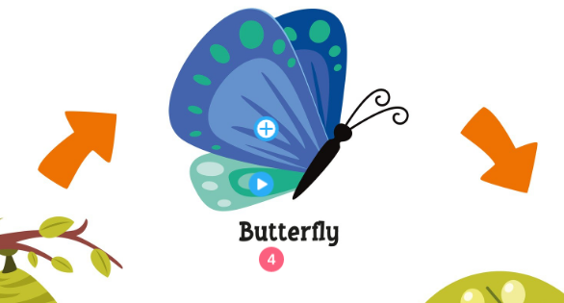
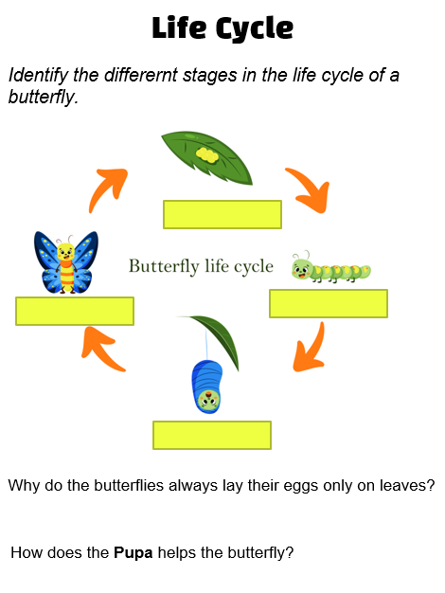
Instructions
Scan the QR code or click on: https://www.thinglink.com/scene/1689324292329702180
You should see different icons or circles on the image that are linked to various pieces of content, such as videos, images, or text. Click or tap on one of these icons to view the content.
Complete the related worksheet.

Slide 11
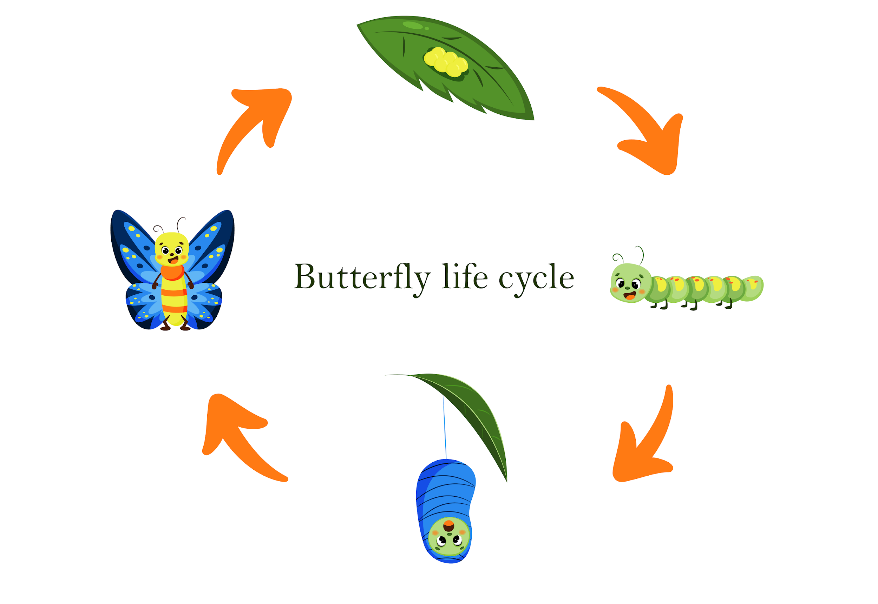
Butterfly
Butterflies lay their eggs on leaves because the leaves provide a source of food for the caterpillars that will hatch from the eggs.
The pupa serves as a shelter and a safe space for the butterfly to transform into an adult butterfly.

Slide 12
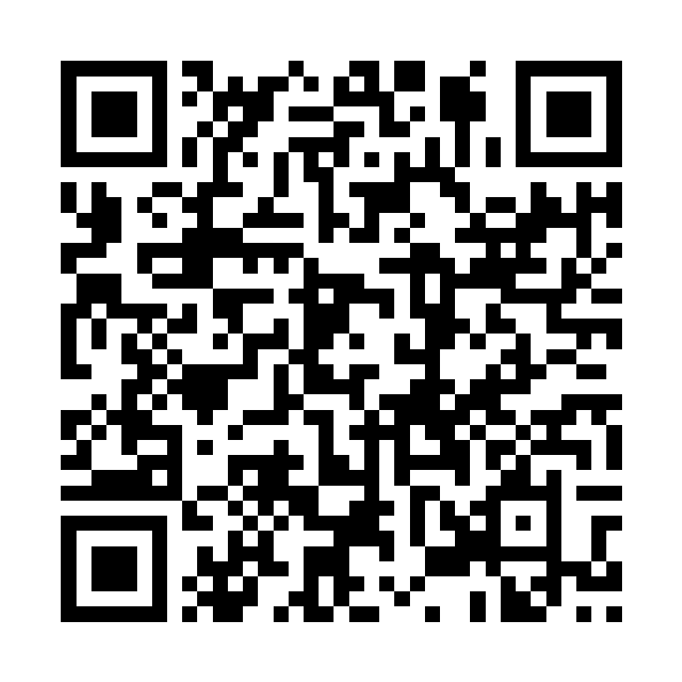
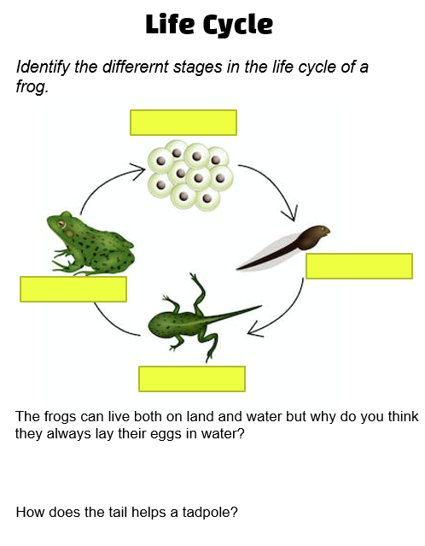
Instructions
Scan the QR code or click on: https://www.thinglink.com/scene/1689324292329702180
You should see different icons or circles on the image that are linked to various pieces of content, such as videos, images, or text. Click or tap on one of these icons to view the content.
Complete the related worksheet.

Slide 13
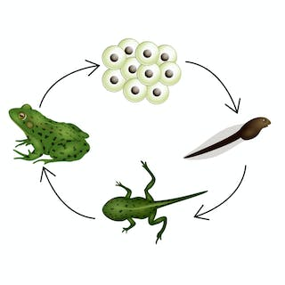
Frog
Tadpoles breathe through gills and can't survive on land until they grow into adult frogs with lungs.
Tadpoles have a tail because it helps them swim in the water.

Slide 14
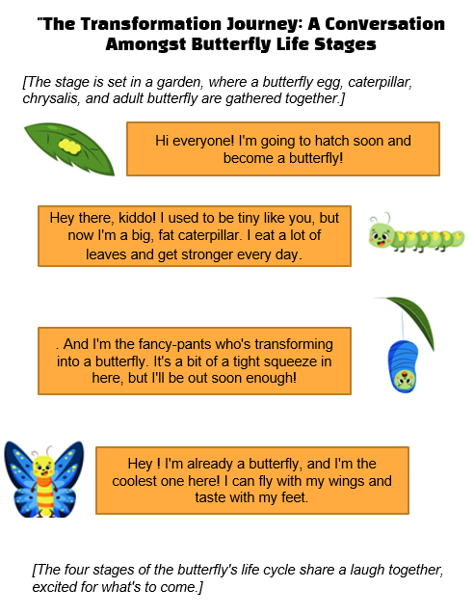
It’s time to write a script
Write a script, including important detail such as the physical characteristics, behaviors for the life cycle of a frog .
Consider adding visual aids such as pictures or diagrams to help illustrate each stage of the life cycle of the frog. This will help your audience better understand the information you are presenting.
Example: Script for life cycle of a butterfly

Slide 15
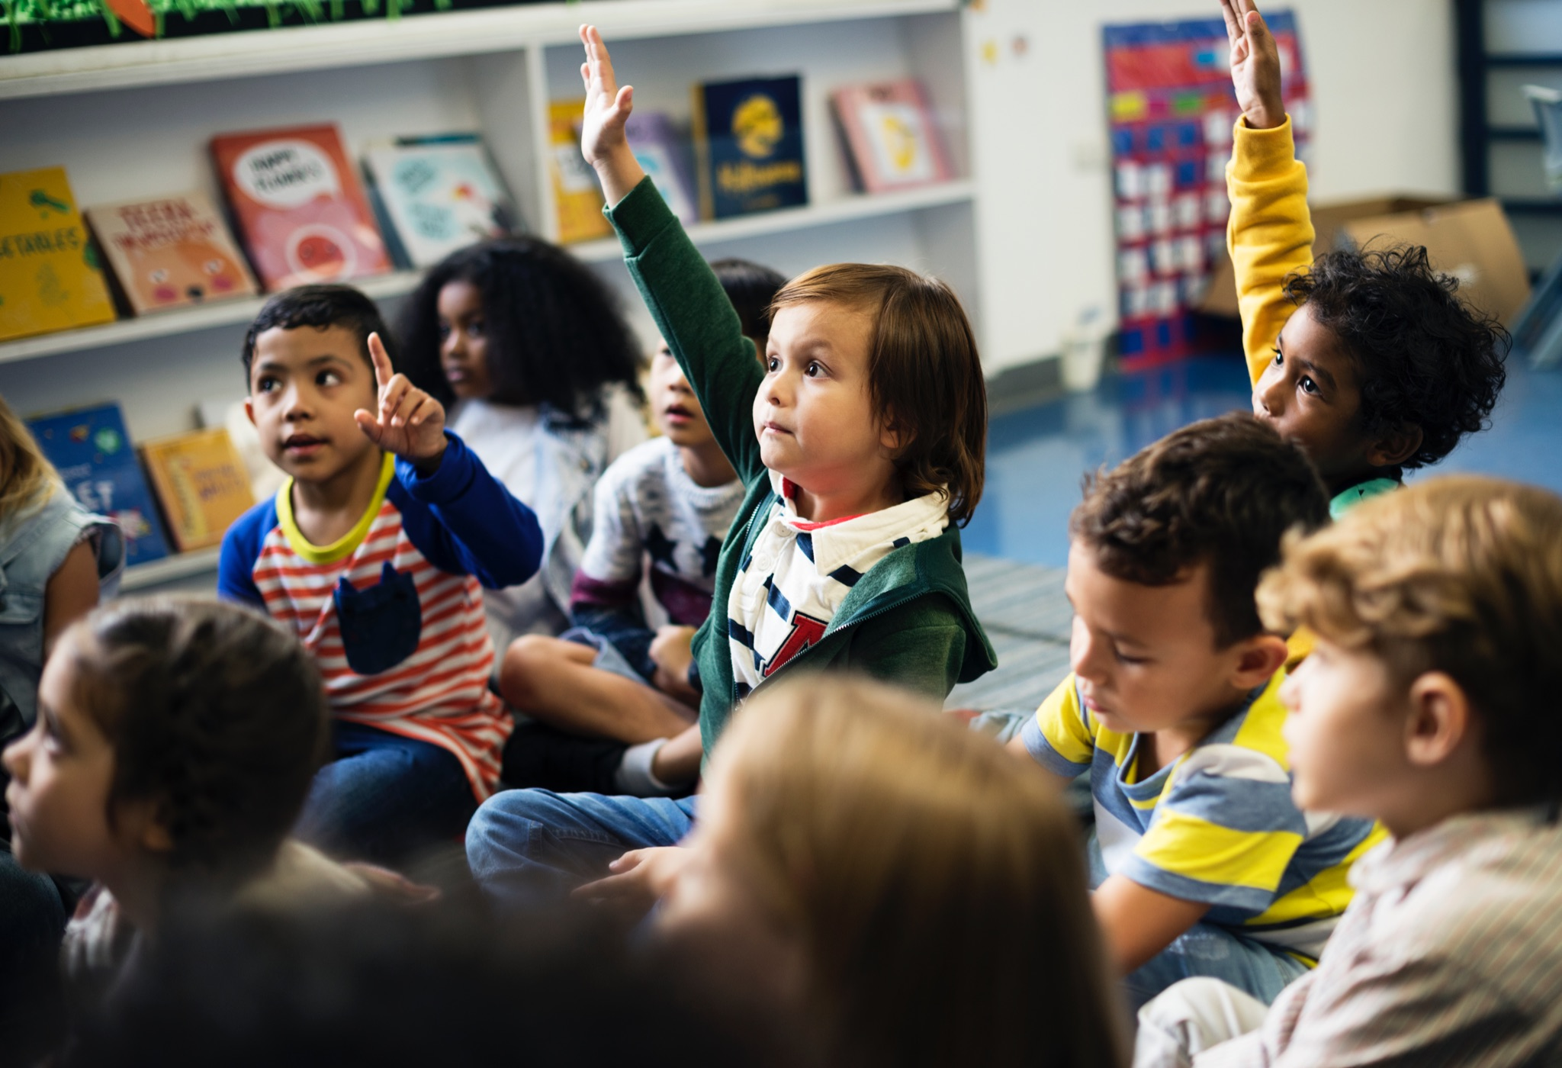
Let’s Summarize!
Describe how you’re feeling after writing your script.

Slide 16
Thank You
edm8ker is a fully owned brand of Makedemy Pte Ltd A member of the SL2 group of social enterprises.

