Slide 1
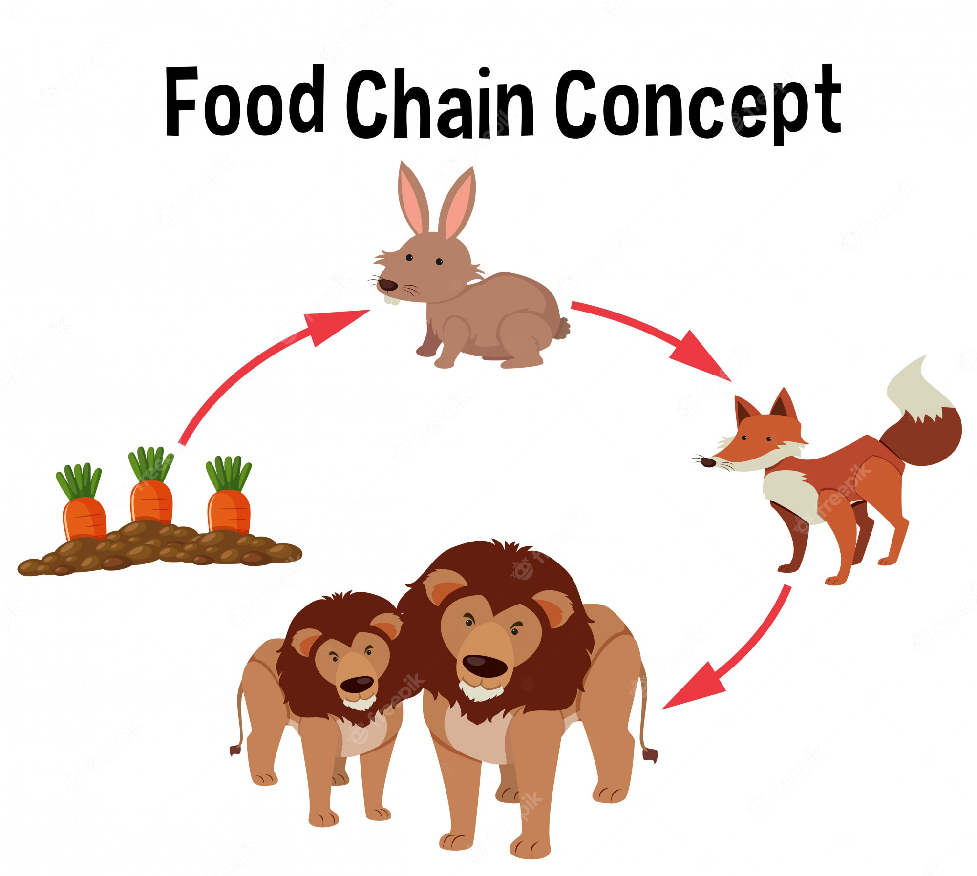
Science Predator’s Food Quest
Fifth Grade
120 minutes

Slide 2
Overview
Understand the concept of a food chain and its importance in ecosystems.
Identify the roles of producers and consumers in a food chain.
Differentiate between herbivores, carnivores, and omnivores, and explain their roles.
Explore the interdependence of organisms in an ecosystem through simulation.
Demonstrate the ability to draw food chains for varied ecosystems, showcasing the connections between organisms and their roles in different habitats.
Notes:
Begin by sharing the overview. Apprise students of the tasks they’d accomplish in the class.

Slide 3
Ground Rules
Be respectful of one another. Listen to your teammates.
Raise your hand if you have anything to share.
Listen closely and follow instructions.
Complete the tasks on time.
Notes:
Discuss the ground rules with learners and stress on the importance of them being followed throughout the class.

Slide 4
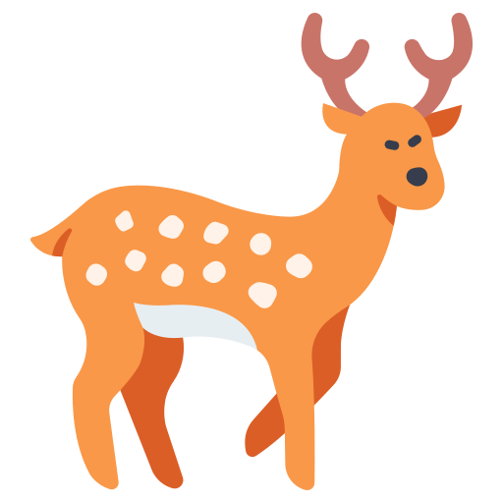
Riddle Safari
1
"With a mane that flows and eyes that gleam,
I'm a hunter fierce, the apex of the scene.
My roar echoes through the wild expanse,
I reign supreme, in nature's dance."
Answer: _ _ _ _

Slide 5
Riddle Safari
2
"With sharp claws and teeth so keen,
I eat meat, my diet's mean.
I hunt my prey with stealth and speed,
I'm a predator, the hunters need.“
Answer: _ _ _ _

Slide 6
Riddle Safari
3
"In meadows green, I graze with delight,
My plant-based diet keeps me light.
I nibble on leaves and grass so sweet,
A peaceful creature, in fields I meet.“
Answer: _ _ _ _

Slide 7
Riddle Safari
4
"With roots that delve and leaves that spread,
I stand tall, in sunlight I'm fed.
Through photosynthesis, I create my own,
The base of the chain, seeds I've sown"
Answer: _ _ _ _

Slide 8
Riddle Safari: Answers
1
2
Which among these can prepare their own food?
LION
WOLF
3
4
DEER
TREE

Slide 9
Producers and Consumers
Plants/Trees can prepare their own food.
Producers:
Producers are like nature's chefs; they make food using sunlight, water, and air.
They're usually plants, like trees and grass.
Consumers:
Consumers are the animals that enjoy the meals made by producers.
There are different types of consumers(Herbivores, Carnivores, and Omnivores).

Slide 10
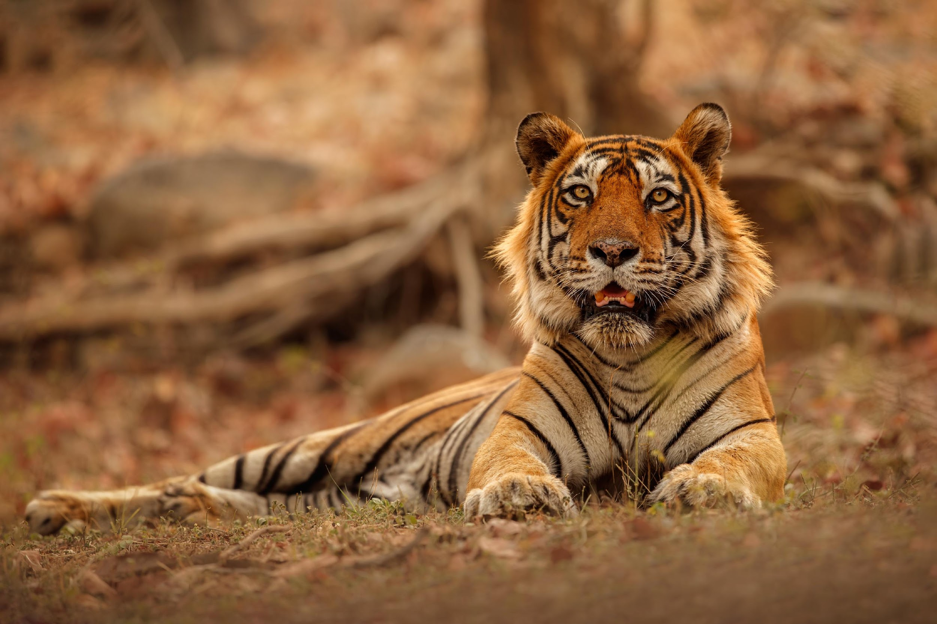
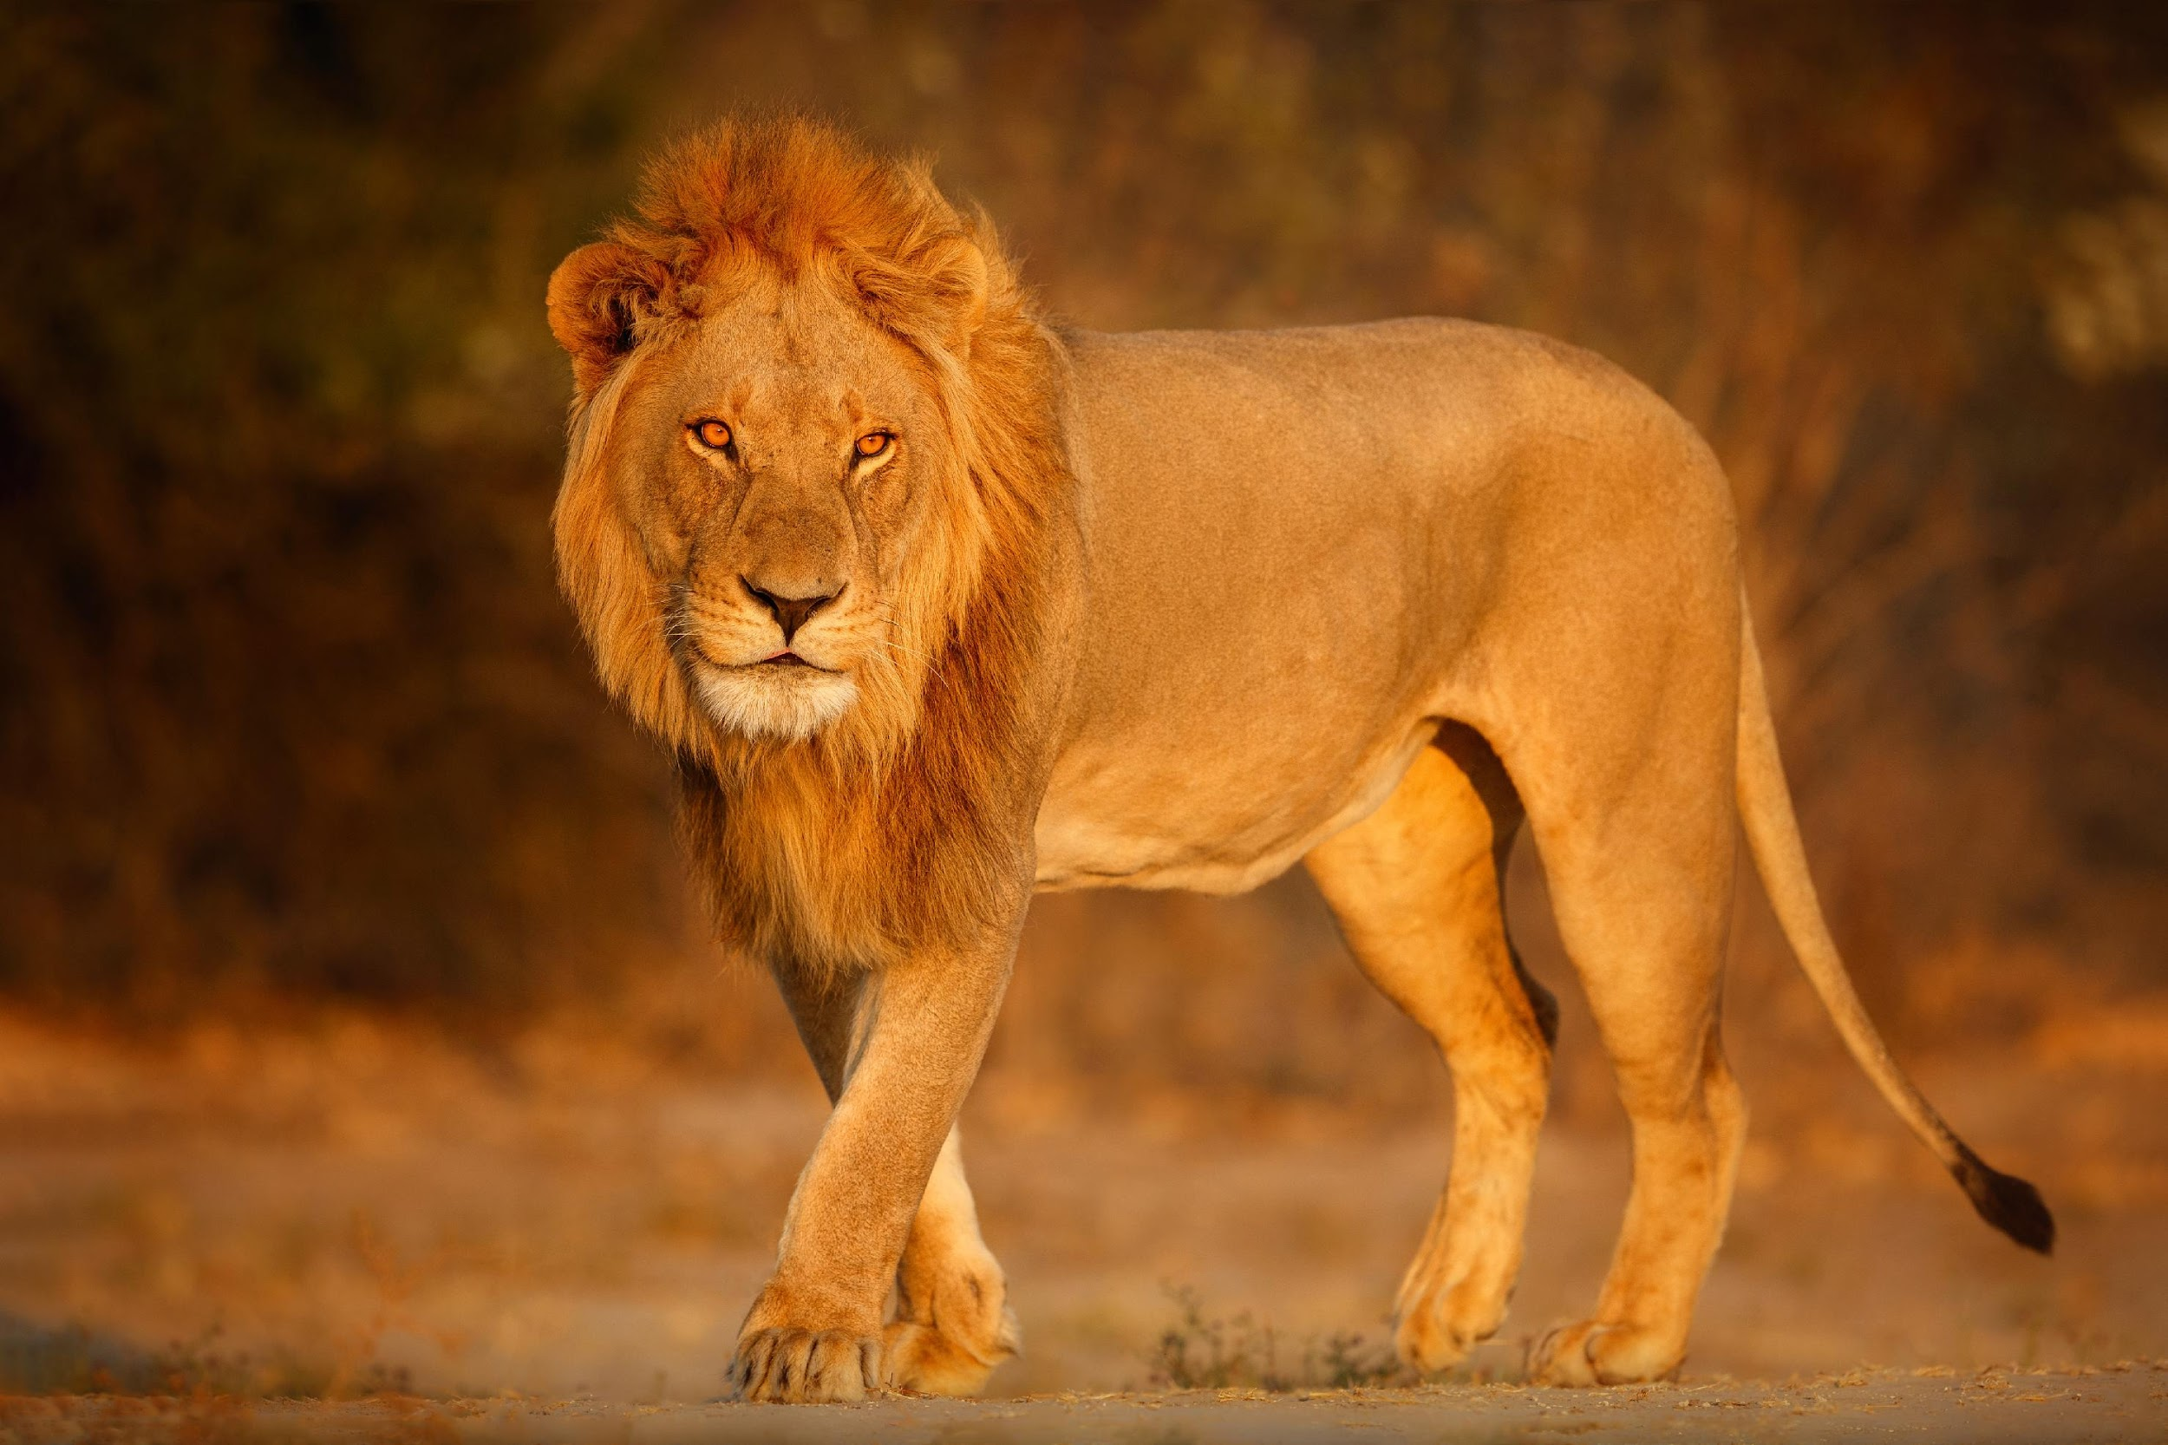
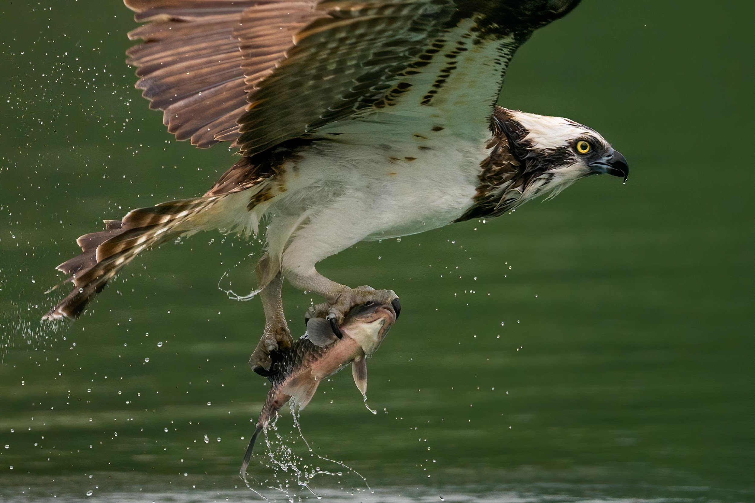
Carnivores - Meat Eaters
Characteristics of Carnivores
Carnivores primarily feed on other animals for their energy and nutrients.
They have sharp teeth, claws, and keen senses which aid in hunting and capturing prey.
LION
TIGER
HAWK

Slide 11
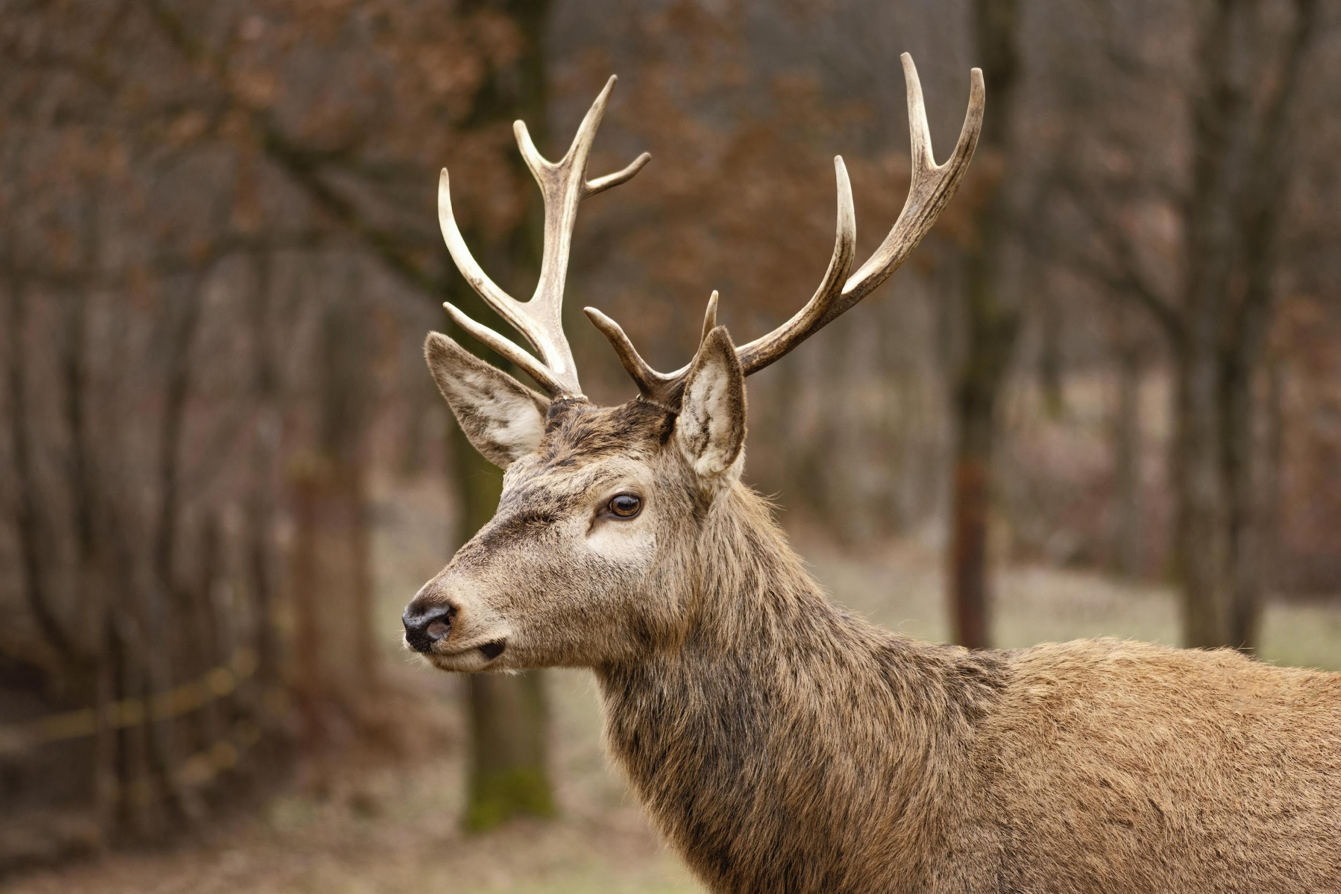
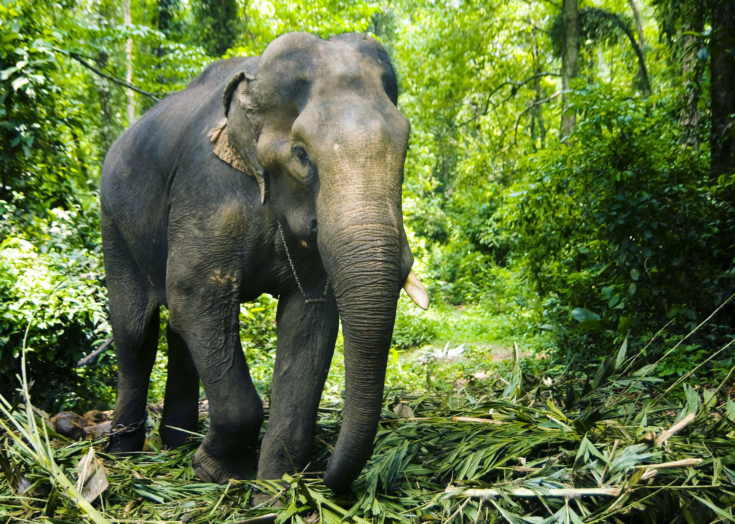
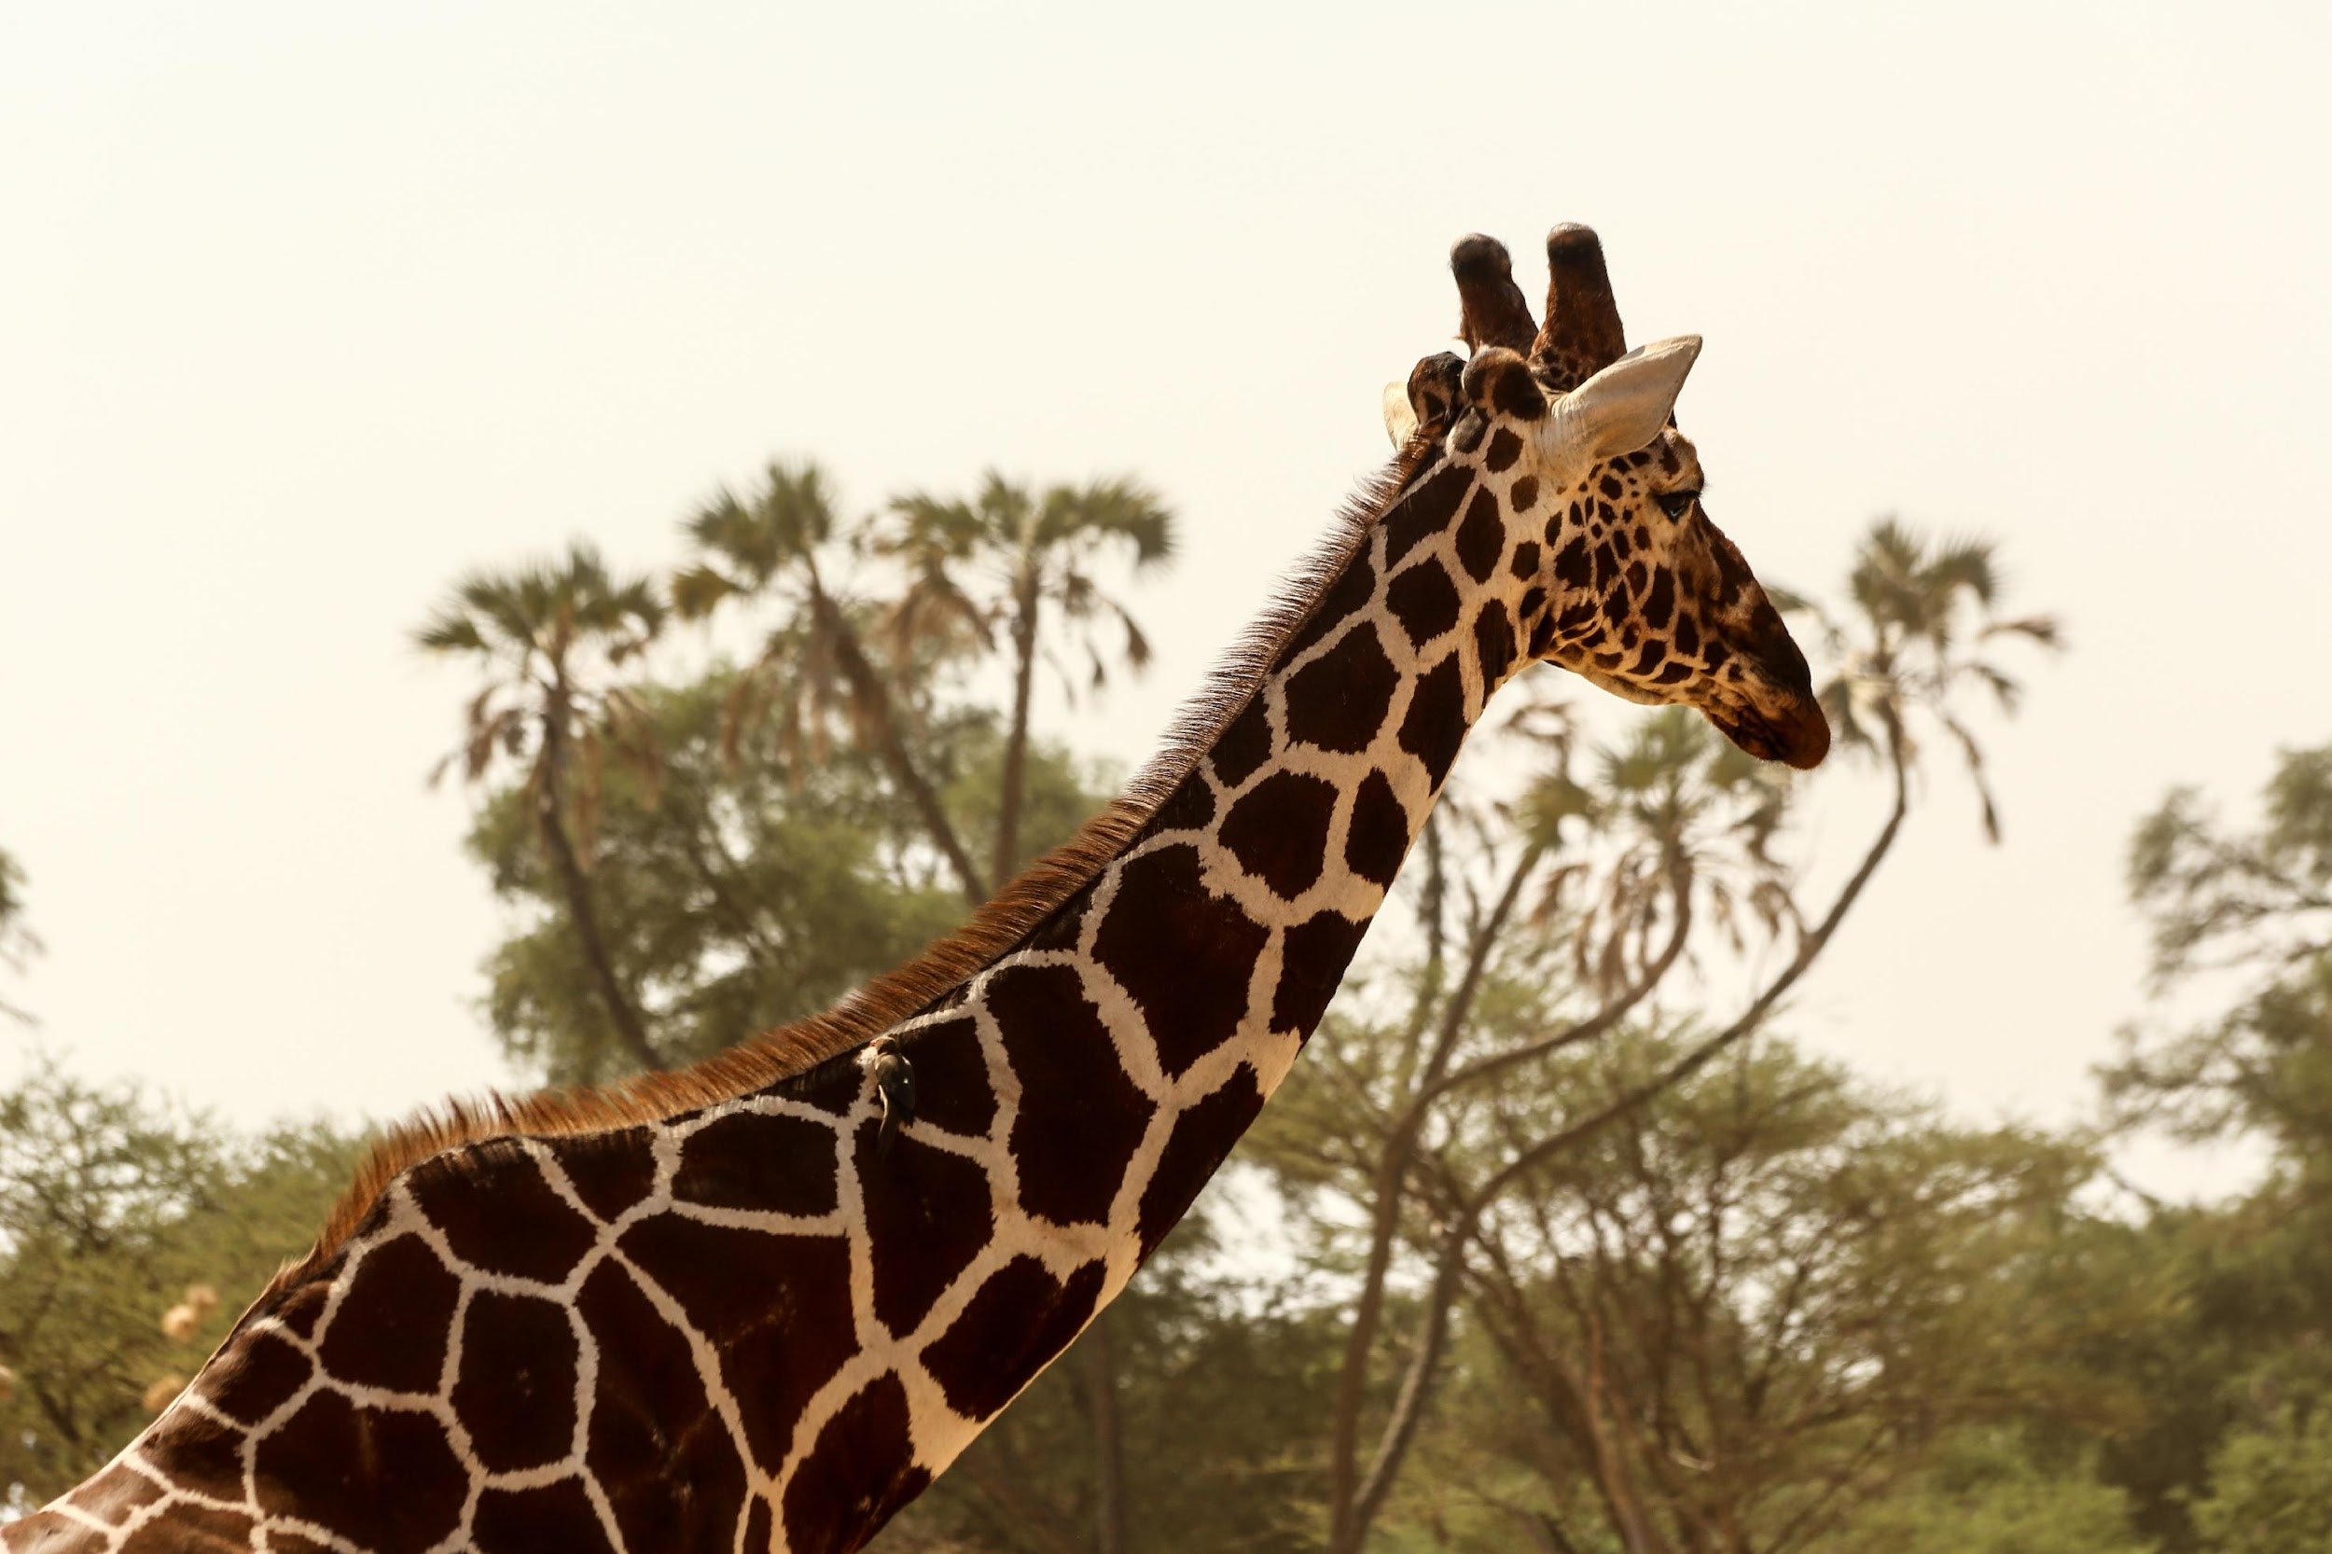
Herbivores - Plant Eaters
Characteristics of Herbivores
Herbivores feed exclusively on plants/grasses/bushes for their energy and nutrients.
They have specialized teeth and digestive systems to process plant matter.
DEER
ELEPHANT
GIRAFFE

Slide 12
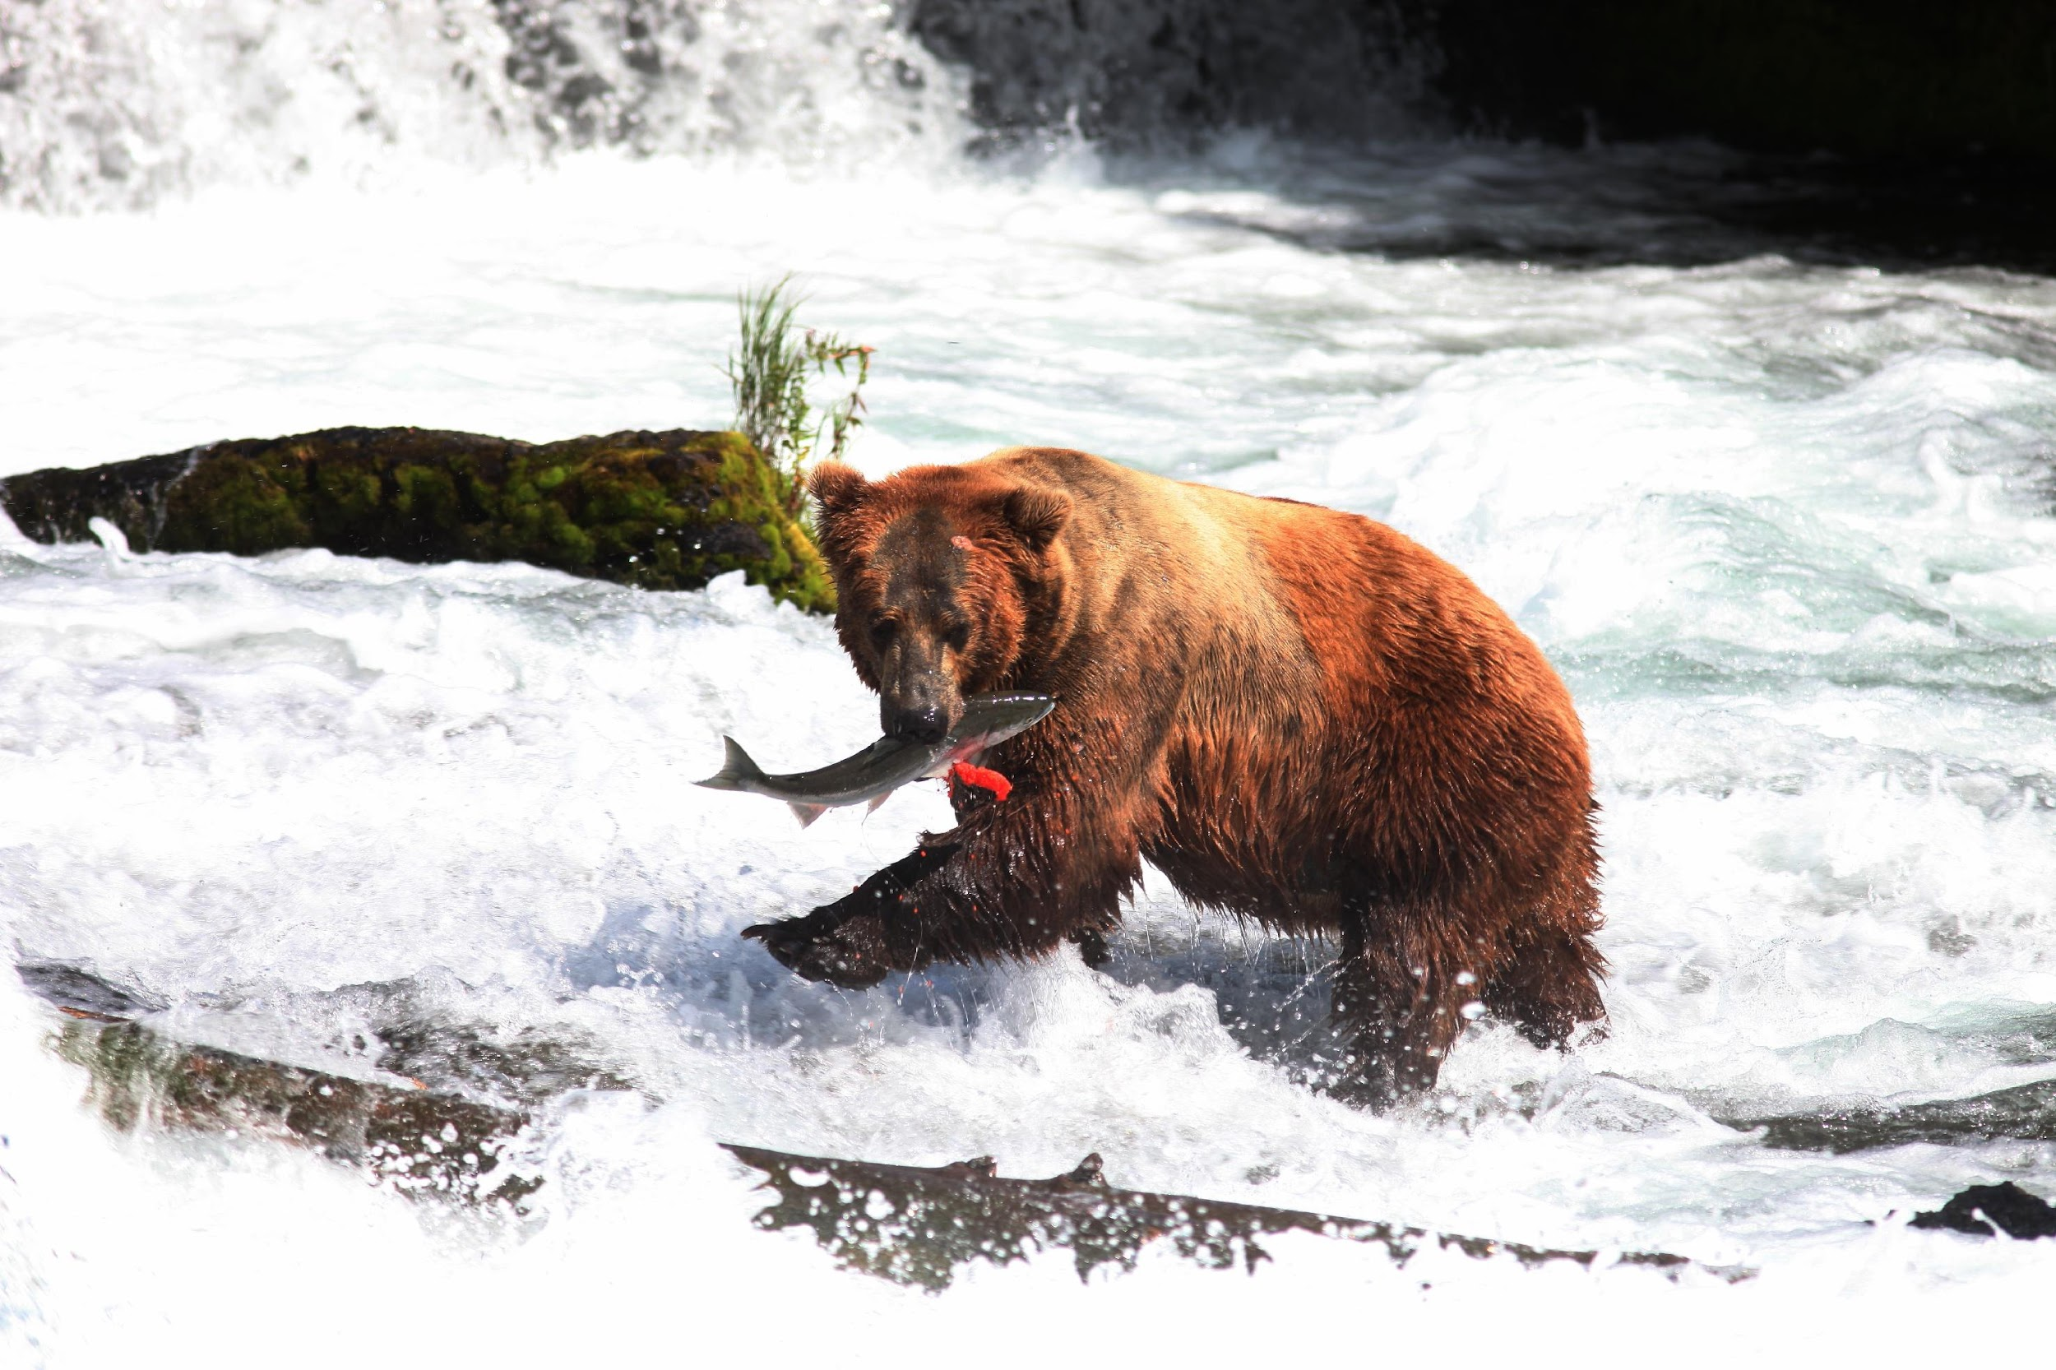
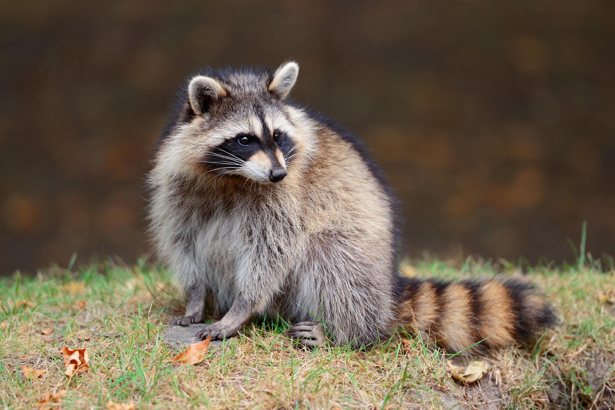
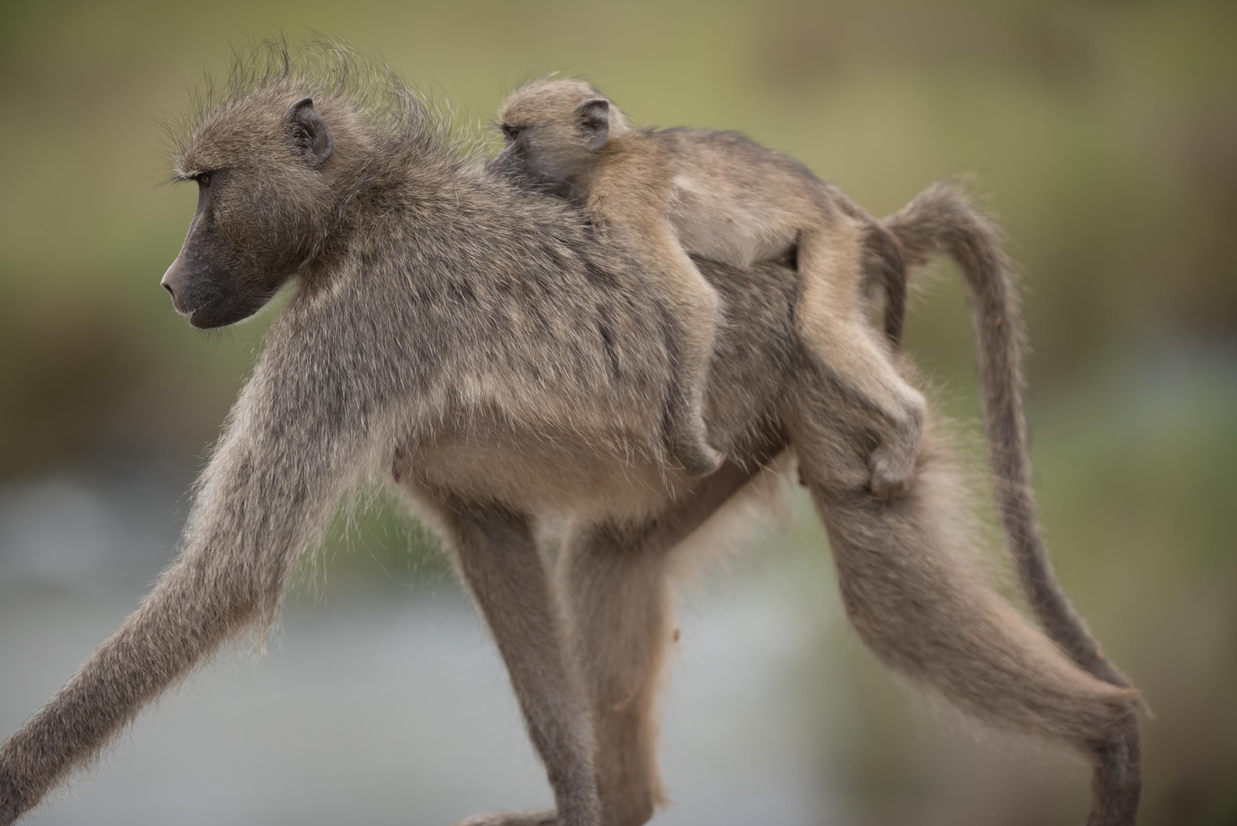
Omnivores – Meat and Plant Eaters
Characteristics of Omnivores
Omnivores consume a wide range of foods for energy and nutrients:
Plant matter: fruits, leaves, and nuts.
Animal matter: insects, small animals, and fish
What do you think humans are? (Carnivores, Herbivores, or Omnivores)
BEAR
RACOON
BABOON

Slide 13
Food Chain
A food chain is like a story that tells us who eats whom in an ecosystem.
It shows how energy and nutrients move from one organism to another.
Producers capture sunlight to create food. When animals eat plants, they get this energy.
As animals eat each other, energy moves along the food chain.
An example of a food chain in grasslands

Slide 14
Introduction to Food Chain Simulator
A food chain simulator is like a game that helps us understand how animals and plants depend on each other for food.
It's a fun way to learn about how all living things are connected in the environment.
Link to the simulation: https://www.learner.org/wpcontent/interactive/envsci/ecology/ecology.html
(Open the link on your devices)

Slide 15
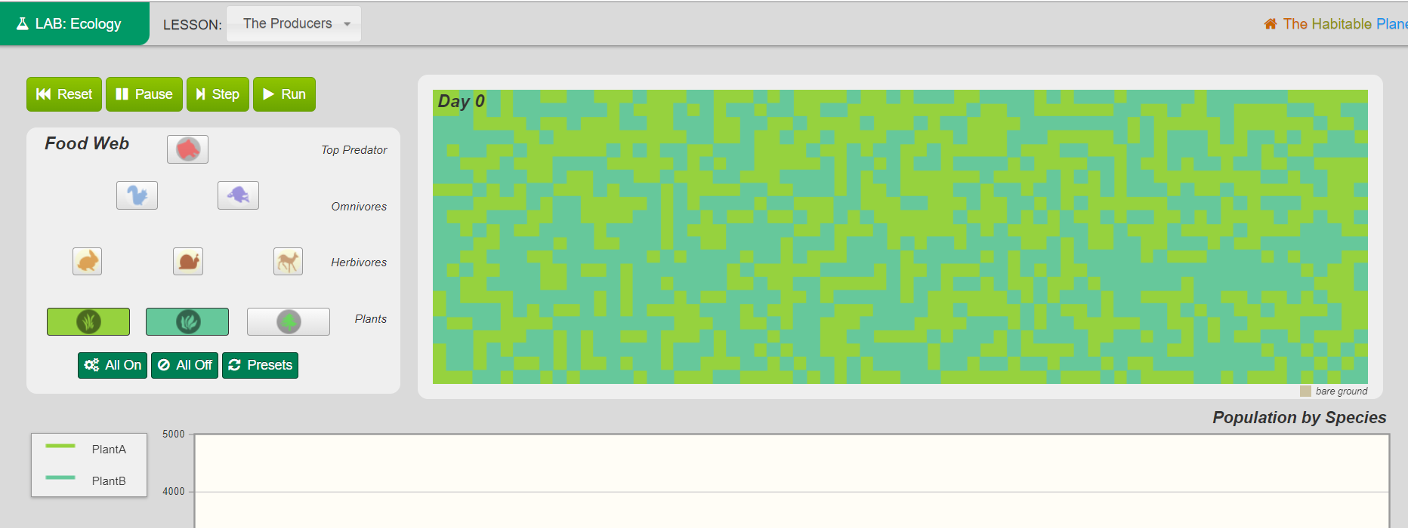
Food Chain Simulator: User Interface
Day Counter
Buttons to control the simulator
Different organisms including producers and consumers
Composition of the ecosystem is displayed here
Graph showing the population of different organisms

Slide 16
Playing With the Simulator
Imagine a fresh ecosystem starting after a big fire or flood. The very first residents in this new place are the plants that make food for everyone else.
Make sure Plants A and B are selected. It should be by default.
Go to the worksheet and run the simulation. Complete Activity I
1
2

Slide 17
Playing With the Simulator: Results
Plant A survived after 100 days. Plant A is like the boss of a place where it grows. It's the plant that is the strongest and most common in that area. It took all the resources(sunlight, nutrients from the soil) for itself. Hence plant B was not able to survive.
Now let’s try to add a herbivore to this ecosystem.

Slide 18
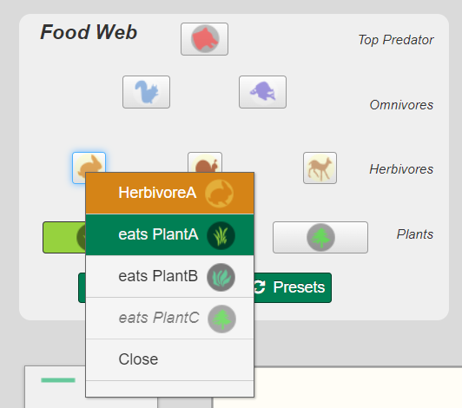
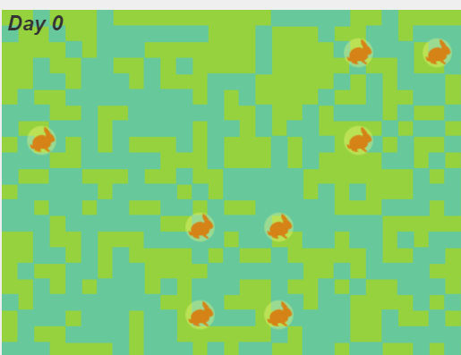
Playing With the Simulator
Go the worksheet and run the simulation. Complete Activity II and III
Click on the rabbit and select eats plant A
2
3
Make sure Plants A and B are selected. It should be by default.
1

Slide 19
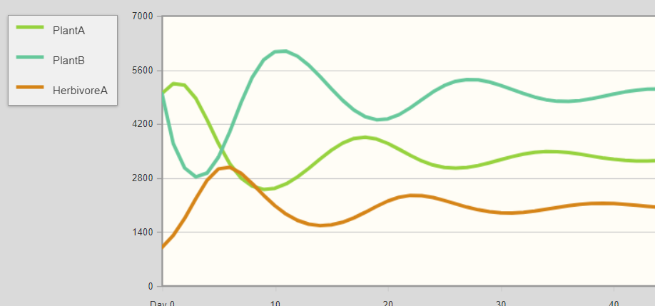
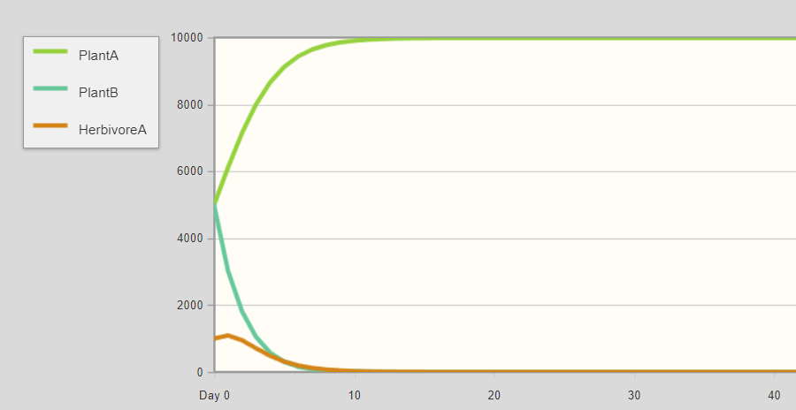
Playing With the Simulator: Results
Herbivore A eats plant A
Herbivore A eats plant B
Herbivore A eats plant A: When herbivore A starts eating it, there's less plant A around. This gives other plants, like plant B, a chance to grow better because they have more space and resources. It results in more balanced ecosystem.
Herbivore A eats plant B: Plant B’s population is already affected due to plant A. If herbivore A starts eating Plant B its population would go down further. Without enough food (plant B), herbivore A might not have enough energy to survive, and it’s population would get wiped out.

Slide 20
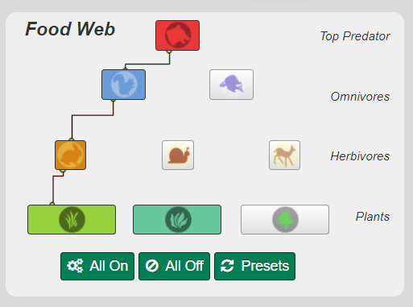
Playing With the Simulator
Set the following food chain and complete Activity IV. Do not run the simulation.
Complete Activity V.

Slide 21
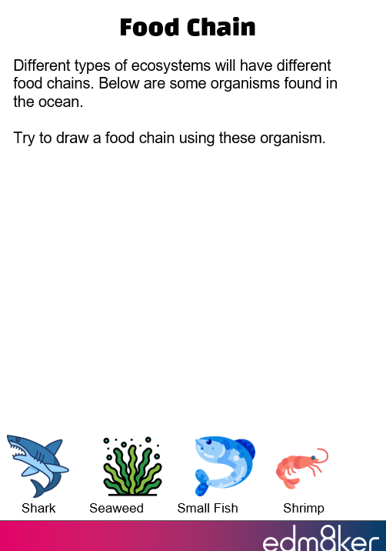
Final Activity
Complete Activity V on your worksheet

Slide 22
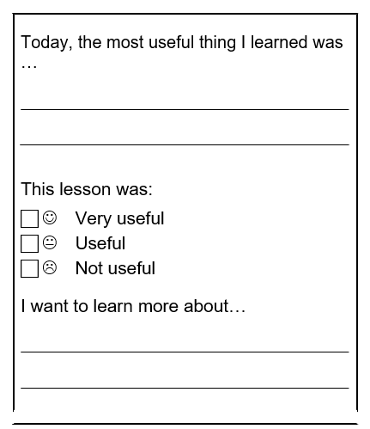
Exit Ticket!
Complete the exit ticket and hand it over.

Slide 23
Thank You
edm8ker is a fully owned brand of Makedemy Pte Ltd A member of the SL2 group of social enterprises.

