Slide 1
Student Handout
Making the future of young minds

Slide 2
Food Chain
Activity I:
Only plants A and B selected as producers.
Answer the questions below.
 | Plant A | Plant B
Starting Population
Ending Population
Which plant species survived after 100 days of running the simulation?
Based on your answer above, why do you think that plant species was able to survive? (Hint: Think about plants that steal resources from other plants)

Slide 3
Food Chain
Activity II:
Plants A and B selected are producers.
Herbivore A eats plant A.
Answer the questions below.
 | Plant A | Plant B | Herbivore A
Starting Population
Ending Population
Which plant species is the boss here? Explain
Does adding the herbivore A(which eats plant A) helps plant B to survive? Why does this happen?

Slide 4
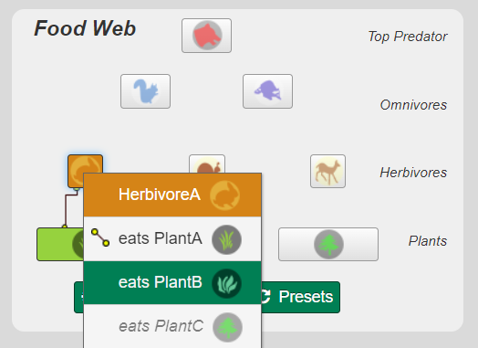
Food Chain
Activity III:
Plants A and B selected are producers.
Herbivore A eats plant B.
What is your key observation? Why did this happen?

Slide 5
Food Chain
Activity IV:
Plants A and B selected are producers.
Herbivore A eats plant A.
Omnivore A eats Herbivore A
The Top Predator eats Omnivore A
Predict whether the population of different organisms will increase/decrease.
Run the simulation, note the actual observation
 | Plant A | Herbivore A | Omnivore A | Top Predator
Prediction
Simulation 1
Simulation 2
Is this ecosystem balanced? Why do you think so?

Slide 6
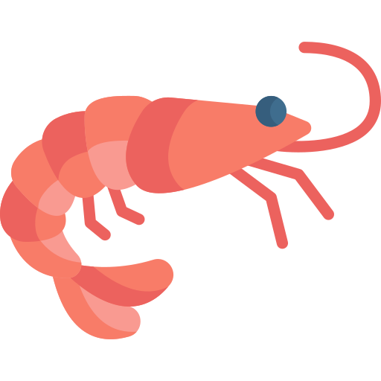
Food Chain
Different types of ecosystems will have different food chains. Below are some organisms found in the ocean.
Try to draw a food chain using these organism.
Shark
Seaweed
Small Fish
Shrimp

