Slide 1
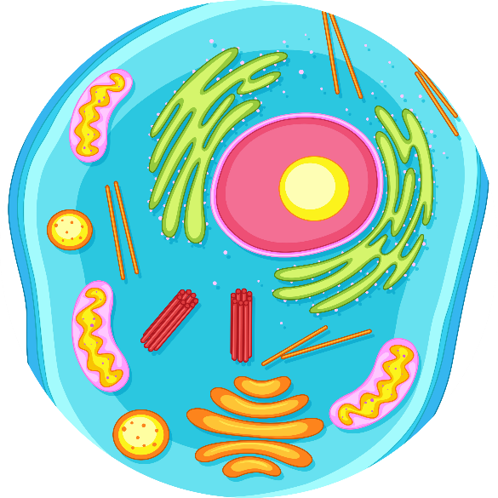
Tiny Titans: The Cell Story
Sixth Grade
120 minutes

Slide 2
Overview
Recognize that cells are the fundamental structural and functional units of living organisms.
Appreciate the diversity of cells in various organisms and understand that living things can be composed of one cell or multiple types of cells.
Identify key organelles within animal cells, including the nucleus, cytoplasm, and cell membrane.
Create an animated cell story using Ninja Brush.
Notes:
Begin by sharing the overview. Apprise students of the tasks they’d accomplish in the class.

Slide 3
Ground Rules
Be respectful of one another. Listen to your teammates.
Raise your hand if you have anything to share.
Listen closely and follow instructions.
Complete the tasks on time.
Notes:
Discuss the ground rules with learners and stress on the importance of them being followed throughout the class.

Slide 4
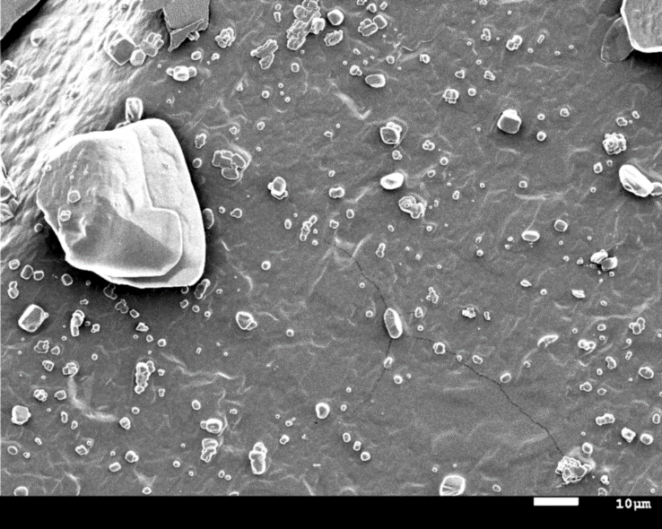
Journey to the microscopic world
Can you guess what is the object shown in the image?

Slide 5
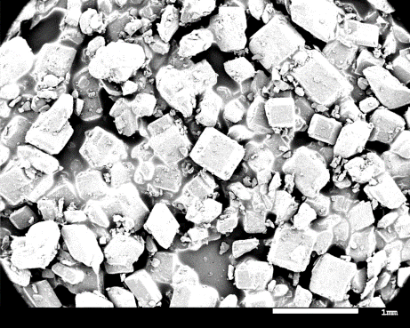
Journey to the microscopic world
Sugar crystals
Magnified image of sugar crystals
Do you know about the device that allowed us to venture into the minuscule realm, revealing secrets that were once invisible to the naked eye?

Slide 6
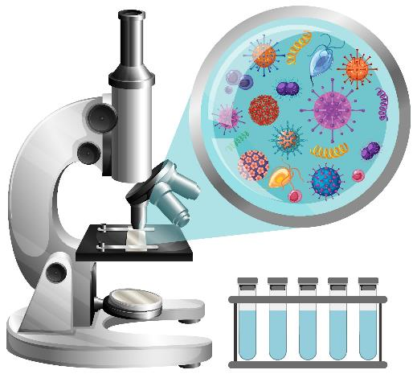
The Microscope
The discovery of the microscope revolutionized the world by unveiling a hidden realm of tiny structures and organisms, leading to groundbreaking advancements in biology, medicine, and scientific understanding.

Slide 7
Microscopic Adventures: A Closer Look
The SEM simulator allows users to view different objects at a microscopic level.
Visit https://myscope-explore.org/virtualSEM_explore.html to being exploration.

Slide 8
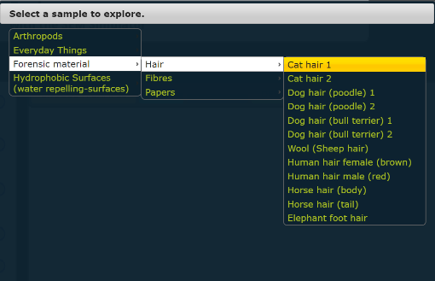
Microscopic Adventures: A Closer Look
1
2
Click on choose a sample
Select a sample of your choice

Slide 9
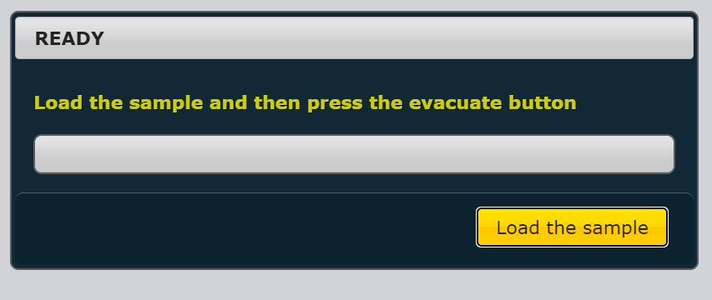
Microscopic Adventures: A Closer Look
3
Click on load the sample

Slide 10
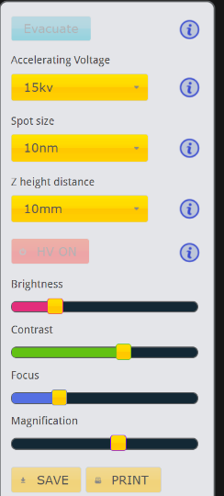
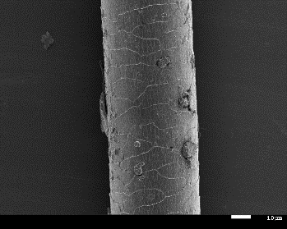
Microscopic Adventures: A Closer Look
4
Click on evacuate
5
Set the values as indicated
6
Click on HV ON
A clear magnified image of a cat’s hair
7
Adjust these values until you get a clear image

Slide 11
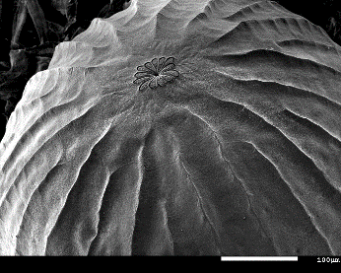
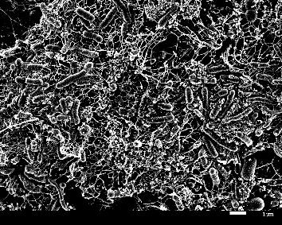
Microscopic Adventures: A Closer Look
What all objects did you see?
Were there any similarities between them?
Is there something even smaller that constructs all these objects?
Moth’s egg
Sponge

Slide 12
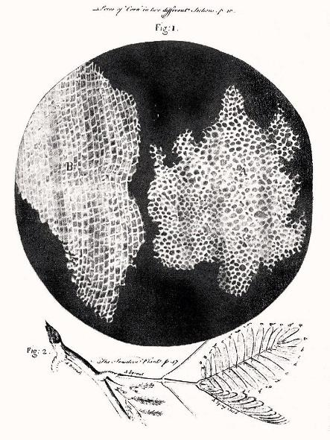
Cell: The building block of life
A cell is like the tiniest building block of life.
It's the basic unit that makes up all living things.
Robert Hooke, an English scientist, is credited with discovering cells by observing cork under a microscope in 1665.
Did you know?
There are roughly about 9,000 to 10,000 cells in the tip of your finger!
Cell structure of cork by Hooke

Slide 13
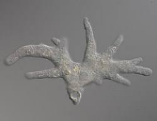
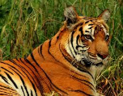
Diversity in Living Organisms
ORGANISMS
UNICELLULAR
MULTICELLULAR
Organisms made up of a single cell
Organisms made up of multiple cells
Amoeba
Bacteria
Plants
Animals

Slide 14
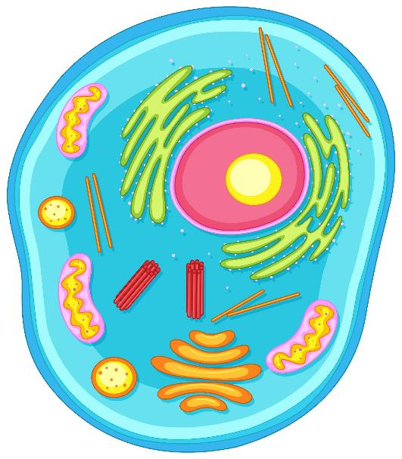
Inside the Cell
What can you see inside the cell?
Animal Cell

Slide 15
Cell Organelles
Cell Membrane
Nucleus
Cytoplasm
Organelles are tiny structures inside cells that work together to keep the cell alive and functioning.
They're like the different parts of a machine that work together to make the whole thing work properly.
Endoplasmic Reticulum
Mitochondria
Animal Cell

Slide 16
Nucleus - The Command Center
Nucleus
Nucleus: The organelle that contains the cell's genetic material (DNA) and controls cellular activities.
It's like the cell's control center, where all the important instructions are stored. Just like your brain tells your body what to do, the nucleus tells the cell what to do.
Animal Cell

Slide 17
Cytoplasm - The Jelly Playground
Cytoplasm
Cytoplasm: The semi-fluid substance within a cell that holds all organelles.
It's a gooey substance that fills up the cell and helps all the organelles float around. Just like you can bounce around in a playground filled with foam, the organelles can move around and do their jobs.
Animal Cell

Slide 18
Cell Membrane - The Protective Wall
Cell Membrane
Cell Membrane: The protective layer that surrounds the cell, controlling the passage of substances in and out.
It's like the gatekeeper, letting in good things (like nutrients) and keeping out bad things (like harmful substances).
Animal Cell

Slide 19
Mitochondria - The Power House
Mitochondria: The cell's power plants that produces energy.
They work hard to produce energy, just like a power plant makes electricity for a city. The energy they make is like the fuel your body needs to do everything from running to thinking!
Mitochondria
Animal Cell

Slide 20
Endoplasmic Reticulum - The Delivery System
Endoplasmic Reticulum: The cell’s delivery system that transports materials within the cell.
Imagine it's a series of tunnels that transport things around the cell. Just like delivery trucks move packages from one place to another, the ER moves proteins and other important materials to where they're needed in the cell.
Endoplasmic Reticulum
Animal Cell

Slide 21
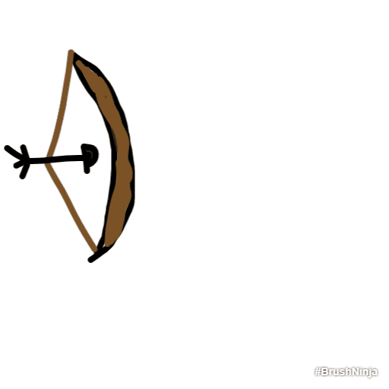
It’s Time for Cell Story
Now it’s time for you to animate your cell story using Brush Ninja.
Brush Ninja is like a digital drawing tool where you can create animations by drawing different pictures in a sequence. It's fun and easy to use, and when you play the pictures in order, they move like a mini movie!
Visit: https://brush.ninja/

Slide 22
Let’s Team Up!
Making the future of young minds

Slide 23
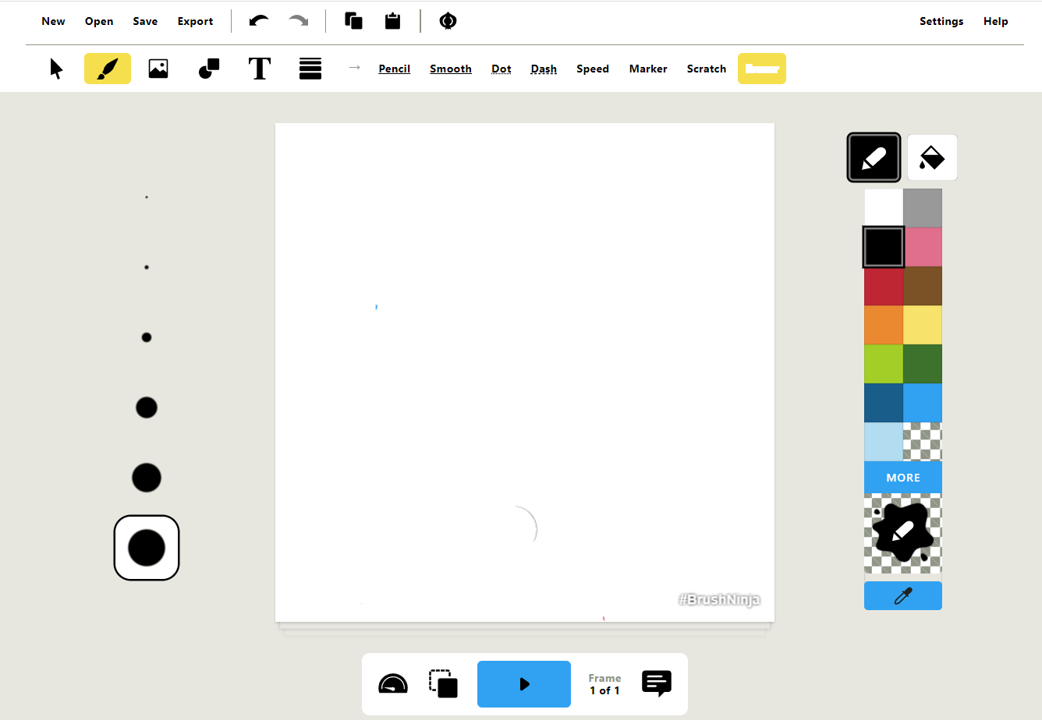
Brush Ninja: User Interface
Menu Bar
Toolbar
Size adjuster
Drawing Area
Color Box
Animation Controls

Slide 24
Instructions
Introduction:
Introduce your cell guide character with a friendly gesture and a warm welcome.
Content:
Animate organelles interacting, use text or speech bubbles for short explanations.
Conclusion:
Summarize the journey, end with a positive message, and create a closing animation.

Slide 25
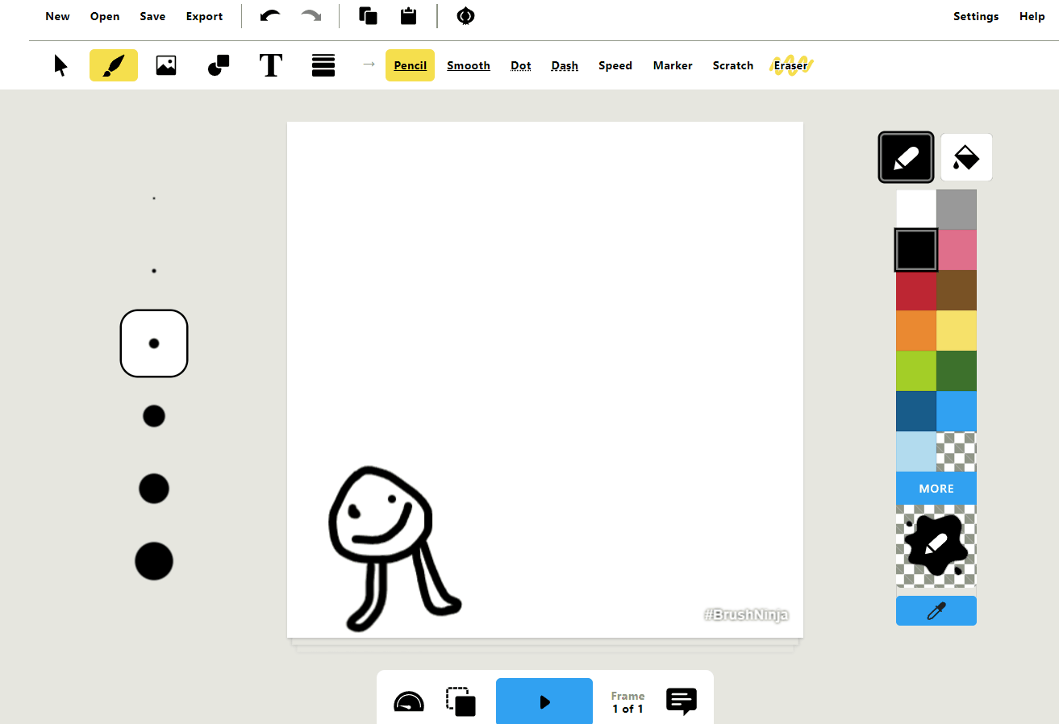
Introduction: Example
Select pencil from the toolbar.
Draw out your character.
Select Text (T) from the toolbar.
Add text to introduce your character.
Click on the pencil icon.
Note: Make sure to use the appropriate size while placing text.

Slide 26
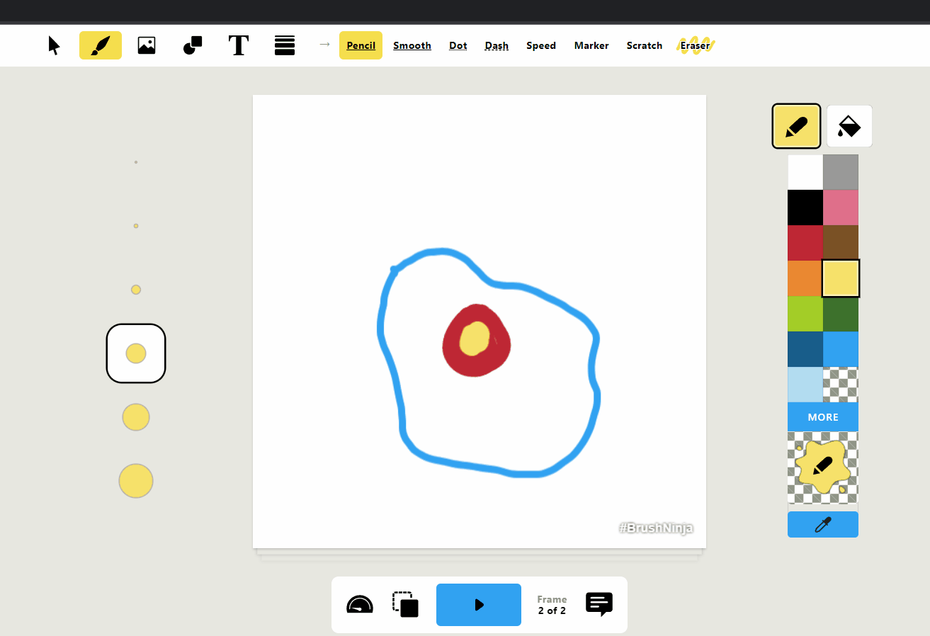
Content: Example
Draw out the basic outline of the cell.
Using the animation toolbar, make it’s copy.
Add content about the nucleus.
Note: Make sure to use the appropriate size while placing text.

Slide 27
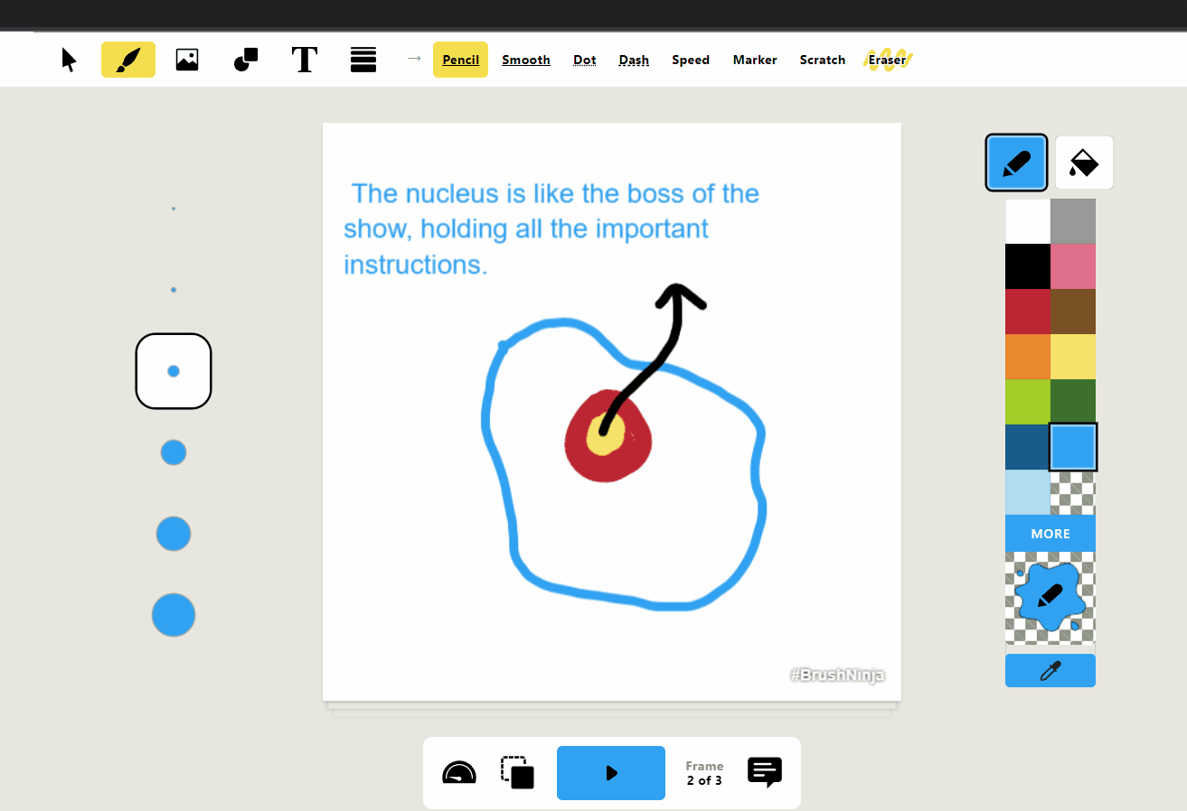
Content: Example
Make a copy of your original outline of the cell.
Add information about another organelle.
Note: You will need to add information about all the organelles along with the conclusion.

Slide 28
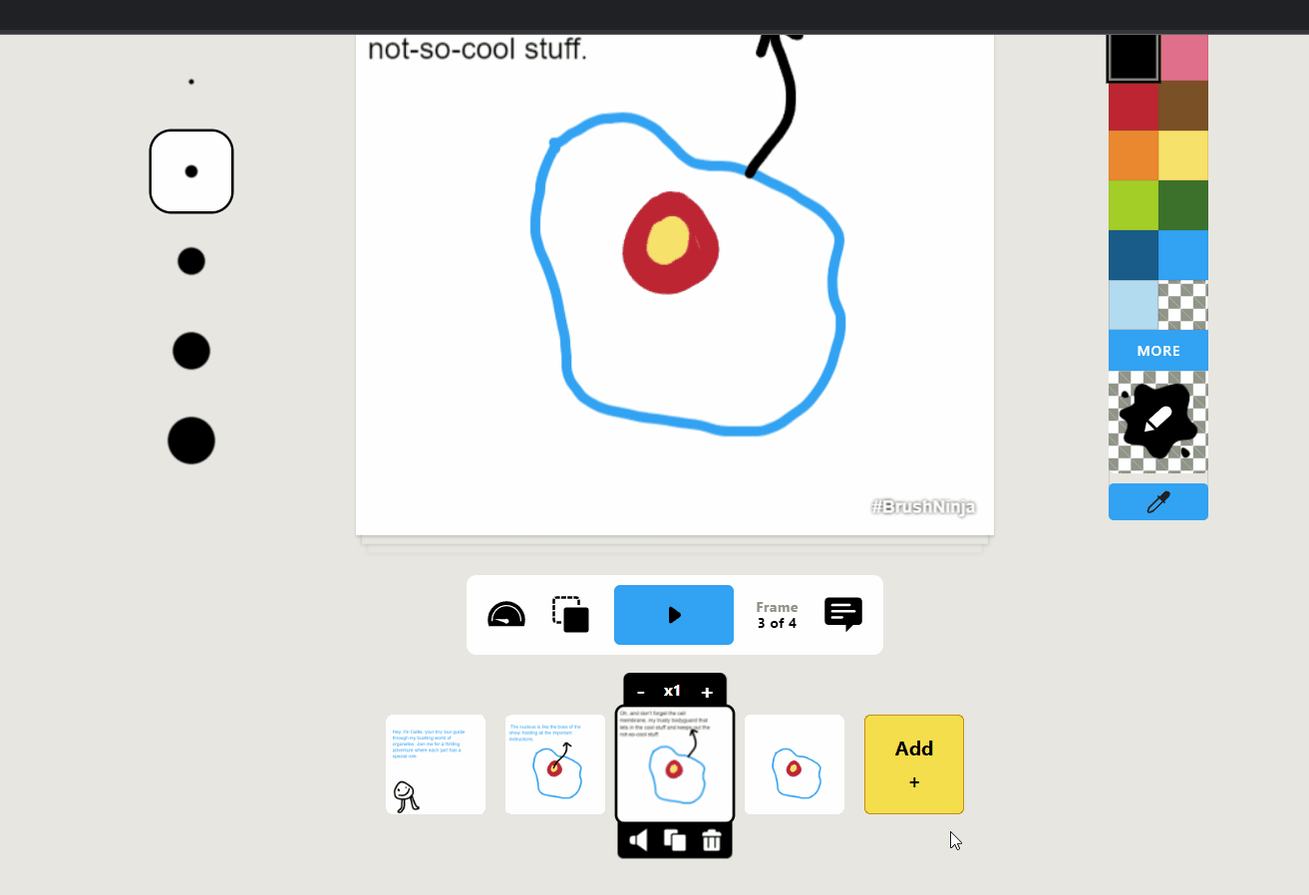
Adjusting Frame Rates
Using the Animation tool bar, adjust the frame rate to 0.5.
This will make sure that each frame remains on the screen for two seconds.
You can further decrease the frame rate if required.
Note: Remove the duplicate frames before playing.

Slide 29
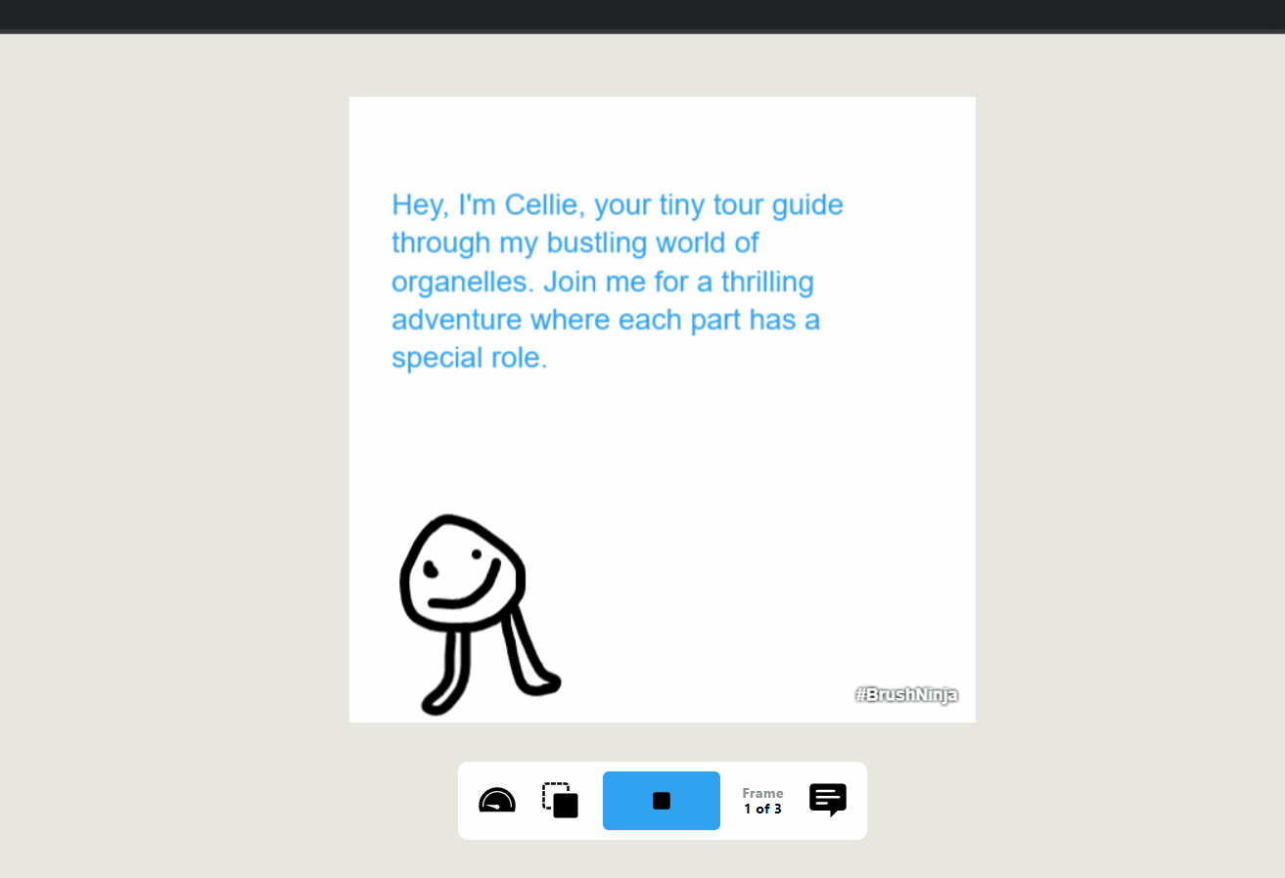
Playing the animation
Once you have created your animated story. Click on the play button.
Make any changes if required, before downloading your file.
Note: Remove the duplicate frames before playing.

Slide 30
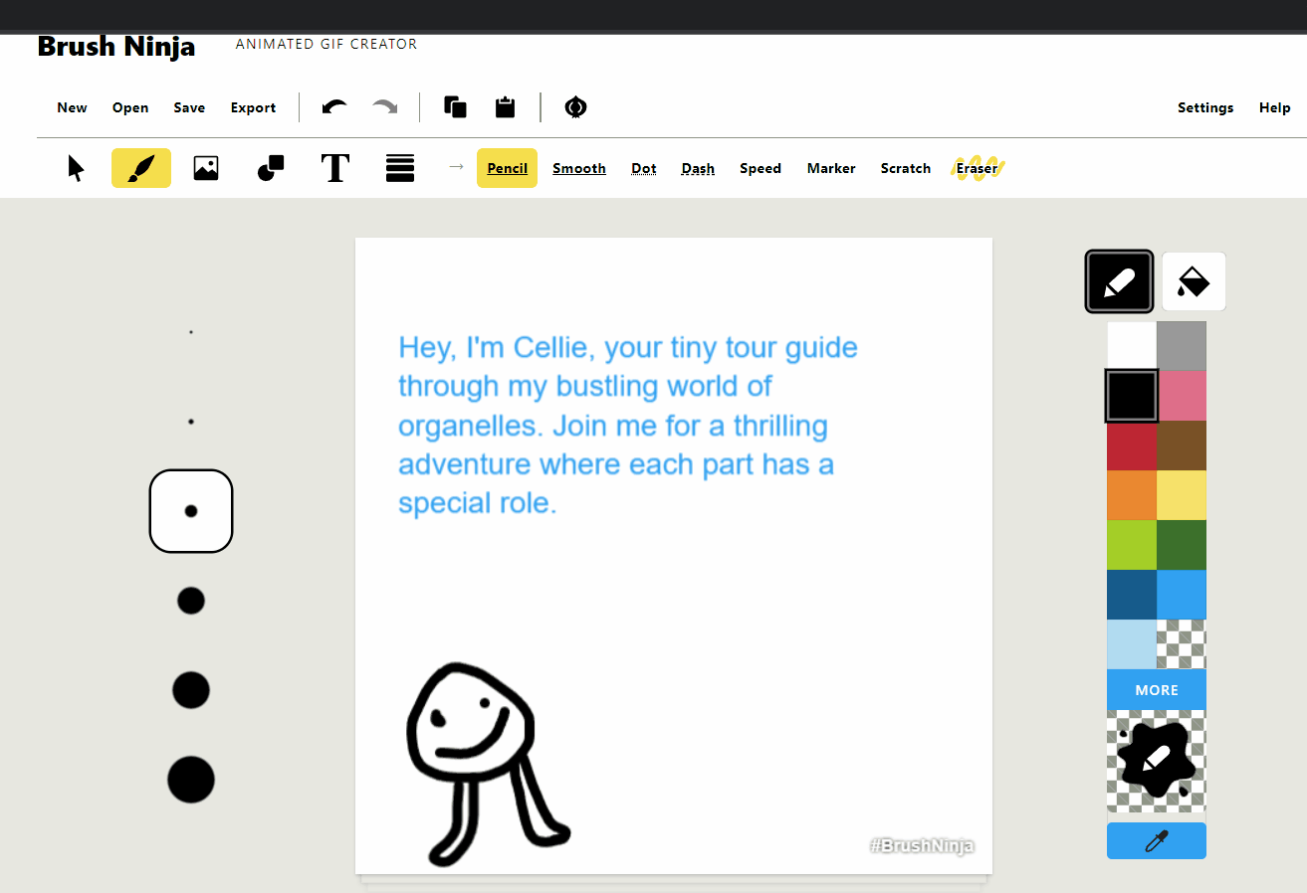
Downloading the file
On the menu bar, click on export.
Name your file.
Click on export as GIF.
Click on download animated GIF.
Note: You can also convert your gif to a video once you have downloaded the GIF.

Slide 31
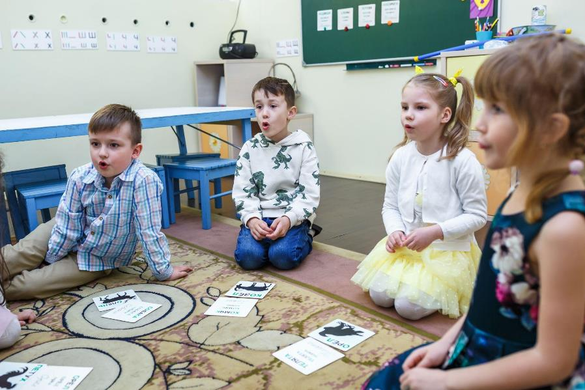
Share and Learn
It’s time for you to share your animated story with other groups.

Slide 32
Rules
A specific time will be set for each group to present their story to the class.
Remember to listen to each group's story respectfully and without interrupting.
Wait for your turn to present your piece to the class.
While others are presenting, sit quietly and pay close attention to their creation.
After each presentation, show your appreciation for their story with applause.

Slide 33
Let’s Summarize
In one sentence, share something new that you learned in today’s class.
What was challenging?
What was easy?

Slide 34
Thank You
edm8ker is a fully owned brand of Makedemy Pte Ltd A member of the SL2 group of social enterprises.

