Slide 1
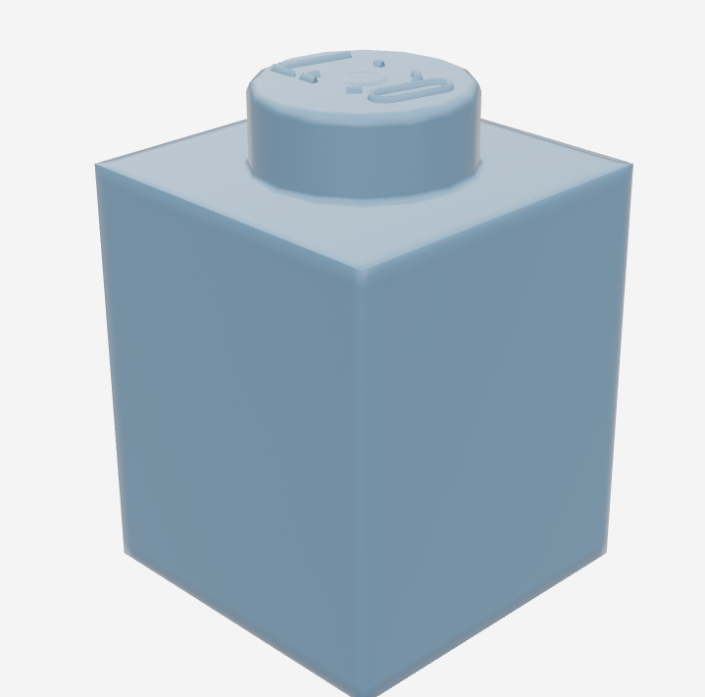
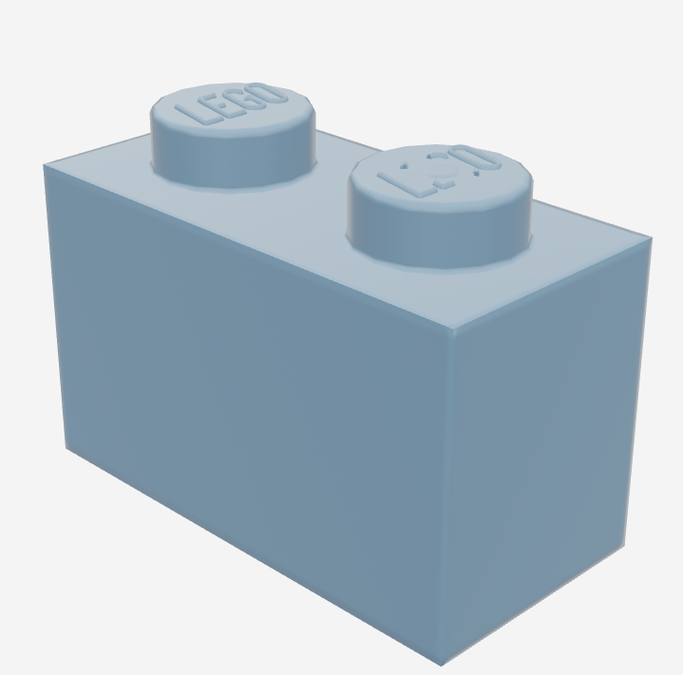
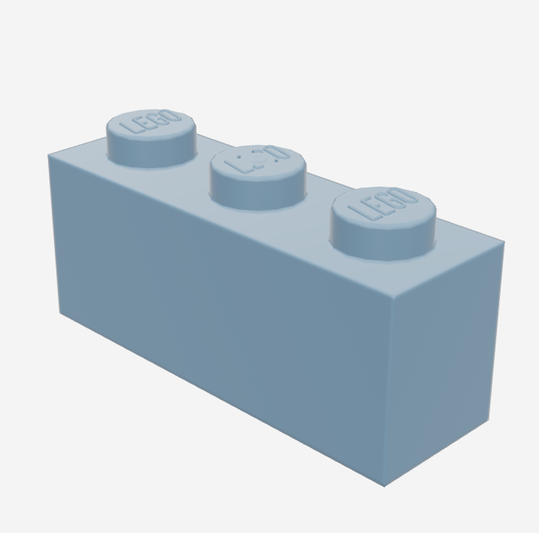
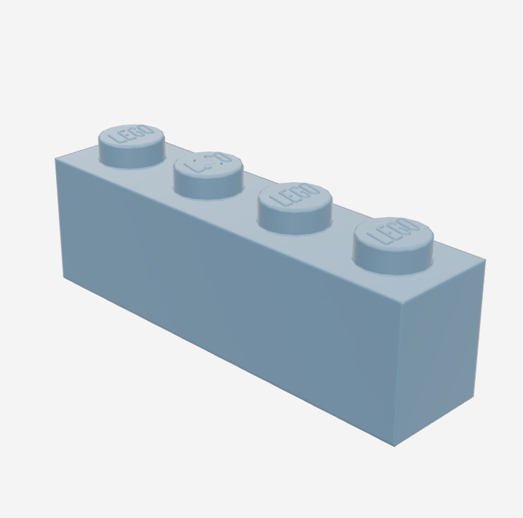
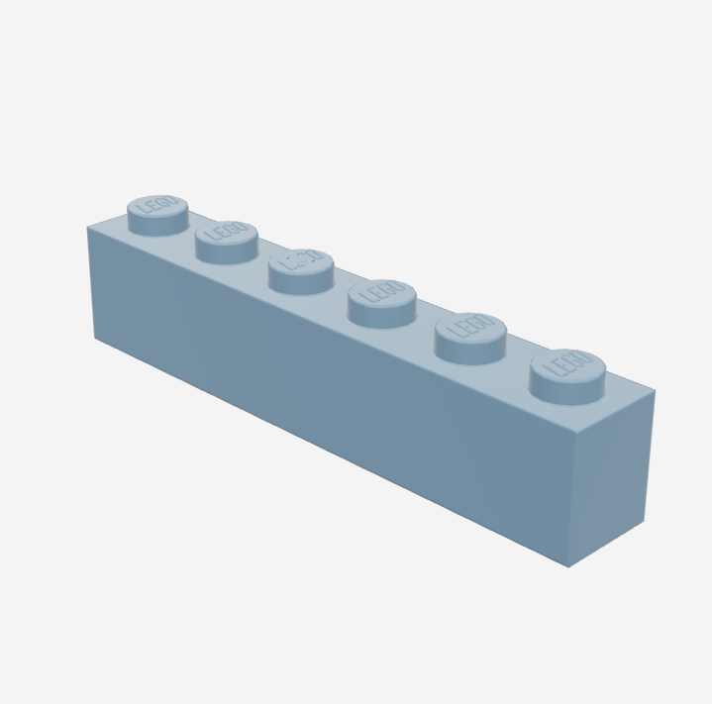
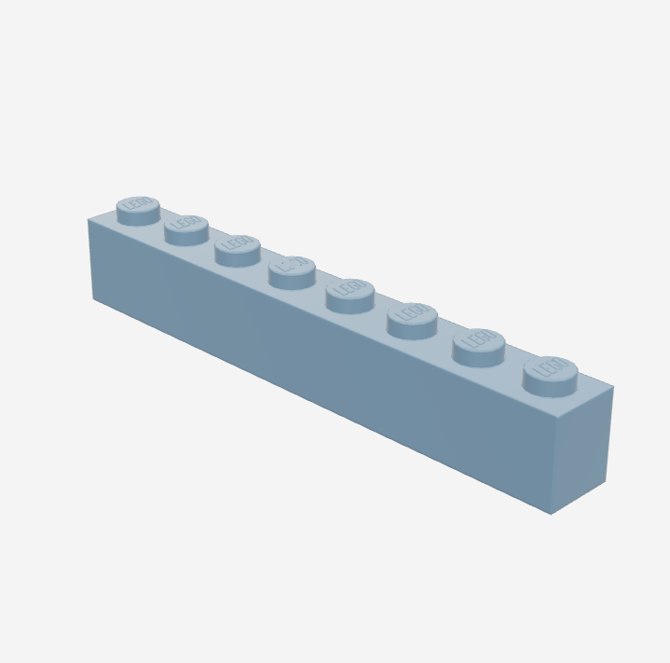
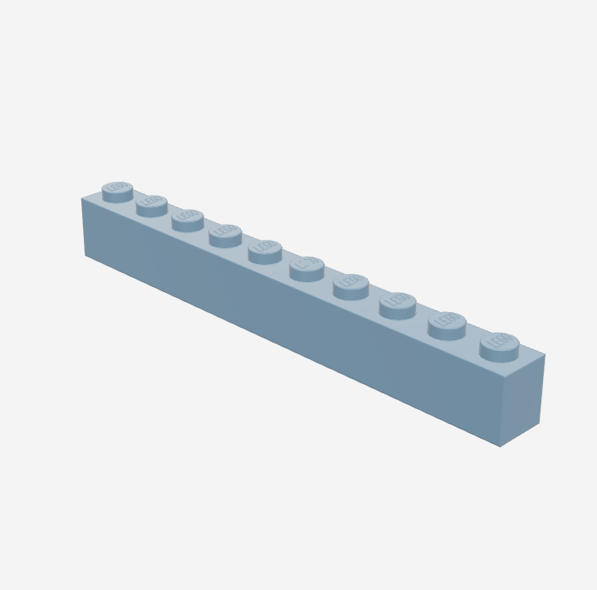
Making the future of young minds
Brick | Type | Transparent brick price | Colored brick Price
 | Brick 1 x 1 | 1 $ | 3 $
 | Brick 1 x 2 | 2 $ | 6 $
 | Brick 1 x 3 | 3 $ | 9 $
 | Brick 1 x 4 | 4 $ | 10 $
 | Brick 1 x 6 | 5 $ | 10 $
 | Brick 1 x 8 | 6 $ | 10 $
 | Brick 1 x 10 | 10 $ | 10 $

Slide 2
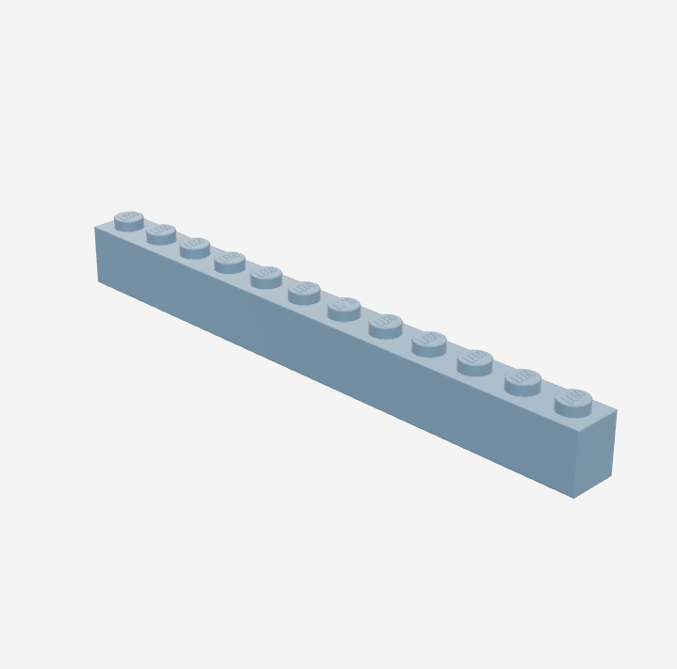
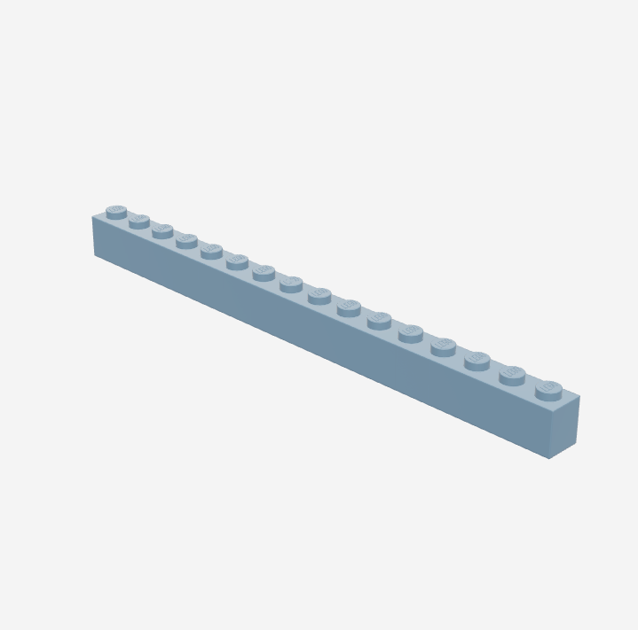
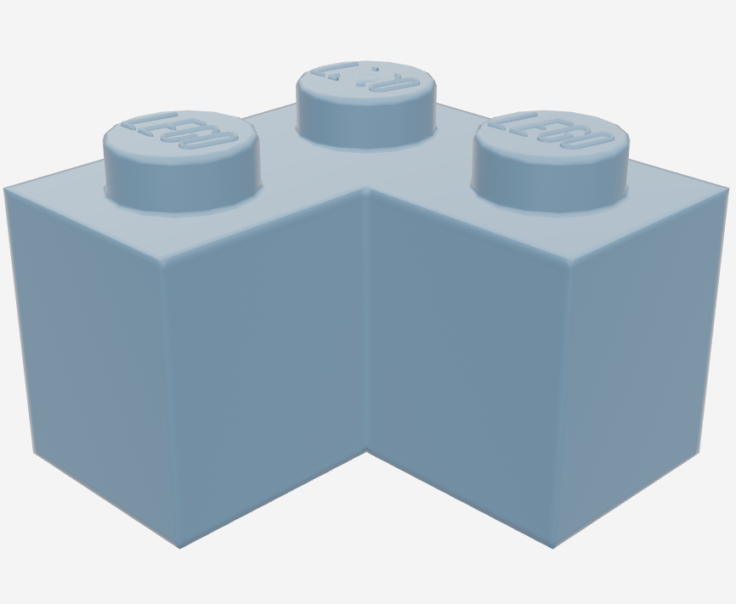
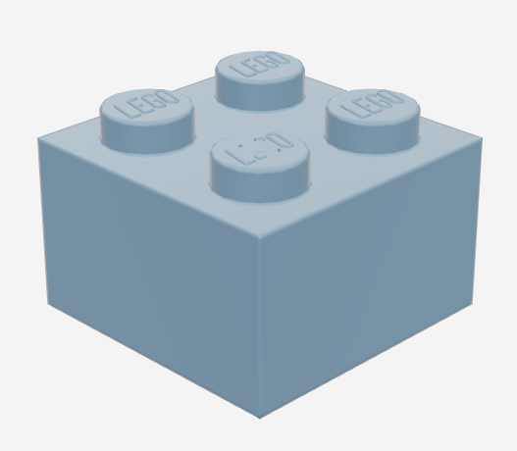
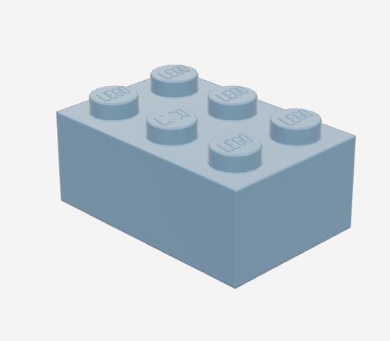
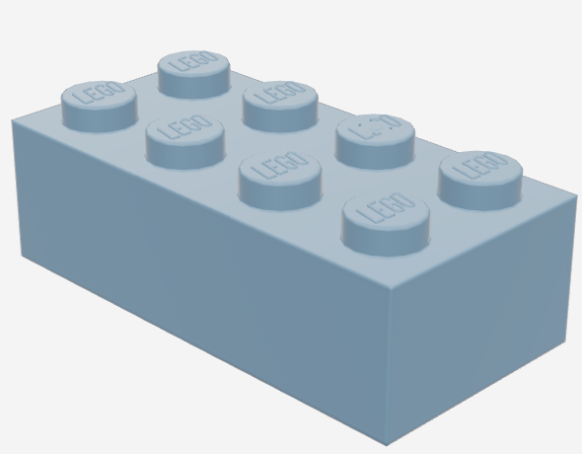
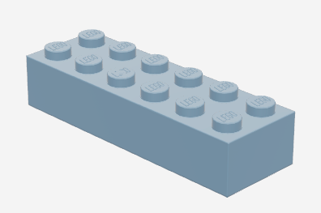
Making the future of young minds
Brick | Type | Transparent price | Colored Price
 | Brick 1 x 12 | 1 $ | 3 $
 | Brick 1 x 16 | 2 $ | 6 $
 | Brick corner 1 x 2 x 2 | 3 $ | 9 $
 | Brick 2 x 2 | 4 $ | 10 $
 | Brick 2 x 3 | 5 $ | 10 $
 | Brick 2 x 4 | 6 $ | 10 $
 | Brick 2 x 6 | 10 $ | 10 $

Slide 3
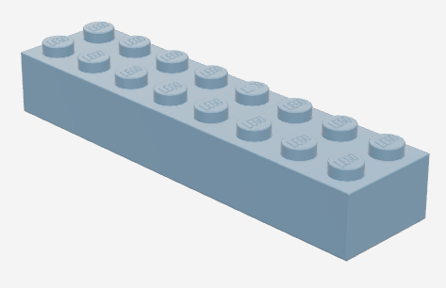
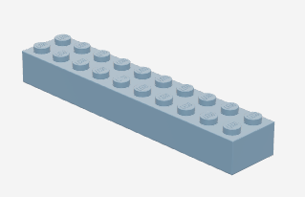
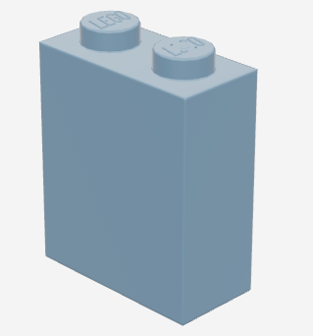
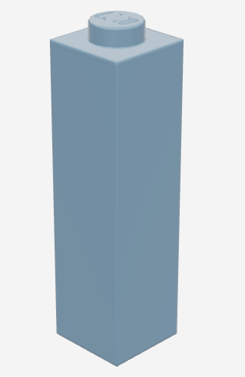
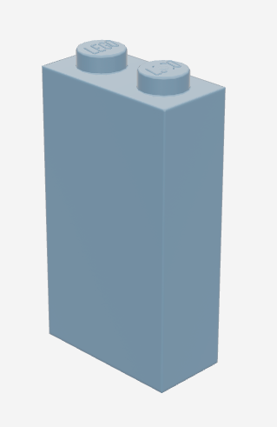
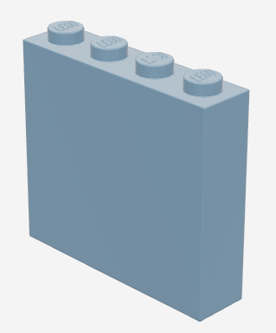
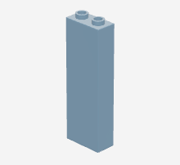
Making the future of young minds
Brick | Type | Transparent brick price | Colored brick price
 | Brick 2 x 8 | 1 $ | 3 $
 | Brick 2 x 10 | 2 $ | 6 $
 | Brick 1 x 2 x 2 | 3 $ | 9 $
 | Brick 1 x 3 x 3 | 3 $ | 6 $
 | Brick 1 x 2 x 3 | 3 $ | 6 $
 | Brick 1 x 4 x 3 | 4 $ | 8 $
 | Brick 1 x 2 x 5 | 7 $ | 9 $

Slide 4
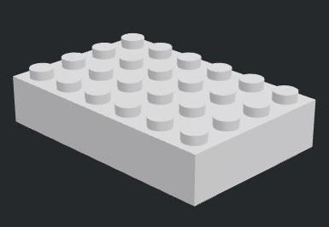
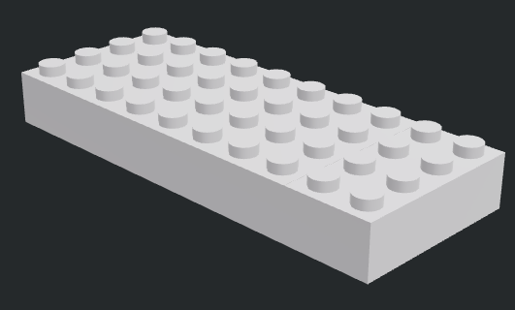
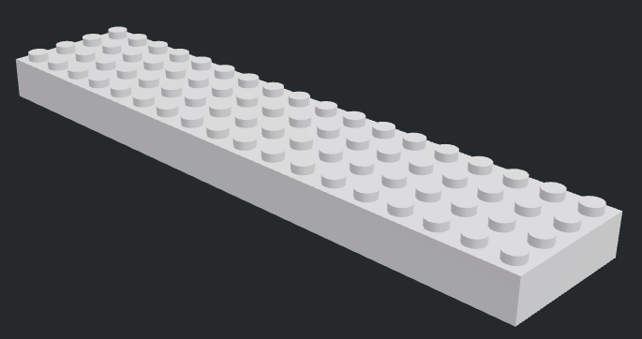
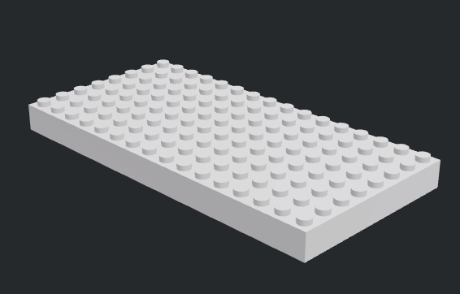
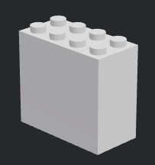
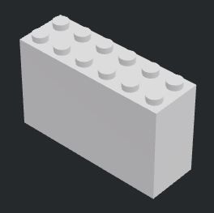
Making the future of young minds
Brick | Type | Transparent brick price | Colored brick price
 | Brick 4 x 6 | 1 $ | 3 $
 | Brick 4 x 10 | 2 $ | 6 $
 | Brick 8 x 8 | 3 $ | 9 $
 | Brick 8 x 16 | 4 $ | 10 $
 | Brick 2 x 2 x 3 | 5 $ | 10 $
 | Brick 2 x 4 x 3 | 6 $ | 10 $
 | Brick 2 x 6 x 3 | 10 $ | 10 $

Slide 5
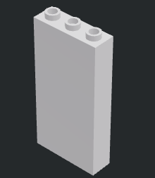
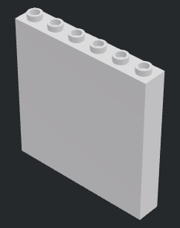
Making the future of young minds
Brick | Type | Transparent brick price | Colored brick price
 | Brick 1 x 1 x 5 | 4 $ | 8 $
 | Brick 1 x 3 x 5 | 5 $ | 6 $
 | Brick 1 x 6 x 5 | 6 $ | 9 $

