Slide 1
Moon Magic
60 minutes

Slide 2
Objectives
Recognize and label the moon phases.
Explain the reasons behind the occurrence of different moon phases.
Train a machine to recognize the differences between moon phases.
Evaluate the capabilities and limitations of machines.

Slide 3
Ground Rules
Be respectful of one another. Listen to your teammates.
Raise your hands if you have anything to share.
Listen attentively and follow instructions.
Complete tasks in
given time

Slide 4
Ever wondered why we observe different shapes and appearances of the moon throughout the month?

Slide 5
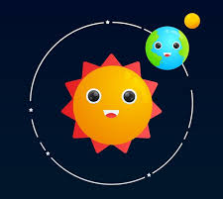
Lunar Phases
The lunar phases are caused by the changing positions of the Moon, the Earth, and the Sun.
As the moon orbits the Earth, different parts of its surface are illuminated by the sun.
The changing positions of the Earth, Moon, and Sun cause different amounts of sunlight to be visible from the Earth, leading to the various phases.

Slide 6
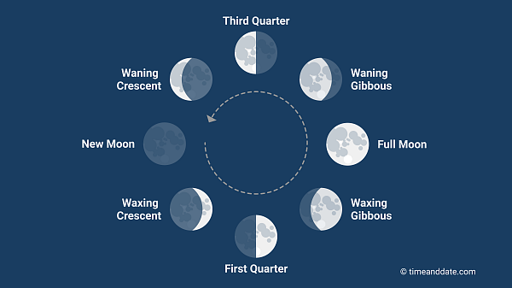

Slide 7
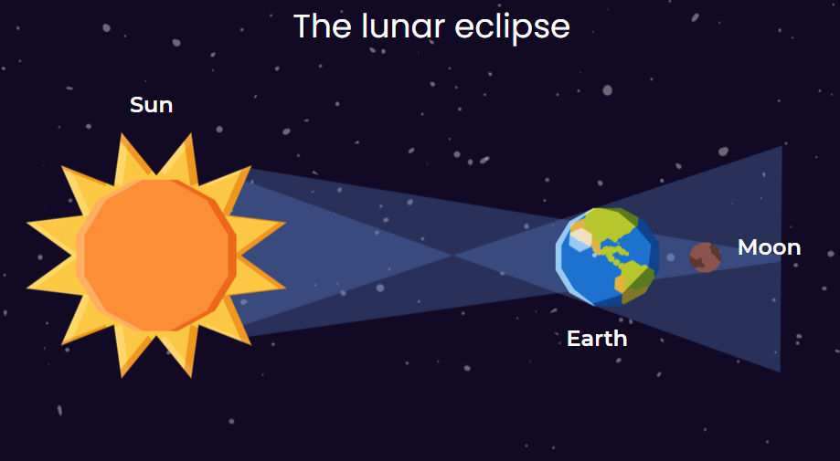
A lunar eclipse happens during a full moon when the Earth gets between the Sun and the Moon. This makes the Earth's shadow fall on the Moon.
For this to occur, the Sun, Earth, and Moon need to be in a straight line.
Not every full moon results in a lunar eclipse because the orbital planes of the Earth and the Moon are not perfectly aligned all the time.
The occurrence of lunar eclipses is predictable and can be calculated based on the positions and orbits of the Earth and the Moon.

Slide 8
Lunar Lens (25 Minutes)
Now that you have an idea about the phases of moon, let’s train a machine to recognize them.
Task 1
Form groups of 4.
Go to Google Teachable Machines to train the machine to identify any 3 phases of the moon.
You can download the images to train your machine from the worksheet provided to you.
Let your teacher guide you on how to use Google Teachable Machine.

Slide 9
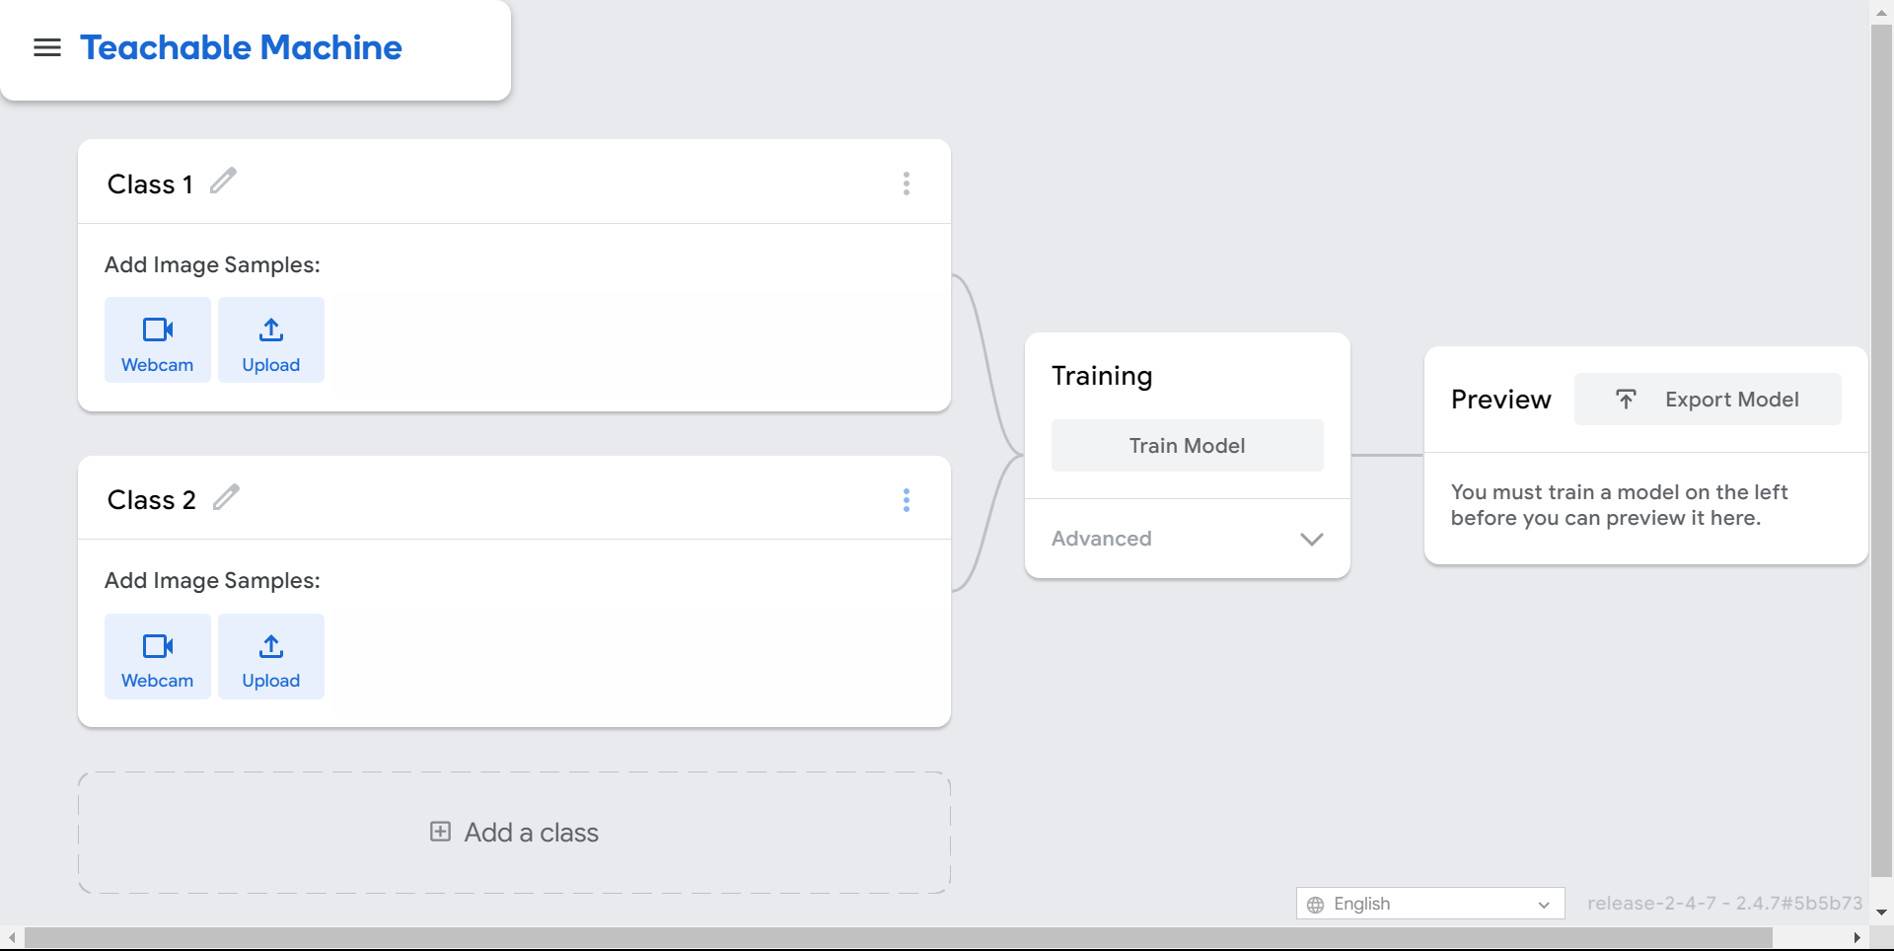
Interface
Change class name here
Upload images here
Train the model here
Add a new class here

Slide 10
Let’s Team Up!
Making the future of young minds

Slide 11
Project Manager
Resource Manager
Time Keeper
Presenters
Help your members stick to the task. Monitor what they are doing.
Collect materials and tools from the teacher. Ensure team members are using them properly. Return when you are done!
Keep track of time and help your teammates stick to the time limit.
Share your creation with the classmates and note down the feedback received.

Slide 12
Lunar Lens (25 Minutes)
Now that you have trained the machine, it is time to test it.
Task 2
Take help from Google Autodraw to draw the 3 phases of the moon you chose.
Save each image.
Upload the image to Google Teachable Machines to test whether the machine is accurately identifying moon phases.
Watch this video to learn how to use Google Autodraw.

Slide 13
Let’s Reflect!
Did the machine accurately recognize the moon phases?
If you used waxing and waning crescent/gibbous as phases, how accurately could the machine differentiate between the two?
In real life, how do you think humans differentiate between waxing and waning gibbous and waxing and waning crescent?
What do you think are some areas of improvement within the project?
What did you find exciting about the different moon phases?

Slide 14
Thank you!
edm8ker is a fully owned brand of Makedemy Pte Ltd
A member of the SL2 group of social enterprises.

