Slide 1
Painting the Past: Narrating Stories Through Cave Paintings
First Grade
120 minutes

Slide 2
Overview
Identify the main idea of an illustration.
Create a cave painting that shares a story.
Narrate and present the cave painting to my peers.
Notes:
Begin by sharing the overview. Apprise students of the tasks they’d accomplish in the class.

Slide 3
Discuss and decide
Task: As a team decide “What to eat for Dinner?”.
Time limit: 2 minutes
Condition:
You cannot talk to each other.
You cannot write it down.
Goal: All team members must have the same meal option, as their response by the end of the timer.

Slide 4
Early Human Communication
How did people communicate before the development of languages?

Slide 5
Communication in Stone Age
Sound
Gestures
Rock Art
By producing unique sound.
Using hand gestures.
By carving rocks.

Slide 6
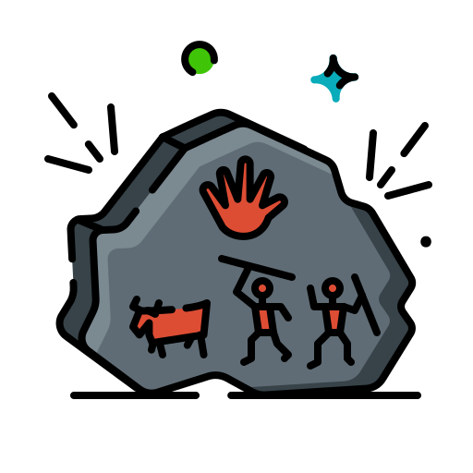
cave paintings
As a type of rock art, a cave painting is an image made by carving a portion of a rock surface.
petro + glyph
stone + carve

Slide 7
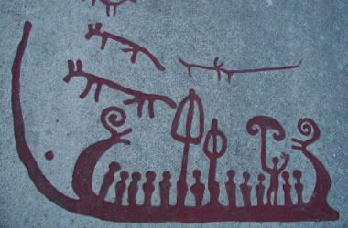
A cave painting in Sweden
What is the early human trying to communicate through this cave painting?
Notes:
Source: https://geology.com/articles/cave paintings/more-cave paintings.shtml

Slide 8
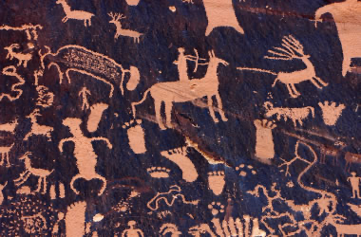
A cave painting in Utah
What is the early human trying to communicate through this cave painting?

Slide 9
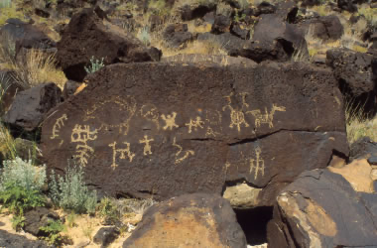
A cave painting in New Mexico
What is the early human trying to communicate through this cave painting?

Slide 10
Creating cave paintings
Task: Create a cave painting that tells a story about your experience in school.
Time limit: 45 minutes

Slide 11
How to create a cave painting
Step 1: Think of a story from your school experience that you want to convey through your cave painting.
Step 2: Decide upon the characters who will be a part of your cave painting.
Fill in the ideation template.
Notes:
https://docs.google.com/document/d/1VFTTavikRtphW97WeEBYMKE-4_BUxyPBOLGZwQrwPvM/edit

Slide 12
How to create a cave painting
Step 3: Using symbols that effectively convey your story, create a cave painting.
Notes:
https://www.wixie.com/o99264

Slide 13
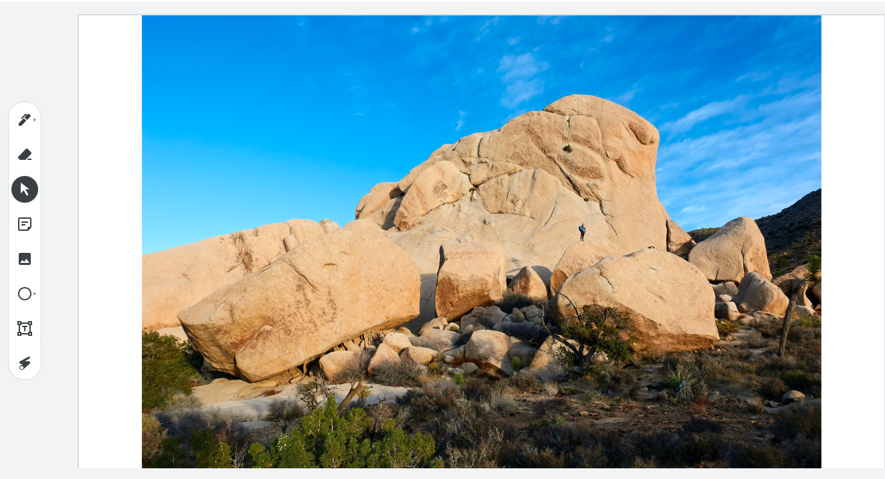
How to create a cave painting

Slide 14
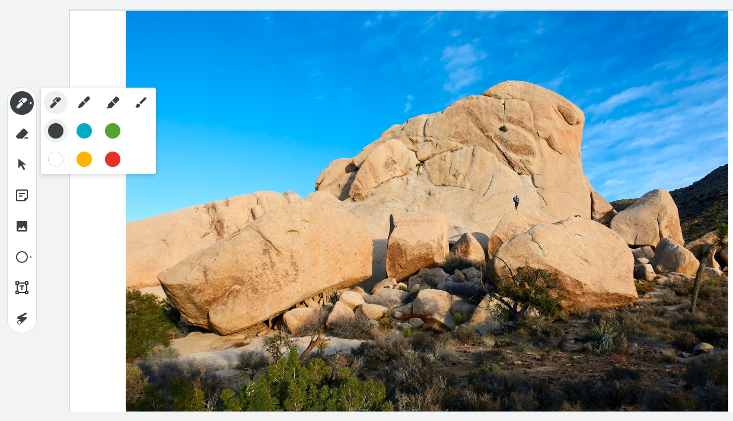
Let’s create a stickman

Slide 15
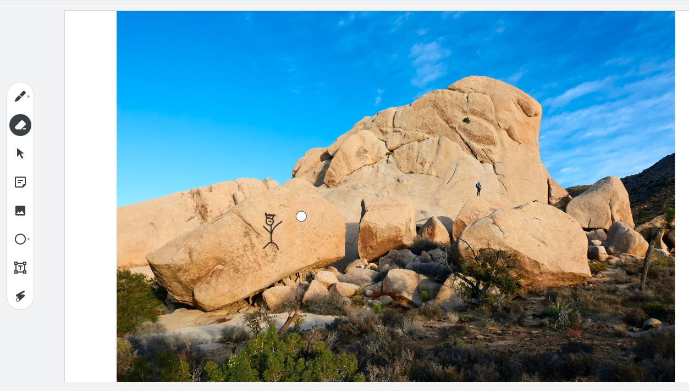
Erase errors

Slide 16
Carving cave paintings
Remember to…
Use different shapes and symbols.
Create cave paintings understandable by others.
Use colors and be creative.

Slide 17
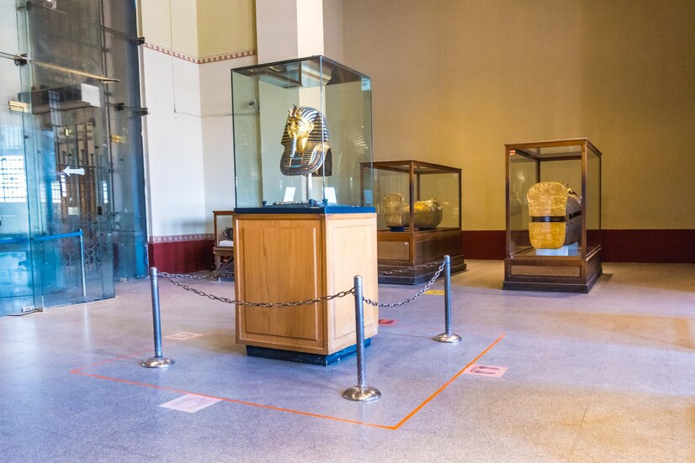
What’s a Museum

Slide 18
Cave painting Museum
It’s time to put all of our cave paintings on display, just like a real museum.
We will:
Walk around and see all the different cave paintings that everyone made!
Look at the cave painting and narrate the story behind it.

Slide 19
Rules for the Museum Walk
Move from one station to the next observing each other's cave painting.
Move to the next station when instructed by the teacher.
Do not touch or make changes to the art work.
Appreciate cave paintings you find amazing!

Slide 20
How to narrate the story?
Observe the elements in the cave painting.
Who are the characters in the painting? Can you describe them?
Where is the painting set? Can you describe the environment or setting?
What is happening in the painting? What are the characters doing?
Talk about what you think is happening in the cave painting.

Slide 21
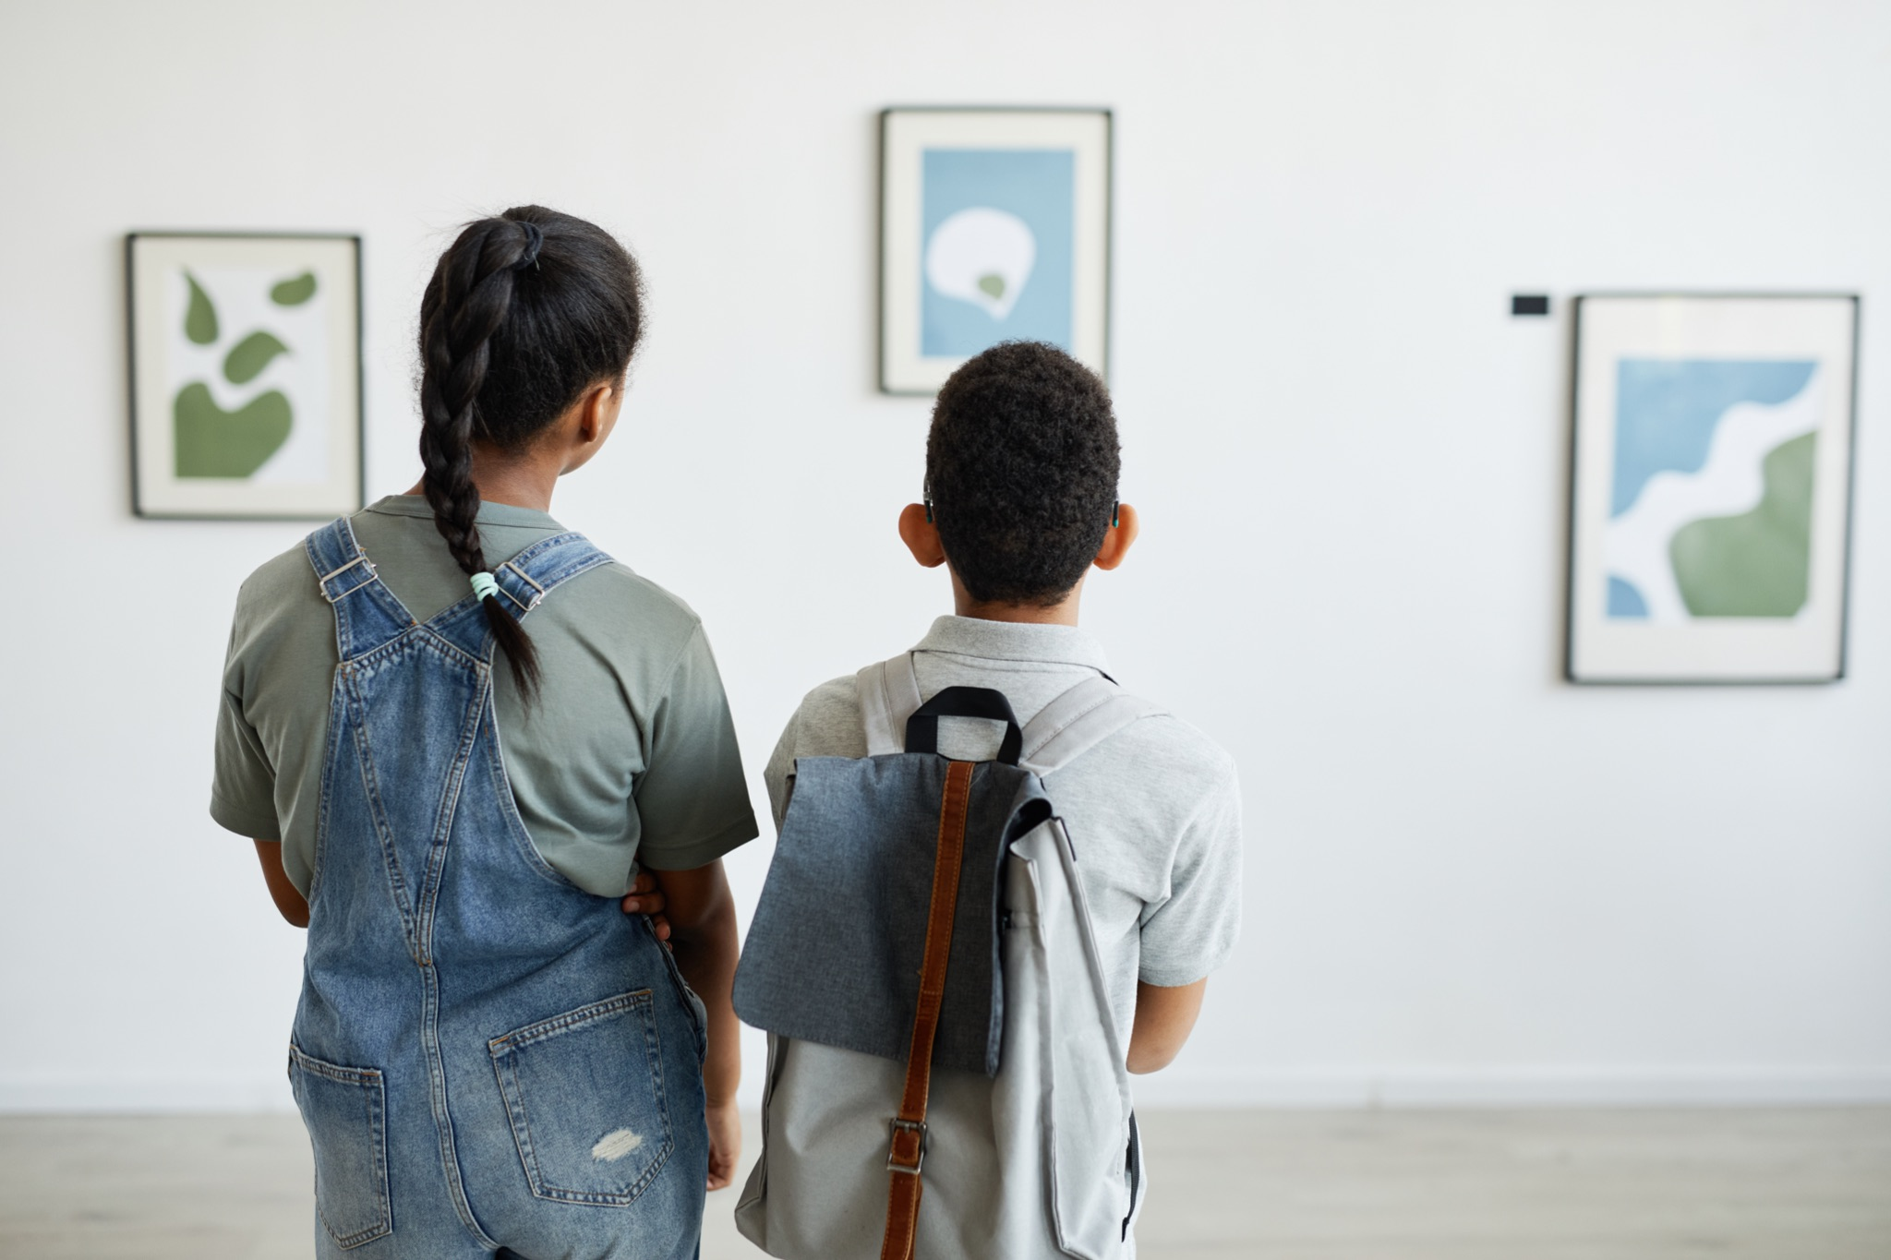
Museum Walk
It’s now time to share your creation with the rest of your class.

Slide 22
Let’s Summarize!
Share about your favorite cave painting .

Slide 23
Thank You
edm8ker is a fully owned brand of Makedemy Pte Ltd A member of the SL2 group of social enterprises.

