Slide 1
Science
Exploring the Parts of the Plant
First grade
120 Minutes

Slide 2
Overview
Introduce plant anatomy components: roots, stems, leaves, flowers, and fruits.
Use AutoDraw for interactive, creative learning.
Teach accurate identification and illustration of plant parts.
Develop practical knowledge of plant anatomy.
Encourage visual representation through AutoDraw.

Slide 3
Ground Rules
Be respectful of one another
Raise your hand if you have anything to share.
Listen attentively and follow instructions.
Complete tasks in given time

Slide 4
Let’s Collaborate
Notes:
Buyers and sellers

Slide 5
Team Roles
Project Manager
Resource Manager
Time Keeper
Help your team members to stick to their tasks!
Monitor what they are doing.
Collect materials and tools from the teacher.
Ensure team members are using them properly.
Return when you are done!
Keep track of time! Check the timer every few mins.
Help team members to complete the task on time.

Slide 6
Meet Emily and Alex, two young adventurers who recently discovered a mysterious plant in the heart of a dense jungle during their summer expedition.
They were astounded by the plant's unique appearance, but they had no idea what it was or its characteristics.

Slide 7
Let's unlock a plant's secrets as detectives in a thrilling botanical adventure of Emily and Alex.

Slide 8
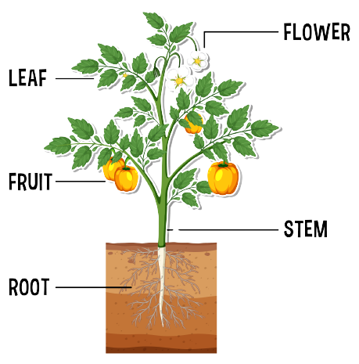
Let’s Help out Emily & Alex to find out the different parts of the plant

Slide 9
Flowers make seeds for new plants and provide food for many animals, like insects, birds, and people.

Slide 10
Stems are like the plant's backbone. They help it stand up and move water and nutrients around.

Slide 11
Leaves are green and make food for the plant from sunlight, water, and air. They're like the plant's kitchen!

Slide 12
Fruits help seeds move to new places when animals eat them.

Slide 13
The root holds the plant in place and drinks water from the ground.

Slide 14
Have you ever looked at the plants around you and noticed how they all have their unique features?

Slide 15
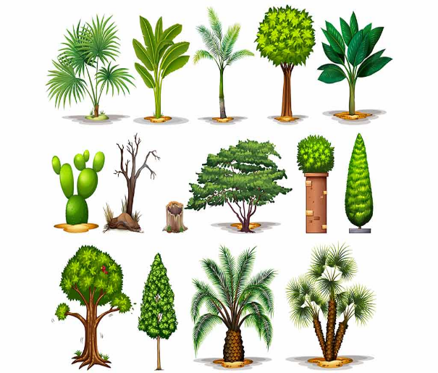
Different Kinds of Plant
Some have bigger roots, others longer stems, and some bloom into large, beautiful flowers.

Slide 16
What if we use your plant knowledge to assist Emily and Alex in recognizing the different plant parts in various kinds of plants?

Slide 17
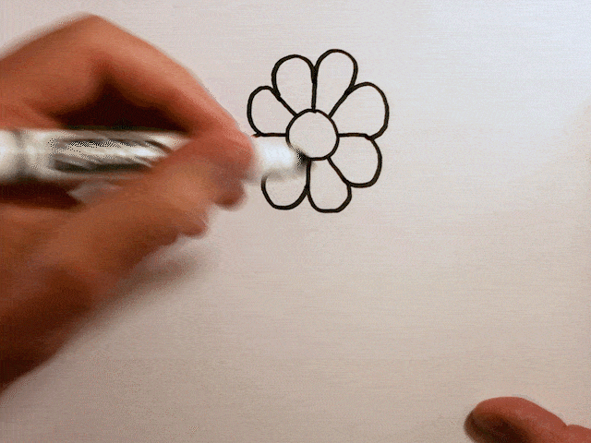
Plant Parts Art Challenge!
Choose a plant commonly seen in your surroundings to draw.
Be creative with colors and patterns.
Label your drawing with the plant parts names.

Slide 18
Introduction to Google AutoDraw

Slide 19
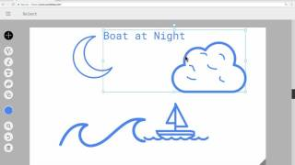
Guide to “Google AutoDraw”

Slide 20
Play time !
Open Google AutoDraw by clicking on the link
https://www.autodraw.com/

Slide 21
Exploring Our Tools!
To select the Image
To Autodraw the Image
To Manually draw the Image
To label the Image
To fill colors
To draw different shapes
To use different colors

Slide 22
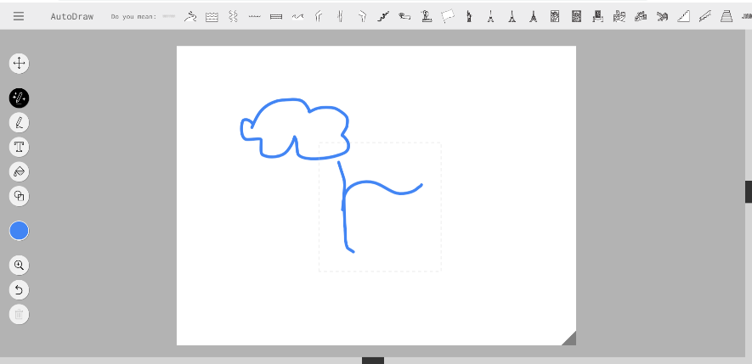
Start Drawing!
Get Inspired by AutoDraw Pattern Recognition
Using the drawing tools, students should start creating a visual representation of their chosen plant part.

Slide 23
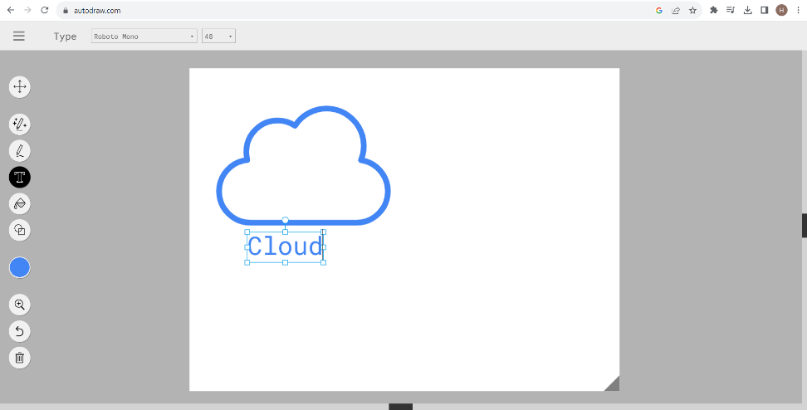
Label the Drawing!
Add a label to identify the parts of the plant they drew.

Slide 24
Share and Discuss
Learners can share their work with the class.

Slide 25
Timer

Slide 26
Presentation
Share your creation with your classmates.
Each student will get 2 minutes to present.
Present your creation.
Discuss the different parts of the plant and their functions.

Slide 27
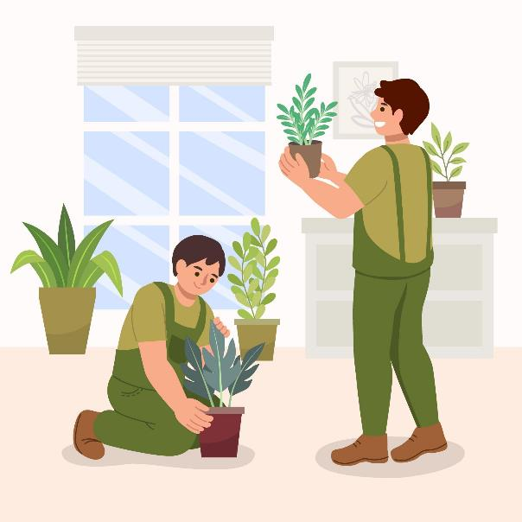
My Plant Anatomy Exploration
Bring a plant from home, nurture it, and see if you can identify its different parts.

Slide 28
Thank You
edm8ker is a fully owned brand of Makedemy Pte Ltd A member of the SL2 group of social enterprises.

