Slide 1
Student Handout
Making the future of young minds

Slide 2
Food Chain
Activity I:
Only plants A and B selected as producers.
Answer the questions below.
 | Plant A | Plant B
Starting Population
Ending Population
Which plant species survived after 100 days of running the simulation?
Plant A
Based on your answer above, why do you think that plant species was able to survive? (Hint: Think about plants that steal resources from other plants)
Plant A is stronger and more common than B. It took all the
Resources and hence plant B was not able to survive.

Slide 3
Food Chain
Activity II:
Plants A and B selected are producers.
Herbivore A eats plant A.
Answer the questions below.
 | Plant A | Plant B | Herbivore A
Starting Population
Ending Population
Which plant species is the boss here? Explain
Plant B
Does adding the herbivore A(which eats plant A) helps plant B to survive? Why does this happen?
Herbivore A helps to remove some of Plant A in the ecosystem by eating them which hinders the growth of Plant A population, allowing B to grow.

Slide 4
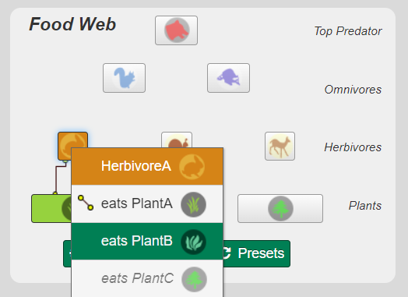
Food Chain
Activity III:
Plants A and B selected are producers.
Herbivore A eats plant B.
What is your key observation? Why did this happen?
Also immediately, Plant B population has been reduced to zero, followed by Herbivore A. Since Plant A and Herbivore A reduces population of Plant B, plant B population keeps decreasing. And when population of plant B is zero, Herbivore B have no more food supply and thus their population has been reduced to zero as well, leaving Plant A as the only surviving creature in the ecosystem.

Slide 5
Food Chain
Activity IV:
Plants A and B selected are producers.
Herbivore A eats plant A.
Omnivore A eats Herbivore A
The Top Predator eats Omnivore A
Predict whether the population of different organisms will increase/decrease.
Run the simulation, note the actual observation
 | Plant A | Herbivore A | Omnivore A | Top Predator
Prediction | Decreases | Decreases | Decreases | Increases
Simulation 1 | Decreases | Increases | Increases | Decreases
Simulation 2 | Decreases | Increases | Increases | Decreases
Is this ecosystem balanced? Why do you think so?
All species have survived and managed to maintain their population at a certain level

Slide 6
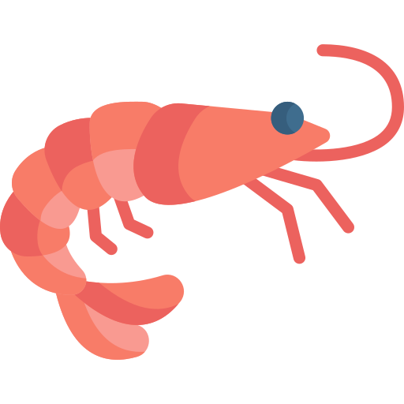
Food Chain
Different types of ecosystems will have different food chains. Below are some organisms found in the ocean.
Try to draw a food chain using these organism.
Shark (Predator)
Small Fish (Omnivore)
Shrimp (Herbivore)
Seaweed
(Producer)
Shark
Seaweed
Small Fish
Shrimp

