Slide 1
Unleashing the Power of Personification!
60 minutes

Slide 2
Objectives
Identify examples of personification in literary texts.
Explain the purpose and effect of using personification in writing.
Produce original examples of personification in written and visual forms.

Slide 3
Ground Rules
Be respectful of one another. Listen to your teammates.
Raise your hands if you have anything to share.
Listen attentively and follow instructions.
Complete tasks in
given time

Slide 4
Read the following sentences carefully
The sun’s rays warmed the earth, providing light to all living beings.
2. The sun smiled down upon the earth, bringing joy to all living beings.

Slide 5
Which sentence is more fun to read and why?

Slide 6
Personification
The second sentence is more fun to read as it uses personification.
Personification is a literary device in which human characteristics, qualities, emotions, or actions are attributed to non-human objects or ideas.
Through personification, writers breathe life into the non-human world, creating a deeper connection between the reader and the subject being described.

Slide 7
Example
The flowers nodded and smiled at the passing bees.
Can you think of any other ways to describe this image using personification?

Slide 8
Personified Playland!
30 minutes
Design a fun and imaginative scene using Genially.
For example, you can create a colorful world with talking animals, dancing flowers, and a friendly sun.
Add a personified description for each element within your scene.
Here is an example of a Personified Playland created using Genially. Tap on each element to view its description. Carefully observe how each element has been personified.

Slide 9
Rules
Form groups of 4 learners each.
Let your teacher guide you on how to use Genially.
Refer to the ground rules.

Slide 10
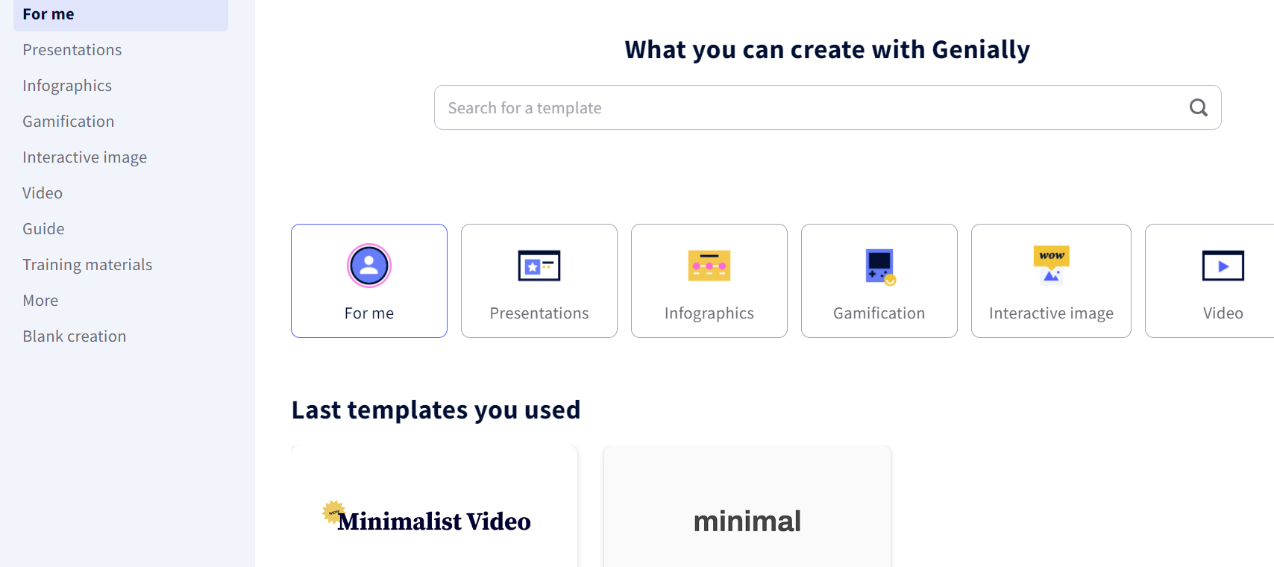
Genially
You can create a wide range of interactive content with Genially.
Choose the template that you think is appropriate for the activity.

Slide 11
Genially
To make your presentation interactive, explore the toolbar at the left of your screen and add exciting elements, such as text, images, resources (shapes, arrows), buttons, and backgrounds to your Personified Playland!

Slide 12
Project Manager
Resource Manager
Time Keeper
Presenters
Help your members stick to the task. Monitor what they are doing.
Collect materials and tools from the teacher. Ensure team members are using them properly. Return when you are done!
Keep track of time and help your teammates stick to the time limit.
Share your creation with the classmates and note down the feedback received.

Slide 13
Personification Showcase!
20 minutes
Now that you are done creating a playland, present your personified creations to the rest of the class.
To make it more fun, act as the personified elements.
For example, if the sentence is “The wobbly table sighed with relief as the meal came to an end.” One of the group members must act as the wobbly table.

Slide 14
Reflection
Did creating personified scenes enhance your understanding of storytelling and visual communication?
What emotions did the personified elements evoke within you? Did they create a sense of wonder or excitement?
How did the use of Genially as a tool for creating this scene contribute to your understanding of design and creativity? Did it inspire you to explore other ways to express your ideas?

Slide 15
Thank you!
edm8ker is a fully owned brand of Makedemy Pte Ltd
A member of the SL2 group of social enterprises.

