Slide 1
CHSA Summer School - Physics and Engineering
Day 1: Solar Charger

Slide 2
When was the last time you went camping, and did you face any challenges regarding powering your electronic devices or keeping them charged during that trip?

Slide 3
The challenge
ASK – RESEARCH – IMAGINE – PLAN – CREATE – TEST – IMPROVE
The widespread use of traditional power sources, such as disposable batteries or fuel-powered generators, during camping trips poses significant environmental concerns and limits access to reliable power sources. With the increasing popularity of camping and outdoor activities, there is an urgent need to transition towards sustainable and eco-friendly power solutions.
In this context, a pressing challenge is to design an efficient and portable solar charger that addresses the demand for reliable and environmentally-friendly power sources during camping trips.

Slide 4
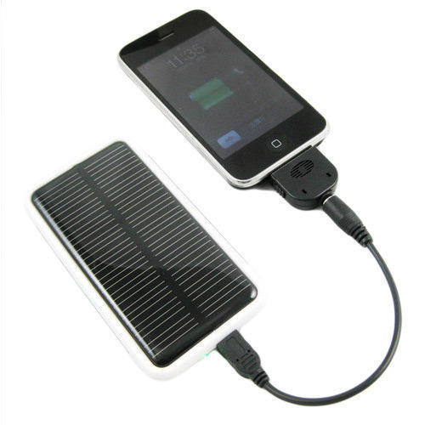
A safe and sustainable alternative: Solar Charger
ASK – RESEARCH – IMAGINE – PLAN – CREATE – TEST – IMPROVE
How does this work?
What should be the design specifications?
What do you think are the materials needed to create a Solar charger?

Slide 5
Design Specifications
ASK – RESEARCH – IMAGINE – PLAN – CREATE – TEST – IMPROVE
Design Specification | Description
Power Output | The solar charger should provide an optimal power output to efficiently charge electronic devices
Solar Panel Efficiency | The solar charger's solar panel should be designed to maximize sunlight absorption and energy conversion efficiency.
Portability | The solar charger should be designed to be lightweight and portable, allowing easy transportation during camping activities.
Charging Ports and Compatibility | The solar charger should feature compatible ports and connectors to accommodate a range of electronic devices.
Durability | The solar charger should be built to withstand outdoor conditions and be resistant to water, dust, and other environmental factors.
Cost-Effectiveness | The solar charger should be designed to be cost-effective.

Slide 6
Research

Slide 7
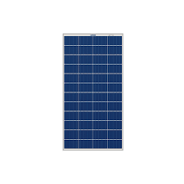
Different parts of a solar charger
ASK – RESEARCH – IMAGINE – PLAN – CREATE – TEST – IMPROVE
Buck converter
USB connector
Buck converter:
regulates and steps down the voltage from the solar panel to match the optimal voltage for charging electronic devices efficiently
Solar Panel: converts sunlight to electricity
USB connector:
To connect different devices for charging

Slide 8
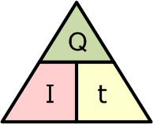
Quick Recap
1
3
2
Which triangle represents the Ohm’s law?

Slide 9
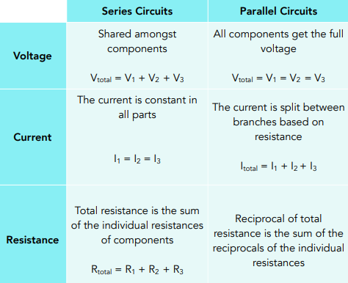
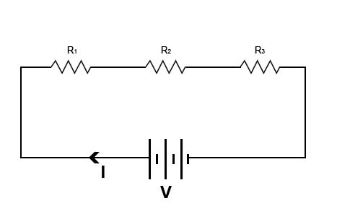
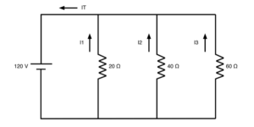
Quick Recap

Slide 10
Energy consumption
Calculate the cost of charging a mobile phone from 0 to 100%. The other details are given below:
Electricity rate: $0.12/kWh
Charging time: 2 hours from 0 to 100%
Mobile phone charger current rating: 2 Amps
Mobile phone charger voltage rating: 5 Volts

Slide 11
Energy consumption
Calculate the cost of charging a mobile phone from 0 to 100%. The other details are given below:
Electricity rate: $0.12/kWh
Charging time: 2 hours from 0 to 100%
Mobile phone charger current rating: 2 Amps
Mobile phone charger voltage rating: 5 Volts
Step 1: Calculate the power rating of the charger
P = V×I
= 2V×5A = 10 W
Step 2: Calculate the energy consumed in two hours
E = P×T
= 10W×2h = 20Wh = 0.02 kWh
Step 3: Calculate the cost of charging
Total cost = 0.02 kWh×0.12/kWh = 0.0024$

Slide 12
Numerical
A solar charger costs $30 and has a power output of 10 Watts. If the average cost of electricity is $0.15 per kilowatt-hour (kWh) and the wattage rating of a mobile charger is 5 Watts, calculate in how much time the cost of the solar charger will be recovered through savings in electricity. Assume the mobile charger is used twice a day to charge a phone.
Hourly energy consumption of the mobile charger = 5 Watts * 2 hours = 10 Watt-hours.
Daily energy consumption in kWh = 10 Watt-hours / 1000 = 0.01 kWh.
Daily cost savings = 0.01 kWh * $0.15/kWh = $0.0015.
Number of years to recover the cost = $30 / ($0.0015 * 365) = 5.48 years

Slide 13
The cost recovery period for a solar charger in this specific example is more than 5 years. So why to use it?

Slide 14
Why to use?
Long-term savings: Recover initial cost and save on electricity bills over time with solar charger's use of free solar energy.
Environmental impact: Reduce reliance on fossil fuels, lower carbon emissions, and contribute to a cleaner environment with solar power.
Independence and portability: Enjoy freedom from traditional power sources and charge devices on the go, ideal for outdoor activities and limited access to outlets.
Emergency preparedness: Stay connected during power outages or emergencies with a reliable backup power source from a solar charger.
Renewable energy transition: Support the growth of renewable energy technologies and a greener future by using a solar charger.

Slide 15
Exit ticket
Complete the exit ticket!!
In the next session, we will look into different types of solar panels and how they can be connected.

Slide 16
Thank You
edm8ker is a fully owned brand of Makedemy Pte Ltd A member of the SL2 group of social enterprises.

