Slide 1
CHSA Summer School - Physics and Engineering
Solar Lamp: Day 1

Slide 2
Welcome to the second unit

Slide 3
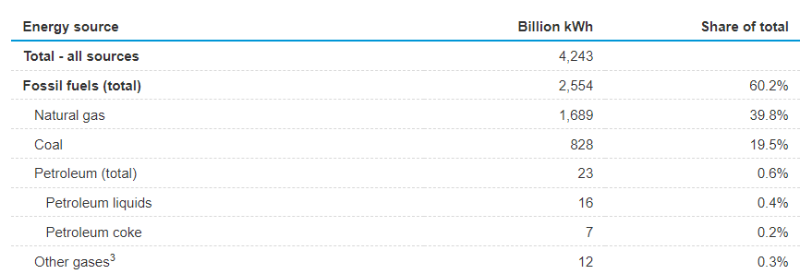
Fossil Fuel Dominance
In 2022, the United States generated approximately 4,243 billion kilowatt hours (kWh) (equivalent to about 4.24 trillion kWh) of electricity.
Majority of this electricity, approximately 60%, was generated from fossil fuels including coal, natural gas, petroleum, and other gases.
What alternative energy sources can reduce reliance on fossil fuels for electricity generation in the United States?

Slide 4
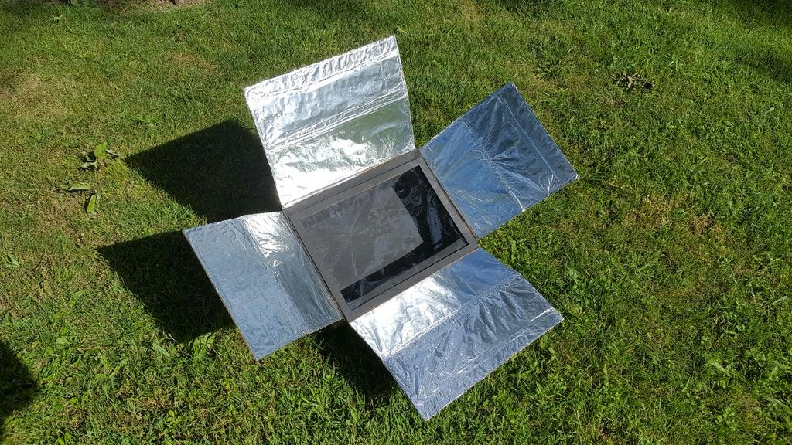
Solar Energy
In the previous unit, we utilized a solar oven to convert solar energy into heat energy.
In this unit, we will explore a new approach to harness solar energy for the production of electrical power/electricity.
What other technology or device can be used to harness solar energy and convert it into electrical power?

Slide 5
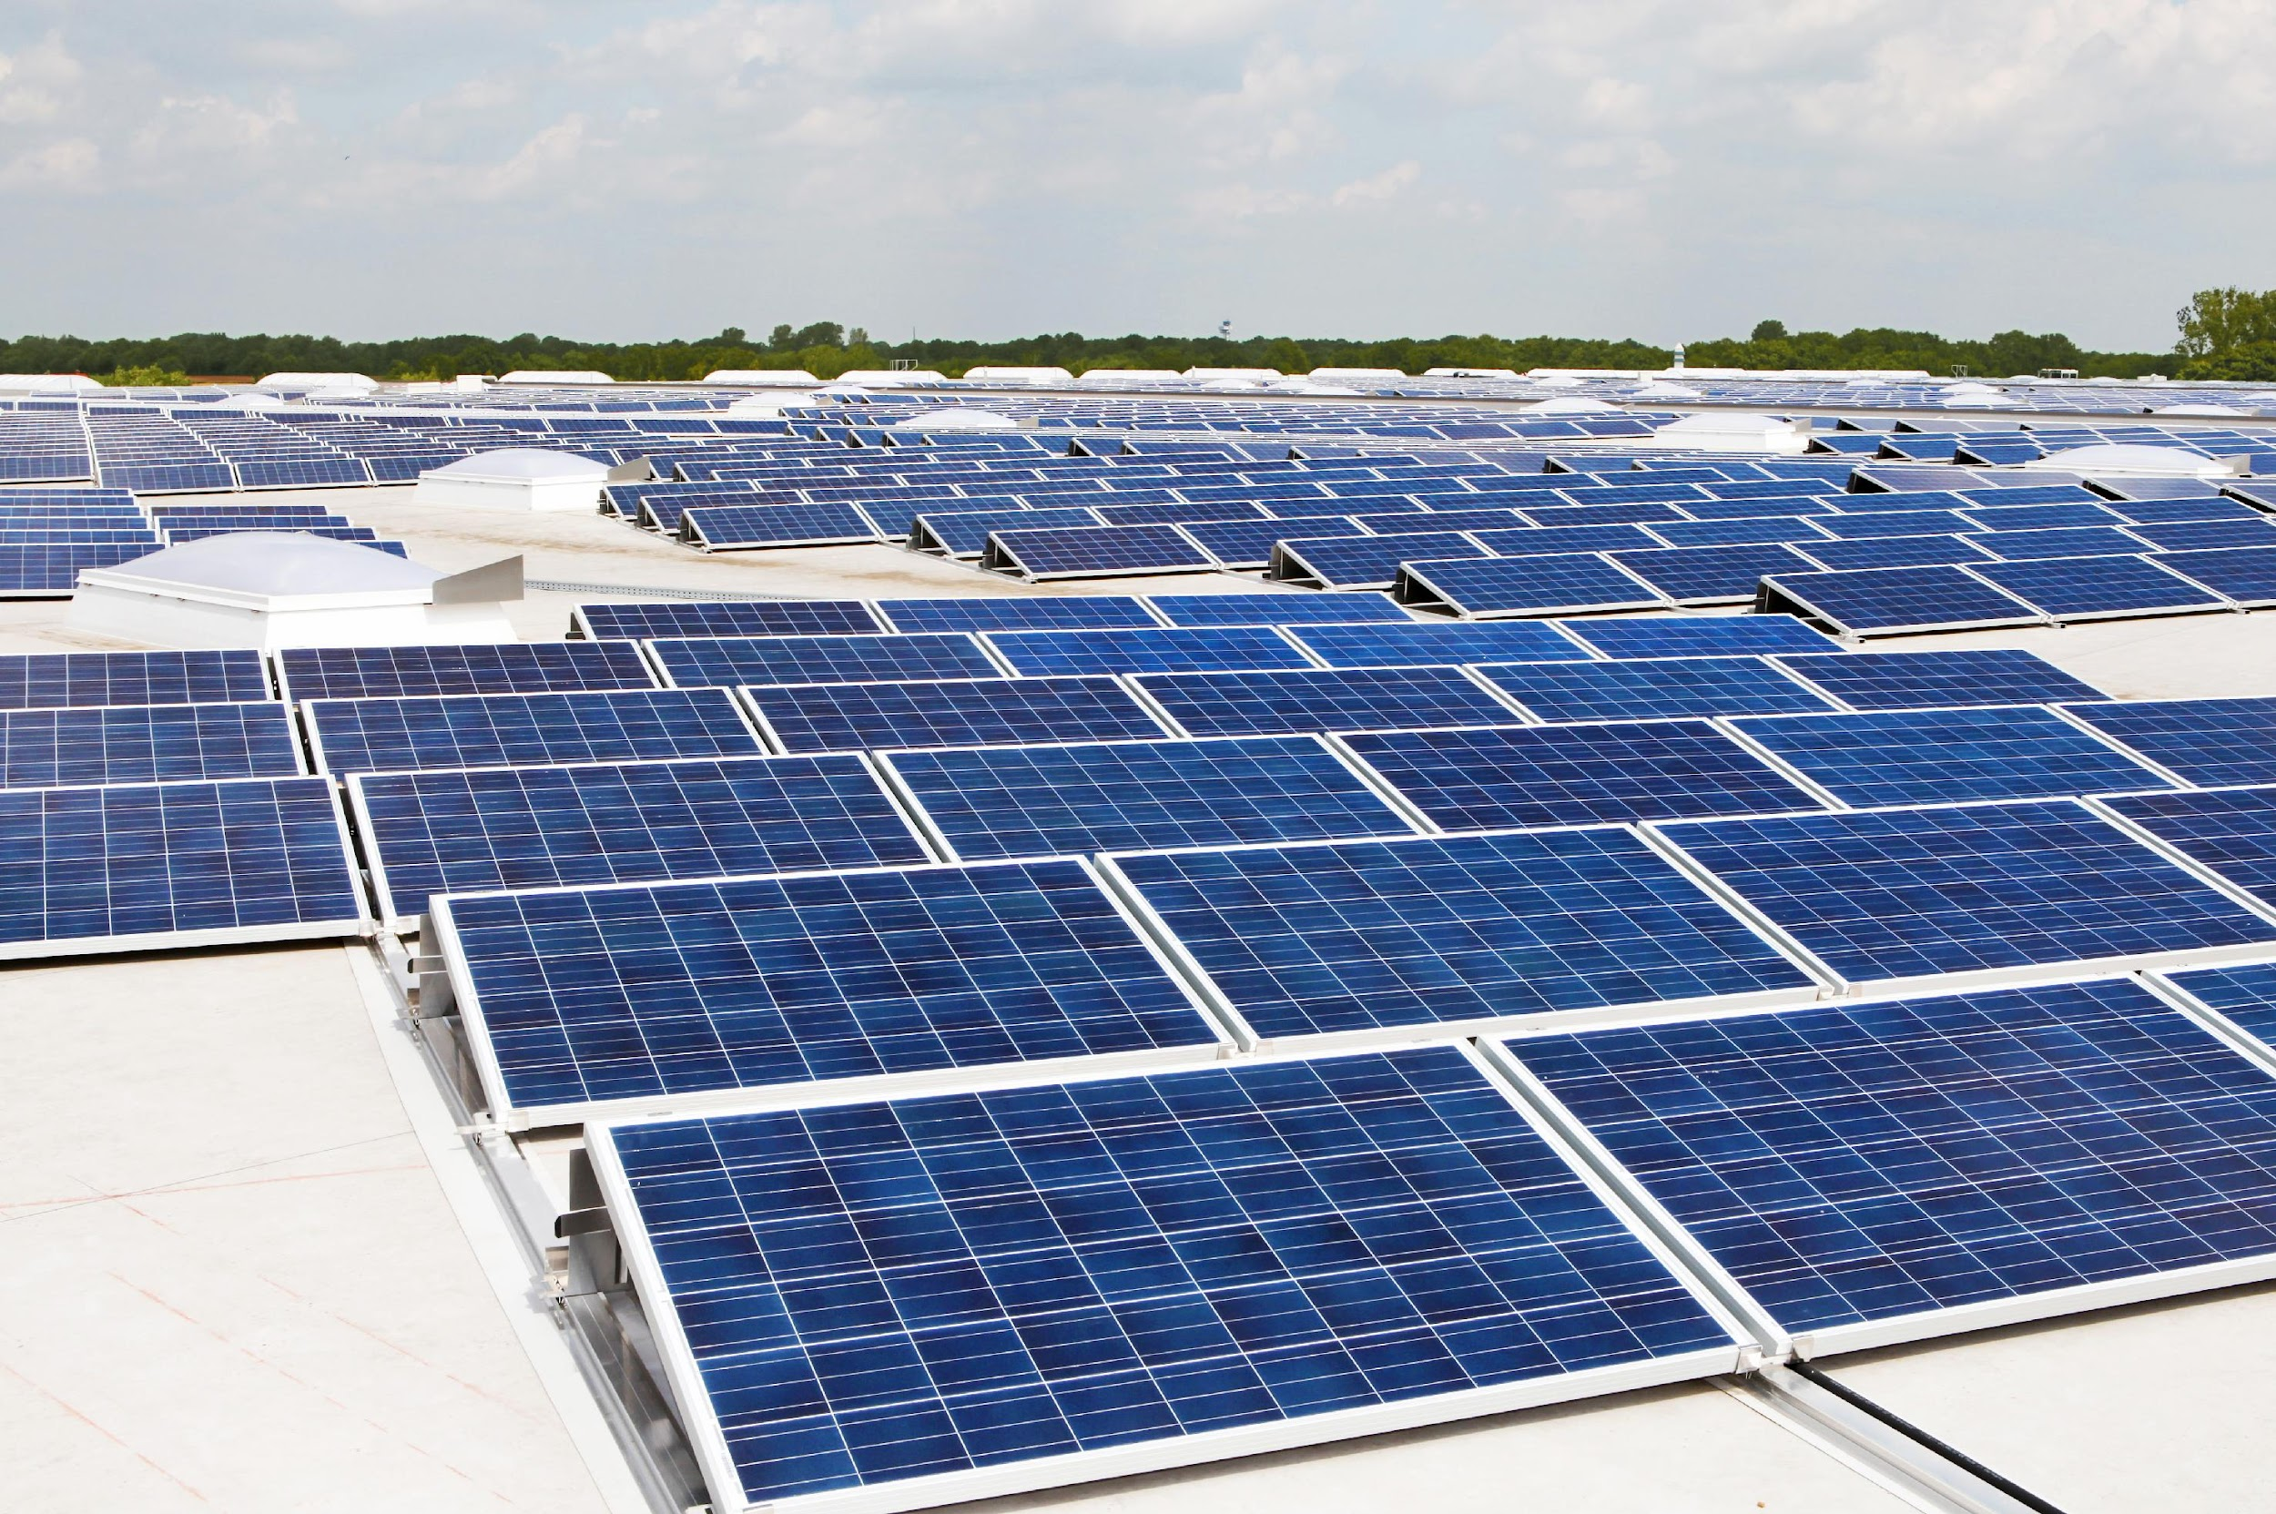
Solar Panels
Solar panels, also known as photovoltaic (PV) panels, are a promising technology for generating electricity from solar energy.
Now, let's take a moment to transport ourselves to a hypothetical scenario – a world without electricity – and reflect on the impact it would have on our lives.

Slide 6
A world without electricity
Imagine a world without electricity. Which aspect would you miss the most?
Light bulbs and electrical lighting
Smartphones and other electronic devices
All of the above! Can't imagine life without any of them.
None of the above. I'd be excited to embrace a technology-free world.

Slide 7
It's hard to imagine a world without electricity. But there are millions of people living without electricity.

Slide 8
ASK

Slide 9
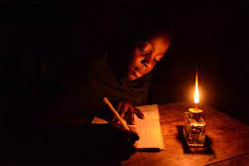
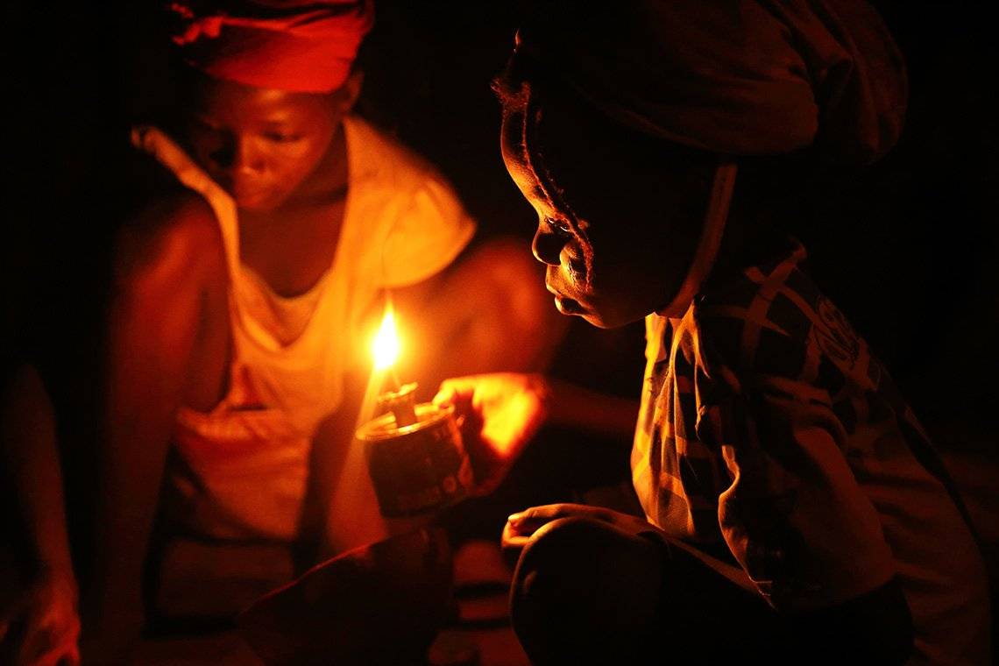
The challenge
ASK – RESEARCH – IMAGINE – PLAN – CREATE – TEST – IMPROVE
The widespread use of kerosene lamps in Uganda and other parts of Africa poses severe health, safety, and environmental risks. With millions of people lacking access to electricity, they rely on dangerous kerosene lamps that emit black carbon, contribute to climate change, and cause fires, resulting in injuries and fatalities. Urgent measures are needed to replace kerosene lamps with safe and sustainable lighting solution. This transition will improve lives, enhance education, promote healthier homes, and mitigate environmental harm.

Slide 10
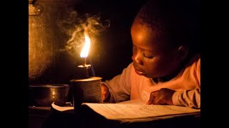
The challenge
ASK – RESEARCH – IMAGINE – PLAN – CREATE – TEST – IMPROVE

Slide 11
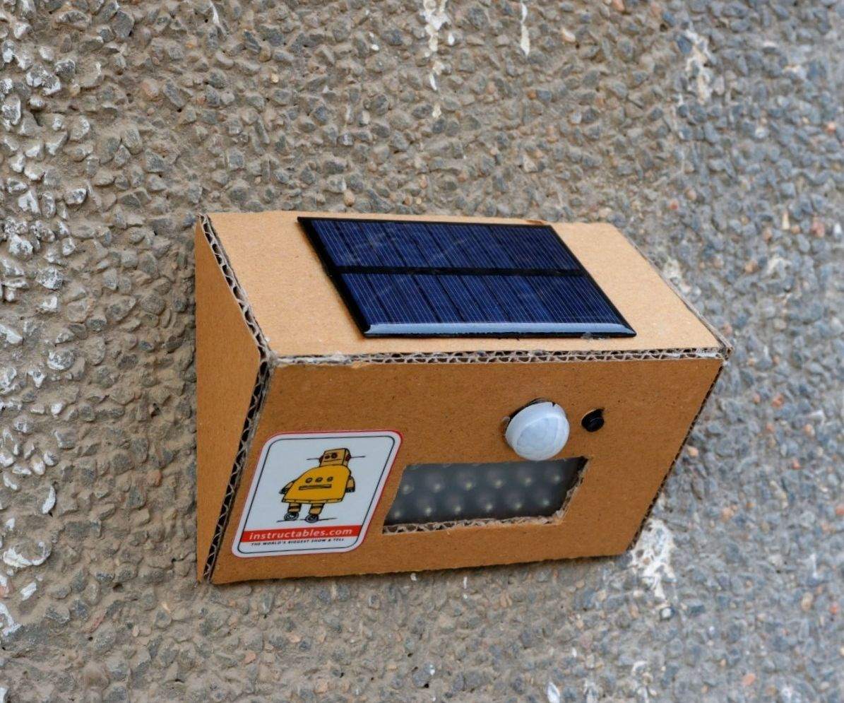
A safe and sustainable alternative: Solar Lamps!
ASK – RESEARCH – IMAGINE – PLAN – CREATE – TEST – IMPROVE
How does this work?
What should be the design specifications?
What do you think are the materials needed to create a Solar lamp?

Slide 12
Design Specifications
ASK – RESEARCH – IMAGINE – PLAN – CREATE – TEST – IMPROVE
Design Specification | Description
Light Output | The lamp should provide sufficient brightness for the intended use.
Battery Capacity | The lamp should include a rechargeable battery to store solar energy for use during nighttime or cloudy conditions.
Charging Time | The solar panel should efficiently charge the battery within a reasonable amount of time,
Operation Time | The lamp should provide illumination for a specified duration, such as 4-8 hours, after a full charge.
Durability | The lamp should be designed to withstand outdoor conditions, including resistance to water, dust, and impact.
Aesthetics | The design of the lamp should be visually appealing and suitable for the intended environment, considering factors like size, shape, and color.

Slide 13
Research

Slide 14
What is electricity?
ASK – RESEARCH – IMAGINE – PLAN – CREATE – TEST – IMPROVE
Current (I)
Electricity or current is a form of energy.
It involves the flow of electric charge, typically carried by electrons.
is measured in units called Amperes (A).
Ammeter is used to measure current.
Mathematically,
current: I = Q/t
The amount of charge (Q) flowing through a circuit per unit of time (t).
Flow of electrons
What makes these electrons move?

Slide 15
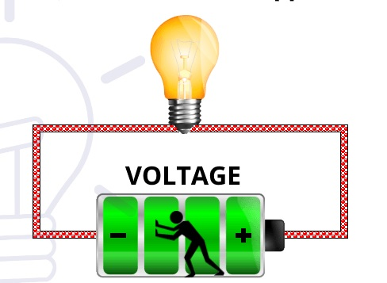
Voltage (V)
ASK – RESEARCH – IMAGINE – PLAN – CREATE – TEST – IMPROVE
Voltage, also known as potential difference, is like the "push" or "force" that makes electric charges move.
In an electrical circuit, voltage is created by a power source, such as a battery or a power outlet.
It is measured in units called Volts (V).
Voltmeter is used to measure voltage.

Slide 16
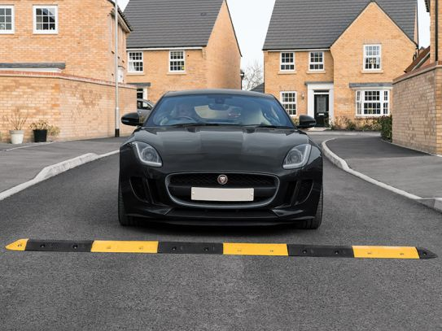
Speed Breakers
ASK – RESEARCH – IMAGINE – PLAN – CREATE – TEST – IMPROVE
Why are speed breakers used on roads?

Slide 17
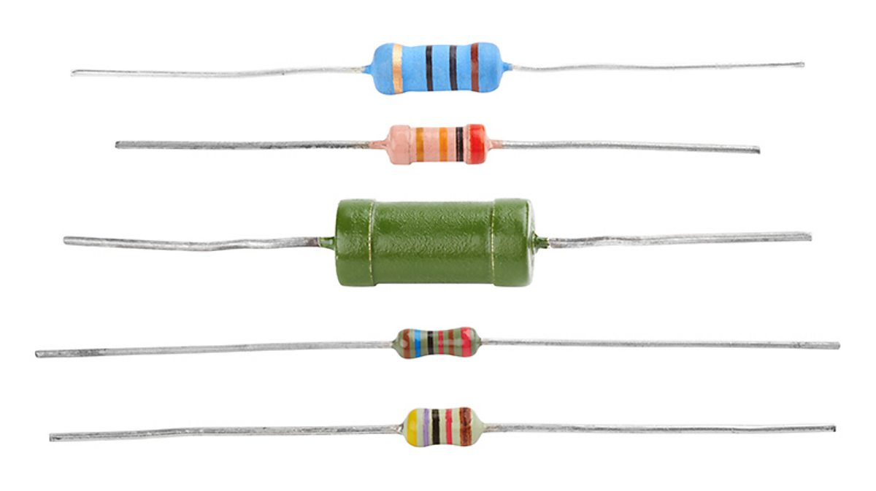
Resistance
Speed breakers act as obstacles that impede the speed of vehicles.
Similarly, in an electrical circuit, resistance is like a speed breaker that opposes the flow of electric current.
Resistance is measured in units called Ohms (Ω)
Resistors

Slide 18
How are current, voltage, and resistance related?

Slide 19
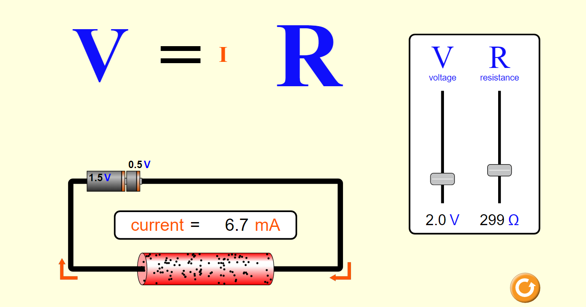
Ohm’s Law
ASK – RESEARCH – IMAGINE – PLAN – CREATE – TEST – IMPROVE
Resistance adjuster
Voltage adjuster
Fill the worksheet
Notes:
https://phet.colorado.edu/sims/html/ohms-law/latest/ohms-law_all.html

Slide 20
Ohm’s Law
ASK – RESEARCH – IMAGINE – PLAN – CREATE – TEST – IMPROVE
Ohm's Law states that the current in a circuit is directly proportional to the voltage applied to it and inversely proportional to the resistance of the circuit.
This means that if the voltage increases, the current will also increase, assuming the resistance remains constant.
Similarly, if the resistance increases, the current will decrease for a given voltage.
It can be summarized by the equation V = IR, where V represents voltage, I represents current, and R represents resistance.

Slide 21
Application of Ohm’s Law
ASK – RESEARCH – IMAGINE – PLAN – CREATE – TEST – IMPROVE
Circuit Design: Ohm's Law is fundamental in designing and analyzing electrical circuits, helping to determine resistor values, current flow, and voltage drops.
Electrical Safety: Ohm's Law is used to calculate current in a circuit, ensuring that components and wiring can handle the current safely and prevent overheating or damage.
Troubleshooting Circuits: Ohm's Law is applied when diagnosing faults in circuits, helping to identify issues such as open circuits, short circuits, or abnormal voltage/current behavior.

Slide 22
Summary
Current: The flow of electric charge in a circuit is called current. It is measured in amperes (A) and represented by the symbol "I.“
Voltage: The pushing force that drives electric charge in a circuit is called voltage. It is measured in volts (V) and represented by the symbol "V."
Resistance: Resistance is the opposition to the flow of current in a circuit. It is measured in ohms (Ω) and represented by the symbol "R."
Ohm's Law: Ohm's Law states that the current flowing through a conductor between two points is directly proportional to the voltage across the two points, and inversely proportional to the resistance. It can be expressed as I = V/R, where I is the current, V is the voltage, and R is the resistance.

Slide 23
Thank You
edm8ker is a fully owned brand of Makedemy Pte Ltd A member of the SL2 group of social enterprises.

