Slide 1
CHSA Summer School - Physics and Engineering
Day 2: Solar Charger

Slide 2
What will we be doing today?
Explore different types of solar panels.
Understand what happens when they are connected in series/parallel.

Slide 3
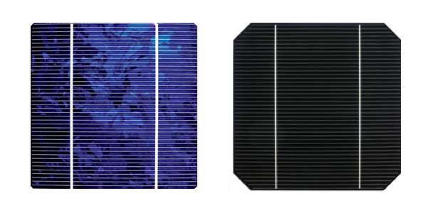
Spot the difference

Slide 4
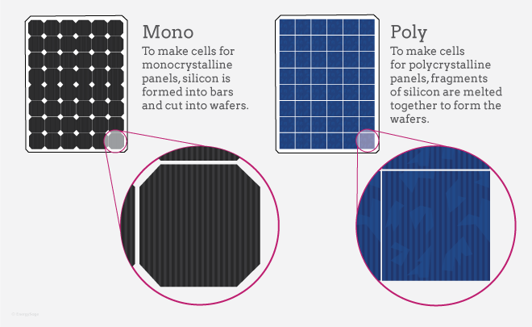
Different types of solar panels

Slide 5
Polycrystalline VS Monocrystalline
Aspect | Polycrystalline | Monocrystalline
Appearance | Speckled or mottled blue | Uniform black or dark color
Efficiency | Slightly lower (typically 15-17%) | Higher (typically 18-20%)
Cost | Relatively lower cost per watt | Relatively higher cost per watt
Durability | Generally durable and long-lasting | Generally durable and long-lasting
Overall Performance | Reliable and cost-effective choice for most applications | Higher efficiency and performance, preferred for space-constrained installations or applications with higher energy requirements

Slide 6
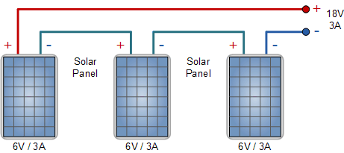
Similar solar panels in series
When solar panels are connected in series, their voltages add up to produce a total output voltage.
Connecting three 6-volt panels in series would result in an 18-volt output.
When multiple solar panels are connected in series, the total current output remains the same as the current output of each panel.
Here three 5A panels connected in series, the array will produce an output current of 3.0 Amperes.
Output Voltage = 18V
Output current = 3A
How to connect in series: Connect the negative terminal of each panel to the positive terminal of the next panel until you have a single positive and negative connection.

Slide 7
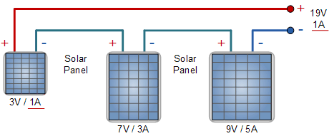
Solar panel with different ratings in series
The output current will be limited to the value of the lowest panel in the series, in this case, 1 Ampere.
Output Voltage = 19V
Output current = 1A

Slide 8
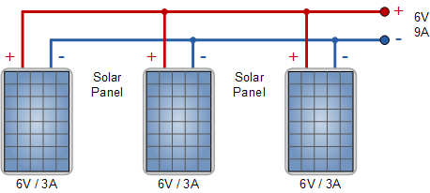
Similar solar panels in parallel
When connected in parallel, the voltage remains the same, while the current is added.
Output Voltage = 6V
Output current = 9A
How to connect in parallel: Connect all the positive terminals together (positive to positive) and all of the negative terminals together (negative to negative) until you are left with a single positive and negative connection.

Slide 9
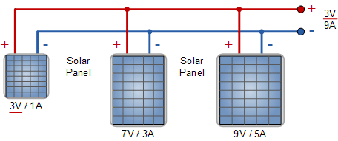
Solar panel with different ratings in parallel
The output voltage will be limited to the value of the lowest panel in the parallel, in this case, 3V.
Output Voltage = 3V
Output current = 9A

Slide 10
Numerical
Two solar panels with different ratings are connected in series. Calculate the time required to charge a 12-volt, 2000mAh battery. The ratings of the solar panels are given below:
Solar Panel 1: Rating: 5V, 300mA
Solar Panel 2: Rating: 6V, 400mA
Go to the worksheet and try solving this.

Slide 11
Numerical: solution
Two solar panels with different ratings are connected in series. Calculate the time required to charge a 12-volt, 2000mAh battery. The ratings of the solar panels are given below:
Solar Panel 1: Rating: 5V, 300mA
Solar Panel 2: Rating: 6V, 400mA
Step 1: Calculate the energy that the battery can store Energy = Power×Time
= (12V×2A)×(1h)
= 24 Wh
Step 2: Calculate the voltage and current rating of the parallel combination
Total voltage in parallel connection:
Total voltage = Voltage of the lowest-rated panel = 5V
Total current in parallel connection:
Total current = Current of Panel 1 + Current of Panel 2
Total current = 300mA + 400mA = 700mA

Slide 12
Numerical: Solution
Two solar panels with different ratings are connected in series. Calculate the time required to charge a 12-volt, 2000mAh battery. The ratings of the solar panels are given below:
Solar Panel 1: Rating: 5V, 300mA
Solar Panel 2: Rating: 6V, 400mA
Step 3: Calculate the Energy the solar panel can provide if exposed to sunlight for t hours
Energy = P×t
= (5V×0.7A)t = 3.5Wt
Step 4: Calculate the charging time
3.5Wt = 24Wh
t= 24Wh/3.5W
= 6.8 hours
Note: All these calculations are made using the assumption that the charging process is 100% efficient.

Slide 13
Exit Ticket
Complete the exit ticket.
For the next session:
Plan (Select the materials required to make the solar charger)
Use Tinkercad to design the outer casing.

Slide 14
Thank You
edm8ker is a fully owned brand of Makedemy Pte Ltd A member of the SL2 group of social enterprises.

