Slide 1
CHSA Summer School - Physics and Engineering
Solar Lamp: Day 2

Slide 2
What did we learn previously?
Understood the problem of kerosene lamps in some countries.
How to tackle the problem? (Using solar lamps)
What does the Ohm’s law states?

Slide 3
Agenda for today
Research: Understanding how solar cells work.
Research: Exploring the photoelectric effect and electrical power.

Slide 4
Can you think of some creative uses of solar panels? E.g. Solar panels seamlessly integrated into jewelry pieces generate electricity from sunlight, adding a touch of elegance and sustainability to fashion.

Slide 5
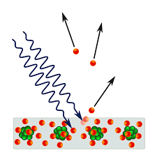
Introduction to the Photoelectric Effect
ASK – RESEARCH – IMAGINE – PLAN – CREATE – TEST – IMPROVE
The photoelectric effect is the phenomenon where electrons are emitted from a material's surface when light of sufficient energy (frequency) is incident upon it.
The effect was first explained by Albert Einstein in 1905 and is a fundamental concept in understanding the behavior of light and matter.

Slide 6
Some Key Terms
ASK – RESEARCH – IMAGINE – PLAN – CREATE – TEST – IMPROVE
Photons
Photons are particles of light. They carry energy and momentum.
The energy of a photon is given by the equation: E = hf
E represents energy.
h is Planck's constant (h ≈ 6.63 x 10⁻³⁴ J·s),
f is the frequency of light.

Slide 7
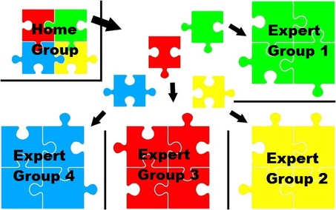
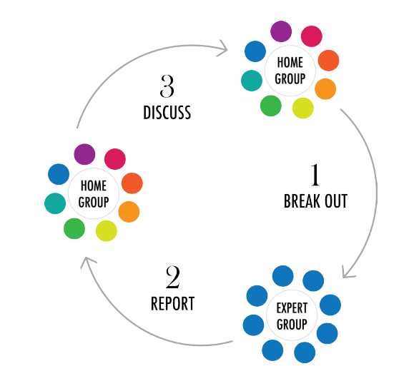
The Jigsaw Classroom

Slide 8
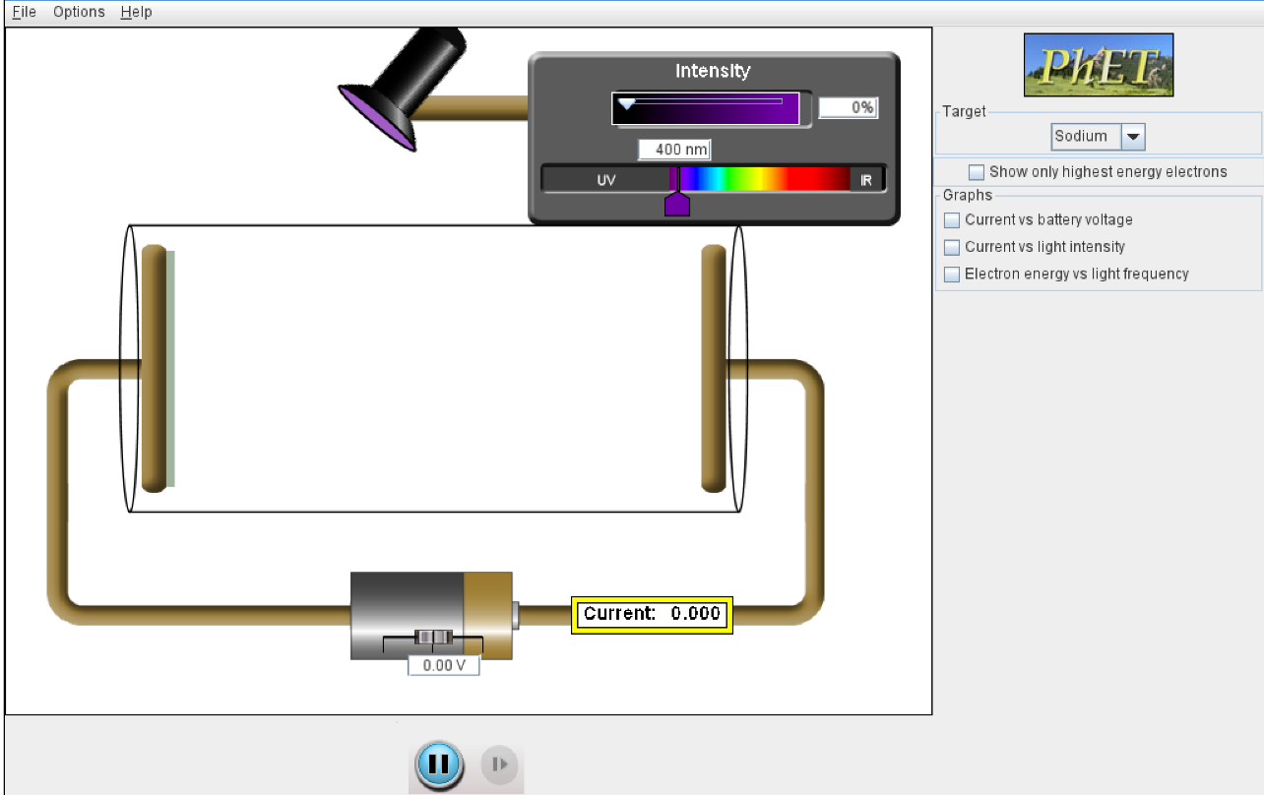
Simulating the PE Effect
ASK – RESEARCH – IMAGINE – PLAN – CREATE – TEST – IMPROVE
Adjust the intensity of the incident radiation.
Adjust the wavelength
Click on play.
Complete questions related to your assigned tasks in the worksheet.
Notes:
https://phet.colorado.edu/sims/cheerpj/photoelectric/latest/photoelectric.html?simulation=photoelectric

Slide 9
Regroup into Home Groups
Share your expertise and findings from your assigned tasks to your group members.
Complete the questions for the remaining tasks in your worksheet.

Slide 10
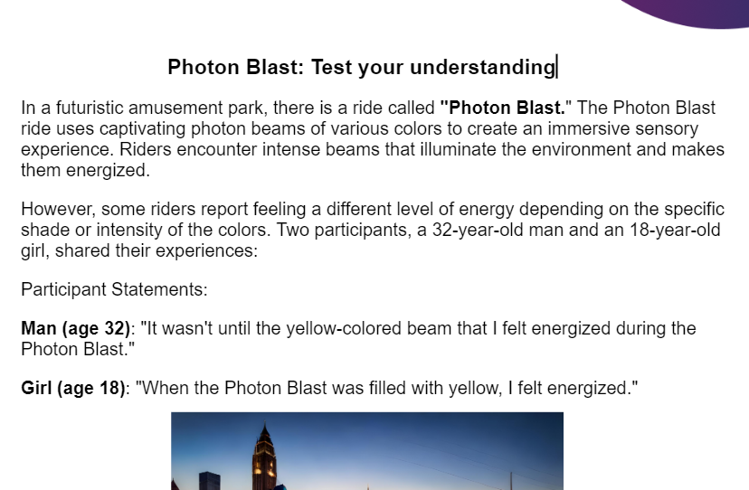
Photon Blast
Decode the mystery of the Photon Blast

Slide 11
The Photoelectric Effect: Summary
ASK – RESEARCH – IMAGINE – PLAN – CREATE – TEST – IMPROVE
If the light's frequency is below a certain threshold, no electrons are emitted. Increasing the frequency above the threshold leads to the emission of electrons with varying kinetic energies.
The intensity of light affects the number of emitted electrons (resulting in more electricity) but not their kinetic energy.
Work Function:
The work function (Φ) of a material is the minimum amount of energy required to remove an electron from its surface.
The work function is specific to each material.

Slide 12
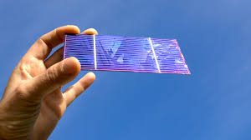
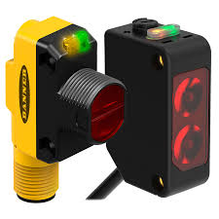
Applications
ASK – RESEARCH – IMAGINE – PLAN – CREATE – TEST – IMPROVE
The photoelectric effect has various applications:
Photocells: Used in solar panels to convert light energy into electrical energy.
Photomultiplier Tubes: Used to detect and amplify extremely weak light signals.
Photoelectric Sensors: Used in various devices like motion detectors, burglar alarms, and automatic doors.
Solar cell
Photoelectric sensor

Slide 13
Working of solar panels
ASK – RESEARCH – IMAGINE – PLAN – CREATE – TEST – IMPROVE
Structure
Solar panels are devices that use the photoelectric effect to convert sunlight into electricity.
A solar panel consists of multiple photovoltaic (PV) cells.
Each PV cell is made up of semiconductor materials, typically silicon, which exhibit the photoelectric effect.
Absorption of Sunlight
Sunlight, which consists of photons, is incident on the solar panel.
The photons carry energy (E = hf) and interact with the semiconductor material.
Electron Excitation
When a photon with sufficient energy strikes the PV cell, it can be absorbed by an electron in the material.
The absorbed energy allows the electron to overcome the work function (Φ) and become excited.
Generation of Electric Current
The excited electrons move freely through the semiconductor material and generate electric current.

Slide 14
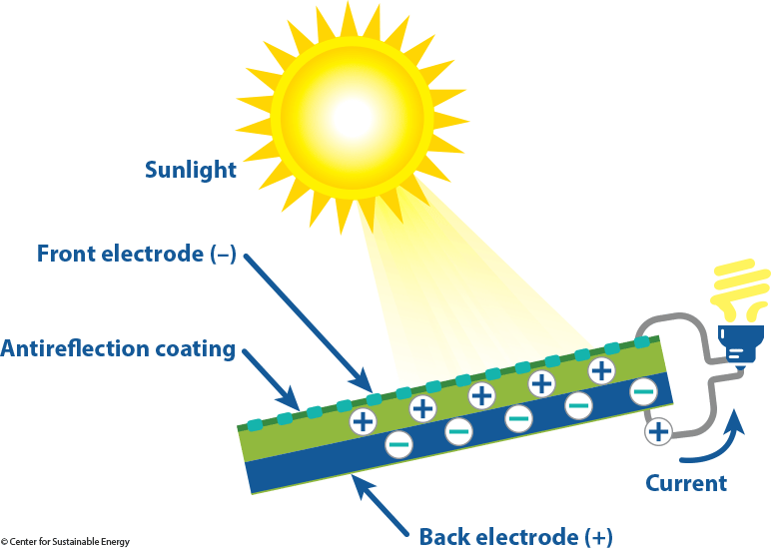
Working of solar panels
ASK – RESEARCH – IMAGINE – PLAN – CREATE – TEST – IMPROVE

Slide 15
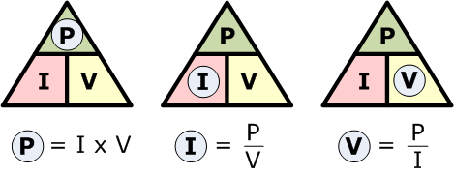
Power
ASK – RESEARCH – IMAGINE – PLAN – CREATE – TEST – IMPROVE
Electrical power refers to the rate at which electrical energy is transferred or consumed.
Power = Energy consumed/Time
The unit of measurement for electrical power is the watt (W).
To calculate electrical power, we use the formula P = VI, where P represents power, V (in Volts) represents voltage, and I (in Amperes) represents current.

Slide 16
Power and Ohm’s Law
ASK – RESEARCH – IMAGINE – PLAN – CREATE – TEST – IMPROVE
P = VI -------------- (1)
According to Ohm’s Law: V = IR
Putting it in equation (1)
P = (IR)I
P = I²R -------------- (2)
Additionally from the ohm’s law I = V/R
Putting it in equation (1)
P = V²/R -------------- (3)

Slide 17
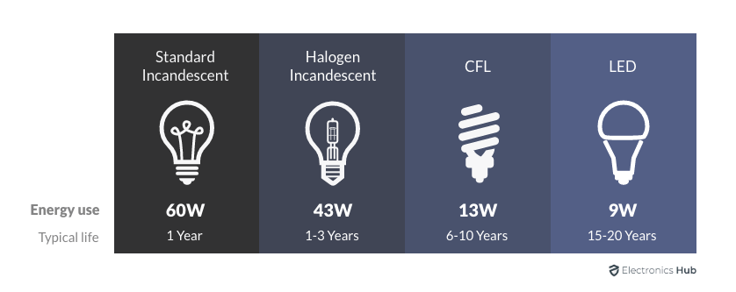
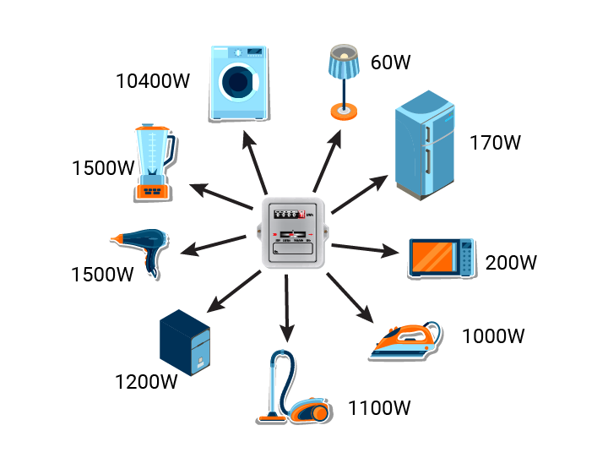
Power Ratings
ASK – RESEARCH – IMAGINE – PLAN – CREATE – TEST – IMPROVE

Slide 18
Which is better?
ASK – RESEARCH – IMAGINE – PLAN – CREATE – TEST – IMPROVE
60W incandescent bulb:
Consumes 60 watts of power.
Produces both light and heat as output.
Incandescent bulbs are known for their lower efficiency because a significant portion of the input power is converted into heat rather than light.
9W LED bulb:
Consumes 9 watts of power.
Produces light as the primary output.
LED bulbs are known for their higher efficiency as they can convert a larger portion of the input power into useful light, resulting in less wasted energy in the form of heat.

Slide 19
Exit Ticket
Fill out the exit ticket.
In the next lesson, we will design our solar lamp.

Slide 20
Thank You
edm8ker is a fully owned brand of Makedemy Pte Ltd A member of the SL2 group of social enterprises.

