Slide 1
CHSA Summer School - Physics and Engineering
Day 3: Solar Lamp

Slide 2
Agenda for today
Learn the basics about series and parallel circuits.
Solve some numerical problems.
IMAGINE: research about different factors related to solar lamps.
PLAN: Design your solar oven!

Slide 3
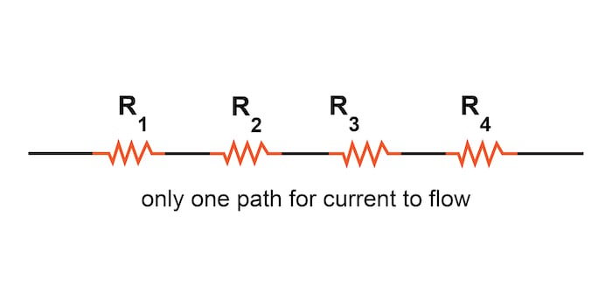
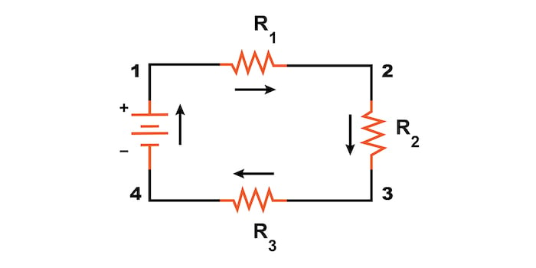
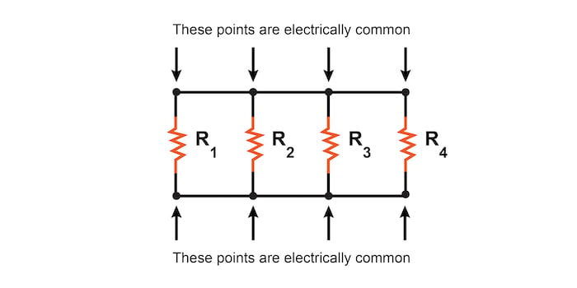
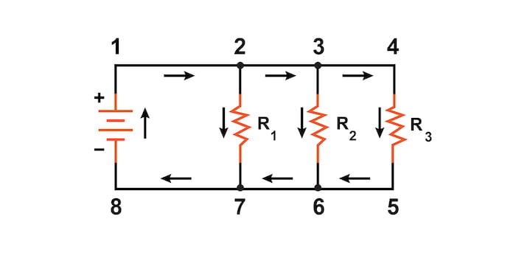
Series and parallel circuit
In a series circuit, components are connected one after another, forming a single pathway for the electric current to flow.
In a parallel circuit, components are connected across separate branches, providing multiple pathways for the electric current to flow.
Which type of circuit is likely to result in the failure of all components if one component fails?

Slide 4
Series: Key Features
Note: Bulbs in series are less bright due to shared voltage than in parallel.

Slide 5
Parallel: Key Features
Note: Bulbs in parallel circuits consume more electricity due to increased current flow.

Slide 6
Problem
A 12W bulb is connected to a 6V power source. Calculate the current drawn by the bulb.

Slide 7
Problem
A 12W bulb is connected to a 6V power source. Calculate the current drawn by the bulb.
We can use the formula: Power (P) = Voltage (V) × Current (I)
Given:
Power (P) = 12W
Voltage (V) = 6V
Step 1: Rearrange the formula to solve for current (I):
I = P / V
Step 2: Substitute the values into the formula:
I = 12W / 6V
Step 3: Perform the calculation:
I = 2A
Therefore, the current drawn by the 12W bulb connected to a 6V power source is 2A.

Slide 8
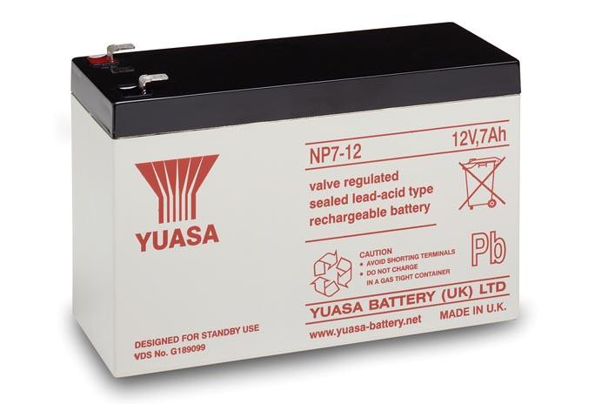
Problem
A battery has a capacity of 7Ah. How long can it power a 100W bulb before the battery is depleted?

Slide 9
Problem
A battery has a capacity of 7Ah. How long can it power a 100W bulb before the battery is depleted?
It's important to note that the capacity of a battery indicates the amount of energy/charge it can store and deliver. This value is used to estimate the runtime or operating time of a device powered by the battery, depending on the power consumption of the device.
I = Q/t
⇒ I×t = Q
⇒ 7A × 1h = 7Ah
It means it can power a device which draws a current of 7A for 1 hour.
Current drawn by the bulb = 100 W/12 V
= 8.33 A
Therefore, time for which it can power the bulb = 7Ah/8.33A
= 0.84 hours

Slide 10
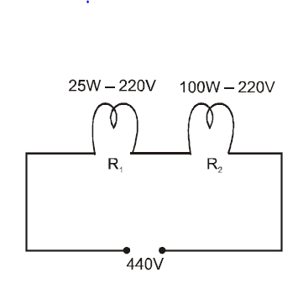
Problem
Two electric bulbs marked 25W−220V and 100W−220V are connected in series to a 440V supply. Calculate the current drawn by each of the bulb.

Slide 11
Problem
Two electric bulbs marked 25W−220V and 100W−220V are connected in series to a 440V supply. Calculate the current drawn by each of the bulb.
In a series circuit, the total current flowing is same as the current flowing through each components.
Therefore, I = I₁ = I₂ = 2/11 A
Note: Potential difference across the 25W bulb (V) =I₁R₁
= 2/11 A ×( 220²/25)
= 352 V
But the bulb is meant to operated at maximum 220 V. Hence it will fuse

Slide 12
Imagine

Slide 13
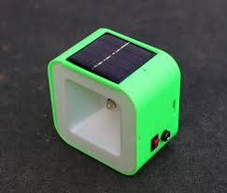
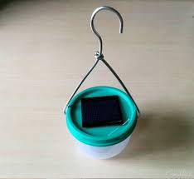
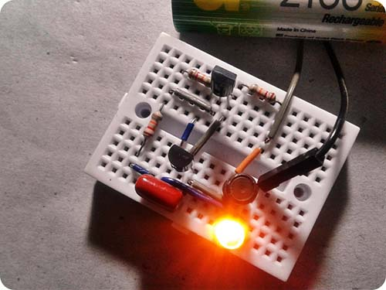
Different types of solar

Slide 14
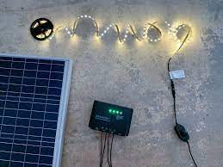
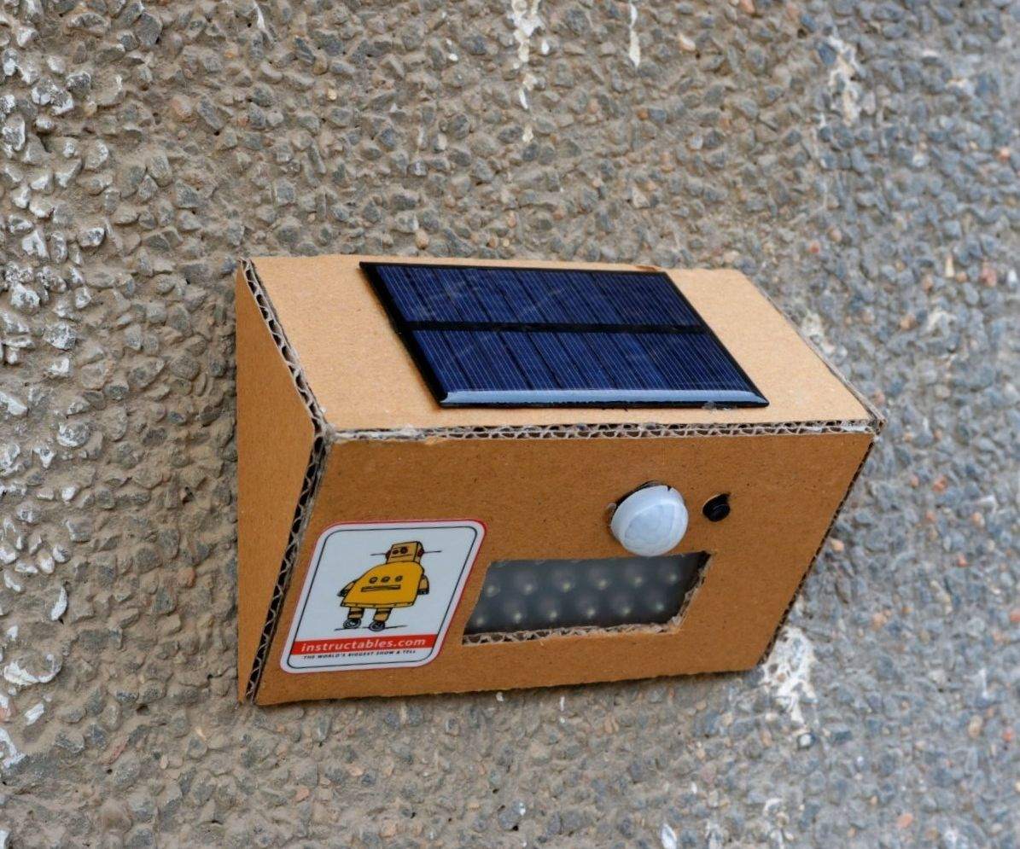
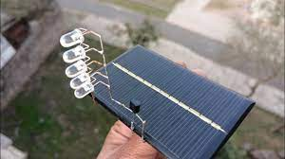
Different types of solar Lamps

Slide 15
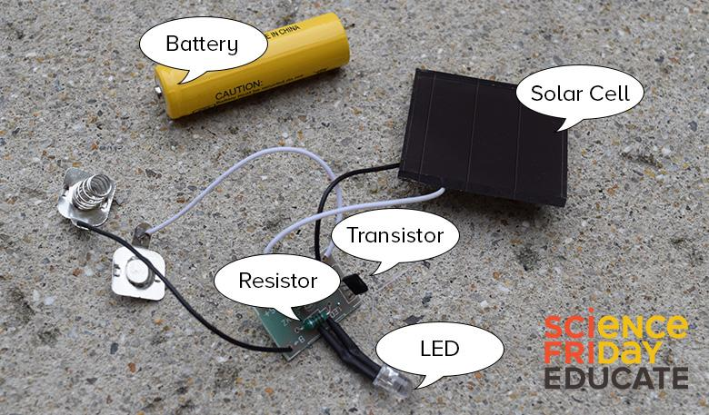
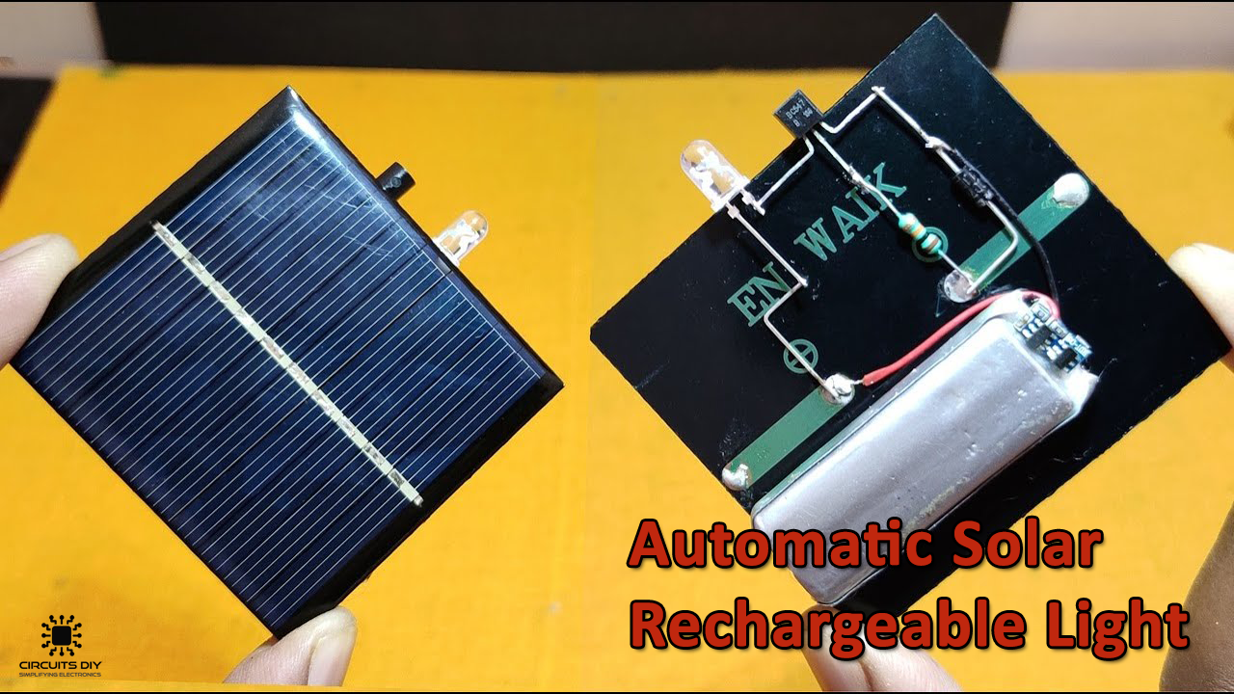
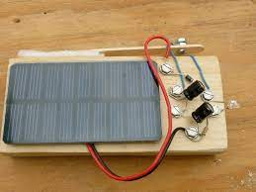
Different types of solar Lamps

Slide 16
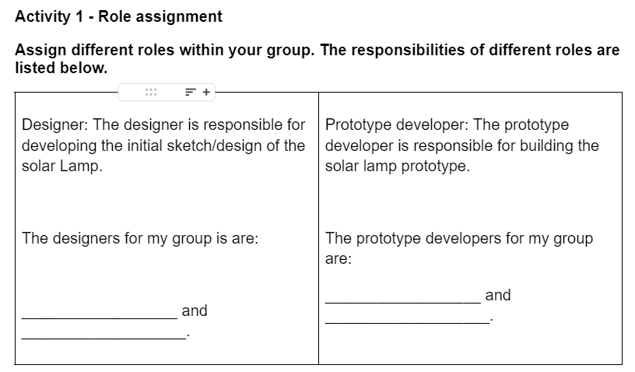
Role Assignments - Activity 1

Slide 17
Complete Activity 2 on your worksheet
ASK – RESEARCH – IMAGINE – PLAN – CREATE – TEST – IMPROVE
Individual research (15 mins)
Share with your group members thereafter (10 mins)
Focus on the features you’d like to incorporate into your design

Slide 18
Decision Matrix: Choosing the right materials
ASK – RESEARCH – IMAGINE – PLAN – CREATE – TEST – IMPROVE
Location of the solar panel
Type of LED bulbs
Material of the Casing
Battery Capacity
Control Mechanism
Wiring and Connectors:
Think of the recyclable materials which meet the needs and can be used
Complete Activity 3-6 on your worksheet

Slide 19
Exit ticket
Begin with a brief summary of the key concept learned, using clear language to convey your understanding.
Share your thoughts and opinions on the lesson, highlighting what you found interesting or engaging.
Pose any remaining questions or areas that require further clarification.
Use an authentic and respectful tone, and consider adding visual elements such as images or emojis to enhance your post.

Slide 20
Exit ticket
Complete the exit ticket and hand it in.
See you tomorrow!! We will be and building our solar lamps.

Slide 21
Thank You
edm8ker is a fully owned brand of Makedemy Pte Ltd A member of the SL2 group of social enterprises.

