Slide 1
CHSA Summer School - Physics and Engineering
Solar Charger: Day 4

Slide 2
What did we do previously?
Selected the materials to build the solar charger
Built a prototype for the the casing using Tinkercad

Slide 3
Agenda for today
Learn the basics of soldering.
CREATE: Using the materials available, prototype your solar charger.

Slide 4
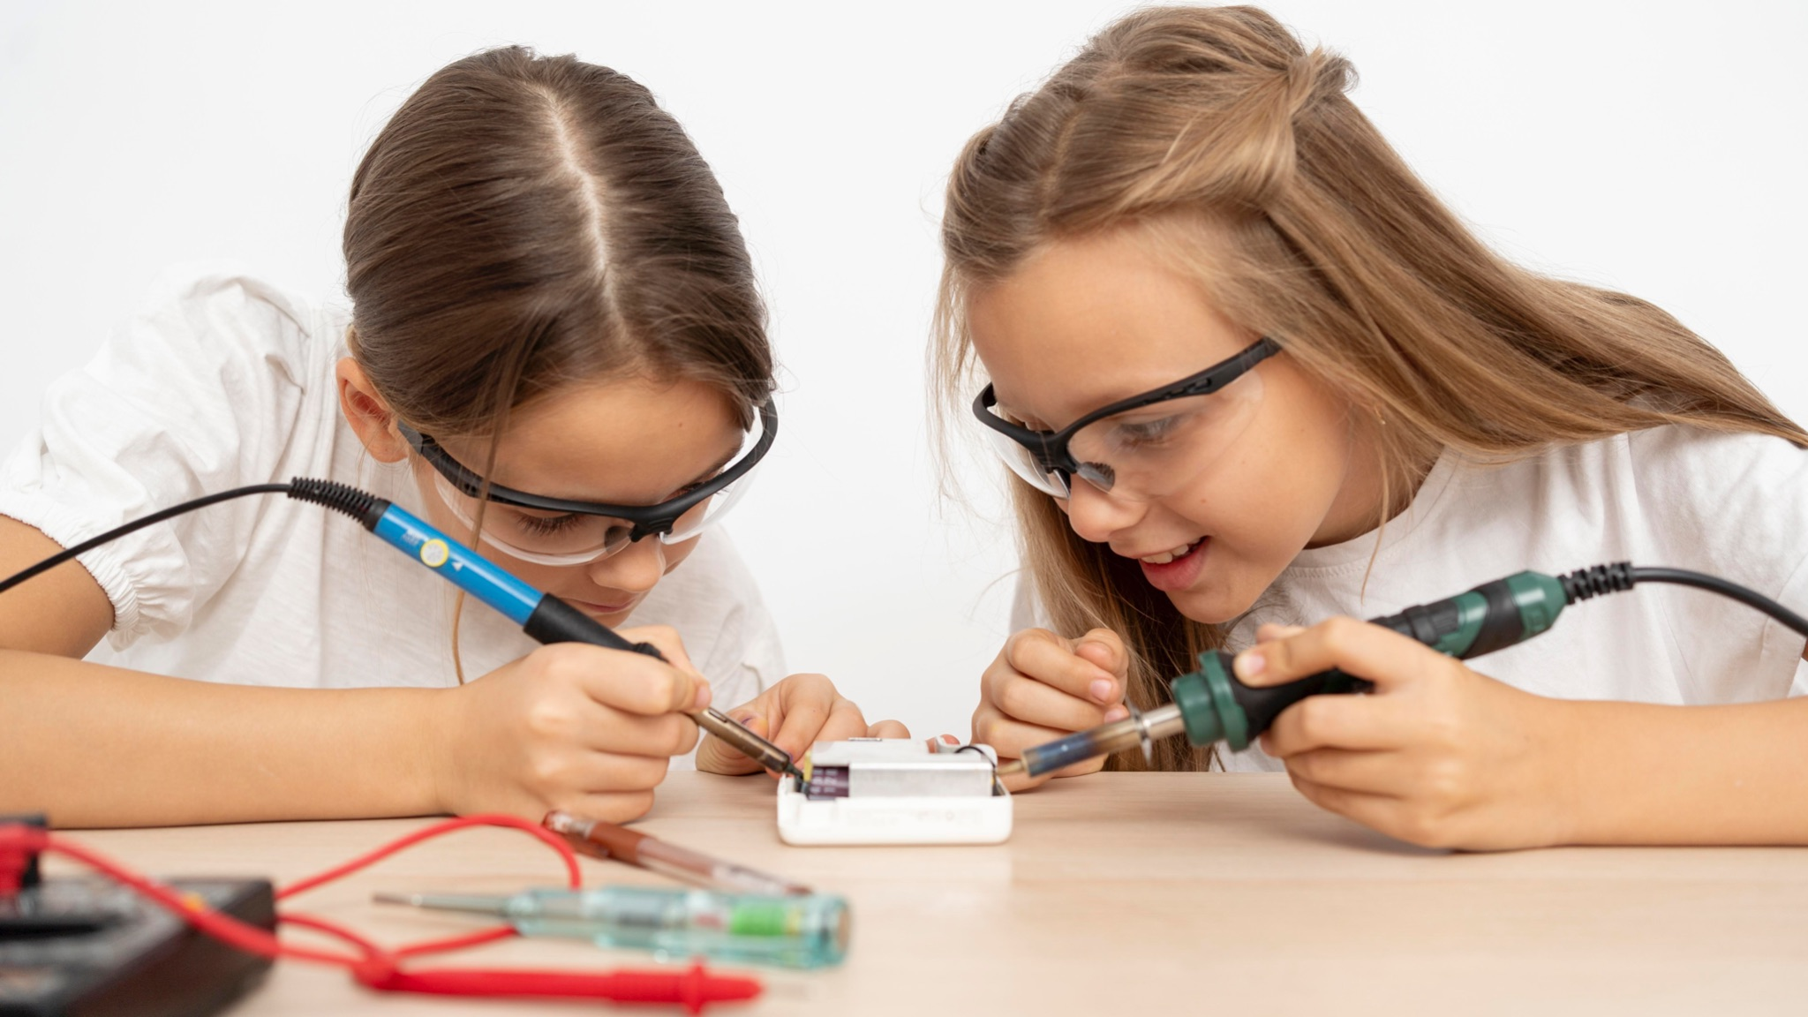
Let’s learn Soldering!

Slide 5
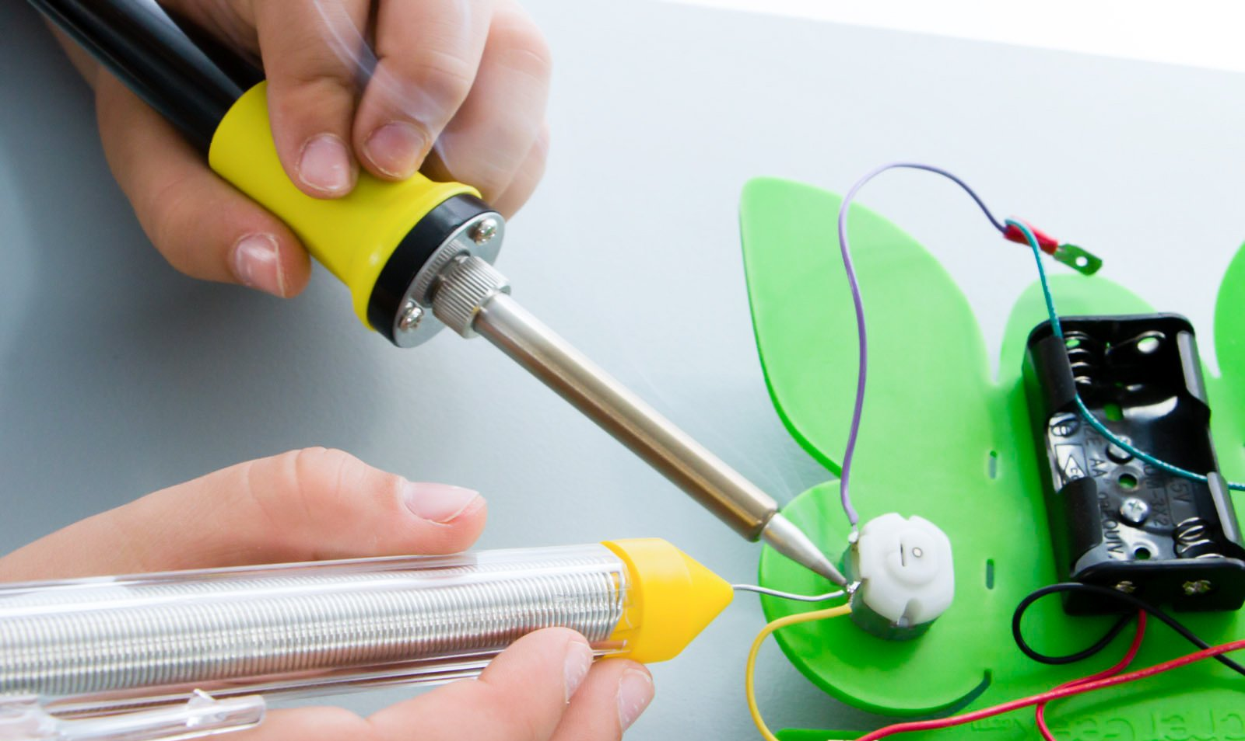
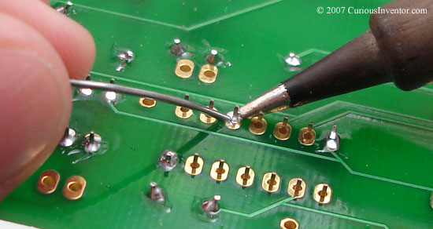
What is Soldering?
Soldering is a process of joining two or more pieces of metal or electronic components together using a low-melting point metal alloy called solder.
The solder is melted and then applied to the joint, where it cools and solidifies, forming a permanent bond.
Soldering is commonly used in electronics, plumbing, and jewelry making, among other fields.

Slide 6
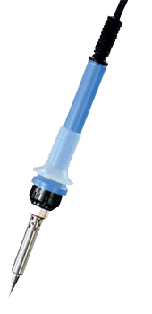
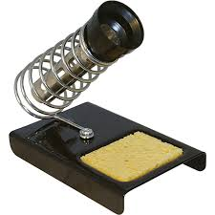
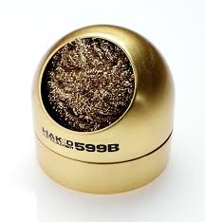
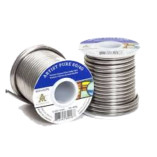
Soldering Essentials
Soldering Iron
Soldering Stand
Solder
Tip Cleaner

Slide 7
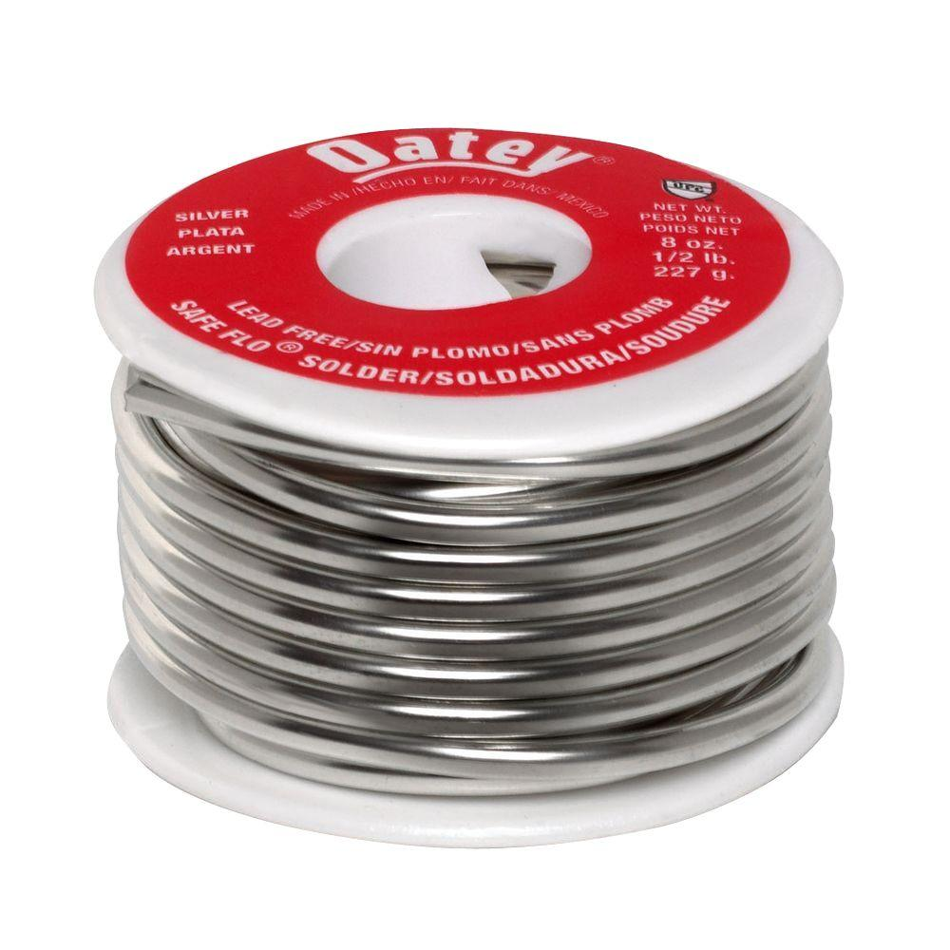
Solder
Metal “glue” used to join together metal parts.
Made of Tin and Copper, sometimes Lead.
Solder
(Filler metal)

Slide 8
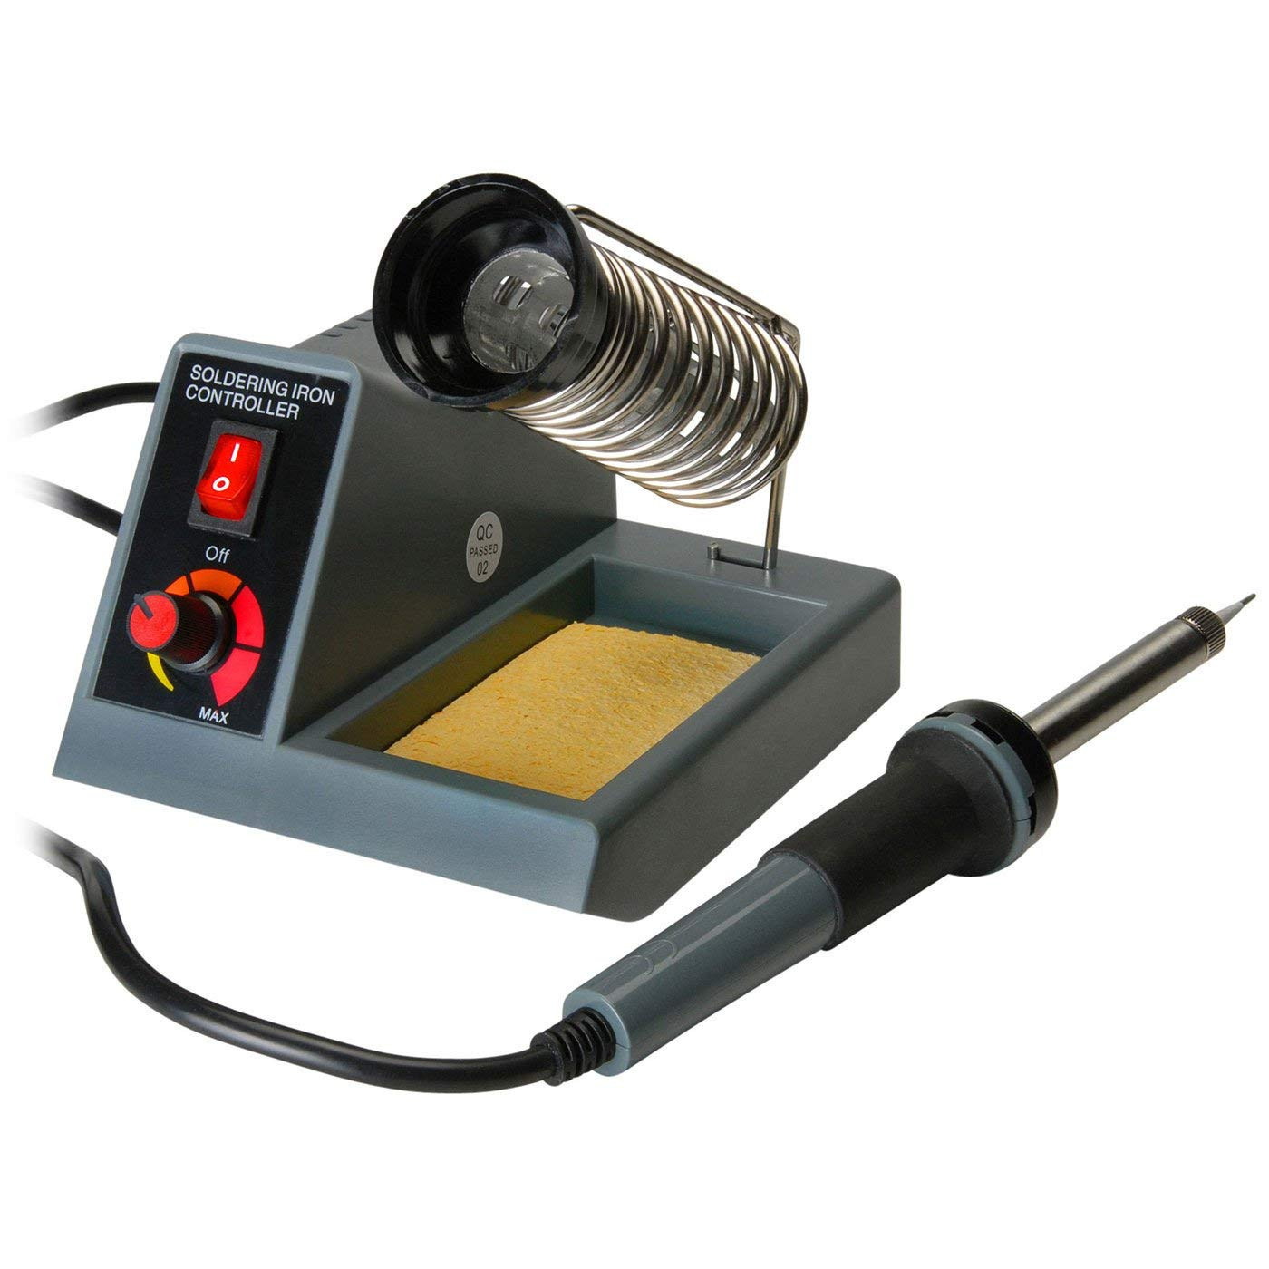
Soldering Iron
The primary function of a soldering iron is to solder electronic components together.
It can also be used to remove or desolder components from a circuit board.
Soldering Iron

Slide 9
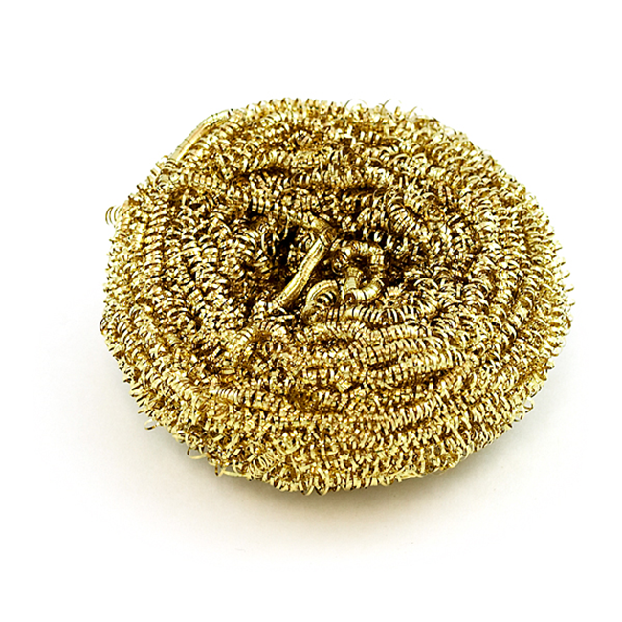
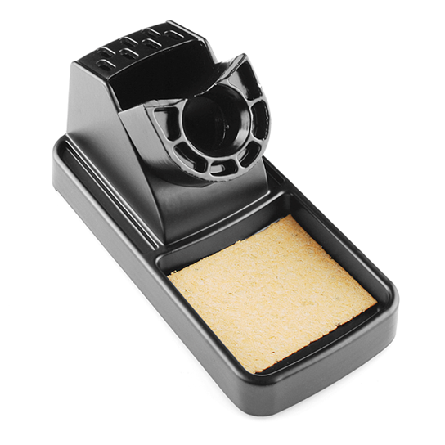
Tip Cleaner
Used to clean off soldering iron tip.
Can be made of various materials.
Should be used every time before soldering a joint.

Slide 10
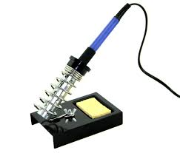
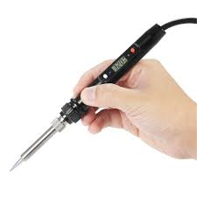
Safety Rules
Turn on iron when ready to use
Place the Iron In holder When Not in Use
Hold Iron only when soldering
Hold the Iron handle only

Slide 11
Safety Rules
Do not touch the solder point or the solder
Turn off the iron when leaving the solder station
Do not inhale the fumes
Hold components firmly

Slide 12
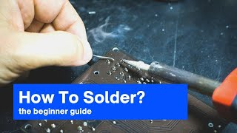
Soldering Steps
Tinning The Tip
Setting The Temp
Hold Iron in Place
Heat Both Substrate
Feed Enough Solder (opposite the iron)

Slide 13
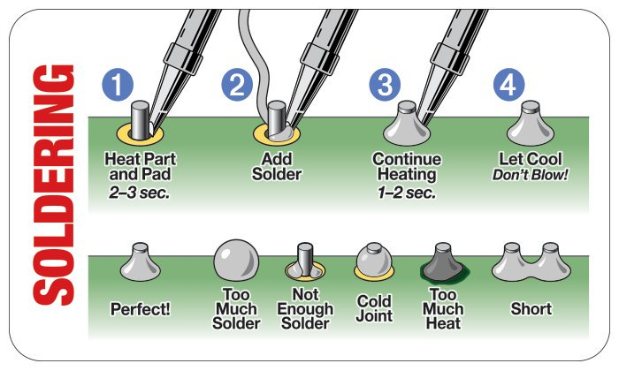
Soldering Steps

Slide 14
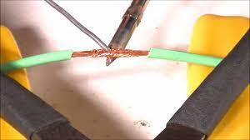
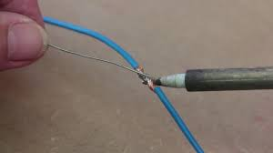
Practice!
Try soldering two pieces of wires together.

Slide 15
Select your materials and design your solar lamp!
ASK – RESEARCH – IMAGINE – PLAN – CREATE – TEST – IMPROVE
Available materials
Material selection
Sketch your design!
Collect materials & start prototyping
Solar panels
Wires
Buck converter
Battery
Cardboard
USB port
Type of solar panels?
Series or parallel?
2 Students: Work on electrical connections
2 Students: Work on the casing

Slide 16
Looking forward…
Testing of solar charger (how do you think we’ll be testing the lamp?)
Bring your mobile phone chargers for the next session.
Brainstorming ways to improve

Slide 17
Thank You
edm8ker is a fully owned brand of Makedemy Pte Ltd A member of the SL2 group of social enterprises.

