Slide 1
Building a Solar Charger
Day 5

Slide 2
What will we be doing today?
TEST: test the efficiency of your solar charger through quantitative and qualitative measures
IMPROVE: reflect on solar charger design and suggest areas for improvement

Slide 3
How might we test the effectiveness of a solar charger?
ASK – RESEARCH – IMAGINE – PLAN – CREATE – TEST – IMPROVE
Does your solar charger meet the design specifications indicated in the design brief?
E.g. of quantitative measures | E.g. of qualitative measures
Charging Efficiency: Time taken to charge the device using the solar charger versus a traditional charger. | Durability and Build Quality
Power Output | Portability and Ease of Use
Weather Conditions: The charger's performance under various weather conditions, such as direct sunlight, cloudy skies, or shade. | - Affordability

Slide 4
Today, we will measure the following to determine the effectiveness of your solar charger
ASK – RESEARCH – IMAGINE – PLAN – CREATE – TEST – IMPROVE
Quantitative measures | Qualitative measures
Power output | Portability and Ease of Use
Charging efficiency | Affordability

Slide 5
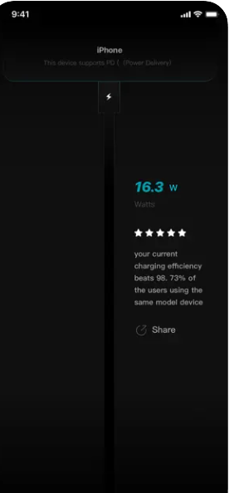
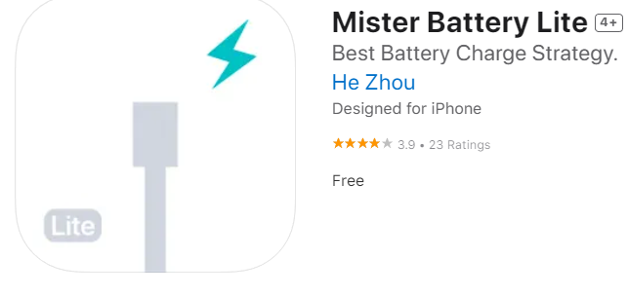
Pre-Prep
On ios devices install the Mister Battery Lite app. This will be used to measure the power. This cannot be used to measure current and voltage.

Slide 6
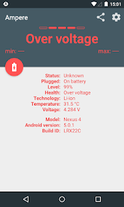
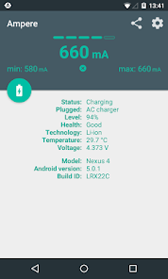
Pre-Prep
On Android phones install the Ampere app. This will be used to measure current and voltage.

Slide 7
Testing the solar charger (Activity 1)
ASK – RESEARCH – IMAGINE – PLAN – CREATE – TEST – IMPROVE
Test your solar charger. Complete activity 1-4 in the worksheets.

Slide 8
Improve your solar charger
ASK – RESEARCH – IMAGINE – PLAN – CREATE – TEST – IMPROVE
Assess the performance of your solar charger and identify areas that require improvement. (Complete Activity 5)
Idle groups are encouraged to assist other groups in the improvement process.

Slide 9
Excited for the next project!
We have successfully completed three projects where we applied Engineering design principles.
Get ready to showcase your knowledge and skills learned across these projects in the final summative assessment.

Slide 10
Thank You
edm8ker is a fully owned brand of Makedemy Pte Ltd A member of the SL2 group of social enterprises.

