Slide 1
Fun with Fractions
Grade 3
60 minutes

Slide 2
Overview
Basics of fraction
Understanding unit fractions
Comparing unit fractions

Slide 3
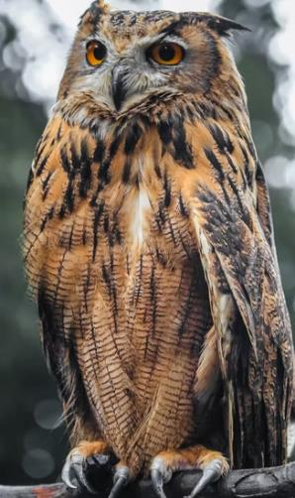
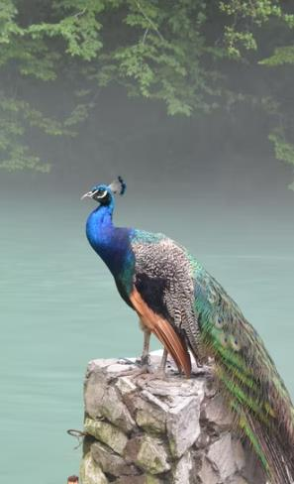
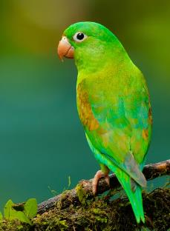
Guess the Bird
Notes:
Teacher start this lesson plan with the game: Guess the Bird?
Where students will guess the birds and teacher will help them by giving various hints to them.

Slide 4
Can you draw your favorite bird?
Paper pencil Watercolours
Paint
Notes:
Now teacher will ask students : How can you draw your favourite picture?
And give examples of various tools and software .

Slide 5
What if you can draw a bird like this?
Notes:
Full screen video view
Is this method interesting? Try to get them excited here.
What did they use for drawing the bird in the video? Get them to the level that they see fractions here. - Let’s create!
Today we are going to fraction
Fraction are
What is the purpose of this slide? (Explain what the activity is? Inspire students on what fraction art is? Features of fraction art or purpose of what fraction art can do)
If questions are asked? Expected student response.
What do I want my students to understand from this slide?

Slide 6
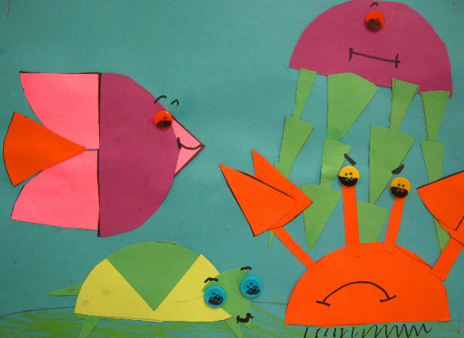
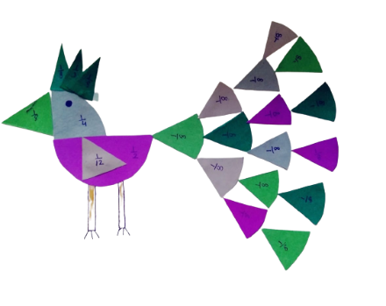
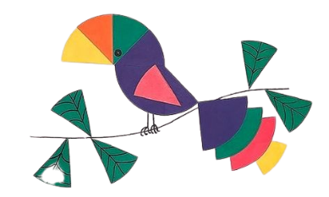
Let’s Create!
Create your favorite bird with fraction pieces like this!

Slide 7
Let’s Team Up!
Notes:
4 students in a group.

Slide 8
Project Leader
Resource Manager
Time Keeper
Presenter
Choose your role
Help your teammates to stick to the task!
Monitor what they are doing.
Collect the materials from the teacher.
Make sure your team to use material carefully.
Return when you are done!
Keep the track of time. Check the timer every few minutes.
Help your team to complete task on time.
Show your Art to the class.
Answer the questions asked.
Note the feedback!
Notes:
Students need to select their roles

Slide 9
Note the Ground Rules
Be respectful. Listen to your teammates.
Be careful with scissors while cutting
Complete tasks in given time
Raise your hands if you have anything to share and ask.
Notes:
Teacher will tell the house rules students need to follow while performing this activity.

Slide 10
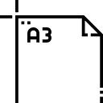
Collect from your teacher:
1. Sheets
2. A pair of scissors
3. A pencil
4. A3 White sheet
5. Glue
6. A marker
Notes:
Distribute materials among the students

Slide 11
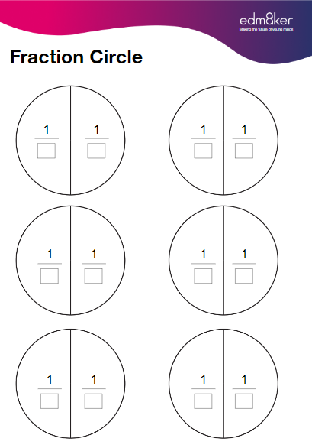
Fun Time!
Check if you have all 4 sheets.
Your pencil in your hand.
Now let’s do some counting!
Notes:
Teacher will check each group if they receive all the required material and are all set to start the activity.

Slide 12
Let’s count!
Count parts of the circles on this sheet.
Fill in the blank with number of parts of the circle.
What is the denominator here?
What will you call this fraction?
Repeat for other sheets.
Notes:
Help students to understand the parts of the circle, identify denominator and what they should call this fraction.

Slide 13
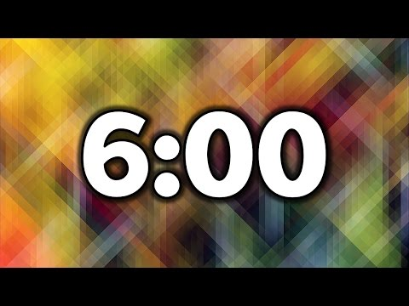
Counting time!

Slide 14
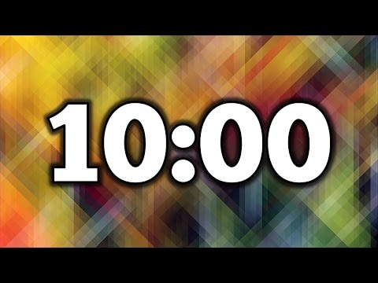
Cut circles into pieces

Slide 15
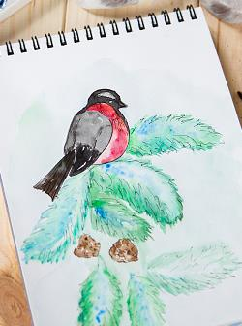
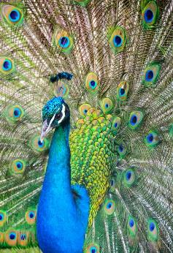
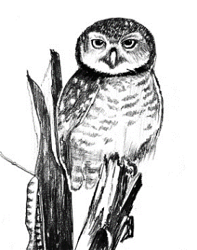
Let’s create a beautiful bird!
Discuss with your teammates:
Which bird do you want to create?
Notes:
Here teacher will create a inspiration among students regarding their fraction art.

Slide 16
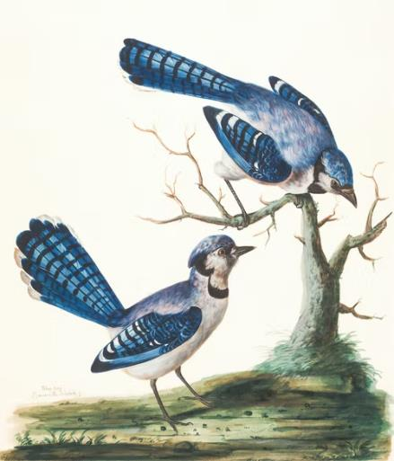
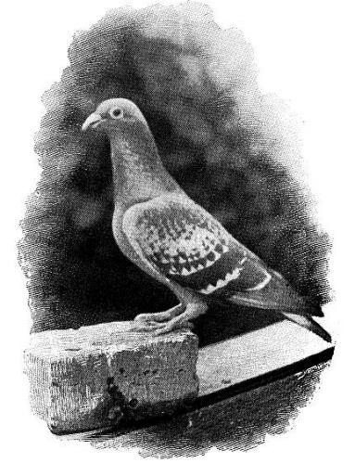

Slide 17
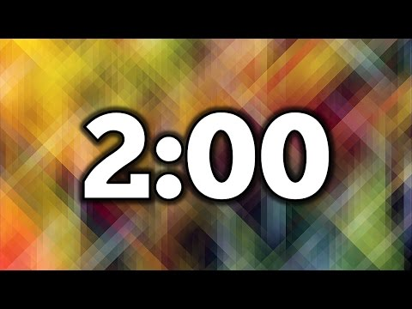
Ideation

Slide 18
Let’s Create a Bird!
Take the white sheet
Draw an outline of the bird (if you want to)
Start pasting pieces on the sheet for creating a bird!
Notes:
Teacher will now observe all the groups creating their own bird art that they ideated .

Slide 19
Creation

Slide 20
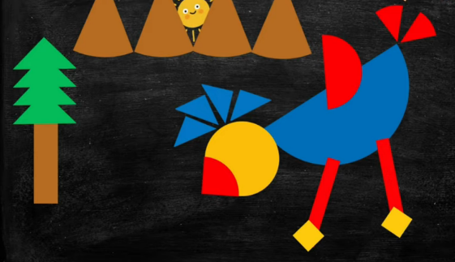
Make it colorful!
Finish the bird first.
Make it more colorful with
Trees
Mountains
Grass
Notes:
Encourage children to finish their bird making first and then if there is more time, they can use it for creating a scenery around it.

Slide 21
Let’s show your art!
Every group will get 2 mins to present.
Tell us:
Which fraction pieces did you choose?
Which fraction is the smallest?
Which fraction is the biggest?
How did you choose the colours?
What did you discuss with your teammates while creating the art?
Notes:
Give them 2 mins to discuss how they want to present and after that start with presentations.

Slide 22
Presentation

Slide 23
Quiz time!
Go to https://create.kahoot.it/share/kahoot-for-formative-assessment/28781ce3-4e60-461b-8397-825ca35e8c95
Let’s play the quiz……
Notes:
5 Minutes- Exit ticket
https://create.kahoot.it/share/kahoot-for-formative-assessment/28781ce3-4e60-461b-8397-825ca35e8c95
Teacher will use this link to access the kahoot quiz.

