Slide 1
Social Studies
Ancient Abodes
Fourth grade
120 Minutes

Slide 2
Overview
Identify different types of houses in Aztec and Mayan era.
Create an Advertisement for the house involving the following components:
-Prehistoric buildings/houses visual
- Framing sales tagline
- Features of the prehistoric houses

Slide 3
Ground Rules
Be respectful of one another
Raise your hand if you have anything to share.
Listen attentively and follow instructions.
Complete tasks in given time

Slide 4
Let’s Collaborate
Notes:
4 students in a group.

Slide 5
Choose your role!
Project Leader
Resource Manager
Clean up crew
Help your teammates to stick to the task!
Monitor what they are doing.
Collect the materials from the teacher. Make sure your team to uses the material carefully.
Return all the material when you are done!
Responsible for cleaning up the materials and work after the project is completed.
Notes:
Students need to select their roles

Slide 6
Have you ever wondered how the ancient kingdoms of Aztecs and Mayans looked like?

Slide 7
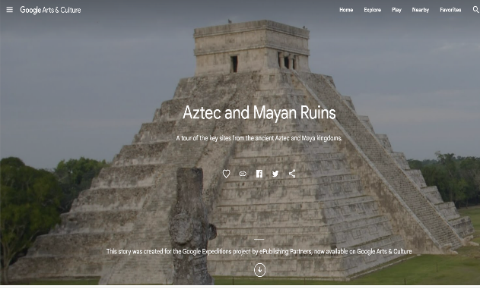
Let’s Find Out!
Let’s explore the ruins of the Aztec and Mayan Kingdoms:
Go to Google arts and culture
Explore the sites of houses/buildings from the Aztec and Mayan kingdom.

Slide 8
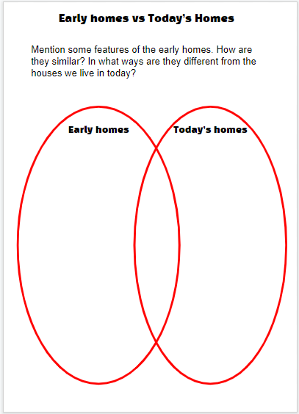
Let’s Dive Deep
Now let’s Dive deep into the kingdoms of Aztecs and Mayans:
Open your student handout
Gather the following information about the houses/buildings from each civilization
Open the student handout and mention the features of early homes that are similar and different from today’s homes.

Slide 9
Maker Challenge!
Craft an advertisement featuring Aztec and Mayan Kingdom houses with unique features and cultural significance.

Slide 10
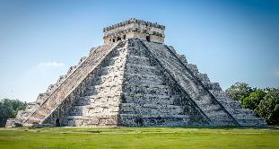
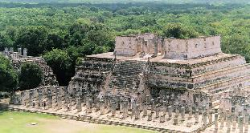
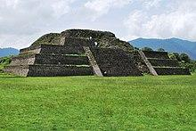
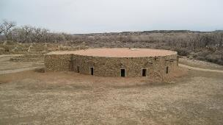
Let’s design an Advertisement!
Discuss with your teammates:
Select the type of house you want to create an advertisement.
Chichen Itza
Templo de los Guerreros
Piramide del sol
The Great Kiva
Notes:
Here teacher will create a inspiration among students to select a house from the civilization that they are putting up for sale.

Slide 11
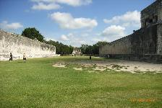
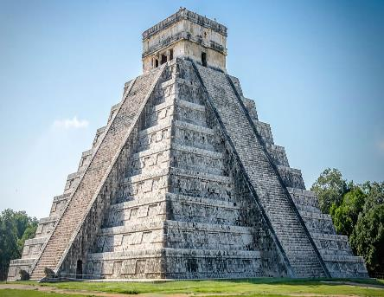
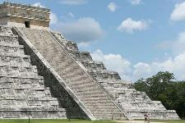
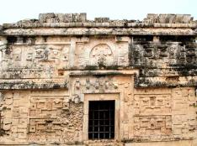
Write the top 3 features of the house.
Example:
Largest ball court
365 steps
A temple of warriors
Chichen Itza
Notes:
Ask them to write down features of their product in the worksheet.

Slide 12
Frame a Tagline!
Example:
"Step into the world of the Mayans at Chichen Itza"
"Discover the mystery and beauty of Chichen Itza"
"Unlock the secrets of Chichen Itza"
Chichen Itza

Slide 13
Let’s Create a Visual Advertisement!
For the house selected by your group

Slide 14
Creation time
Open canva by clicking on the link https://www.canva.com/en_in/
Notes:
Image source: https://medium.com/canva

Slide 15
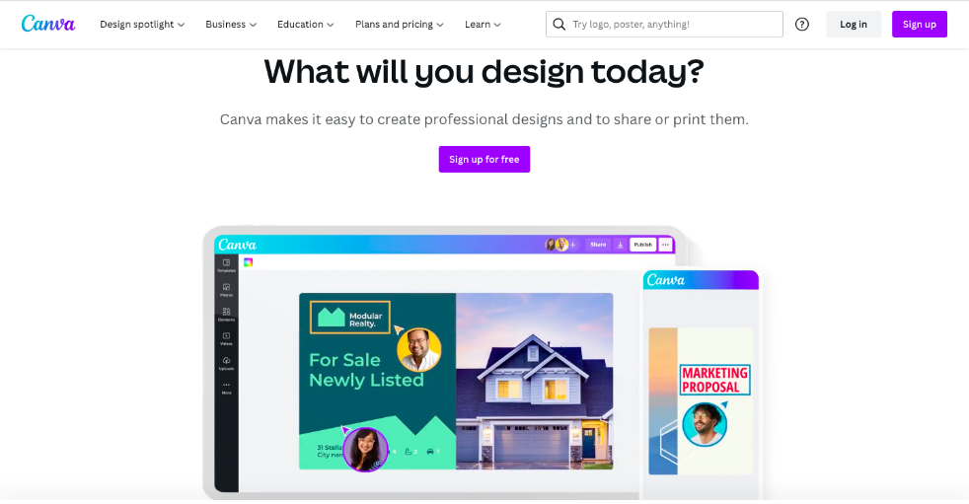
Creating your food story
Click on “Sign up”

Slide 16
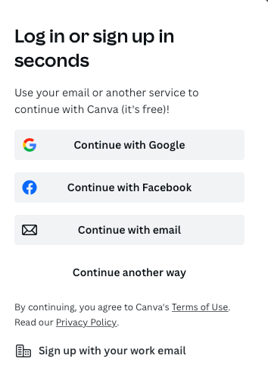
Setting up Canva
Click on “Continue with Email”.

Slide 17
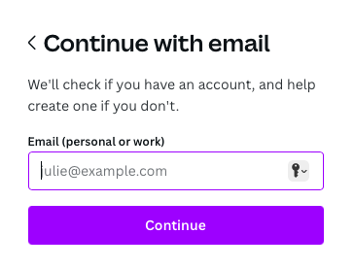
Setting up Canva
Enter your email address
Click “continue”.

Slide 18
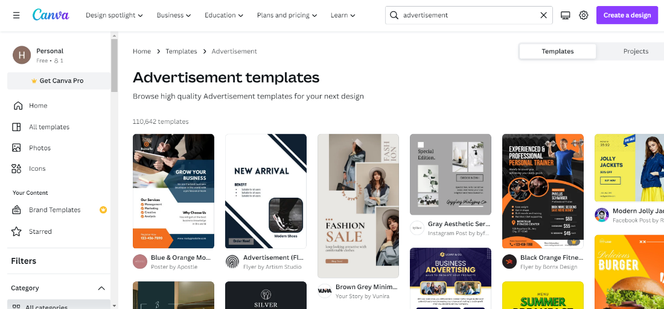
Select the template

Slide 19
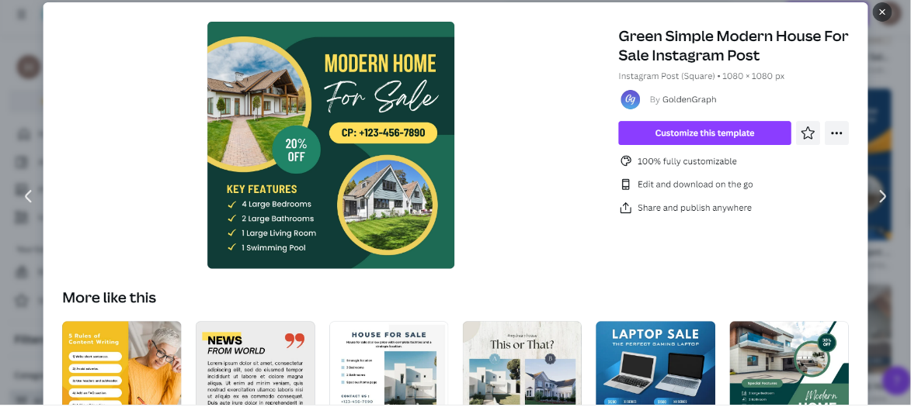
Choose & Customize
“Click here “to customize this template
Choose any template

Slide 20
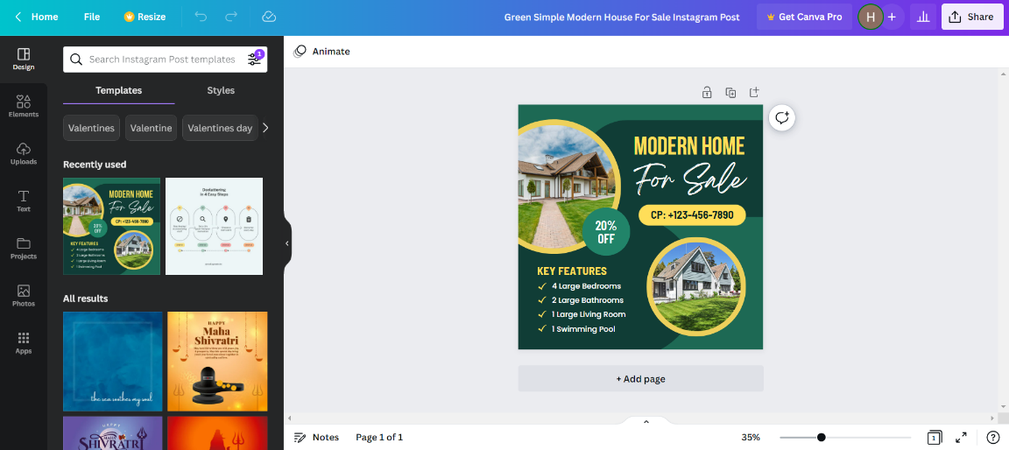
Let’s create!
Choose any template
Make it creative by using these supporting elements

Slide 21
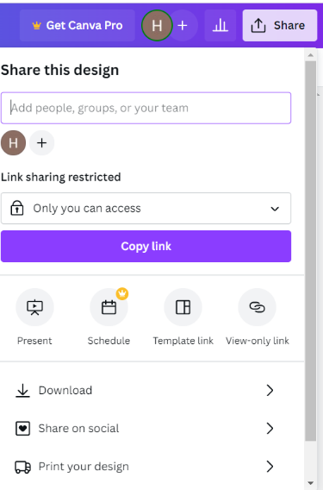
Share it !
After you copy the link of your creation, share it with your classmates by posting it on padlet QR code.
“Click here” to share your creation with others
“Click here” to copy this link
Notes:
Padlet link :https://padlet.com/s4ieducator40/pjg0vxjag9jvj85j

Slide 22
Timer

Slide 23
Presentation
Share your Landform prototype with your classmates.
How to present your advertisement? Share with your classmates:
What did you learn about the prehistoric houses of the Aztec and Mayan Civilizations?
What features did you include in your classified ad to make the house appealing ?
What lessons can we learn from prehistoric housing design in terms of sustainability?

Slide 24
Thank You
edm8ker is a fully owned brand of Makedemy Pte Ltd A member of the SL2 group of social enterprises.

