Slide 1
Science Energize the Future
Fourth Grade
120 minutes

Slide 2
Overview
Understand the concept of energy and how it is used in our daily lives.
Identify different types of energy sources, including renewable and non-renewable sources.
Explain how renewable energy sources like solar, wind, and water are good for the environment and can help create a sustainable society.
Demonstrate ways to conserve energy and reduce their own energy use at home and in their daily lives.
Understand the basic concepts of 3D design and modeling in Tinkercad.
Notes:
Begin by sharing the overview. Apprise students of the tasks they’d accomplish in the class.

Slide 3
Ground Rules
Be respectful of one another. Listen to your teammates.
Raise your hand if you have anything to share.
Listen closely and follow instructions.
Complete the tasks on time.
Notes:
Discuss the ground rules with learners and stress on the importance of them being followed throughout the class.

Slide 4
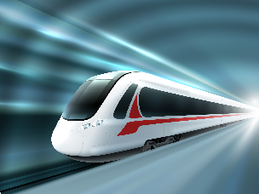
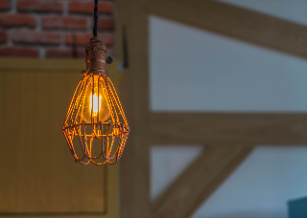
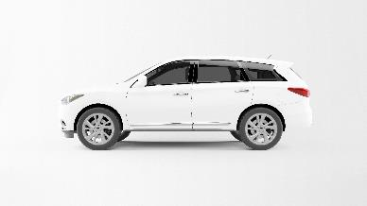
What do these require to run?
Bullet Train
Bulb
Car
Solar system:

Slide 5
Energy
Bullet Train: Electricity
Bulb: Electricity
Car: gasoline
They require energy to run.
Solar system:

Slide 6
What are some objects that you use in your daily life that require energy to operate?

Slide 7
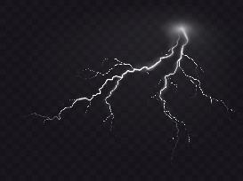
Energy
Energy is the ability to do work or cause change.
Energy is an essential aspect of our daily lives. It helps us perform various activities and tasks, such as cooking food, running appliances, powering transportation, and lighting our homes.
Did you know?
The energy generated by a single bolt of lightning is enough to power a 100-watt light bulb for more than 3 months.
Solar system:

Slide 8
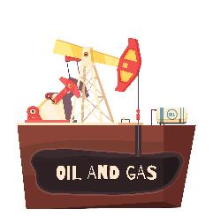
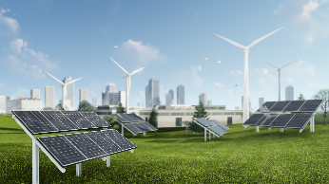
Types of energy resources
There are two main types of energy resources: renewable energy and non-renewable energy.
Non-renewable energy: Energy derived from resources that cannot be replaced within a short period of time, such as coal, oil, and natural gas.
Renewable energy: Energy derived from natural resources that can be replenished over a relatively short period of time, such as solar, wind, or water energy.
Solar and wind energy
Solar system:

Slide 9
Renewable vs. Non-Renewable
 | Renewable Energy Sources | Non-Renewable Energy Sources
Environmental impact | Generates little to no harmful gases. | Generates a lot of harmful gases.
Cost | Cheaper in the long run because we don't have to pay for fuel, like we do with non-renewable energy. | Costs can go up and down a lot, which can make it hard to plan for the future.

Slide 10
What do we use?
About 79% of the U.S.A’s energy comes from fossil fuels- coal, natural gas, petroleum, and other gases.
Did You Know?
85% of the total primary energy supply in Iceland is derived from renewable energy sources.
Source: Centre for sustainable system
Solar system:

Slide 11
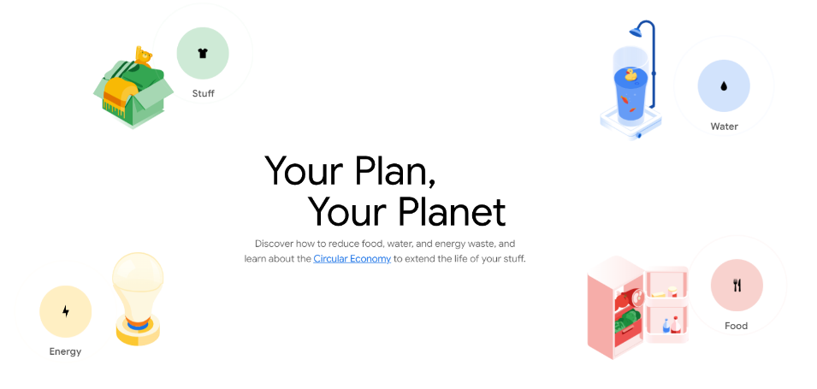
Small changes equals big impact
We mostly rely on non-renewable energy to fulfill our energy needs. Therefore, what minor adjustments can we make to conserve energy?
Let’s Explore using Google Sustainability

Slide 12
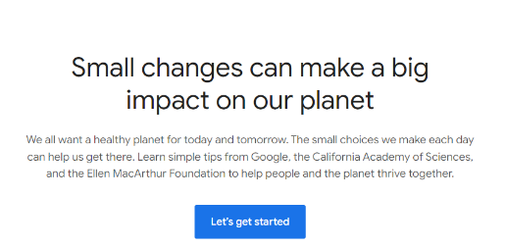
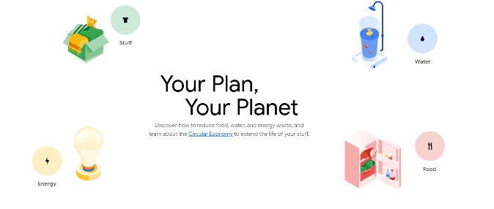
Guide access to Google Sustainability
Log on to: https://yourplanyourplanet.sustainability.google/
Click on ‘Let’s get started’
Click on ‘Energy’

Slide 13
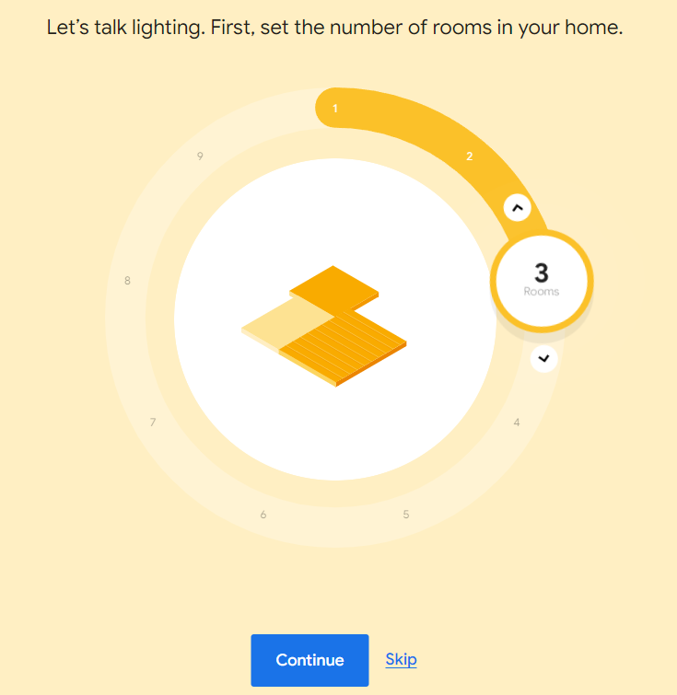
Instructions
Read the question and answer accordingly.
Click on ‘Continue’ to proceed further.

Slide 14
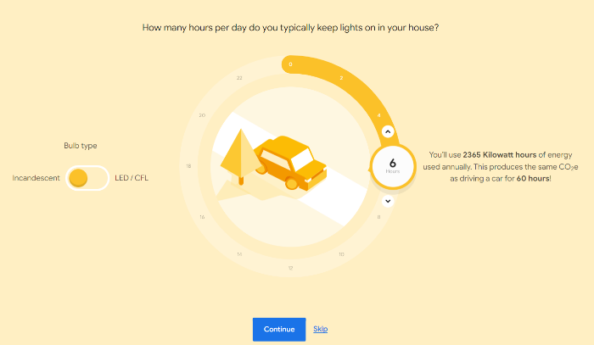
Instructions
Pay attention to the amount of gas released
Complete all other steps. Have fun exploring!
Solar system:

Slide 15
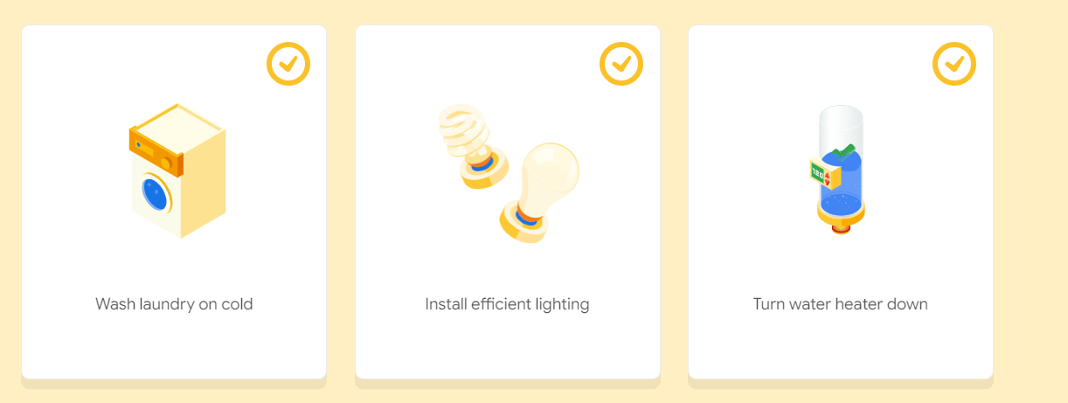
How we can inspire our families to adopt sustainable habits?
Did you pledge to adopt these small changes?
Go to the worksheet and fill it.
Solar system:

Slide 16
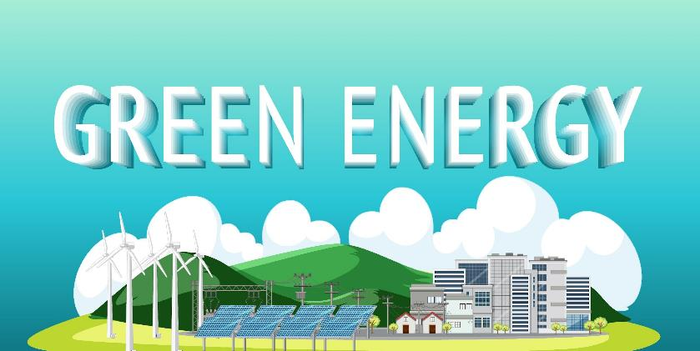
Towards a green future
While adopting sustainable habits is an important step towards reducing our impact on the environment, it is not enough on its own to solve the complex challenges we face today.
As we look towards the future, we need to transition to renewable energy sources in order to address the pressing environmental challenges we face.
Solar system:

Slide 17
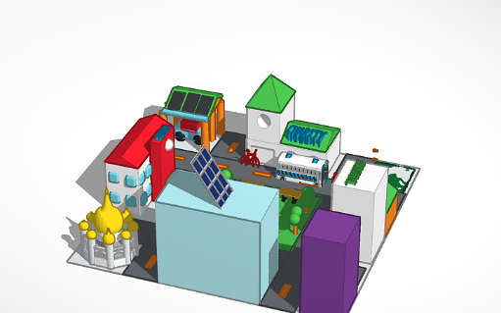
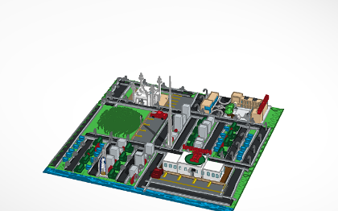
Introduction: Tinkercad
Tinkercad is a cool tool that helps you make 3D designs and models.
Tinkercad provides a fun and creative way to learn about renewable energy and apply these concepts in practical ways to make the world a better place.
You will utilize Tinkercad to design and create a 3D model of a green society.
Solar system:

Slide 18
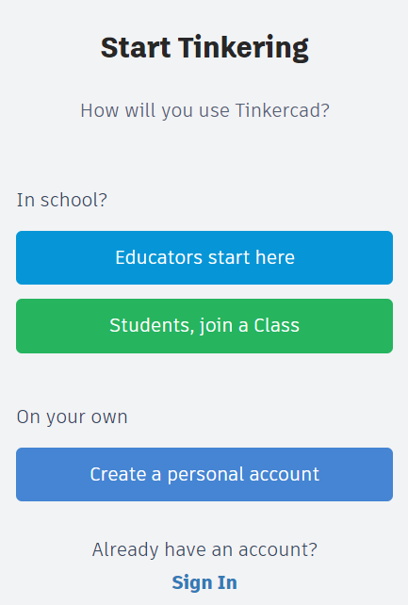
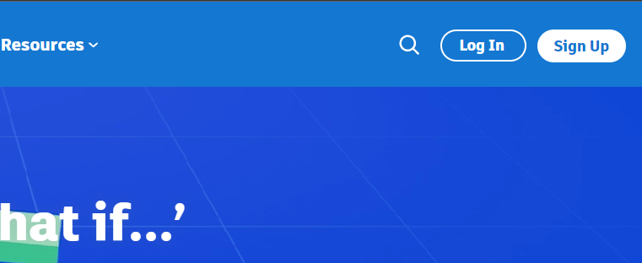
Login Instructions
If you don’t have a account, you must set one up first. Go to www.tinkercad.com
Click on ‘Sign Up’
Create an personal account. Complete the account registration process.

Slide 19
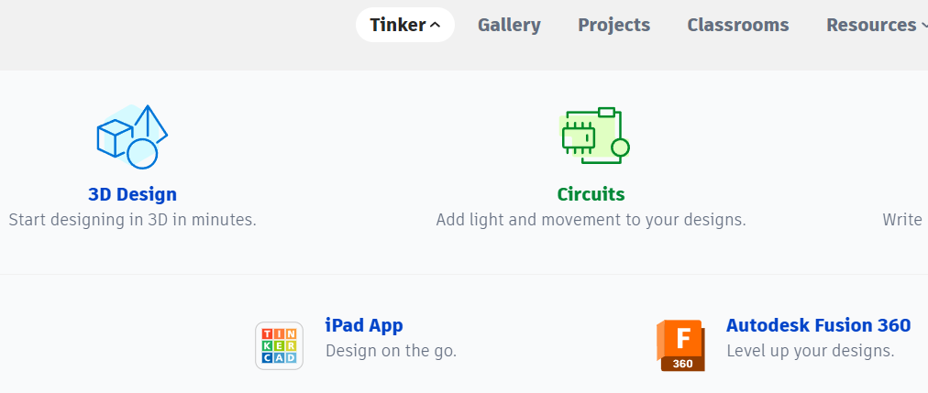
Learning the Basics
Click on ‘Tinker’
Click on ‘3D Design’

Slide 20
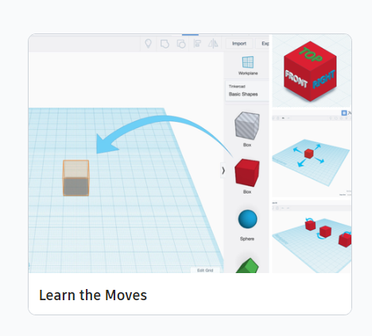
Learning the Basics
3. Scroll down to the bottom
4. Click on ‘Learn the Moves’

Slide 21
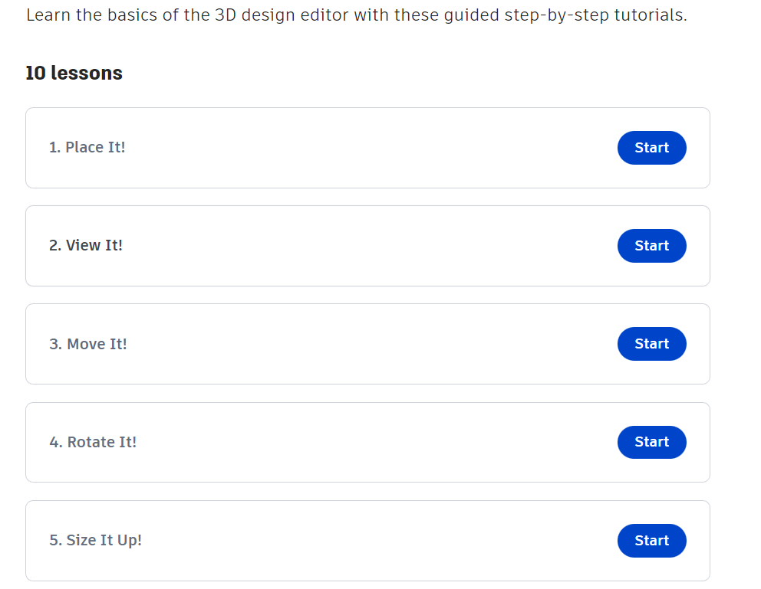
Learning the Basics
Complete these seven basic tutorials.

Slide 22
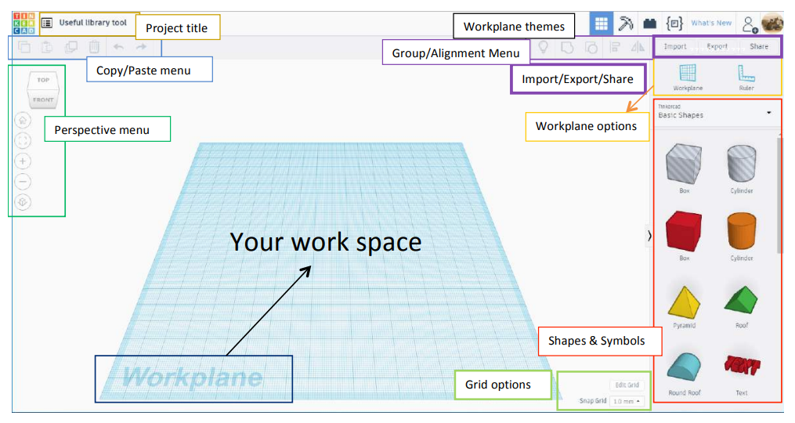
Tinkercad: User Interface

Slide 23
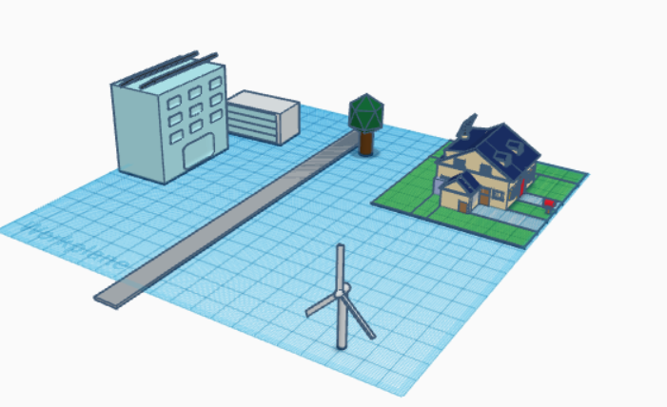
Create your own green society
Open the link: https://www.tinkercad.com/things/0ulGs6omKtZ?sharecode=uWJWSTXPONRz9VcmAyrwi40s99u94oiH69W5ac3ZXf4
You are already given a pre-designed model.
Duplicate and move different objects (houses, trees, solar panels, wind turbines) to complete your green society.

Slide 24
Design tips for building a Green City
When building a city that reflects a green society, take note of the following infrastructural features.
A very common feature of a green city are bike lanes on public roads and public parks.
You can incorporate any number of design elements into your city’s design as you wish.

Slide 25
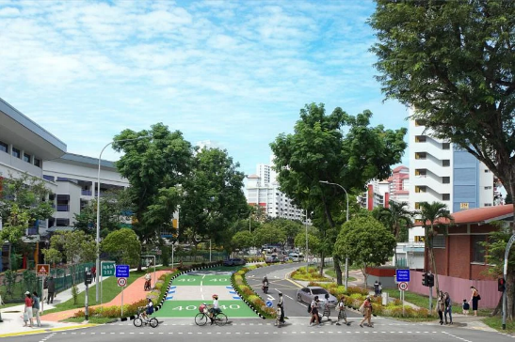
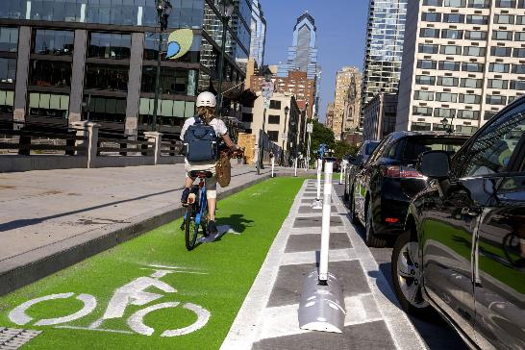
Pedestrian-friendly sidewalks that have both walking and cycling paths
Dedicated bike lanes on roads

Slide 26
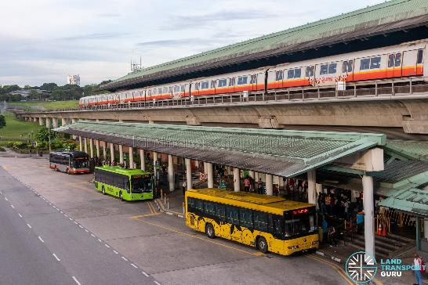
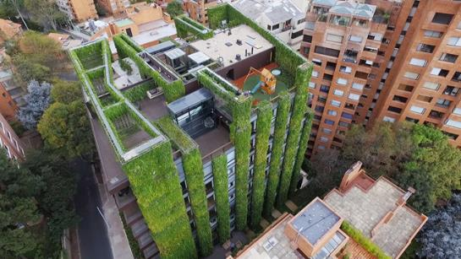
Train and bus stations (encourage usage of public transport)
Green roofs and green walls on buildings

Slide 27
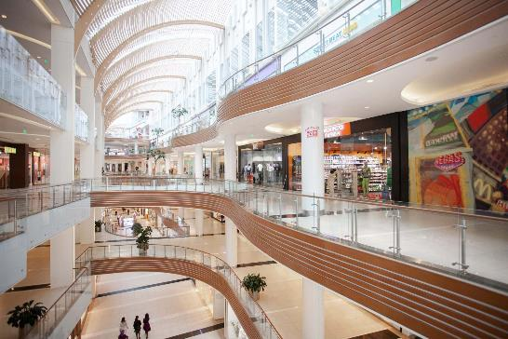
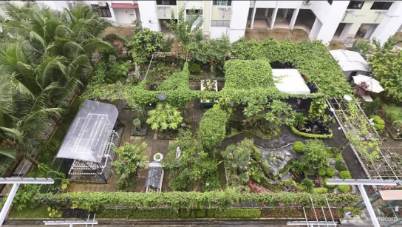
Harness natural light for lighting interiors (eg. glass roofs/windows etc.)
Community gardens that promote urban agriculture

Slide 28
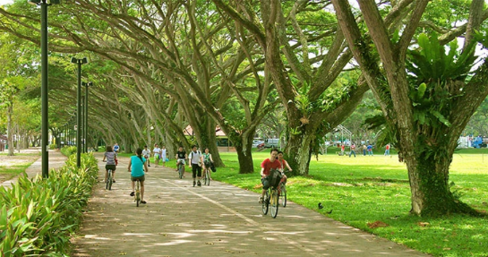
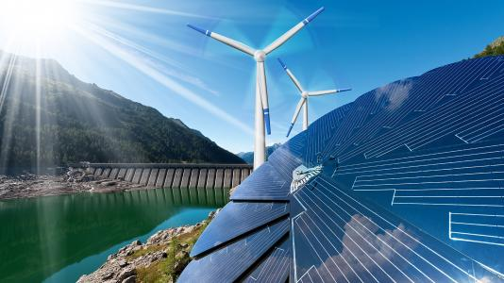
Rain gardens, urban forests, public parks and gardens
Solar panels, wind turbines, hydroelectric dams

Slide 29
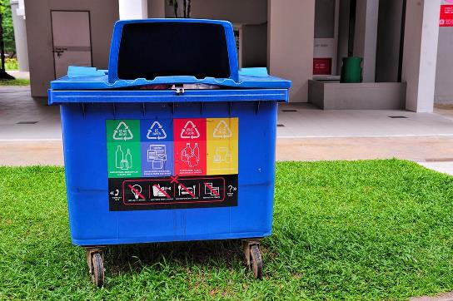
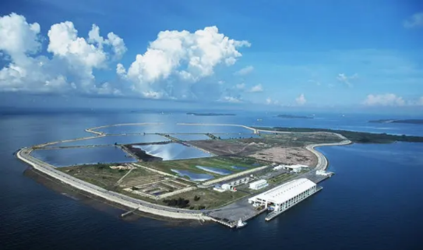
Recycling Bins (promotes waste reduction and recycling)
Designate land area for a landfill in your city

Slide 30
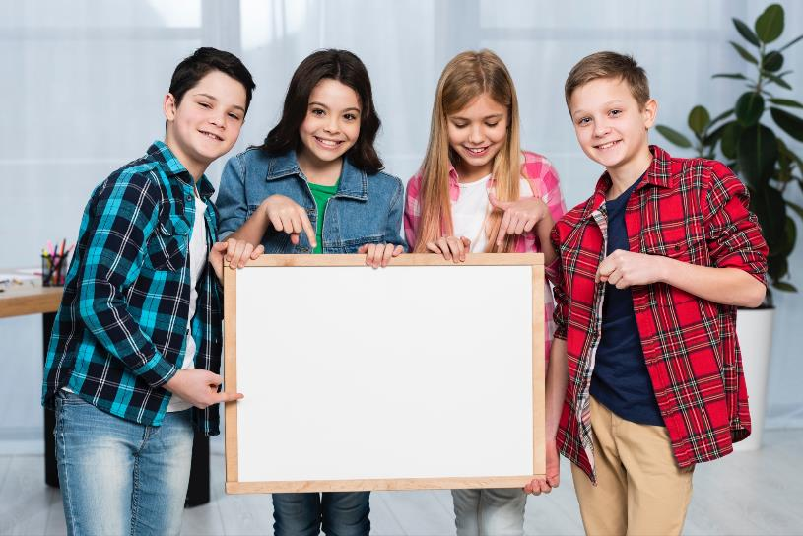
Let’s Present
Time to share your creation with the rest of the class.

Slide 31
Format of Presentation
Introduction: Introduce your team.
Context: Share the context and the design inspiration behind your clean energy society.
Design elements: Highlight the key design elements of your clean energy society, like the placement of windmill, solar panels or any other infrastructural elements and the rationale behind them.
Challenges: Mention the planning and design challenges you faced while creating and how you overcame them.
Conclusion: Conclude your presentation with an argument on what makes your design the most efficient green society.
Q&A: Open the floor for peer feedback.
Notes:
Walk learners through, what would an Ideal presentation look like.

Slide 32
Let’s Summarize!
Describe how you’re feeling after creating your green society, in one word.

Slide 33
Thank You
edm8ker is a fully owned brand of Makedemy Pte Ltd A member of the SL2 group of social enterprises.

