Slide 1
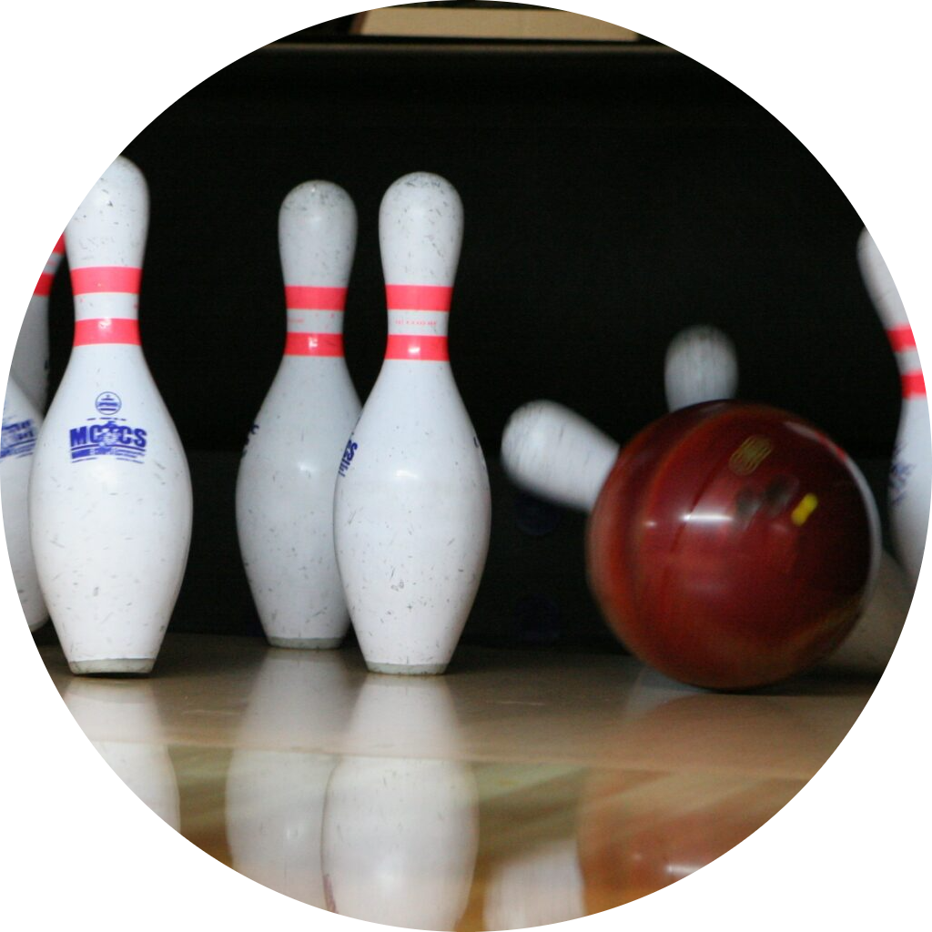
Bowling with Friction
Grade 6
60 minutes

Slide 2
Overview
Understand the concept of friction and its role in daily activities.
Explore factors influencing friction, such as nature of the surfaces in contact and weight.

Slide 3




Ground Rules
Be respectful of one another. Listen to your teammates.
Raise your hand if you have anything to share.
Listen closely and follow instructions.
Complete the tasks on time.
Notes:
Discuss the ground rules with learners and stress on the importance of them being followed throughout the class.

Slide 4
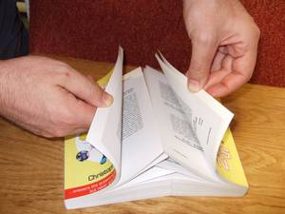
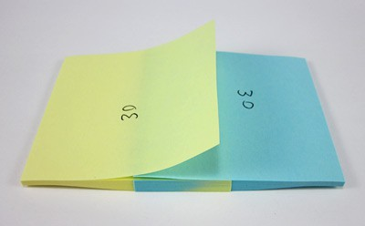
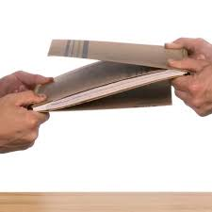
Overlapping Notebooks Unite!
Find a partner and gather two notebooks.
Take one notebook in each hand and carefully overlap them, aligning the pages so that they completely cover each other.
Press down firmly on the notebooks to make sure they are tightly secured together.
Try separating them by pulling them apart with a firm and steady force.
Aligning the pages of the notebooks
Separating the notebooks

Slide 5
Were you able to separate them?

Slide 6
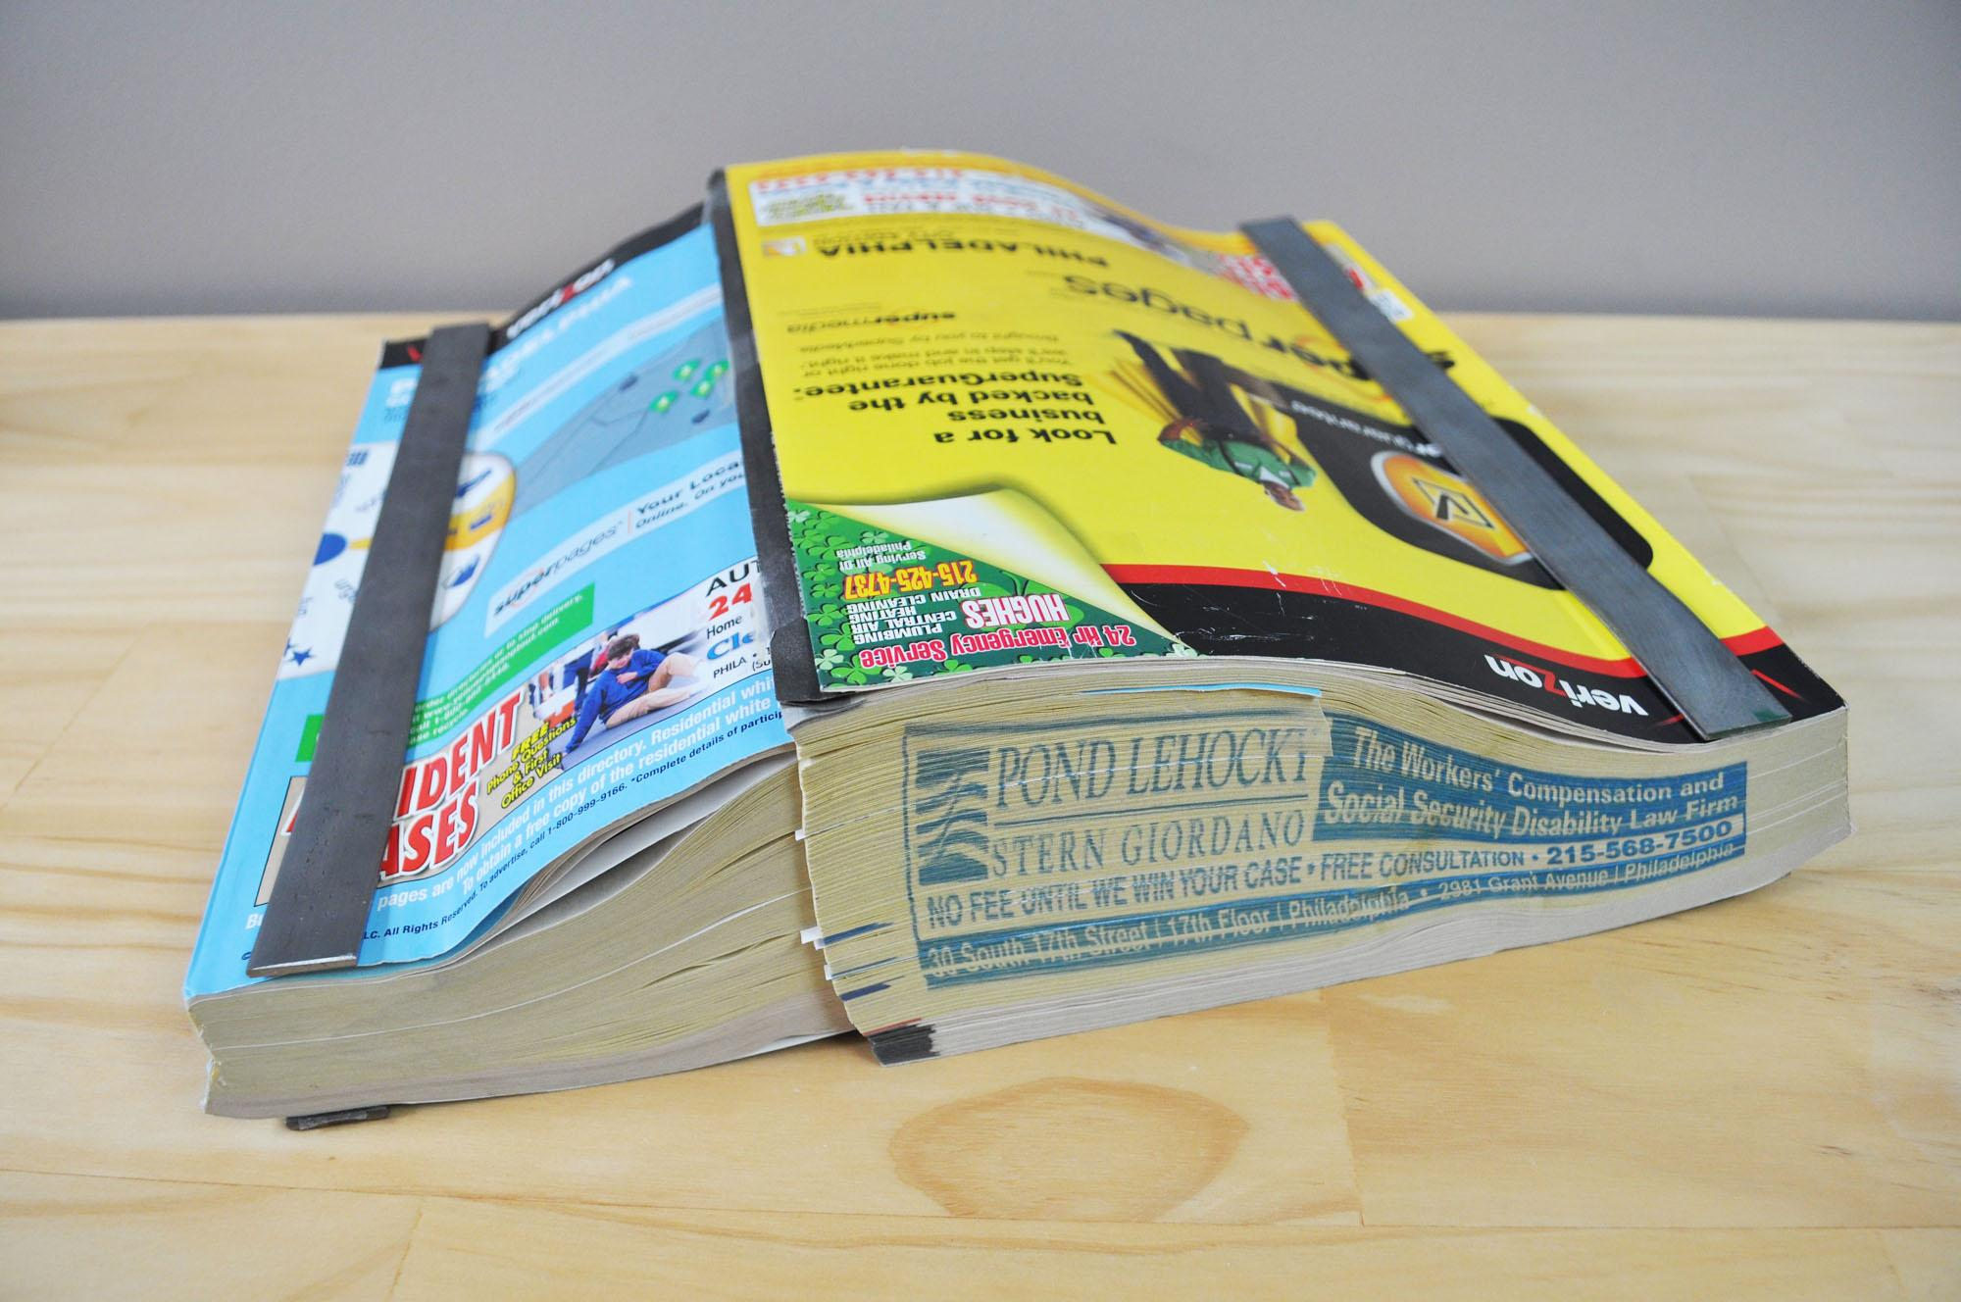
How much force is required?
It’s quite difficult to separate these two notebooks. How much force do you think will be required to separate two phone books?
a. Force of 10 men
b. Force of two cars
c. Force of two army tanks
d. None of the above

Slide 7
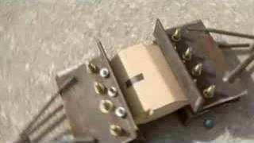
How much force is required?
Watch this Video
You require the force of two army tanks!!!!

Slide 8
So what’s this mysterious force holding these books together?

Slide 9
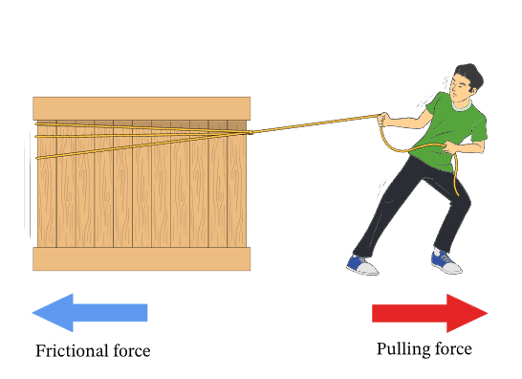
It’s friction
Friction: It is defined as the resistance offered by the surfaces in contact when they move past each other.
Have you ever tried to pull a heavy object on a floor?
Frictional force always acts in the opposite direction to the applied force. When you push or pull an object, the frictional force acts to resist the motion or prevent the object from sliding.

Slide 10
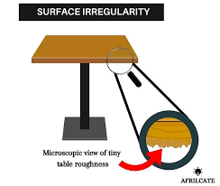
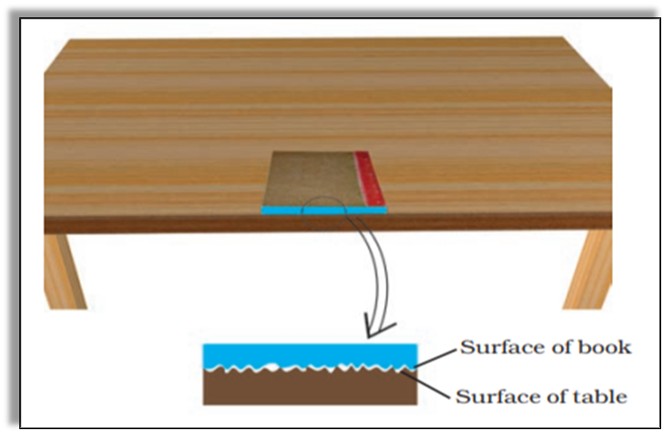
What causes friction?
Friction is caused by the roughness or texture of surfaces that come into contact. Even surfaces that may appear smooth at a macroscopic level have tiny bumps and irregularities at a microscopic level. When two objects are in contact, these rough surfaces interlock and create resistance, resulting in friction.

Slide 11

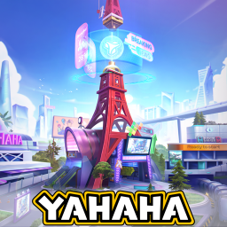
Introducing YAHAHA!
YAHAHA is an online free-to-play platform which allows you to create immersive worlds - similar to Roblox. With YAHAHA, you can create and enjoy amazing 3D games without needing advanced technical knowledge. It's as easy as using simple tools and templates to let your imagination run wild.
We will use Yahaha to explore one of the factors that affects frictional force.

Slide 12
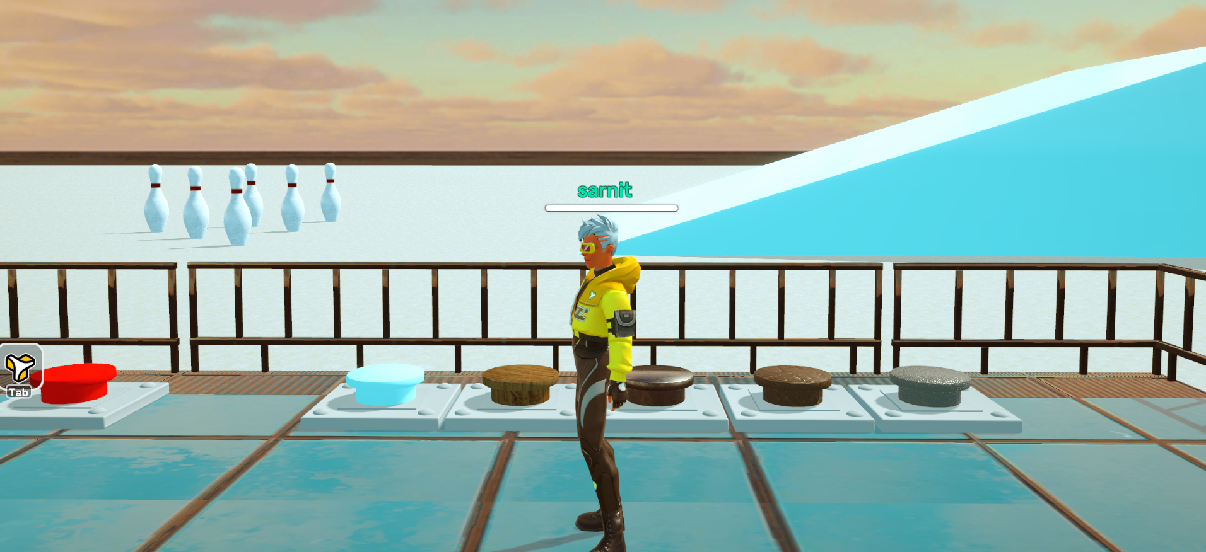
Bowling with Friction
Presented by YAHAHA
Observe as your teacher plays the game and complete your worksheet.

Slide 13
Factors affecting friction
Nature of the surfaces in contact: Rougher surfaces generate more friction compared to smoother surfaces.
In contrast to a rough surface, on a smooth surface, there are fewer interlocking between the surfaces, resulting in less friction and easier movement.

Slide 14
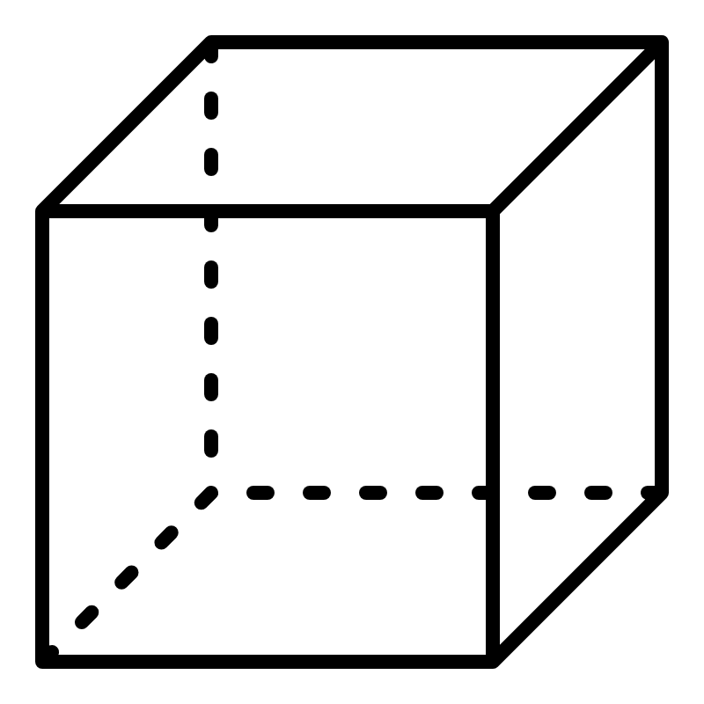
Let’s predict!
You are rolling two cubes of similar material down the slope. The cubes are have different sizes.
Which will experience more friction? Which one do you think will roll down faster?

Slide 15
Factors affecting friction
Weight: Greater the weight or mass of an object, the greater the frictional force between the object and the surface.
When an object is heavier, it presses down with a greater force on the surface, resulting in stronger interlocking between the object and the surface. This leads to an increase in the frictional force between them.

Slide 16

In which case there will be more frictional force between the surface and the box?
Box is flipped
2
1

Slide 17
Factors affecting friction
Box is flipped
1
2
In both cases, frictional force will be the same.
Friction force is independent of area of contact. It depends only on the nature of surfaces in contact and weight of the body.

Slide 18
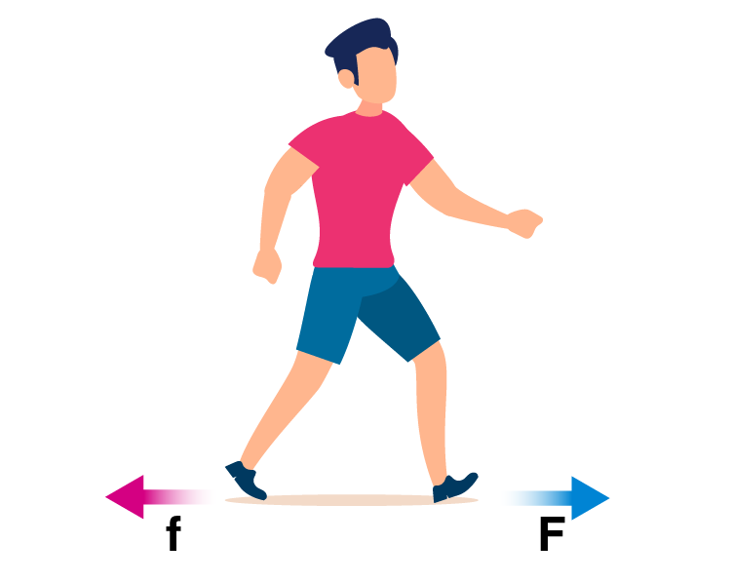
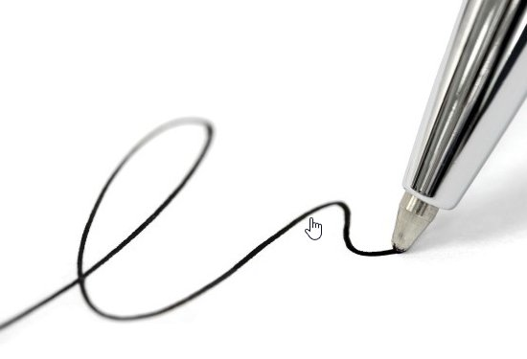
Friction: A necessary evil
When we walk or run, friction keeps us from slipping and helps us stay balanced.
Walking
When we write, friction between the pen or pencil and the paper allows us to control our movements and create legible writing
Can you think of situations where friction isn’t required?
Writing

Slide 19
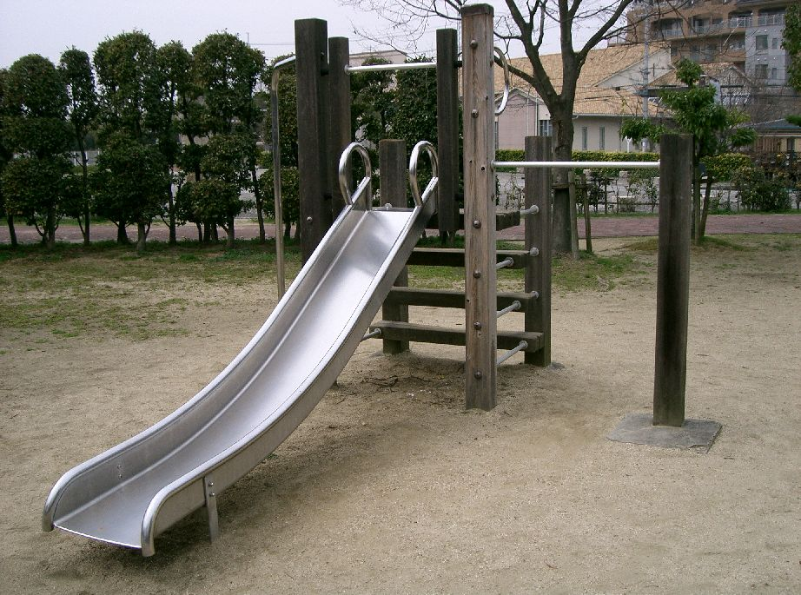
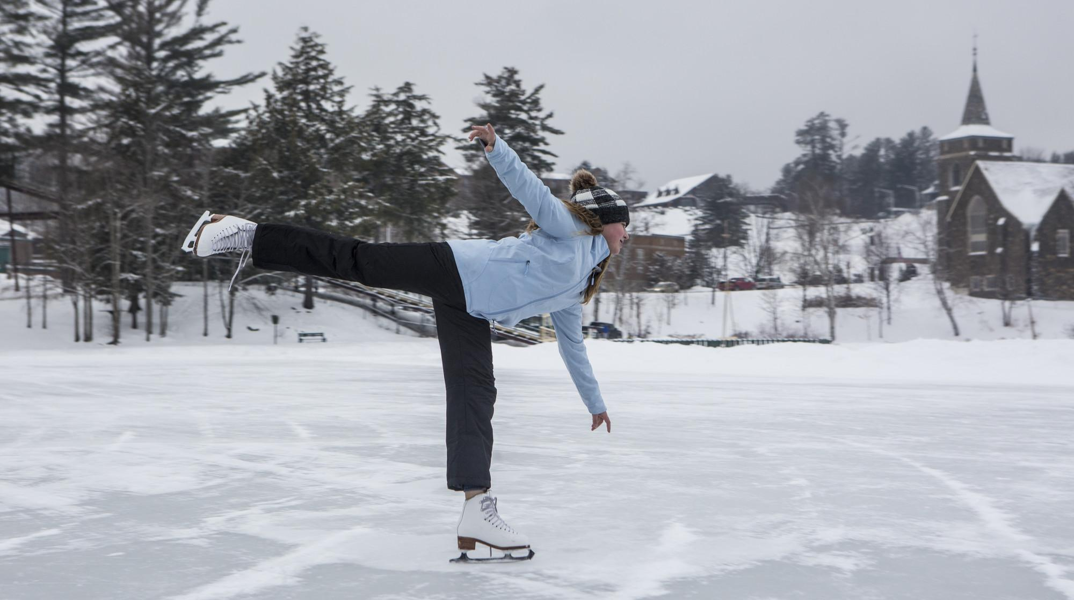
Friction: You are not welcome!
When we try to slide down a playground slide, friction can slow us down and make it harder to glide smoothly.
It can feel like the slide is sticking to our clothes or skin, making the sliding experience a bit less exciting and more challenging.
Slides in playground
The general low level of friction on ice allows a skater to glide along the surface smoothly.
Ice Skating

Slide 20
Exit Ticket!
Complete your exit ticket and hand it in

Slide 21




Thank You
edm8ker is a fully owned brand of Makedemy Pte Ltd
A member of the SL2 group of social enterprises.

