Slide 1
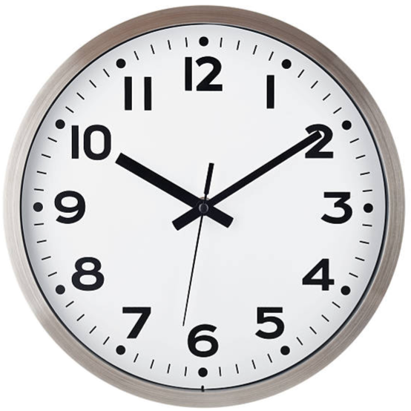
Mathematics Journey through time
Second
120 minutes

Slide 2
Overview
Identify the parts of an analog clock (e.g. hour hand, minute hand, numbers) and understand their roles in showing time.
Recognize and identify the hours on an analog clock, and be able to read and write them using both analog and digital formats.
Understand the different parts of the day (e.g. morning, afternoon, evening) and how they relate to time, including distinguishing between A.M. and P.M.
Apply knowledge of time to real-life situations (e.g. telling time in daily routines, scheduling activities) using A.M. and P.M. concepts.
Notes:
Begin by sharing the overview. Apprise students of the tasks they’d accomplish in the class.

Slide 3
Ground Rules
Be respectful of one another. Listen to your teammates.
Raise your hand if you have anything to share.
Listen closely and follow instructions.
Complete the tasks on time.
Notes:
Discuss the ground rules with learners and stress on the importance of them being followed throughout the class.

Slide 4
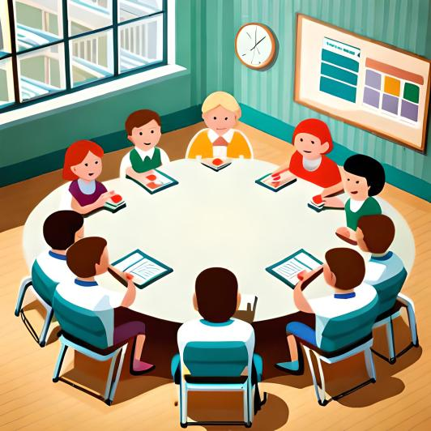
Body clock game
Sit in a circle and remember your assigned number from 1 to 12.
Look at the analog clock and notice the two hands - a long hand and a short-hand.
When the teacher points to a number on the clock, stand up if you have that number.
If you stand up for the wrong number or don't stand up for the correct number, you're out of the game.
Keep playing until only one person is left standing - that person wins!

Slide 5
Extra rules
Even if you don't have a number assigned to you, you can still join the Body Clock Game by using the clock to point to specific numbers.

Slide 6
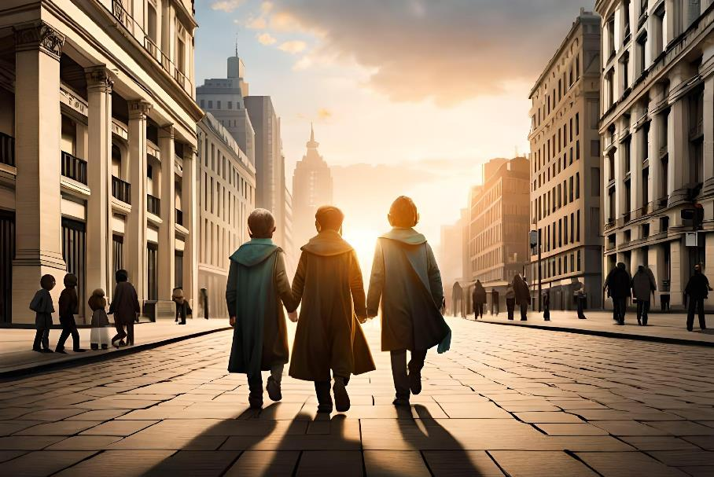
Journey through time
You are a member of a team of time travelers, preparing to embark on a mission to explore different time periods and learn about reading time. Your team has been chosen to visit different eras and gather data about how people told time.
How excited are you for this journey?

Slide 7
Introduction to ThingLink
ThingLink is a great tool for creating interactive images and videos.
We will use it to explore different time periods.

Slide 8
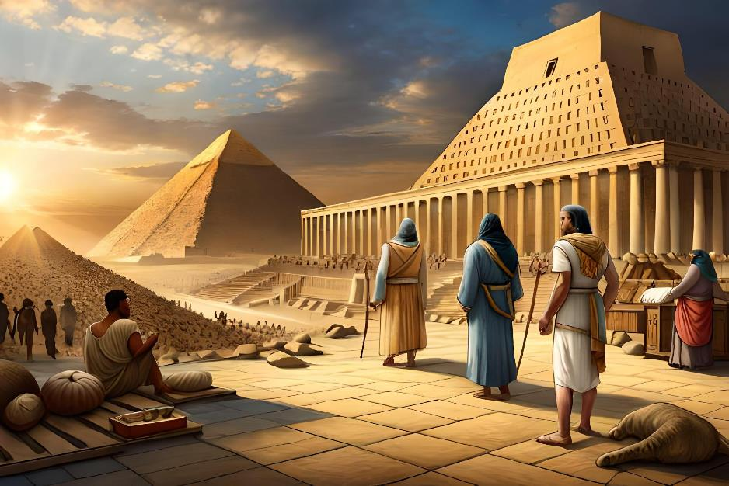
Ancient Egypt
As you approach Ancient Egypt, you are amazed by the towering pyramids and the bustling marketplaces. Your team lands and begins to explore, looking for evidence of how people told time.
There you come across a puzzle. Solve it to continue further.

Slide 9
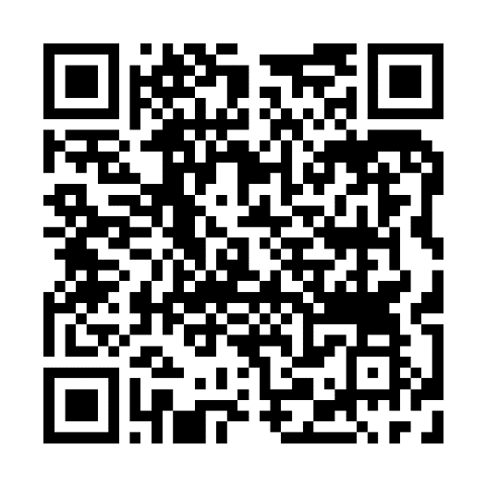
Instructions
Scan the QR code or click on: https://www.thinglink.com/video/1700087137279410789

Slide 10
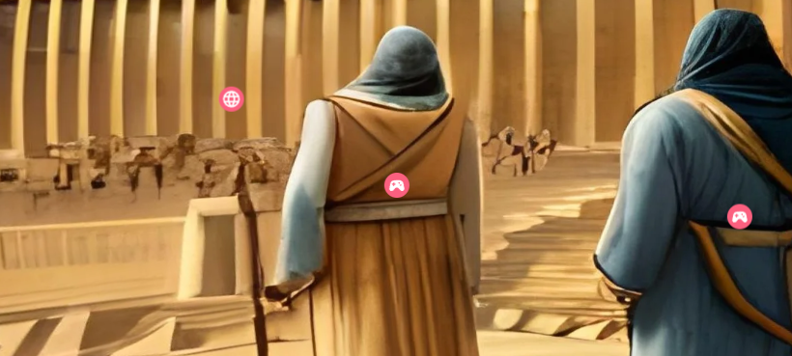
Instructions
Click on the globe icon to know what puzzle/challenge you need to solve.
Click on the game icon to get clues to solve the puzzle.
Click on the i icon to get information.
Click on the different icons to know more about the scenes.

Slide 11
Are there any disadvantages of Sundial?

Slide 12
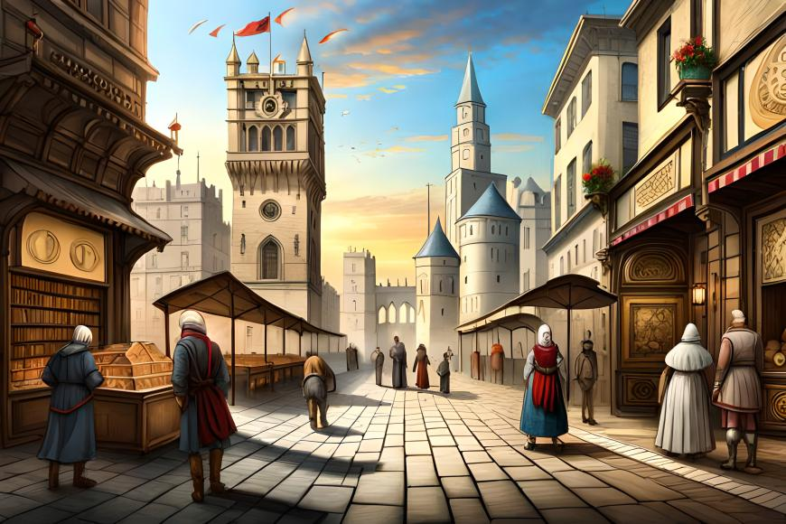
Middle Ages
As you leave Ancient Egypt and journey towards the Middle Ages, you are struck by the towering castles and busy market-places.
You quickly come across an hourglass, which was used to measure time using sand.

Slide 13
Hourglass
An hourglass is like a special timer that people used a long time ago. It is made of two glass parts connected by a small hole in the middle.
When we turn the hourglass over, sand trickles through the hole from the top part to the bottom part. We can use the sand to see how much time has passed.

Slide 14
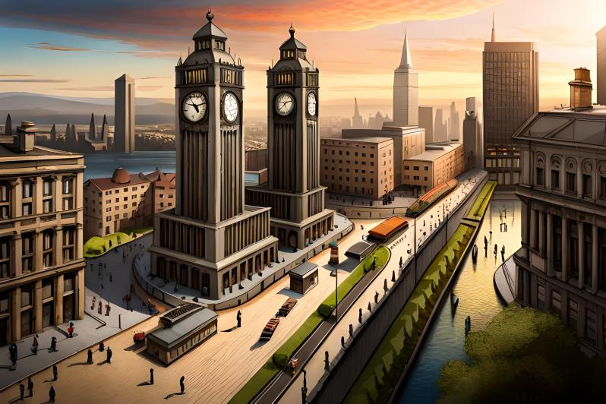
Age of Pendulum clocks
You travel to your next destination and find a big clock called a pendulum clock. But it is not working properly.
You must fix the pendulum clock in order to continue.

Slide 15
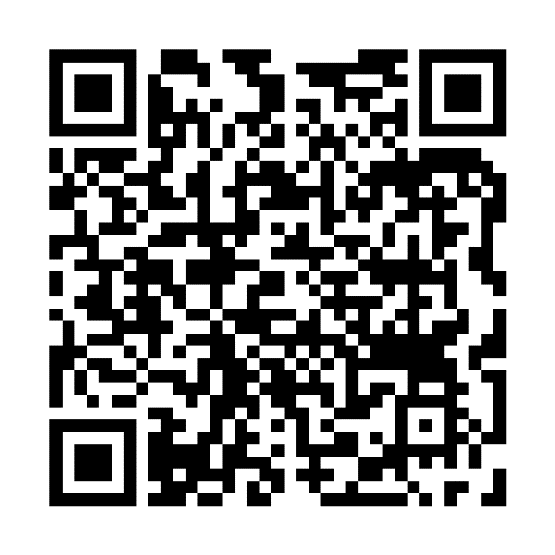
Instructions
Scan the QR code or click on:
https://www.thinglink.com/video/1702031376691233572

Slide 16
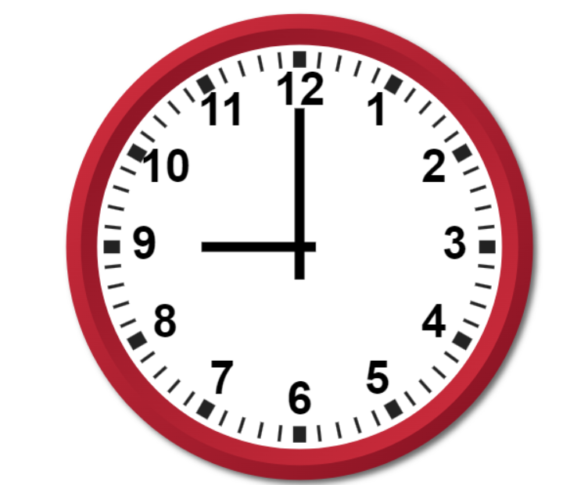
How to tell time
When the minute hand points to 12, it is shows a full hour.
We call this time ‘o’clock’.
This clock is showing that the time is 9 o’clock.

Slide 17
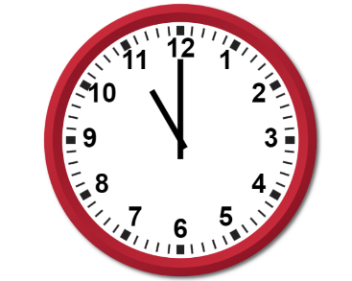
What time is it?
It’s 12 o’clock.
It’s 7 o’clock.
It’s 11 o’clock.

Slide 18
What time is it?
It’s 5 o’clock.

Slide 19
What time is it?

Slide 20
What time is it?
It’s 1 o’clock.

Slide 21
Four Quarters
If we were to slice the clock into 4 equal sections, we would have four quarters.
4
1
3
2

Slide 22
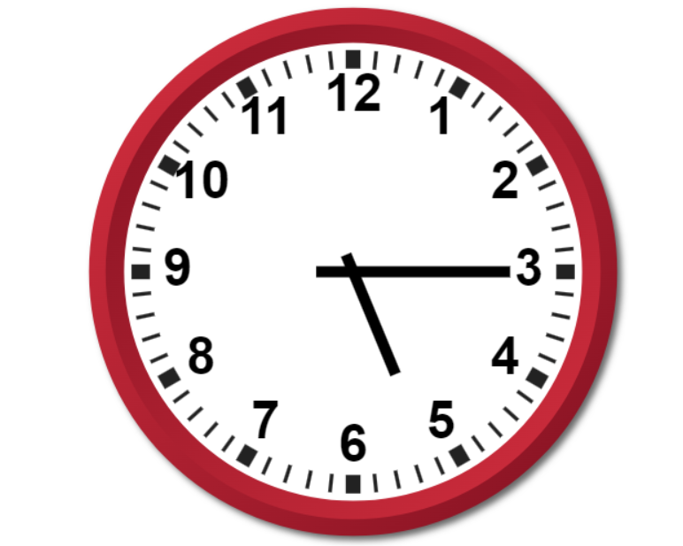
Quarter past
When the minute hand(longer hand) moves from 12 to 3. It is quarter past the hour.
The clock shows quarter past 5.

Slide 23
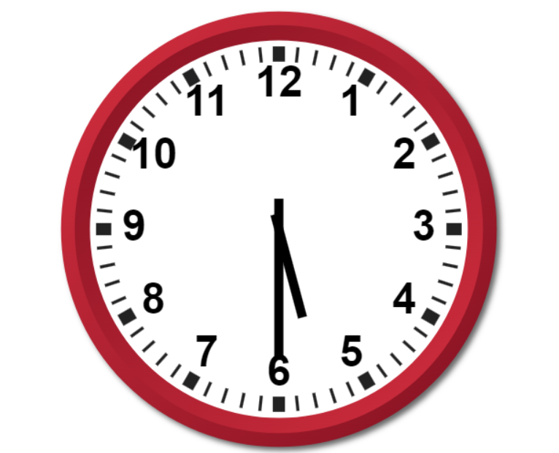
Half past
When the minute hand(longer hand) moves from 12 to 6. It is half past the hour.
The clock shows half past 5.

Slide 24
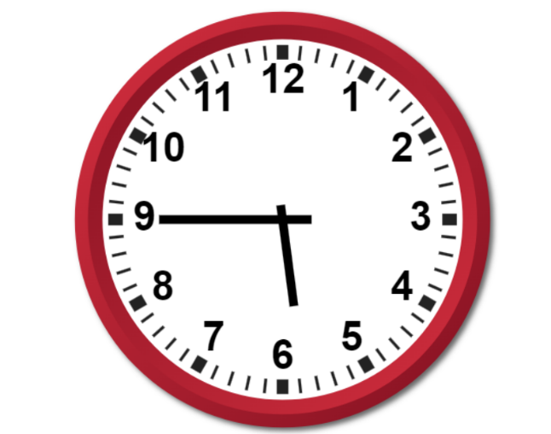
Quarter to
When the minute hand(longer hand) moves from 12 to 9. It is quarter to the hour.
The clock shows quarter to 6.

Slide 25
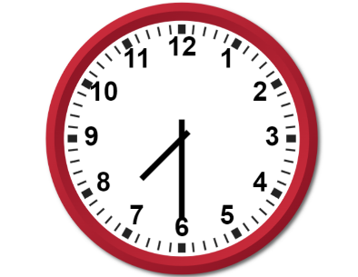
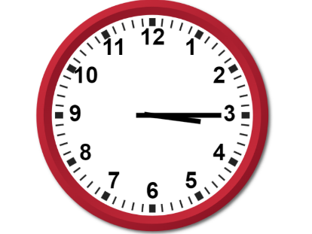
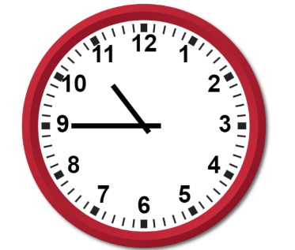
What time is it?

Slide 26
What time is it?
Half past 7
Quarter past 3
Quarter to 11

Slide 27
What time is it?
Half past 7
Quarter past 3
Quarter to 11

Slide 28
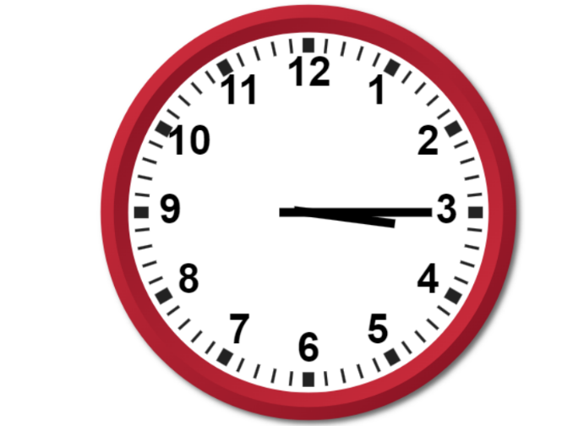
Counting by 5
How many minutes are there in a clock?

Slide 29
Counting by 5
55
O’clock
There are 60 minutes in a clock.
These 60 minutes are divided across the 12 numbers.
There are 5 minutes from 12-1, 1-2, 2-3 and so on.
5
50
10
45
15
40
20
35
30
25
1 hour = 60 minutes, 1 minute = 60 seconds

Slide 30
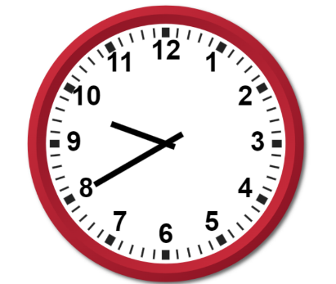
Telling time
5:10
10:25
9:40
A colon is used in time to separate hours and minutes.

Slide 31
The mystery
Suzie at the school library
Suzie at her home
Look at the clock behind Suzie. How can she at two places at the same time?

Slide 32
The mystery
Suzie at the school library: Morning
Suzie at her home: Night
When we look at a clock there could be confusion about whether a time refers to morning or afternoon/evening. Using A.M. and P.M. helps us communicate time more accurately and avoids misunderstandings.

Slide 33
A.M and P.M
12:00 A.M midnight
12:00 P.M. noon
We sleep during this time
We eat lunch during during this time
Use A.M: When we are referring to the time before noon.
Use P.M: When we are referring to the time past noon.

Slide 34
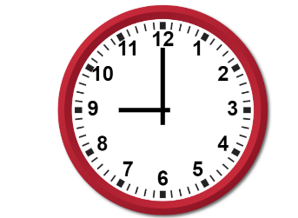
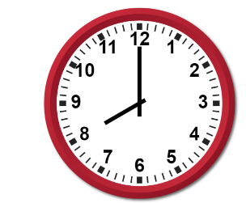
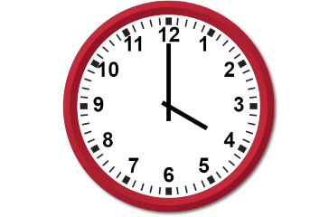
A.M or P.M ?
Eating dinner
Eating breakfast
Sleeping
Playing at park

Slide 35
A.M or P.M ?
Eating dinner
Eating breakfast
Sleeping
Playing at park
9:00 P.M
8:00 A.M
4:00 A.M
4:00 P.M

Slide 36
Back to the present
You and your team of time travelers have arrived in a bustling city filled with modern buildings. You begin to explore and come across a secret door.

Slide 37
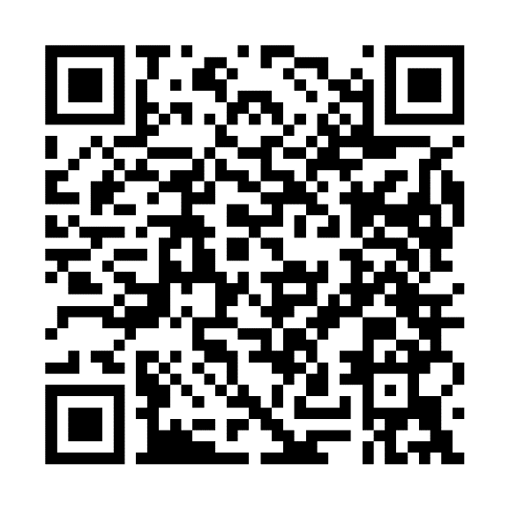
Instructions
Scan the QR code or click on:
https://www.thinglink.com/video/1702279577008603940

Slide 38
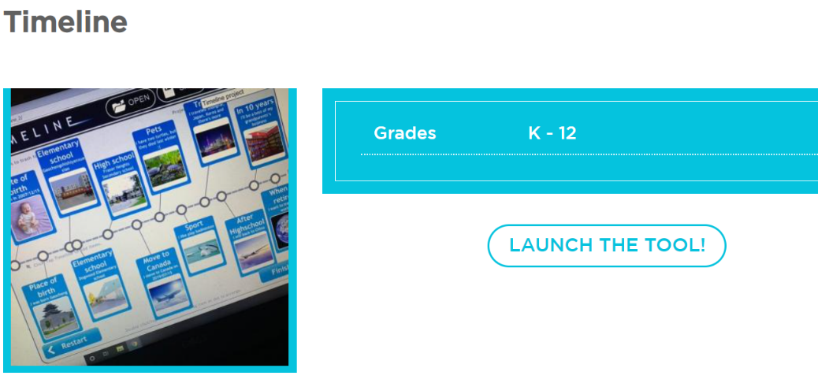
Make your timeline
Visit: https://www.readwritethink.org/classroom-resources/student-interactives/timeline
Click on launch the tool.

Slide 39
Instructions
Enter your name
Enter your project title
Click on start

Slide 40
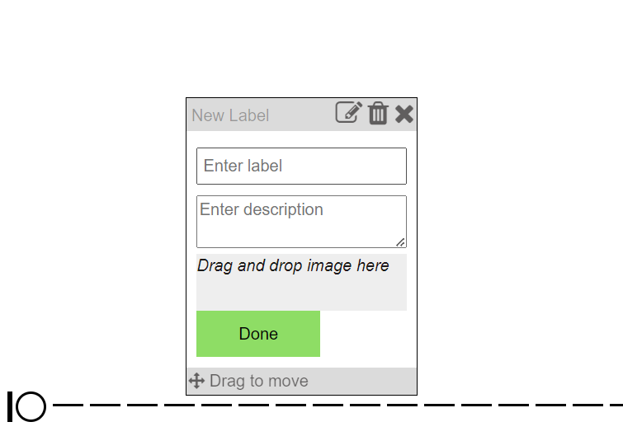
Instructions
Click on the circle on bottom left.
Enter label: Enter the time in A.M/P.M.
Enter the description of what you do during that time
Click on done.
Try to present your entire day in the form of a timeline.
Take a screenshot of your final timeline.

Slide 41
Thank You
edm8ker is a fully owned brand of Makedemy Pte Ltd A member of the SL2 group of social enterprises.

