Slide 1
Student Handout
Making the future of young minds

Slide 2
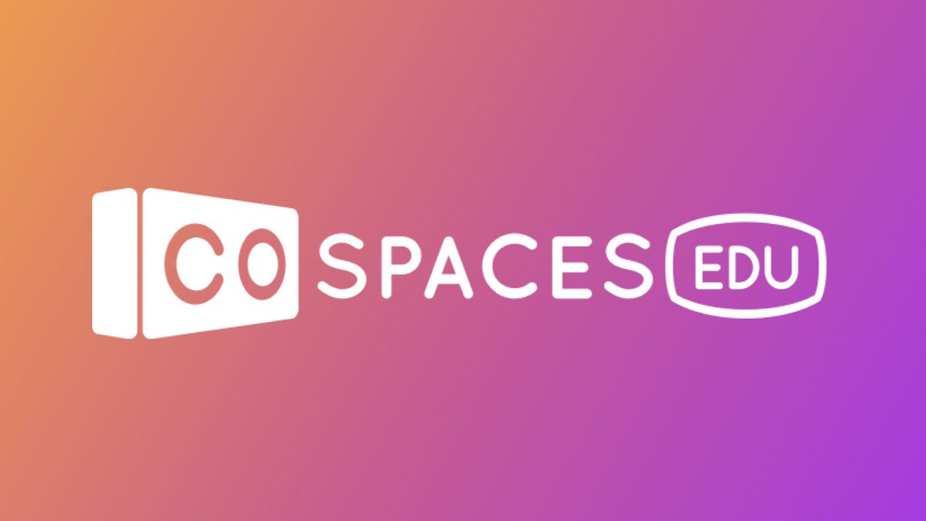
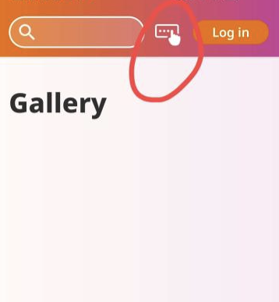
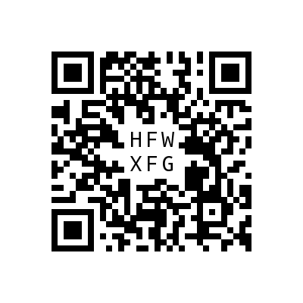
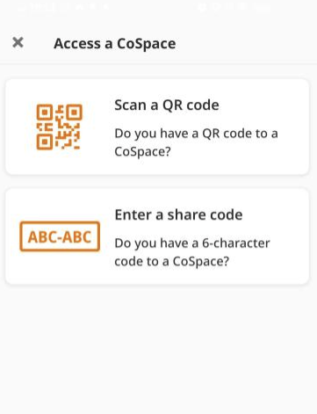
Guide to Access CoSpaces
1
Open the Cospaces Edu app on your iPad.
2
After the app opens, look for the three dots as shown in the picture and look for the option to scan a QR code.
3
Click on the scan QR code option and scan the QR code with your ipad to view the scenes on your merge cube.
4
Scan the QR code given below and you should be able to see the virtual scene for your lesson.

Slide 3
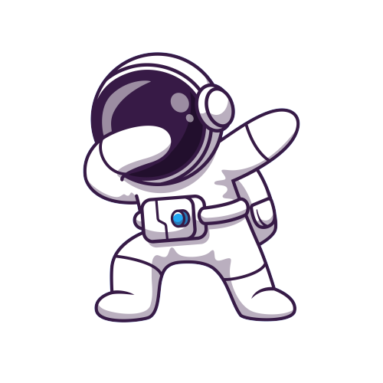
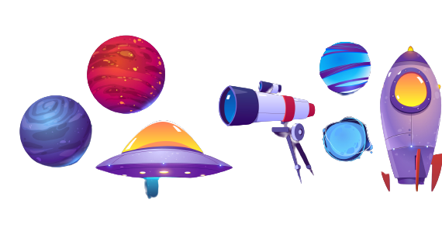
Initial Report
The solar system is made up of the _____ and all the planets and objects that orbit around it. The sun is a big, glowing ball of hot gas that gives light and heat to the solar system. It's the center of the solar system and everything moves around it.
The eight planets in the solar system are Mercury, Venus, Earth, Mars, Jupiter, Saturn, Uranus, and Neptune. Each planet is different and has its own special features.
_________ is the smallest planet and is also the closest to the sun. _________is the fifth planet from the sun and it's the biggest planet in the solar system. ________ is the eighth and last planet from the sun and it's very far away from the sun.
There are also many other objects in the solar system, like asteroids and comets. _______ are small, rocky objects that orbit the sun and some of them can be found between Mars and Jupiter.
That's my initial report about the solar system.

Slide 4
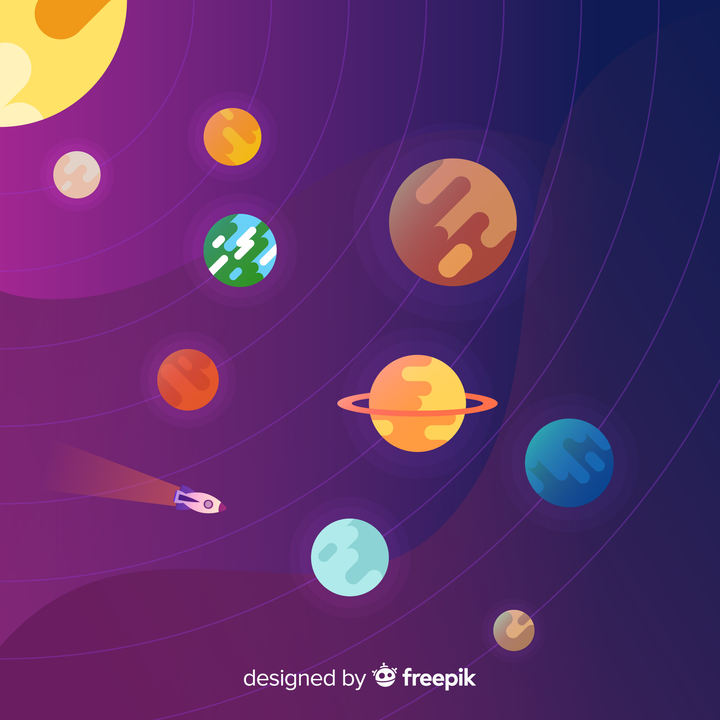
Identify the planets and give them nicknames
Jupiter: King of planets
Mars: Red wonderland
MY SOLAR SYSTEM
Think about the planet's unique characteristics, such as its color, size, and shape.
Use your imagination and come up with a witty nickname.

