Slide 1
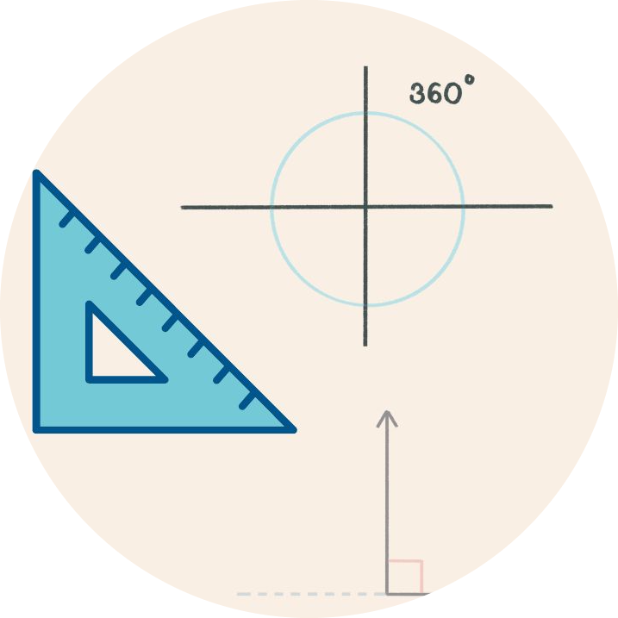
Playing With Angles
Fourth Grade
90 minutes

Slide 2
Overview
Comprehend the fundamental concepts related to angle measurement, including concepts like acute, obtuse, and right angles.
Demonstrate the ability to sketch angles of specified measures, showcasing their understanding of angle construction.
Employ their understanding of angles to create artistic and geometric patterns using Pencil Code.
Notes:
Begin by sharing the overview. Apprise students of the tasks they’d accomplish in the class.

Slide 3
Ground Rules
Be respectful of one another. Listen to your teammates.
Raise your hand if you have anything to share.
Listen closely and follow instructions.
Complete the tasks on time.
Notes:
Discuss the ground rules with learners and stress on the importance of them being followed throughout the class.

Slide 4
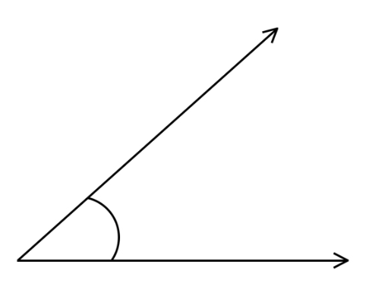
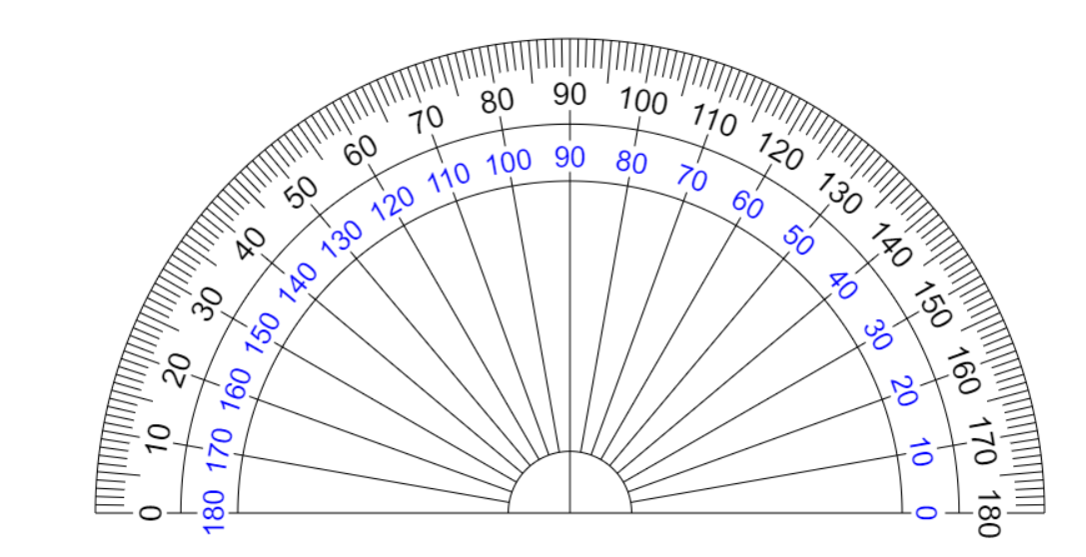
Angles
Angle
An angle is formed by two rays that share a common endpoint.
It's typically measured in degrees.
Endpoint(also called vertex)
A protractor is used to measure and draw angles in geometry.
Protractor

Slide 5
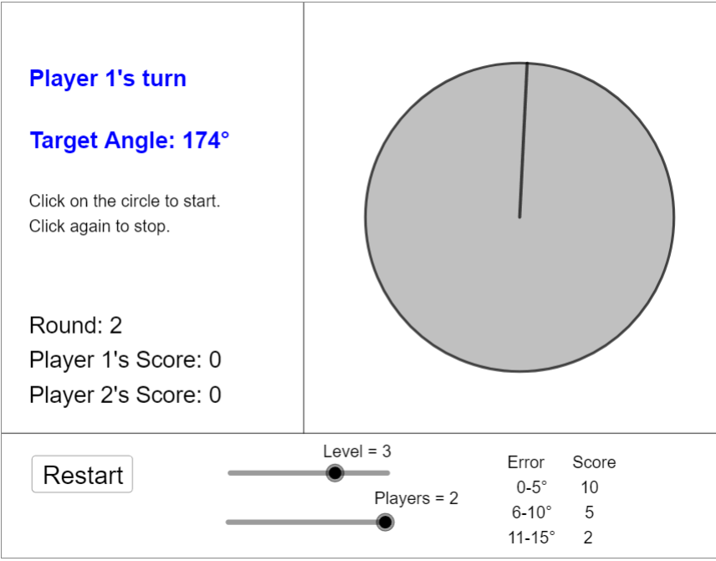
Playing With Angles
Visit https://nrich.maths.org/1235

Slide 6
Playing With Angles
The instructions to play the game are on the left side.
Try to score 4-5 points.
You can also play the game in pairs.
Drag to change levels
Can be played b/w 2 players

Slide 7
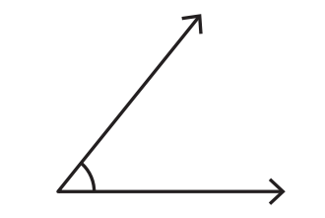
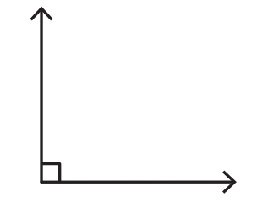
Types of Angles
Acute angle
An acute angle is an angle that measures less than 90 degrees. It is smaller and narrower than a right angle.
Right angle
A right angle is an angle that measures exactly 90 degrees. It forms a perfect "L" shape.

Slide 8
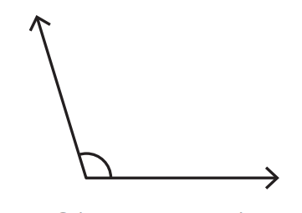
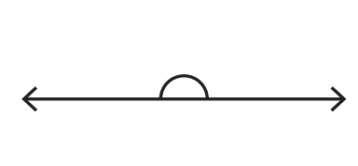
Types of Angles
Obtuse angle
An obtuse angle is an angle that measures more than 90 degrees but less than 180 degrees. It is larger and wider than a right angle.
Straight angle
A straight angle is an angle that measures exactly 180 degrees. It forms a straight line, with two rays pointing in opposite directions.

Slide 9
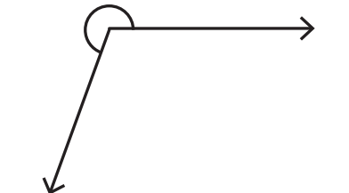
Types of Angles
Reflex angle
A reflex angle is an angle that measures more than 180 degrees but less than 360 degrees. It extends beyond a full circle and points backward.
Full angle
A full angle, also known as a complete angle, is an angle that measures exactly 360 degrees. It forms a complete circle, with rays returning to their starting position.

Slide 10
How to Use a Protractor
Place the Protractor: Put the protractor on the paper so that the center point (the hole in the middle) lines up with the corner of the angle you want to measure.
Align the Base Line: Make sure the straight edge (base line) of the protractor lines up with one of the angle's arms. This is the line where you start measuring.
Read the Degrees: Look at the numbers on the curved part of the protractor. Start from zero at the base line and read the number where the other arm of the angle points. This is the measurement of your angle in degrees.

Slide 11
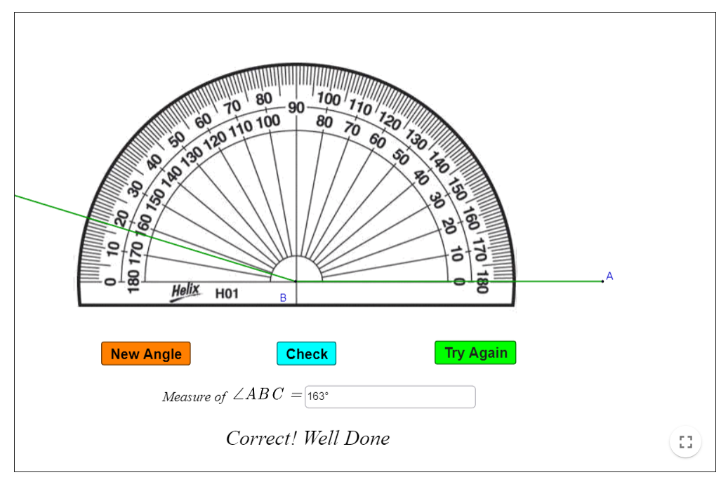
Practice!
Visit https://www.geogebra.org/m/mME9Fdby
You can read the instructions at the top.
Try to measure different angles using the virtual protractor.

Slide 12
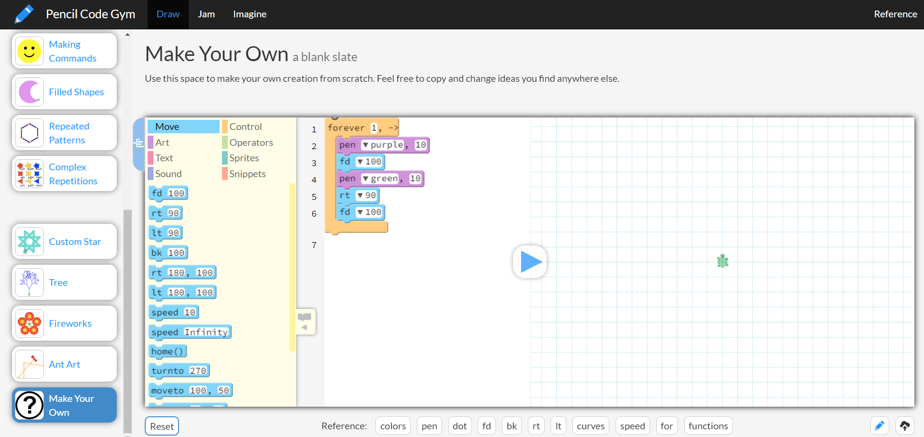
Pencil Code
Pencil code is like a virtual pencil to make art on the computer by giving simple instructions.
It can help you explore geometry in a creative way.
You can use it to draw shapes, lines, and patterns, and even make interactive designs.

Slide 13
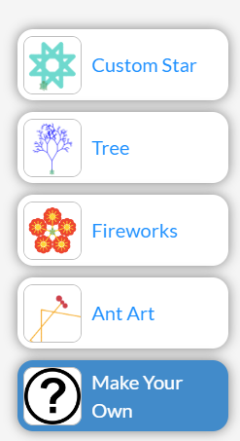
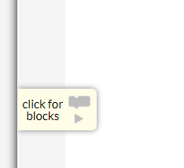
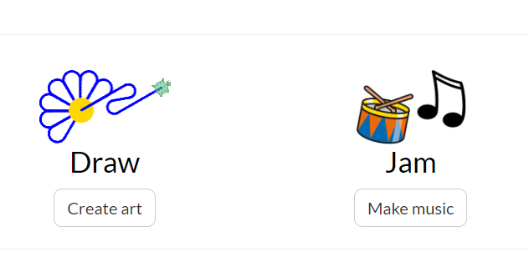
Pencil Code: How to Begin
Visit https://pencilcode.net/
Click on Create art
3. Click on Make Your Own
4. Click on click for blocks

Slide 14
Pencil Code: User interface
Code blocks
Output Area
Code Area
Play/Pause

Slide 15
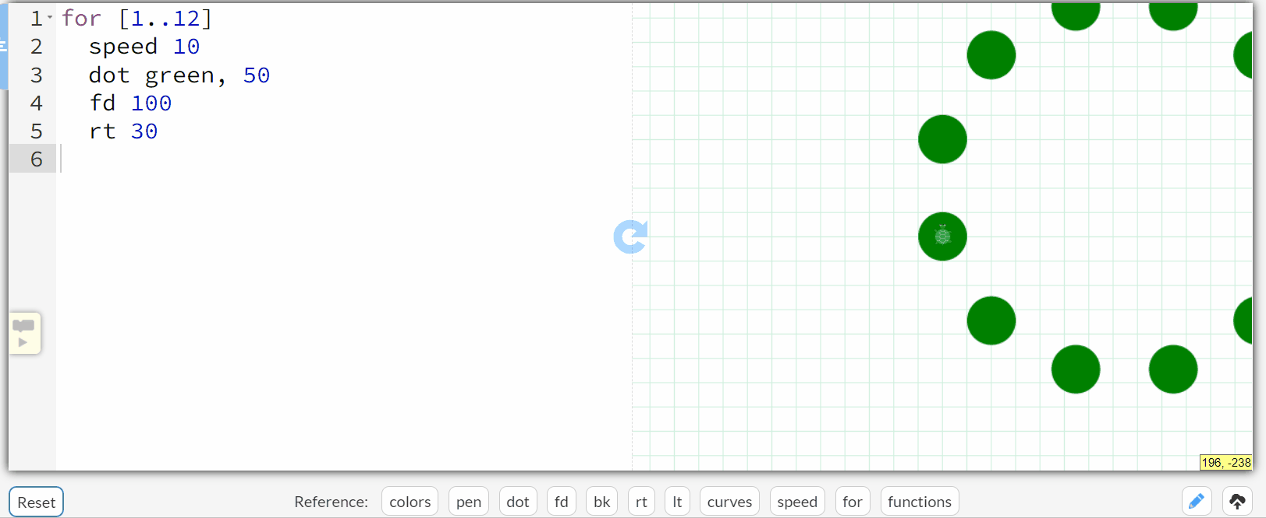
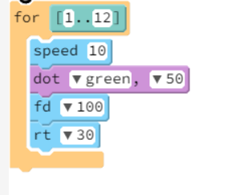
Make your Circle
Delete any existing code if present.
From “controls” drag and drop the “for” block.
A "for loop" tells the computer to do something over and over again.
Indicates the no. of times the loop will run (in this case it’s 12 times)
Do the same for pen as indicated.
From “Move” drag and drop the fd block.
Set the step to 100.
Click on the play button.
To control the speed of the turtle
To set the color and size of the dot
To move forward by 100 steps
To turn right by 30 degrees
Try changing the color and make bigger/smaller circles.

Slide 16
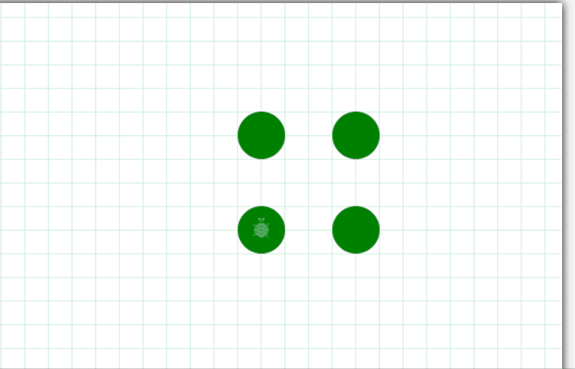
Make your Square
What do you need to change in the previous code to make a square? Try it out.

Slide 17
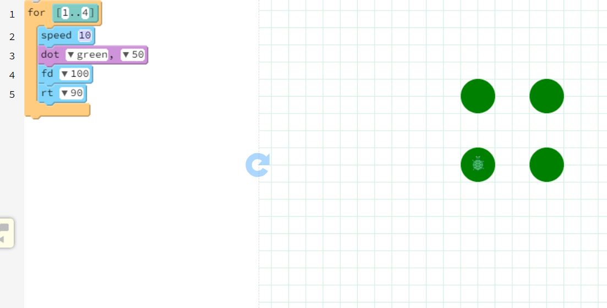
Make your Square
The loop needs to run only 4 times
The turtle needs to turn right at 90 degrees for a square

Slide 18
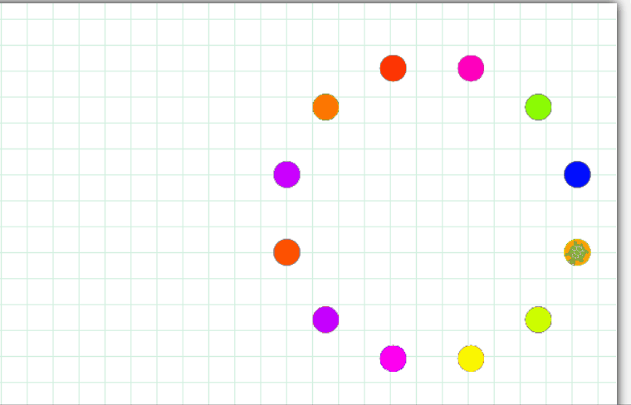
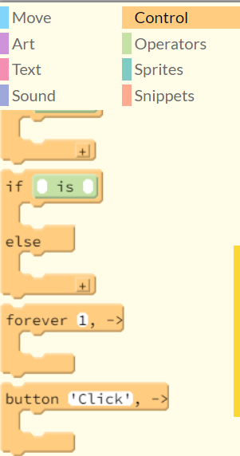
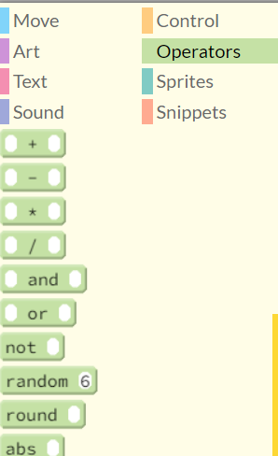
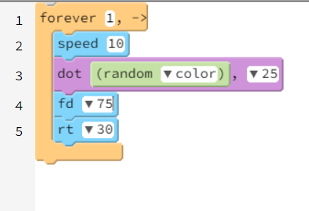
Extra Elements
This is a forever loop. You can find it in control
This is a random function. Here it generates random color. You can find it in operators

Slide 19
Create Your Art
Now using these as references, try creating your unique design.
Experiment with different shapes, angles, and colors.

Slide 20
Share and Learn
It’s time for you to share your creation with others.

Slide 21
Rules for the Gallery Walk
Move from one station to the next observing each other's shape art.
Observe closely how creatively your peers have used code to create artwork.
Appreciate the work you like by saying things like “I like… in your art”.
Only one team at each station.
Move to the next station when instructed by the teacher.

Slide 22
Let’s Summarize
In one sentence, share something new that you learned in today’s class.
What was challenging?
What was easy?

Slide 23
Thank You
edm8ker is a fully owned brand of Makedemy Pte Ltd A member of the SL2 group of social enterprises.

