Slide 1
Student Handout
Making the future of young minds

Slide 2
Early homes vs Today’s Homes
What are some features of the early homes. How are they similar? In what ways are they different from the houses we live in today?
Early homes
Today’s homes

Slide 3
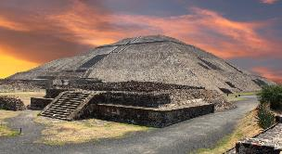
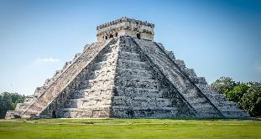
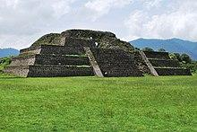
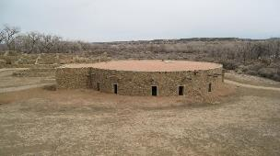
Identify and select the prehistoric houses given below.

Slide 4
Steps for building an Advertisement:
Select a prehistoric house
Mention top 3 features of the selected house.
Frame a tagline

