Slide 1
Social Studies
Demand & Supply
Fifth grade
120 Minutes

Slide 2
Overview
Define the law of demand and supply.
Explain how changes in prices affect demand and supply.
Apply the law of demand and supply in real-life scenarios.

Slide 3
Ground Rules
Be respectful of one another
Raise your hand if you have anything to share.
Listen attentively and follow instructions.
Complete tasks in given time

Slide 4
Let’s Collaborate
Notes:
Buyers and sellers

Slide 5
Team Roles
Project Manager
Resource Manager
Time Keeper
Help your team members to stick to their tasks!
Monitor what they are doing.
Collect materials and tools from the teacher.
Ensure team members are using them properly.
Return when you are done!
Keep track of time! Check the timer every few mins.
Help team members to complete the task on time.

Slide 6
Have you ever been to a market place with a large number of buyers and sellers.

Slide 7
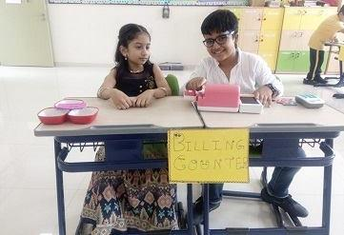
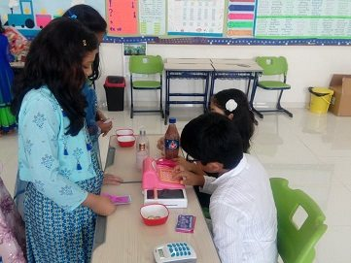
Let’s conduct a mock market
Let’s conduct a mock marketplace inside the classroom where :
Divide whole class into two groups : “Buyers” and “sellers”
Provide “Buyers” with the budget of $50.
Provide “Sellers” with a variety of items and set price for them.
Allow the Sellers and Buyers to negotiate until they reach to an agreement.

Slide 8
Reflection
Once the mock marketplace activity is complete:
Gather the data of the selling price of each item.
Take the information about the demand of each item.
Plot the data on the graph to show the relationship of price with quantity supplied and demanded.

Slide 9
Demand and Supply

Slide 10
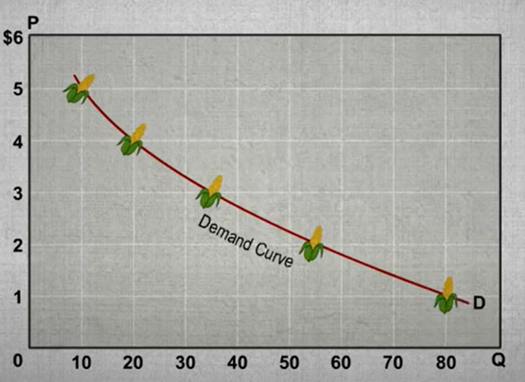
Law of Demand
The law of demand states that when the price of a product goes up, the quantity demanded will go down – and vice versa.

Slide 11
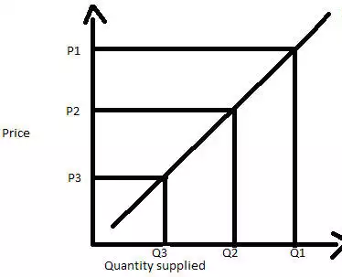
Law of Supply
The law of supply states that quantity supplied increases as price increases.

Slide 12
Have you ever wondered how the demand and supply of an item regulate in a city?

Slide 13
Let’s find out by building a city with “Simcity”

Slide 14
Let’s find out by building a city with “Simcity”

Slide 15
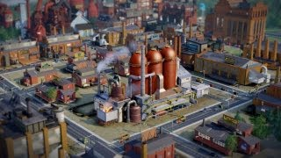
Guide to “Simcity”

Slide 16
Play time !
Open Simcity by clicking on the link
https://www.ldplayer.net/games/simcity-buildit-on-pc.html#google_vignette
And click download on the first link
Notes:
Image source: https://medium.com/canva

Slide 17
Building your own city
Install Simcity on Ld player

Slide 18
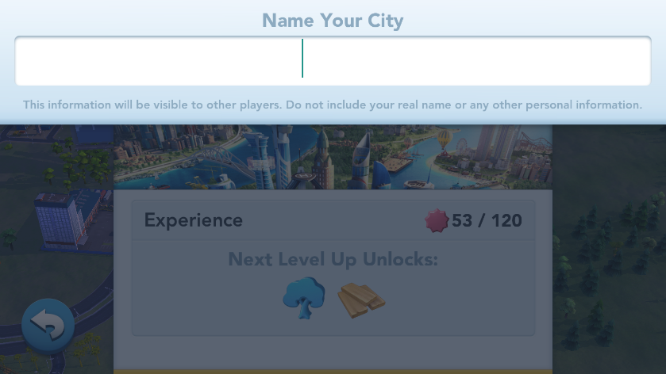
Setting up your city’s name
Give a Name to your city

Slide 19
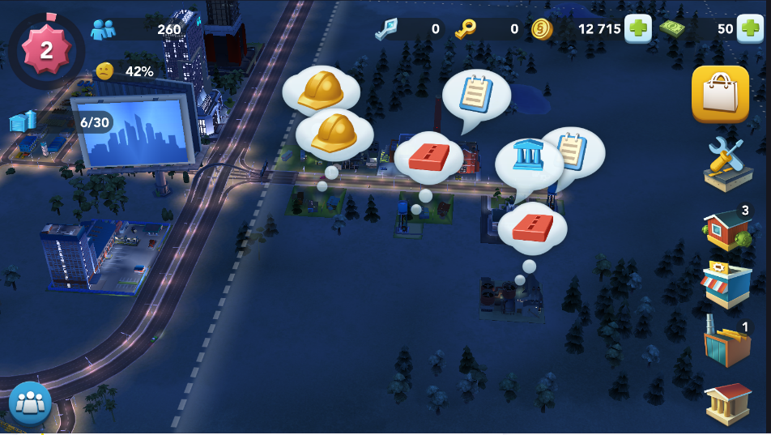
Setting up various buildings and amenities
Explore the various tools and build your city

Slide 20
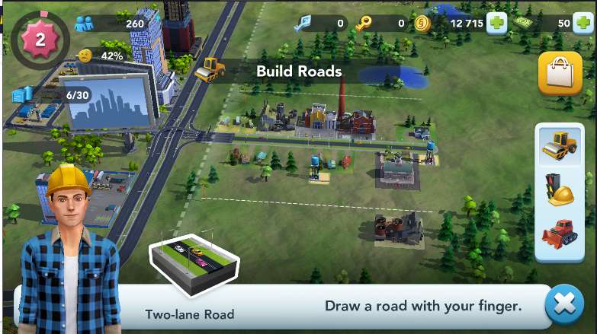
Select the type of road
Start with the building roads in your Simcity game.
You can go for one-lane or two -lane roads.

Slide 21
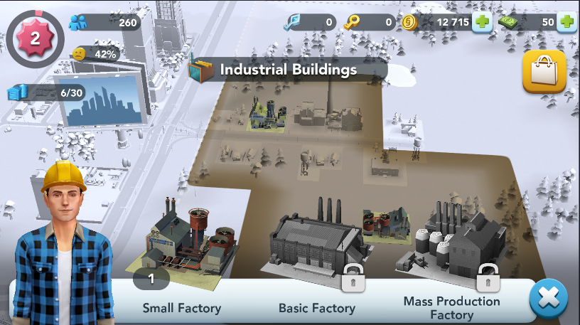
Setting up industrial buildings
If your group is focusing on building a city with a high demand for necessary goods, then you can go for building more industrial buildings.

Slide 22
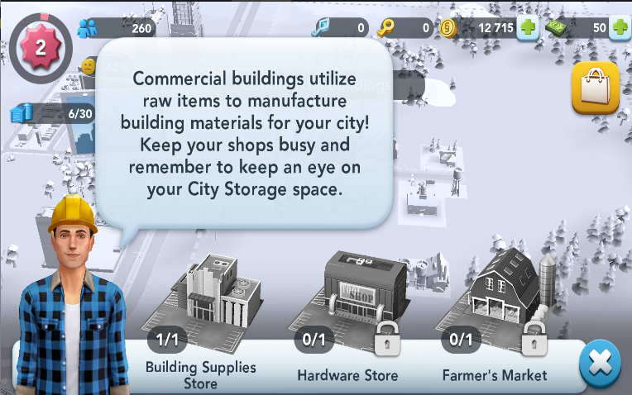
Setting up commercial buildings
If your group focuses on building a city with a high demand for luxury goods, then you can go for building more commercial buildings.

Slide 23
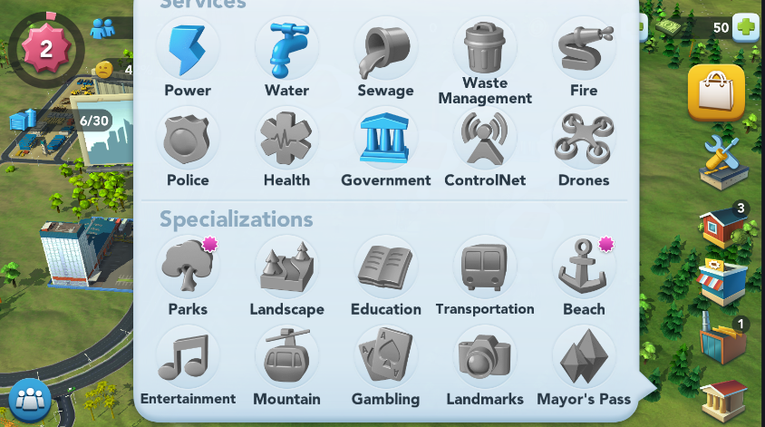
Choose & Customize
“Click here “to customize and provide utilities for your city
Choose any utility

Slide 24
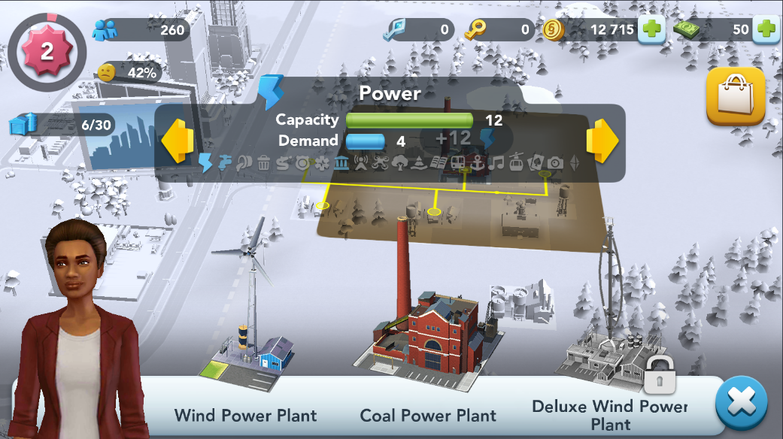
You can choose the utility based on their capacity and demand

Slide 25
Wrap it up !
Your mission is to unlock at least three utilities
30 minutes will be given to you to open at least three utilities and then you can view the city structure of your classmates to see what things you could have done differently in the city planning.
Notes:
Padlet link :https://padlet.com/s4ieducator40/pjg0vxjag9jvj85j

Slide 26
Presentation
Share your city building with your classmates.
Each group will get 2 minutes to present.
Introduce your group.
Mention your city name
How did price affect the usage and demand of the utilities?
What aspects of city planning did you learn about after using “Simcity”?

Slide 27
Reflection
Now share your experience while playing SimCity and making decisions as a mayor and how you have reflected demand and supply in an economy.
In simcity how does the law of supply and demand affect the growth and development of the city? Can you give some examples?
Did you have a surplus or any shortage of any particular resource? How did you address that issue?
Did you notice any patterns in the demand for different goods and services in your city ? How did you respond to these patterns?

Slide 28
Constructive Feedback!
Be specific. Instead of saying “Great Work”, share what you liked in the project.
Share what can be improved.
Use respectable language: “I think..”, “You might want to…”, “I could have done it this way…”

Slide 29
Thank You
edm8ker is a fully owned brand of Makedemy Pte Ltd A member of the SL2 group of social enterprises.

